Slide 1
Modelling and Simulation
Lecture 1 - SS 2014 – Michel Kana

Slide 2
What do we do in today's lecture?
Organization of the course
Entrance test
Semester Schedule
Requirements for a grade
Why modeling and simulation?
Modeling guidelines
Review of some mathematical concepts
Summary

Slide 3
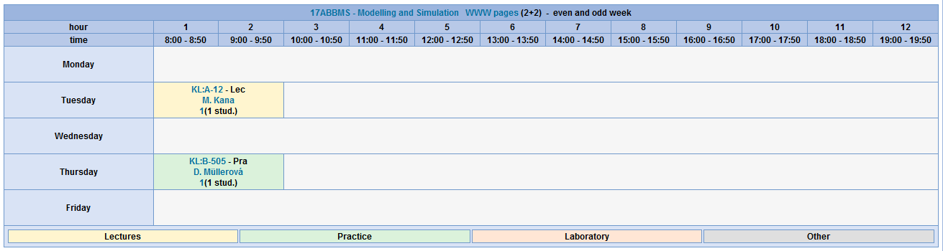
How is the course organized?
Biomedical Technician BMT (17ABBMS)
1 group
2 students
13 lectures x 1.5 hours
13 tutorials x 1.5 hours

Slide 4
What you should already know
Biomedical Technician BMT (17ABBMS)
Linear Algebra and Differential Calculus
Integral Calculus
Programming in Matlab
Introduction to Signals and Systems

Slide 5
Semester schedule
17ABBMS
Population models
Compartmental models
Advanced Topics
1th lecture
Introduction to Mathematical Modeling
5th lecture
1 - compartmental models
8th lecture
Identifiability analysis
2nd lecture
Models for single specie populations
6th lecture
More - compartmental models
9th lecture
Identifiability analysis
3rd lecture
Models for two species populations
7th lecture
More - compartmental models
10th lecture
Identification of model parameters
11th lecture
Sensitivity analysis
4th lecture
Epidemiology models
12th lecture
Final exam
11th lecture
Final presentations

Slide 6
Requirements for grade
Attendance to ALL tutorials
In case of non-attendance, provide a valid reason
12 points from tutorials
1 point per week for each attendance
28 points from practical projects
10 points for designing your project
13 points for implementing your project
5 points for presenting your project
Guidelines will be given in lesson 8
60 points from final exam
40 points about the lectures
20 points about the tutorials

Slide 7
Entrance test

Slide 8
Motivation for Modeling and Simulating
Goal: gain knowledge about complex physiological and pathophysiological behavior
understanding and testing hypothesis
measuring inferences
teaching
simulating and designing experiments
A model is an approximated representation of the real system using mathematical tools
data-driven or black box models
physiologically-based models
Examples of applications:
study the liberation, absorption, distribution and elimination of drugs in the body
estimate quantities of a substrate or hormone that are not directly measurable because they are in non-accessible portion of the body
predict the most possible time when a patient with renal failure should undergo haemodialysis
understand heart failure, which is a leading cause of death in humans
estimates the tone of sympathetic and parasympathetic discharge on the cardiovascular system

Slide 9
Guidelines for Modeling

Slide 10
Guidelines for Modeling
Defining the problem
define the biological or physiological background of the process or problem we aim to model
example
study the extraction rate of glucose from the body into urines in order to understand glucosuria
make assumptions
examples
the body is considered as an homogeneous compartment system with blood as solvent and glucose as solute
glucose is extracted from the body using urines as a medium
set the focus to some processes and eliminate others
example
we do not consider insulin and glucagon regulation

Slide 11
Guidelines for Modeling
Designing the experiment
build an experimental setup for making observations in order to validate the model later on
define inputs
example
one-time 100 mg intra-venous glucose intake
define outputs
example
glucose amount in urines in mg, measured per hour over 12 hours

Slide 12
Guidelines for Modeling
Describing the model mathematically
describe the static and dynamic properties of the system using mathematical notations:
differential equations, phase plane analysis, stability theory, bifurcation theory, linear transformation theory, linear systems theory, complex variable techniques, partial differential equations, asymptotic methods, perturbation theory
define input variables and constants
example
one-time glucose input as a constant with value 100 mg
define state variables
example
glucose amount in the urines in mg
define parameters
examples
rate of extraction of glucose into urines

Slide 13
Guidelines for Modeling
Performing identifiability analysis
answers the question if the hidden model parameters are calculable given perfect input-output data
example
can the rate of elimination of glucose into urines can be estimated if we know the amount of glucose intake and the glucose amount in urines?
if we cannot identify parameters it is advisable to return to the previous stage and readjust the mathematical model

Slide 14
Guidelines for Modeling
Implementing the model
solve the model on a computer
example
Simulink implementation of the model of glucose extraction to urines
visually observe how the computer model is predicting physiological variables
example
the change of glucose amount in urines over time
the computer model produces predictive values of the output vector, also called simulated behavior

Slide 15
Guidelines for Modeling
Performing parameters estimation
perform experiments and collect real life measurements of the observable variables
example
100 mg glucose is given to subjects orally, urine samples are taken every hour and glucose amount is measured
the measured data represent the observed behavior of the system
the difference between simulated and observed behavior is called residual
find the unique set of parameter values for which the residual is closed to zero
example
find the extraction rate for which the computer model will simulated the same glucose amounts that were measured

Slide 16
Guidelines for Modeling
Performing sensitivity analysis
check if the quality of the measurement data is sufficient for identifying the model parameters
example
should urine samples be taken every 30 min instead?
finding the optimal experimental design that helps finding the best possible parameter estimate
usually by performing partial differentiation of model outputs with regards to the parameters

Slide 17
Guidelines for Modeling
Validating the model
validate the model performance against known physiological behaviour
example
study residuals from the parameters estimation activity and the plausibility of the estimates
evaluate the variances and correlation of parameter estimates

Slide 18
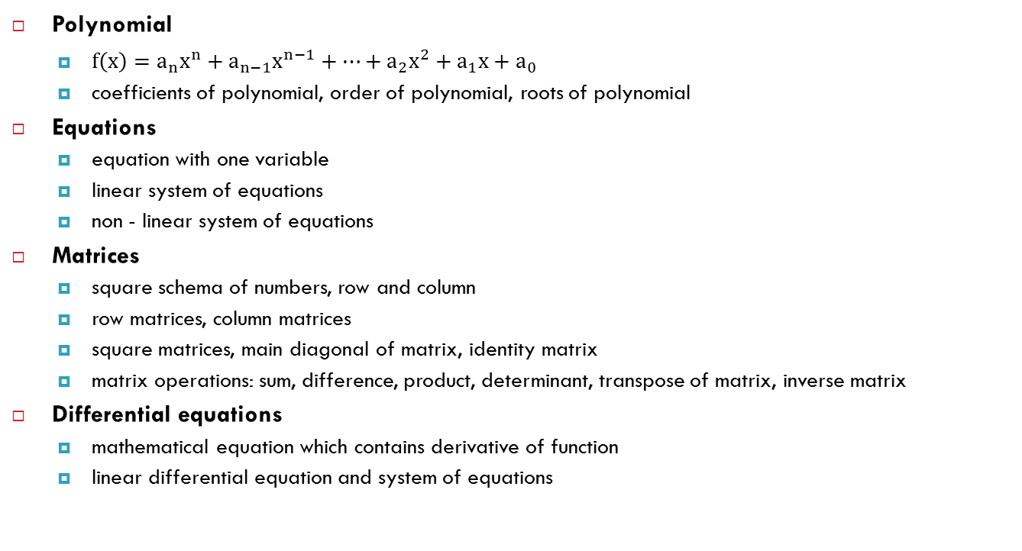
Review of some mathematical concepts
Polynomial
$f\left(x\right)=a_{n}x^{n}+a_{n−1}x^{n−1}+…+a_{2}x^{2}+a_{1}x+a_{0}$
coefficients of polynomial, order of polynomial, roots of polynomial
Equations
equation with one variable
linear system of equations
non - linear system of equations
Matrices
square schema of numbers, row and column
row matrices, column matrices
square matrices, main diagonal of matrix, identity matrix
matrix operations: sum, difference, product, determinant, transpose of matrix, inverse matrix
Differential equations
mathematical equation which contains derivative of function
linear differential equation and system of equations

Slide 19
Summary of today's lecture
[Organization of practices]
13 hours with modeling guidelines, population modeling, compartmental modeling, and the creation of own models.
To obtain the credit you need 50 points.
12 points can be obtained for active participation in the practices. 60 points can be obtained for the final exam, which will take place in the 12th lesson, 28 points can be obtained from final presentations that will take place in the 13th lesson.
[Mathematical concepts]
Polynomials, equations, matrices
[Modeling guidelines]
Defining the Problem, Designing the Experiment, Describing the Model Mathematically, Performing Identifiability Analysis, Implementing the Model, Performing Parameters Estimation, Performing Sensitivity Analysis, Validating the Model
[What comes next?]
Next week we will study single specie population models

