Slide 1
Modelling and Simulation
Lesson 13 - SS 2014 – Michel Kana

Slide 2
What do we do in today's lesson?
Parameters Estimation

Slide 3
Semester schedule
17ABBMS
Population models
Compartmental models
Advanced Topics
1th lecture
Introduction to Mathematical Modeling
5th lecture
1 - compartmental models
9th lecture Apr 15
Identifiability analysis
2nd lecture
Models for single specie populations
6th lecture
More - compartmental models
12th lecture May 6
Identifiability analysis
3rd lecture
Models for two species populations
7th lecture
More - compartmental models
13th lecture May 13
Identification of model parameters
14th lecture May 20
Sensitivity analysis
4th lecture
Epidemiology models
8th (Apr 8), 10th (Apr 22) and 11th (Apr 29) lessons are postponed
11th (May 1) and 12th (May 8) tutorials are postponed
May 27: final exam, May 29: correction of final exam June 1: final presentations and grades

Slide 4
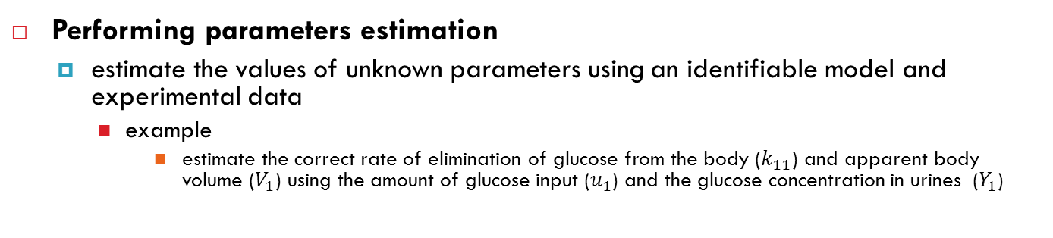
Purpose of parameters estimation
Performing parameters estimation
estimate the values of unknown parameters using an identifiable model and experimental data
example
estimate the correct rate of elimination of glucose from the body ($k_{11}$) and apparent body volume ($V_{1}$) using the amount of glucose input ($u_{1}$) and the glucose concentration in urines ($Y_{1}$)

Slide 5
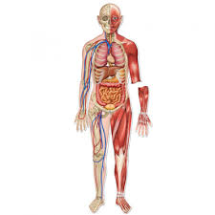
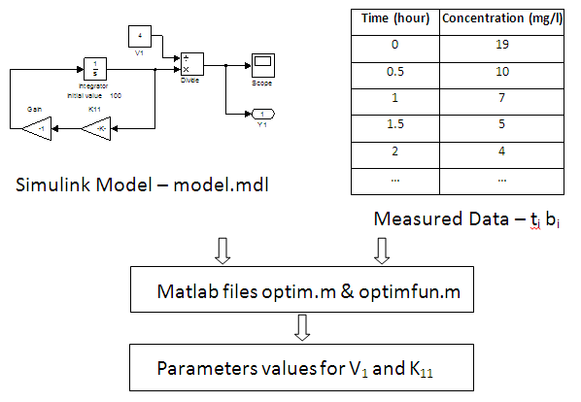
Purpose of parameters estimation

Slide 6
Methodology for parameters estimation
Collecting experimental data
a specific drug dosage is given to subjects and drug concentrations are measured in certain compartments at regular time intervals
The measured data represent the observed behavior of the system
Simulating the model with an initial guess of parameter values
For initial parameter values it would produce simulated values of drug concentration change in the compartment
The model output is called simulated behavior
Fitting experimental data
Calculate the difference between simulated values and measured values
That difference is called objective function or residuals
Estimate the perfect parameters values
Find the unique set of parameter values for which the difference between simulated and observed behavior is closed to zero
This is an optimization problem

Slide 7
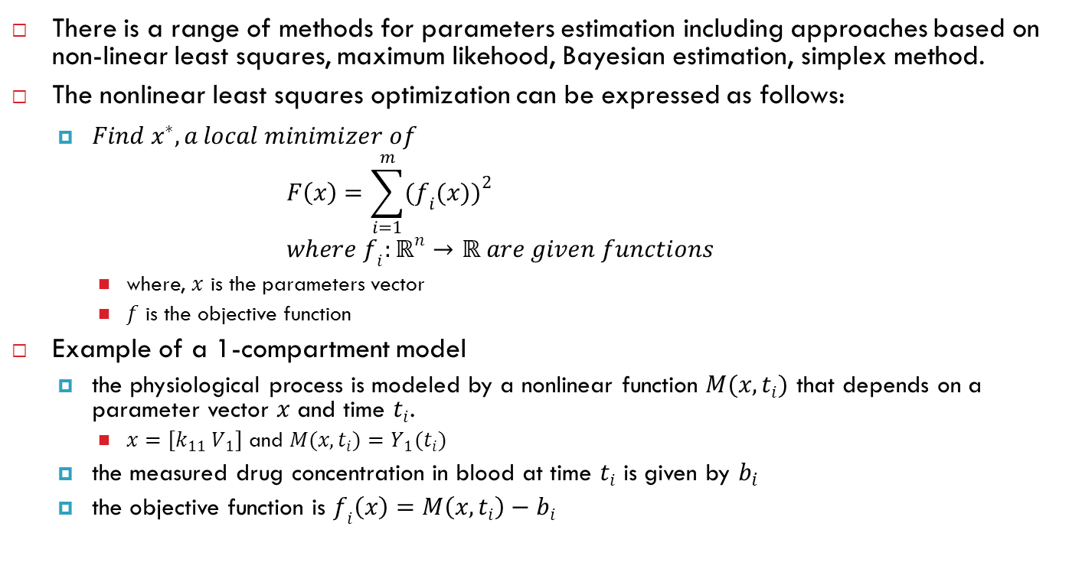
Formal definition of parameters estimation
There is a range of methods for parameters estimation including approaches based on non-linear least squares, maximum likehood, Bayesian estimation, simplex method.
The nonlinear least squares optimization can be expressed as follows:
$Find x^{∗}, a local minimizer of$ $F\left(x\right)=\sum_{i=1}^{m}{{(f_{i}(x))}^{2}}$ $where f_{i}:ℝ^{n}→ℝ are given functions$
where, $x$ is the parameters vector
$f$ is the objective function
Example of a 1-compartment model
the physiological process is modeled by a nonlinear function $M(x, t_{i})$ that depends on a parameter vector $x$ and time $t_{i}$.
$x=[k_{11} V_{1}]$ and $M(x, t_{i})=Y_{1}(t_{i})$
the measured drug concentration in blood at time $t_{i}$ is given by $b_{i}$
the objective function is $f_{i}\left(x\right)=M\left(x, t_{i}\right)−b_{i}$

Slide 8
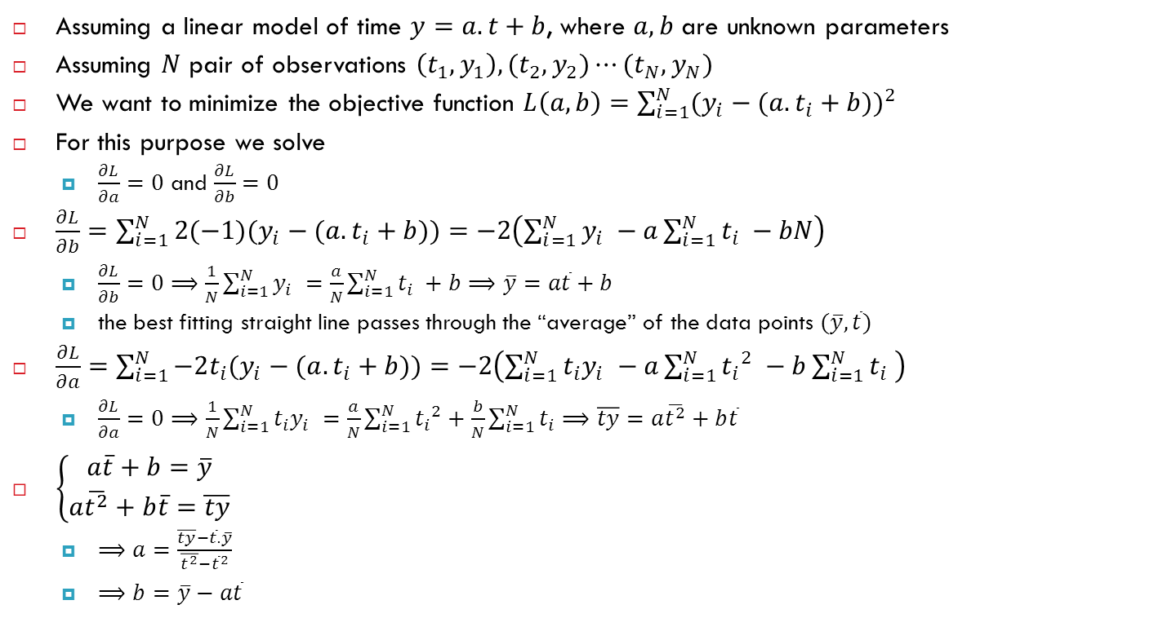
Linear regression
Assuming a linear model of time $y=a.t+b$, where $a, b$ are unknown parameters
Assuming $N$ pair of observations $\left(t_{1}, y_{1}\right),(t_{2}, y_{2})⋯(t_{N}, y_{N})$
We want to minimize the objective function $L\left(a,b\right)=\sum_{i=1}^{N}{{(y_{i}−(a.t_{i}+b))}^{2}}$
For this purpose we solve
$\frac{∂L}{∂a}=0$ and $\frac{∂L}{∂b}=0$
$\frac{∂L}{∂b}=$ $\sum_{i=1}^{N}{2(−1)(y_{i}−(a.t_{i}+b))}=−2\left(\sum_{i=1}^{N}{y_{i} }−a\sum_{i=1}^{N}{t_{i} }−bN\right)$
$\frac{∂L}{∂b}=0⟹\frac{1}{N}\sum_{i=1}^{N}{y_{i} }=\frac{a}{N}\sum_{i=1}^{N}{t_{i} }+b⟹\overline{y}=a\overline{t}+b$
the best fitting straight line passes through the “average” of the data points $(\overline{y},\overline{t})$
$\frac{∂L}{∂a}=\sum_{i=1}^{N}{−2t_{i}(y_{i}−(a.t_{i}+b))}=$ $−2\left(\sum_{i=1}^{N}{{t_{i}y}_{i} }−a\sum_{i=1}^{N}{{t_{i}}^{2} }−b\sum_{i=1}^{N}{t_{i} }\right)$
$\frac{∂L}{∂a}=0⟹\frac{1}{N}\sum_{i=1}^{N}{{t_{i}y}_{i} }=\frac{a}{N}\sum_{i=1}^{N}{{t_{i}}^{2}}+\frac{b}{N}\sum_{i=1}^{N}{t_{i}}⟹\overline{ty}=a\overline{t^{2}}+b\overline{t}$
$\left\{\begin{aligned}a\overline{t}+b=\overline{y} \\ a\overline{t^{2}}+b\overline{t}=\overline{ty}\end{aligned}\right.$
$⟹a=\frac{\overline{ty}−\overline{t}.\overline{y}}{\overline{t^{2}}−{\overline{t}}^{2}}$
$⟹b=\overline{y}−a\overline{t}$

