Slide 1
Modelling and Simulation
Lecture 2 - SS 2014 – Michel Kana

Slide 2
Agenda
Corrections of entrance test
Summary of the previous exercise
Malthus population model
Logistic population model
Summary

Slide 3
Correction of the entrance test

Slide 4
Summary of the previous practice
[Foundations of Mathematics]
Coefficients of polynomial, order of polynomial, roots of polynomial
Equation with one variable, linear system of equations, non - linear system of equations
Square schema of numbers, row and column
Linear differential equation and system of equations
[Modeling guidelines]
Defining the Problem, Designing the Experiment, Describing the Model Mathematically, Performing Identifiability Analysis, Implementing the Model, Performing Parameters Estimation, Performing Sensitivity Analysis, Validating the Model

Slide 5
Population modeling
Definitions
Population is group of individuals of any species that live in a well defined geographical area, share or compete for similar resources
Population size is the total number of individuals in the population at a given time
Birth Rate is the average number of new individuals added per unit population due to births, hatchings and germinations.
Death Rate is the average number of natural deaths per unit population per unit time.
A population at any given time is composed of individuals of different age/age group
Age groups are: pre-reproductive, reproductive and post- reproductive
Population growth depends on factors such as food, weather, predators, competition
Population Density indicates the number of individual or the size of population found in a unit area or space at a given time
Basic problem
identify classes of population interactions that could lead to the observed type of dynamics
identify unique predictions of each competing hypothesis that can be tested using observational data
understanding patterns in cross-species comparisons
managing fisheries/hunting/harvesting for the highest possible sustainable yield
developing recovery plans for species threatened by extinction
trying to contain or prevent the spread of invasive species
Approach
Model the change in population size due to the interaction of organisms with the environment, with individuals of their own kind, and with other types of organisms
Notes:
For these questions, we are often interested in how a population, or set of interacting populations, responds to a change in system parameters.
For example: how does a change in harvesting effort affect an exploited population, or how does a reduction in some cause of juvenile mortality affect a species at risk of extinction?

Slide 6
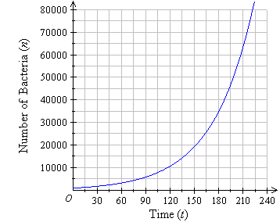
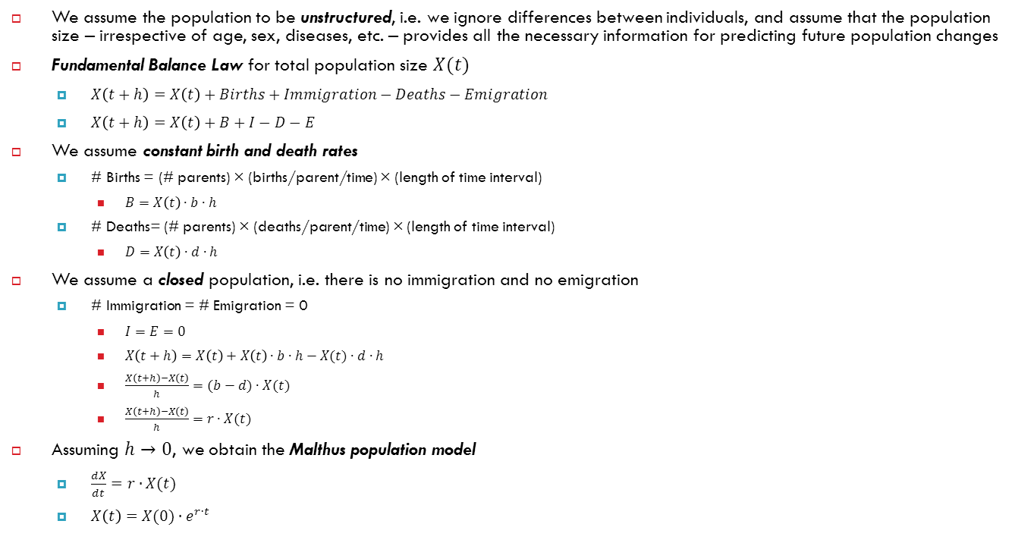
Malthus model
We assume the population to be unstructured, i.e. we ignore differences between individuals, and assume that the population size – irrespective of age, sex, diseases, etc. – provides all the necessary information for predicting future population changes
Fundamental Balance Law for total population size $X(t)$
$X\left(t+h\right)=X\left(t\right)+Births+Immigration−Deaths−Emigration$
$X\left(t+h\right)=X\left(t\right)+B+I−D−E$
We assume constant birth and death rates
# Births = (# parents) × (births/parent/time) × (length of time interval)
$B=X\left(t\right)∙b∙h$
# Deaths= (# parents) × (deaths/parent/time) × (length of time interval)
$D=X\left(t\right)∙d∙h$
We assume a closed population, i.e. there is no immigration and no emigration
# Immigration = # Emigration = 0
$I=E=0$
$X\left(t+h\right)=X\left(t\right)+X\left(t\right)∙b∙h−X(t)∙d∙h$
$\frac{X\left(t+h\right)−X\left(t\right)}{h}=(b−d)∙X(t)$
$\frac{X\left(t+h\right)−X\left(t\right)}{h}=r∙X(t)$
Assuming $h→0$, we obtain the Malthus population model
$\frac{dX}{dt}=r∙X(t)$
$X\left(t\right)=X(0)∙e^{r∙t}$
Notes:
if r > 0 (i.e. if b > d) the population grows exponentially without limit, and if r < 0 it decreases to 0. The latter is all too credible nowadays for nonhuman species, but even for humans the former is not. A more plausible model has to put limits on growth.
Biological examples of this equation are the growth of mankind, the exponential growth of a pathogen in a host, the growth of a tumor, and so on.

Slide 7
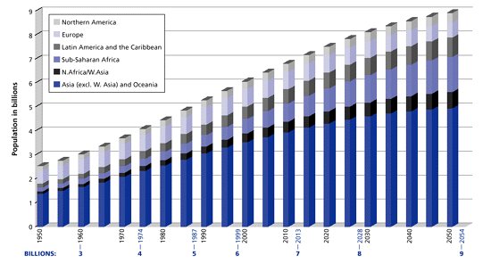
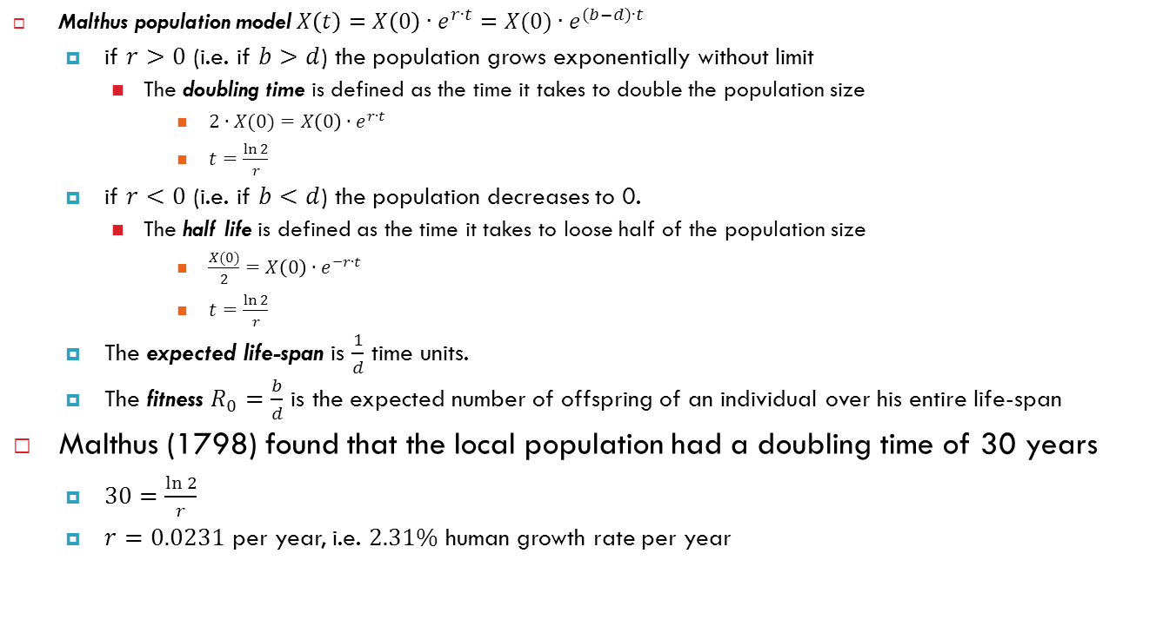
Malthus model - Analysis
Malthus population model$X\left(t\right)=X\left(0\right)∙e^{r∙t}=X(0)∙e^{(b−d)∙t}$
if $r>0$ (i.e. if $b>d$) the population grows exponentially without limit
The doubling time is defined as the time it takes to double the population size
$2∙X(0)=X\left(0\right)∙e^{r∙t}$
$t=\frac{\ln{2}}{r}$
if $r<0$ (i.e. if $b<d$) the population decreases to 0.
The half life is defined as the time it takes to loose half of the population size
$\frac{X(0)}{2}=X\left(0\right)∙e^{−r∙t}$
$t=\frac{\ln{2}}{r}$
The expected life-span is $\frac{1}{d}$ time units.
The fitness $R_{0}=\frac{b}{d}$ is the expected number of offspring of an individual over his entire life-span
Malthus (1798) found that the local population had a doubling time of 30 years
$30=\frac{\ln{2}}{r}$
$r=0.0231$ per year, i.e. $2.31\%$ human growth rate per year
Notes:
if r > 0 (i.e. if b > d) the population grows exponentially without limit, and if r < 0 it decreases to 0. The latter is all too credible nowadays for nonhuman species, but even for humans the former is not. A more plausible model has to put limits on growth.
Biological examples of this equation are the growth of mankind, the exponential growth of a pathogen in a host, the growth of a tumor, and so on.

Slide 8
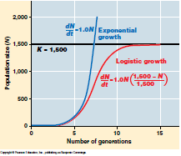
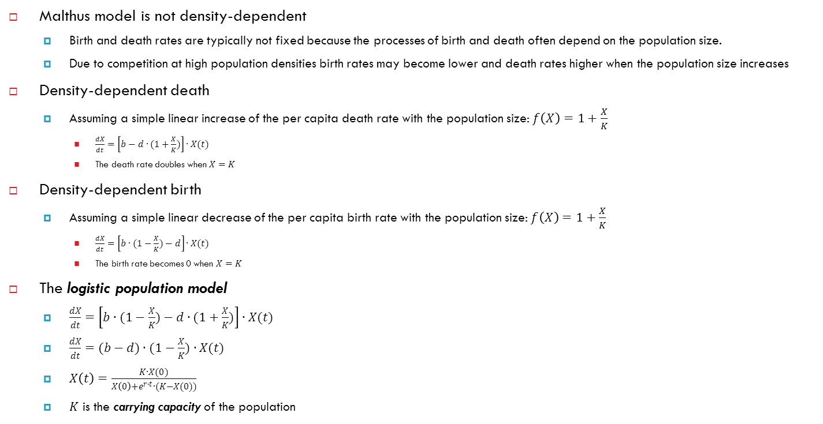
Logistic model
Malthus model is not density-dependent
Birth and death rates are typically not fixed because the processes of birth and death often depend on the population size.
Due to competition at high population densities birth rates may become lower and death rates higher when the population size increases
Density-dependent death
Assuming a simple linear increase of the per capita death rate with the population size: $f\left(X\right)=1+\frac{X}{K}$
$\frac{dX}{dt}=\left[b−d∙(1+\frac{X}{K})\right]∙X(t)$
The death rate doubles when $X=K$
Density-dependent birth
Assuming a simple linear decrease of the per capita birth rate with the population size: $f\left(X\right)=1+\frac{X}{K}$
$\frac{dX}{dt}=\left[b∙(1−\frac{X}{K})−d\right]∙X(t)$
The birth rate becomes 0 when $X=K$
The logistic population model
$\frac{dX}{dt}=\left[b∙(1−\frac{X}{K})−d∙(1+\frac{X}{K})\right]∙X(t)$
$\frac{dX}{dt}=(b−d)∙(1−\frac{X}{K})∙X(t)$
$X\left(t\right)=\frac{K∙X(0)}{X\left(0\right)+e^{r∙t}∙(K−X(0))}$
$K$ is the carrying capacity of the population
Notes:
Relationship between biological processes and population density

Slide 9
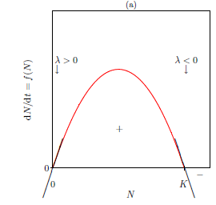
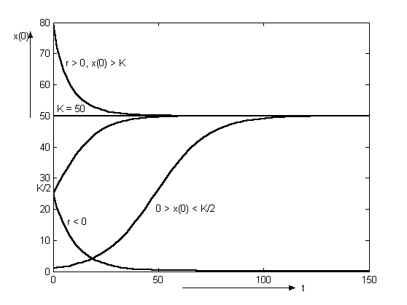

Logistic model - analysis
The steady state of the logistic model is obtained at any $X$ when $\frac{dX}{dt}=0$
$X=0$
$X=K$
Effect of the initial population size
$r>0$ and $0<X\left(0\right)<\frac{K}{2}$
The graph of $X(t)$ is sigmoid with inflection at $\frac{K}{2}$
$r>0$ and $\frac{K}{2}<X\left(0\right)<K$
The graph of $X(t)$ is a concave curve increasing to $K$
$ρ>0$ and $X\left(0\right)>K$
The graph of $X(t)$ is a concave curve decreasing to $K$
Notes:
Relationship between biological processes and population density

Slide 10
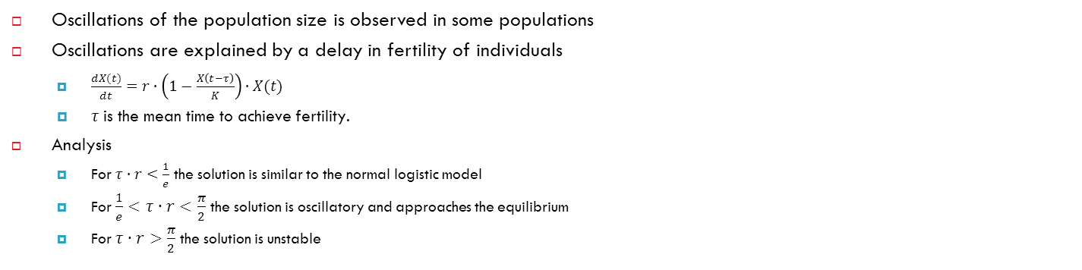
Logistic model with delay
Oscillations of the population size is observed in some populations
Oscillations are explained by a delay in fertility of individuals
$\frac{dX(t)}{dt}=r∙\left(1−\frac{X\left(t−τ\right)}{K}\right)∙X(t)$
$τ$is the mean time to achieve fertility.
Analysis
For $τ∙r<\frac{1}{e}$ the solution is similar to the normal logistic model
For $\frac{1}{e}<τ∙r<\frac{π}{2}$ the solution is oscillatory and approaches the equilibrium
For $τ∙r>\frac{π}{2}$ the solution is unstable

Slide 11
Summary of today's practice
[Population models]
Study the dynamics of unstructured populations due to the interactions with the environment, and with individuals of own kind.
Malthus model: growth is unlimited
Logistic model: growth is limited by the capacity of the studied population
Logistic model with delay: growth is delayed by the mean time to reach fertility
[What is next?]
Next week we will continue with model of two species populations.

