Slide 1
Modelling and Simulation
Lesson 3- SS 2014 – Michel Kana

Slide 2
What do we do in today's practice?
Summary of the previous practice
Two species populations models of predator - prey
Two species populations models with competition
Two species populations models with cooperation
Epidemiology models
Summary

Slide 3
Summary of the previous practice
[Population models]
Population models with age structure
Two species populations models of predator - prey: Lotka – Volterra

Slide 4
Interacting populations
Interspecific interactions are those interactions of population of two different species
Predation
Individuals of one species called Predator kill and consume individuals of the other species called Prey
Parasitism
Individuals of one species depend and benefit on individuals of the other species (Host) for food and shelter, while damaging them
Competition
individuals of different species compete for the same resources that are limited
Commensalism
Individuals of one species depend and benefit on individuals of the other species who are neither harmed nor benefitted
Mutualism
Both species are benefitted
Notes:
Herbivores are the predators for plants
Prey species have evolved various defense mechanisms to reduce the impact of predation
Resources need not be limiting for competition to occur
Host gets damaged due to parasite whereas parasite gets benefitted
Malaria Parasite has one intermediate host (mosquito) to spread to other host.
Barnacles growing on the back of whales are the examples of commensalism
Mutualism: plants depend on insects for pollination and in return they give them nectar or pollens to eat

Slide 5
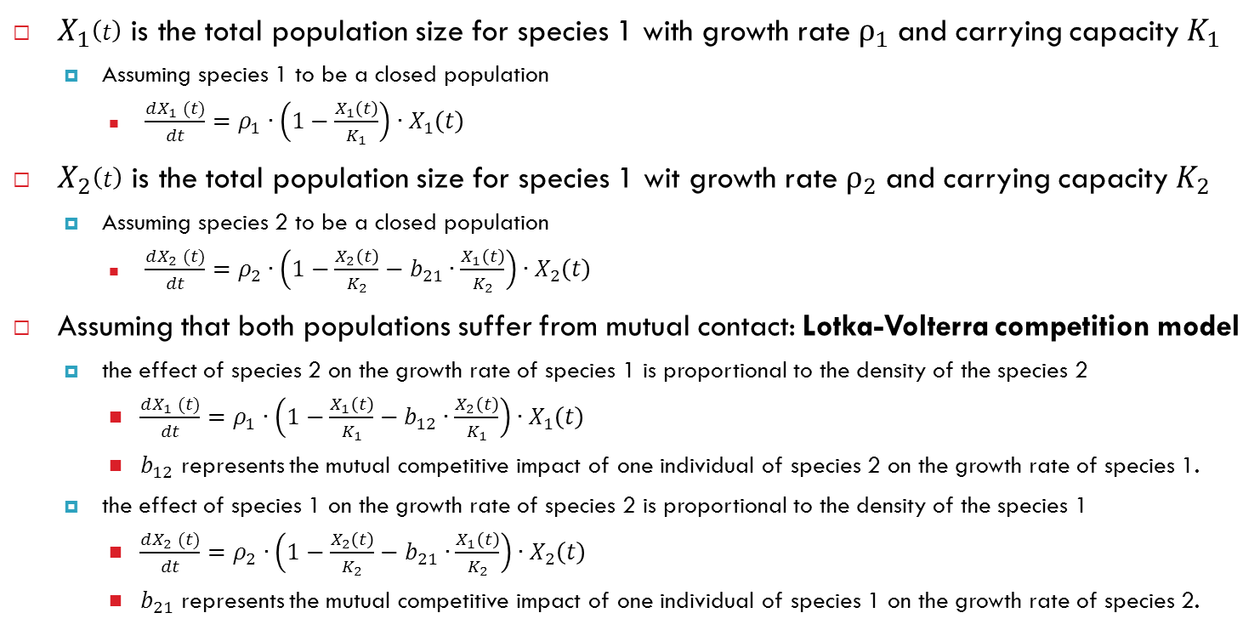
Two species populations models with competition
$X_{1}\left(t\right)$ is the total population size for species 1 with growth rate $ρ_{1}$ and carrying capacity $K_{1}$
Assuming species 1 to be a closed population
$\frac{dX_{1} (t)}{dt}=ρ_{1}∙\left(1−\frac{X_{1}\left(t\right)}{K_{1}}\right)∙X_{1}\left(t\right)$
$X_{2}\left(t\right)$ is the total population size for species 1 wit growth rate $ρ_{2}$ and carrying capacity $K_{2}$
Assuming species 2 to be a closed population
$\frac{dX_{2} (t)}{dt}=ρ_{2}∙\left(1−\frac{X_{2}\left(t\right)}{K_{2}}−b_{21}∙\frac{X_{1}\left(t\right)}{K_{2}}\right)∙X_{2}\left(t\right)$
Assuming that both populations suffer from mutual contact: Lotka-Volterra competition model
the effect of species 2 on the growth rate of species 1 is proportional to the density of the species 2
$\frac{dX_{1} (t)}{dt}=ρ_{1}∙\left(1−\frac{X_{1}\left(t\right)}{K_{1}}−b_{12}∙\frac{X_{2}\left(t\right)}{K_{1}}\right)∙X_{1}\left(t\right)$
$b_{12}$ represents the mutual competitive impact of one individual of species 2 on the growth rate of species 1.
the effect of species 1 on the growth rate of species 2 is proportional to the density of the species 1
$\frac{dX_{2} (t)}{dt}=ρ_{2}∙\left(1−\frac{X_{2}\left(t\right)}{K_{2}}−b_{21}∙\frac{X_{1}\left(t\right)}{K_{2}}\right)∙X_{2}\left(t\right)$
$b_{21}$ represents the mutual competitive impact of one individual of species 1 on the growth rate of species 2.

Slide 6
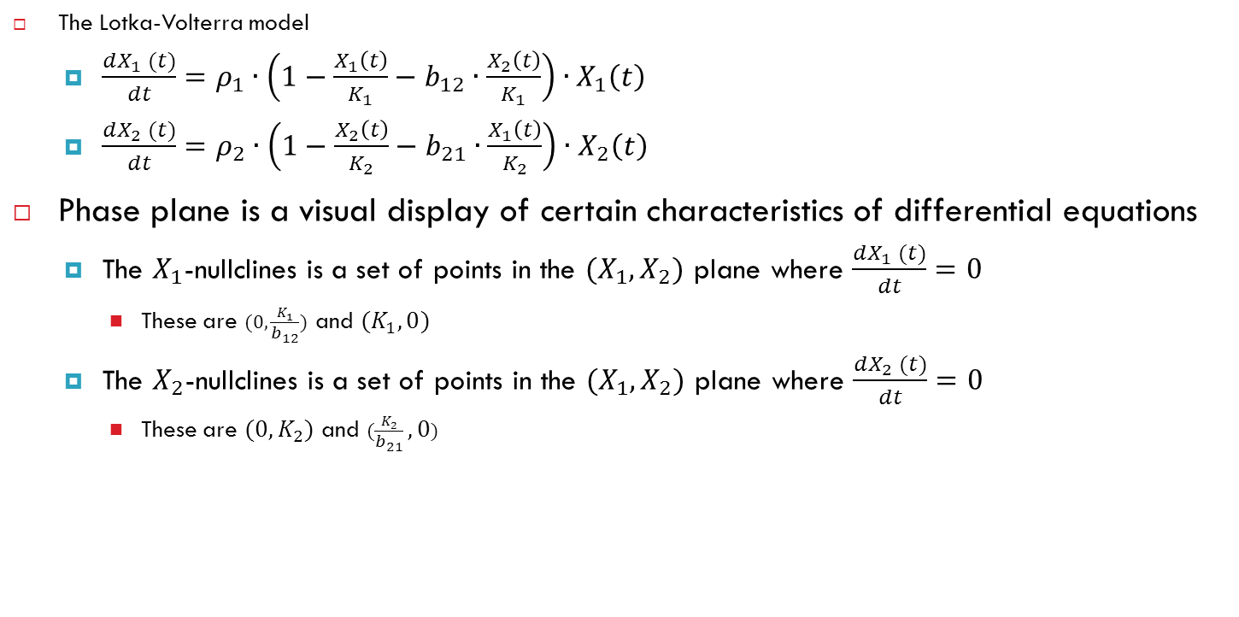
Lotka-Volterra competition model - analysis
The Lotka-Volterra model
$\frac{dX_{1} (t)}{dt}=ρ_{1}∙\left(1−\frac{X_{1}\left(t\right)}{K_{1}}−b_{12}∙\frac{X_{2}\left(t\right)}{K_{1}}\right)∙X_{1}\left(t\right)$
$\frac{dX_{2} (t)}{dt}=ρ_{2}∙\left(1−\frac{X_{2}\left(t\right)}{K_{2}}−b_{21}∙\frac{X_{1}\left(t\right)}{K_{2}}\right)∙X_{2}\left(t\right)$
Phase plane is a visual display of certain characteristics of differential equations
The $X_{1}$-nullclines is a set of points in the ${(X}_{1},X_{2})$ plane where $\frac{dX_{1} (t)}{dt}=0$
These are $(0,\frac{K_{1}}{b_{12}})$ and $(K_{1},0)$
The $X_{2}$-nullclines is a set of points in the ${(X}_{1},X_{2})$ plane where $\frac{dX_{2} (t)}{dt}=0$
These are $(0,K_{2})$ and $(\frac{K_{2}}{b_{21}},0)$

Slide 7
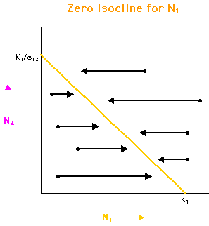
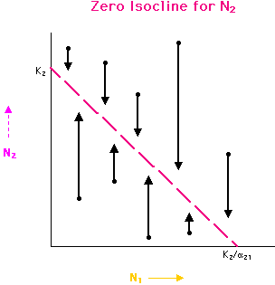
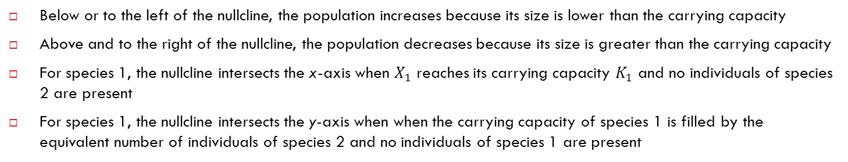
Lotka-Volterra competition model - analysis
Below or to the left of the nullcline, the population increases because its size is lower than the carrying capacity
Above and to the right of the nullcline, the population decreases because its size is greater than the carrying capacity
For species 1, the nullcline intersects the x-axis when $X_{1}$ reaches its carrying capacity $K_{1}$ and no individuals of species 2 are present
For species 1, the nullcline intersects the y-axis when when the carrying capacity of species 1 is filled by the equivalent number of individuals of species 2 and no individuals of species 1 are present
Source: http://www.tiem.utk.edu/~gross/bioed/bealsmodules/competition.html

Slide 8
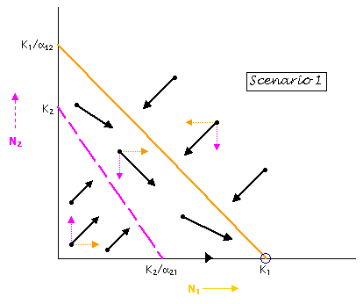
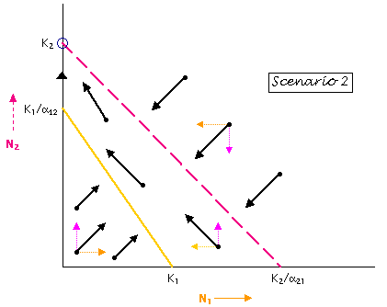
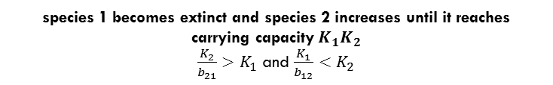
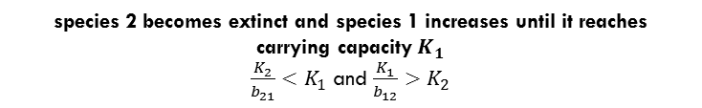
Lotka-Volterra competition model - analysis
species 2 becomes extinct and species 1 increases until it reaches carrying capacity$K_{1}$
$\frac{K_{2}}{b_{21}}<K_{1}$ and $\frac{K_{1}}{b_{12}}>K_{2}$
species 1 becomes extinct and species 2 increases until it reaches carrying capacity$K_{1}K_{2}$
$\frac{K_{2}}{b_{21}}>K_{1}$ and $\frac{K_{1}}{b_{12}}<K_{2}$
Source: http://www.tiem.utk.edu/~gross/bioed/bealsmodules/competition.html

Slide 9
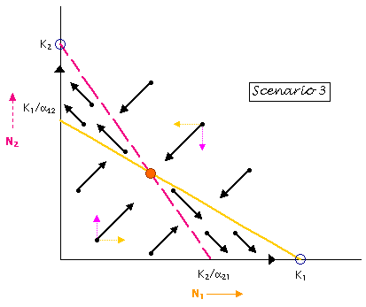
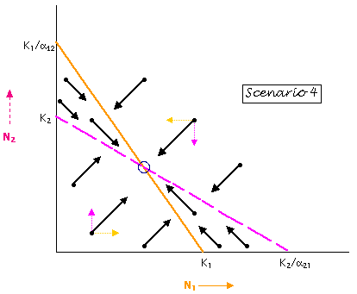

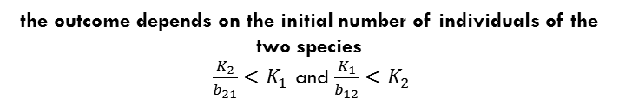
Lotka-Volterra competition model - analysis
the outcome depends on the initial number of individuals of the two species
$\frac{K_{2}}{b_{21}}<K_{1}$ and $\frac{K_{1}}{b_{12}}<K_{2}$
Coexist of both species
$\frac{K_{2}}{b_{21}}>K_{1}$ and $\frac{K_{1}}{b_{12}}>K_{2}$
Source: http://www.tiem.utk.edu/~gross/bioed/bealsmodules/competition.html

Slide 10
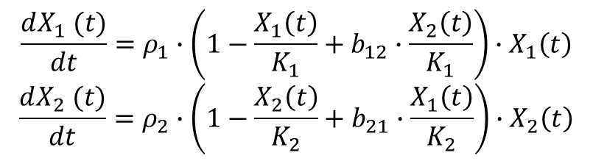
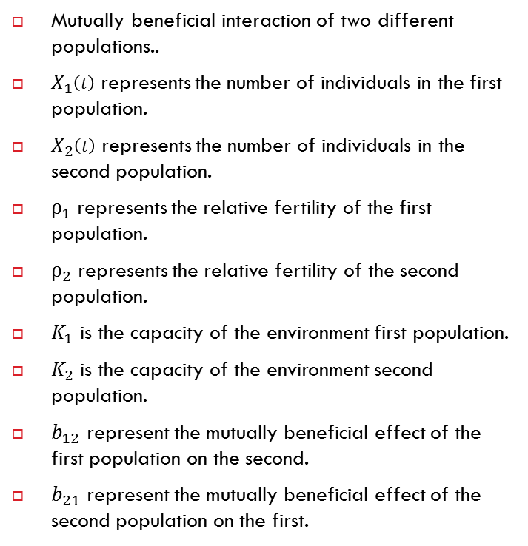
Two species populations models with mutualism
Mutually beneficial interaction of two different populations..
$X_{1}\left(t\right)$ represents the number of individuals in the first population.
$X_{2}\left(t\right)$ represents the number of individuals in the second population.
$ρ_{1}$represents the relative fertility of the first population.
$ρ_{2}$represents the relative fertility of the second population.
$K_{1}$ is the capacity of the environment first population.
$K_{2}$ is the capacity of the environment second population.
$b_{12}$ represent the mutually beneficial effect of the first population on the second.
$b_{21}$ represent the mutually beneficial effect of the second population on the first.
$$\frac{dX_{1} (t)}{dt}=ρ_{1}∙\left(1−\frac{X_{1}\left(t\right)}{K_{1}}+b_{12}∙\frac{X_{2}\left(t\right)}{K_{1}}\right)∙X_{1}\left(t\right)$$
$$\frac{dX_{2} (t)}{dt}=ρ_{2}∙\left(1−\frac{X_{2}\left(t\right)}{K_{2}}+b_{21}∙\frac{X_{1}\left(t\right)}{K_{2}}\right)∙X_{2}\left(t\right)$$

Slide 11
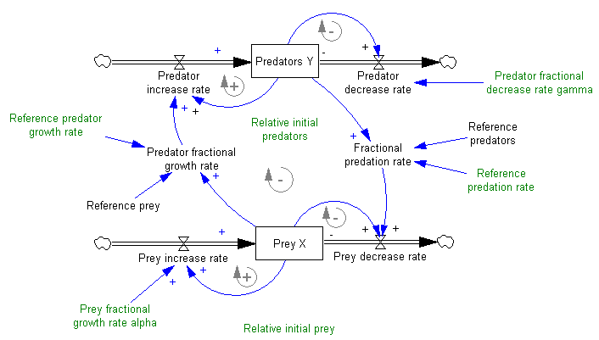
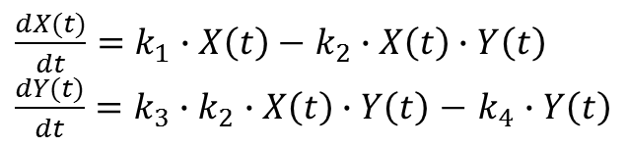
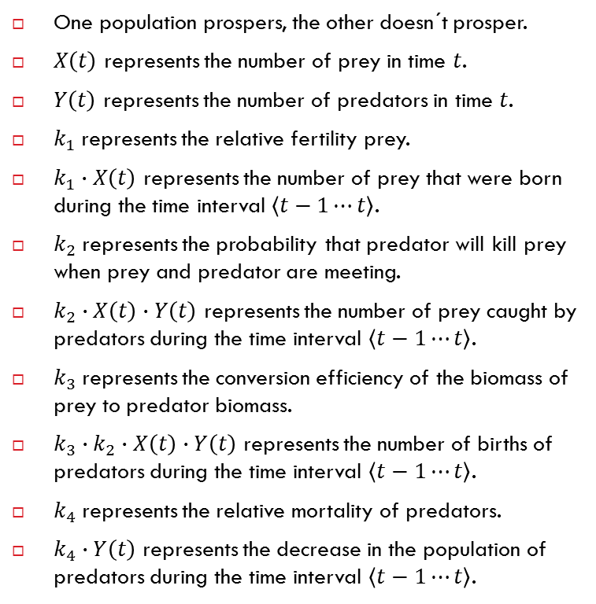
Two species populations models of predator - prey
One population prospers, the other doesn´t prosper.
$X\left(t\right)$ represents the number of prey in time $t$.
$Y\left(t\right)$ represents the number of predators in time $t$.
$k_{1}$represents the relative fertility prey.
$k_{1}∙X\left(t\right)$ represents the number of prey that were born during the time interval $\left\langle t−1⋯t\right\rangle$.
$k_{2}$represents the probability that predator will kill prey when prey and predator are meeting.
$k_{2}∙X\left(t\right)∙Y\left(t\right)$ represents the number of prey caught by predators during the time interval $\left\langle t−1⋯t\right\rangle$.
$k_{3}$represents the conversion efficiency of the biomass of prey to predator biomass.
${k_{3}∙k}_{2}∙X\left(t\right)∙Y\left(t\right)$ represents the number of births of predators during the time interval $\left\langle t−1⋯t\right\rangle$.
$k_{4}$represents the relative mortality of predators.
$k_{4}∙Y\left(t\right)$ represents the decrease in the population of predators during the time interval $\left\langle t−1⋯t\right\rangle$.
$\frac{dX(t)}{dt}=k_{1}∙X\left(t\right)−$ $k_{2}∙X\left(t\right)∙Y\left(t\right)$
$\frac{dY(t)}{dt}={k_{3}∙k}_{2}∙X\left(t\right)∙Y\left(t\right)$ $−$ $k_{4}∙Y\left(t\right)$

Slide 12
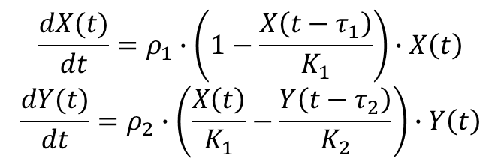
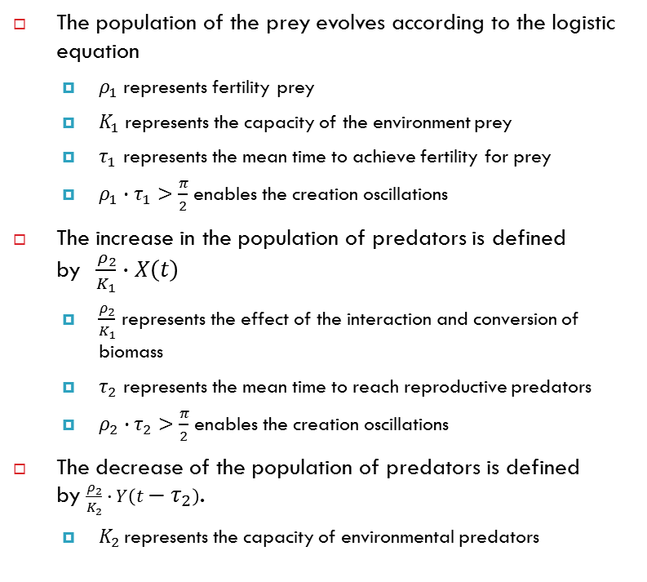
Two species populations models of predator - prey with delay
The population of the prey evolves according to the logistic equation
$ρ_{1}$represents fertility prey
$K_{1}$represents the capacity of the environment prey
$τ_{1}$ represents the mean time to achieve fertility for prey
${ρ_{1}∙τ}_{1}>\frac{π}{2}$enables the creation oscillations
The increase in the population of predators is defined by$\frac{ρ_{2}}{K_{1}}∙X\left(t\right)$
$\frac{ρ_{2}}{K_{1}}$ represents the effect of the interaction and conversion of biomass
$τ_{2}$ represents the mean time to reach reproductive predators
${ρ_{2}∙τ}_{2}>\frac{π}{2}$enables the creation oscillations
The decrease of the population of predators is defined by $\frac{ρ_{2}}{K_{2}}∙Y\left(t−τ_{2}\right)$.
$K_{2 }\text{represents}$ the capacity of environmental predators
$$\frac{dX(t)}{dt}=ρ_{1}∙\left(1−\frac{X\left(t−τ_{1}\right)}{K_{1}}\right)∙X\left(t\right)$$
$$\frac{dY(t)}{dt}=ρ_{2}∙\left(\frac{X\left(t\right)}{K_{1}}−\frac{Y\left(t−τ_{2}\right)}{K_{2}}\right)∙Y\left(t\right)$$

Slide 13
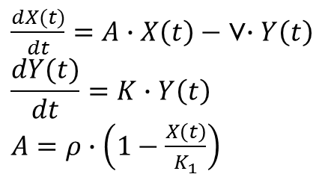
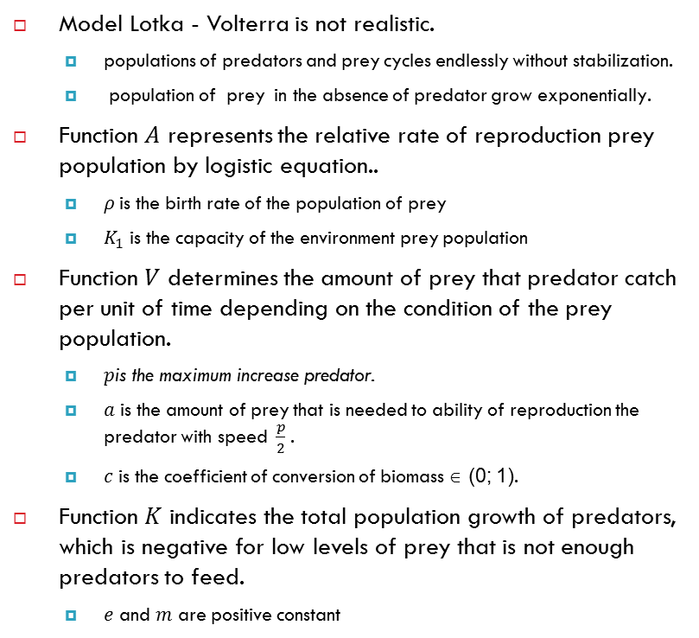
Kolmogorov models of predator - prey
Model Lotka - Volterra is not realistic.
populations of predators and prey cycles endlessly without stabilization.
population of prey in the absence of predator grow exponentially.
Function 𝐴 represents the relative rate of reproduction prey population by logistic equation..
$ρ$is the birth rate of the population of prey
$K_{1}$ is the capacity of the environment prey population
Function 𝑉 determines the amount of prey that predator catch per unit of time depending on the condition of the prey population.
$p\text{is} \text{the} \text{maximum} \text{increase} \text{predator}$.
$a$ is the amount of prey that is needed to ability of reproduction the predator with speed $\frac{p}{2}$.
$c$ is the coefficient of conversion of biomass ∈ (0; 1).
Function 𝐾 indicates the total population growth of predators, which is negative for low levels of prey that is not enough predators to feed.
$e$ and $m$ are positive constant
$\frac{dX(t)}{dt}=A∙X\left(t\right)−$ V$∙Y\left(t\right)$
$$\frac{dY(t)}{dt}=K∙Y\left(t\right)$$ $A$ $=ρ∙\left(1−\frac{X\left(t\right)}{K_{1}}\right)$ $$V=\frac{p∙X\left(t\right)}{c∙\left(a+X\left(t\right)\right)} \\ K=e∙V−m$$
Equation of Kolmogorov model

Slide 14
Summary of today's practice
[Population models]
Two species populations models of predator – prey: Lotka– Volterra with delay, Kolmogorov model
Two species populations models with competition
Two species populations models with cooperation
Epidemiology models.
[What is next?]
Next week we will continue with compartment models.

