Slide 1
Modelling and Simulation
Lesson 4- SS 2014 – Michel Kana

Slide 2
What do we do in today's practice?
Summary of the previous practice
Population model with age structure
Epidemiology models
Summary

Slide 3
Summary of the previous practice
[Population models]
Two species populations models of predator – prey
Two species populations models with competition
Two species populations models with mutualism

Slide 4
Population models with age structure
A single species is not only modeled as one population, but instead as a structured population
demographic differences among individuals as a function of stages or classed
stage or class can be age, size, etc.
Stages can be discrete or continuous function of time
Discrete if experimental data is collected at regular time intervals, e.g. yearly or seasonal
Continuous if experimental data is collected continuously over time
Examples
partition an insect population into egg, larva , pupa, and adult stages
partition a mammal population into age classes
Notes:
A structured population model tracks the dynamics not only of total population, but also the distribution of the variables that differentiate individuals
Fecundity in animals often varies with age, while in plants, fecundity typically depends on size
Field data is often collected at regular time intervals, for instance on a yearly or seasonal basis, so it is often easier and more practical to model

Slide 5
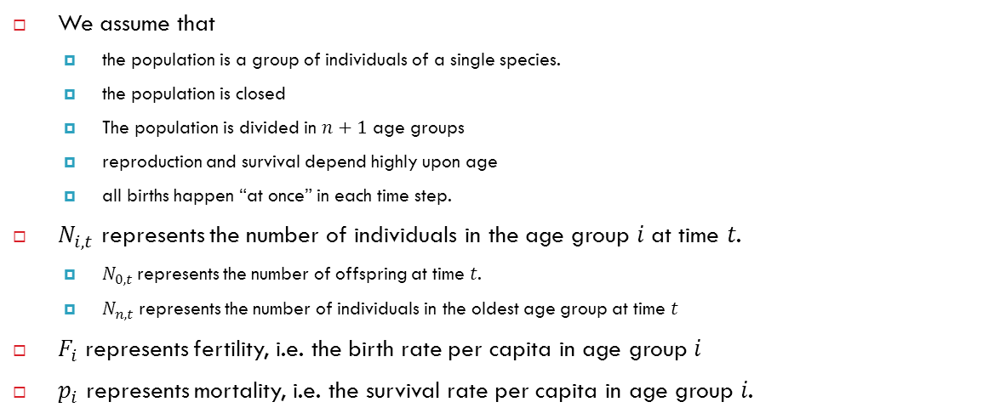
Population model with discrete age structure
We assume that
the population is a group of individuals of a single species.
the population is closed
The population is divided in $n+1$ age groups
reproduction and survival depend highly upon age
all births happen “at once” in each time step.
$N_{i,t}$ represents the number of individuals in the age group 𝑖 at time 𝑡.
$N_{0,t}$represents the number of offspring at time 𝑡.
$N_{n,t}$represents the number of individuals in the oldest age group at time 𝑡
$F_{i}$ represents fertility, i.e. the birth rate per capita in age group 𝑖
$p_{i}$ represents mortality, i.e. the survival rate per capita in age group 𝑖.

Slide 6
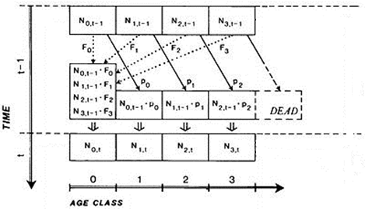
Population model with discrete age structure
Source: http://mathbio.colorado.edu

Slide 7
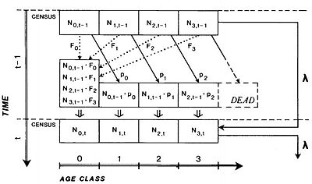
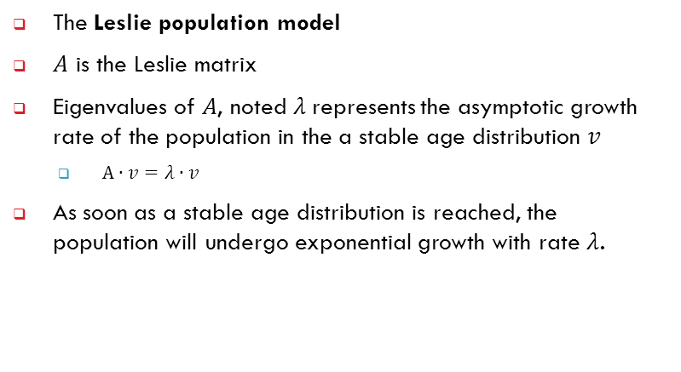
Population models with discrete age structure
The Leslie population model
$A$ is the Leslie matrix
Eigenvalues of 𝐴, noted $λ$represents the asymptotic growth rate of the population in the a stable age distribution 𝑣
$A∙v=λ∙v$
As soon as a stable age distribution is reached, the population will undergo exponential growth with rate $λ$.

Slide 8
Population models with discrete age structure
Consider a structured population with 6 age groups.
10 individuals in each age group at time 0.
The age group 0 and 1 are not fertile.
In the age group 2-4, there are 0.35% of offspring per individual at each time step.
In the age group 5, there are 0.10% of offspring per individual at each time step.
In all age groups (except of group 5), 80% of individuals survive with each time step.

Slide 9
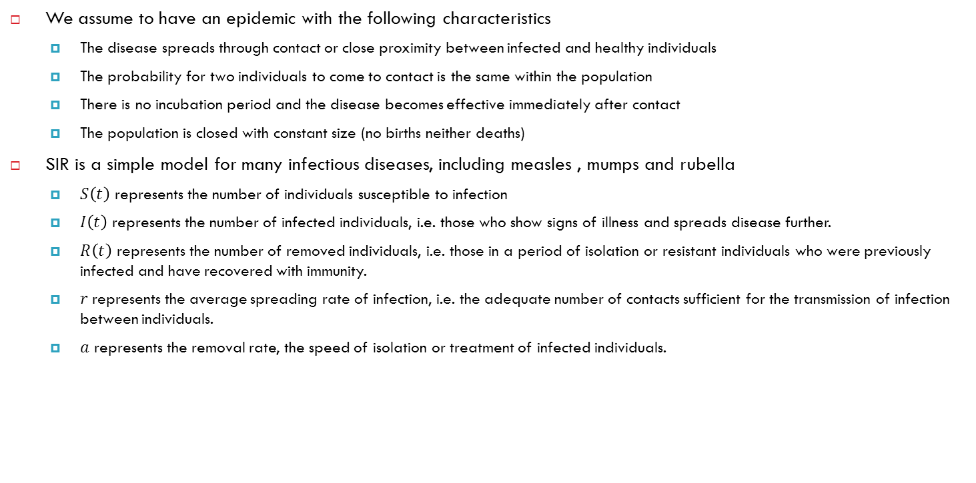
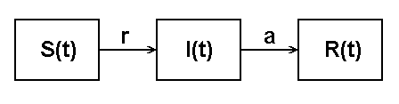
Epidemiology models - SIR
We assume to have an epidemic with the following characteristics
The disease spreads through contact or close proximity between infected and healthy individuals
The probability for two individuals to come to contact is the same within the population
There is no incubation period and the disease becomes effective immediately after contact
The population is closed with constant size (no births neither deaths)
SIR is a simple model for many infectious diseases, including measles , mumps and rubella
$S\left(t\right)$ represents the number of individuals susceptible to infection
$I\left(t\right)$ represents the number of infected individuals, i.e. those who show signs of illness and spreads disease further.
$R\left(t\right)$ represents the number of removed individuals, i.e. those in a period of isolation or resistant individuals who were previously infected and have recovered with immunity.
$r$represents the average spreading rate of infection, i.e. the adequate number of contacts sufficient for the transmission of infection between individuals.
$a$ represents the removal rate, the speed of isolation or treatment of infected individuals.

Slide 10
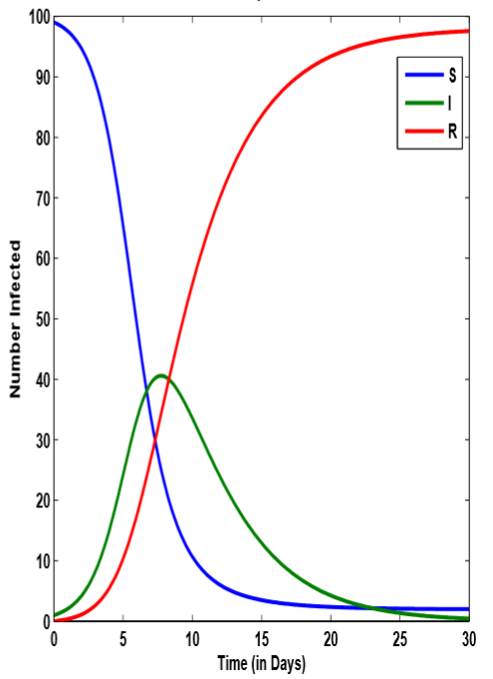
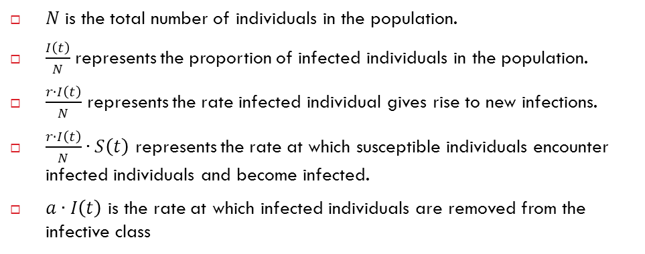
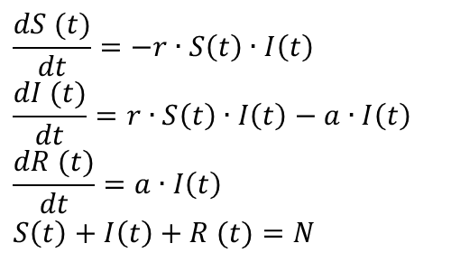
Epidemiology models - SIR
$N$ is the total number of individuals in the population.
$\frac{I\left(t\right)}{N}$ represents the proportion of infected individuals in the population.
$\frac{r∙I\left(t\right)}{N}$ represents the rate infected individual gives rise to new infections.
$\frac{r∙I\left(t\right)}{N}∙S\left(t\right)$ represents the rate at which susceptible individuals encounter infected individuals and become infected.
$a∙I\left(t\right)$ is the rate at which infected individuals are removed from the infective class
$$\frac{dS (t)}{dt}=−r∙S\left(t\right)∙I\left(t\right)$$
$$\frac{dI (t)}{dt}=r∙S\left(t\right)∙I\left(t\right)−a∙I\left(t\right)$$
$$\frac{dR (t)}{dt}=a∙I\left(t\right)$$
$$S\left(t\right)+I\left(t\right)+R (t)=N$$

Slide 11
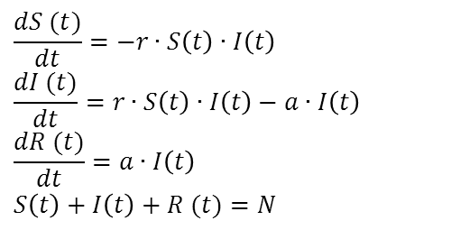

Epidemiology models - SIR
Equilibrium occurs
Before disease begins spreading $S(0)=N$ and $R(0)=0$
Disease begins to spread if $\frac{dI (t)}{dt}>0$
$r∙S\left(0\right)∙I\left(t\right)−a∙I\left(t\right)>0$
$\left(r∙S\left(0\right)∙−a\right)∙I\left(t\right)>0$
$r∙S\left(0\right)∙−a>0$
$\frac{r}{a}∙S\left(0\right)>1$
$\frac{r}{a}∙S\left(0\right)$ is the basic contact number
$\frac{r}{a}∙S\left(0\right)>1$: infection will be established in the population. Infection peaks and then disappears.
$\frac{r}{a}∙S\left(0\right)<1$: the infection dies out and there is no epidemic.
After disease has moved through the entire population $S=$0 and $R=N$
$$\frac{dS (t)}{dt}=−r∙S\left(t\right)∙I\left(t\right)$$
$$\frac{dI (t)}{dt}=r∙S\left(t\right)∙I\left(t\right)−a∙I\left(t\right)$$
$$\frac{dR (t)}{dt}=a∙I\left(t\right)$$
$$S\left(t\right)+I\left(t\right)+R (t)=N$$

Slide 12
Summary of today's lesson
[Population models]
Models of structured populations
Epidemiology models
[What is next?]
1-compartment model.

