Slide 1
Modelling and Simulation
Lesson 5- SS 2014 – Michel Kana

Slide 2
What do we do in today's lesson?
Summary of the previous practice
Epidemiology models
Compartmental modeling
Summary

Slide 3
Summary of the previous practice
[Population models]
Models of structured populations

Slide 4
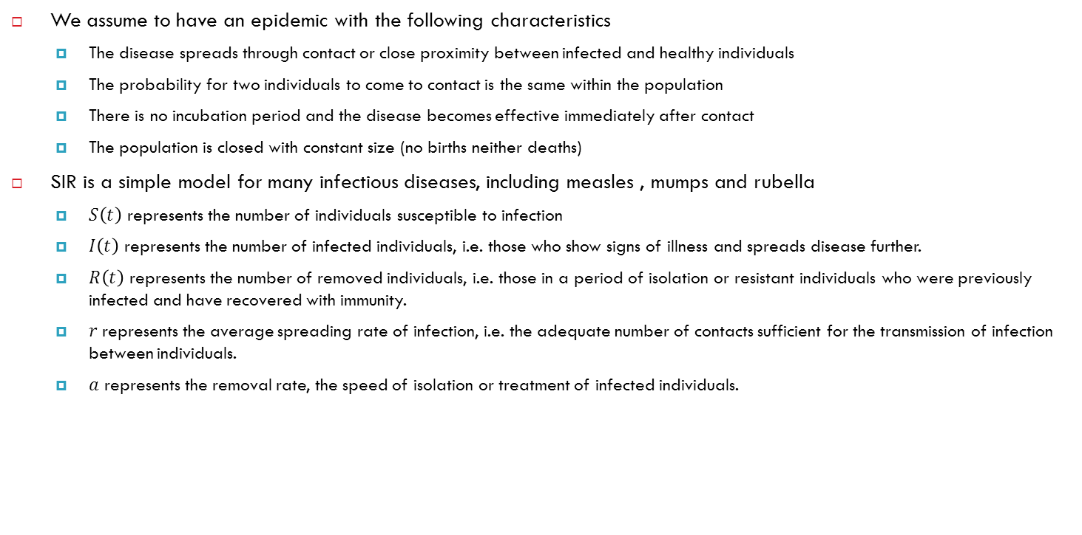
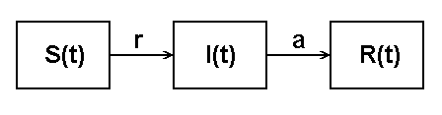
Epidemiology models - SIR
We assume to have an epidemic with the following characteristics
The disease spreads through contact or close proximity between infected and healthy individuals
The probability for two individuals to come to contact is the same within the population
There is no incubation period and the disease becomes effective immediately after contact
The population is closed with constant size (no births neither deaths)
SIR is a simple model for many infectious diseases, including measles , mumps and rubella
$S\left(t\right)$ represents the number of individuals susceptible to infection
$I\left(t\right)$ represents the number of infected individuals, i.e. those who show signs of illness and spreads disease further.
$R\left(t\right)$ represents the number of removed individuals, i.e. those in a period of isolation or resistant individuals who were previously infected and have recovered with immunity.
$r$represents the average spreading rate of infection, i.e. the adequate number of contacts sufficient for the transmission of infection between individuals.
$a$ represents the removal rate, the speed of isolation or treatment of infected individuals.

Slide 5
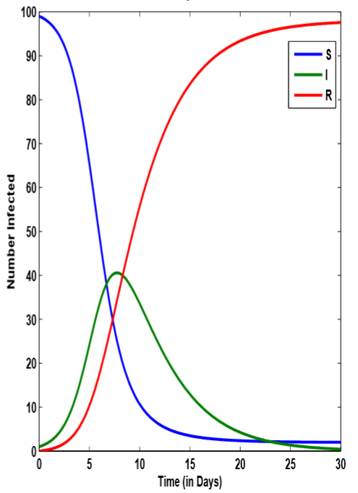
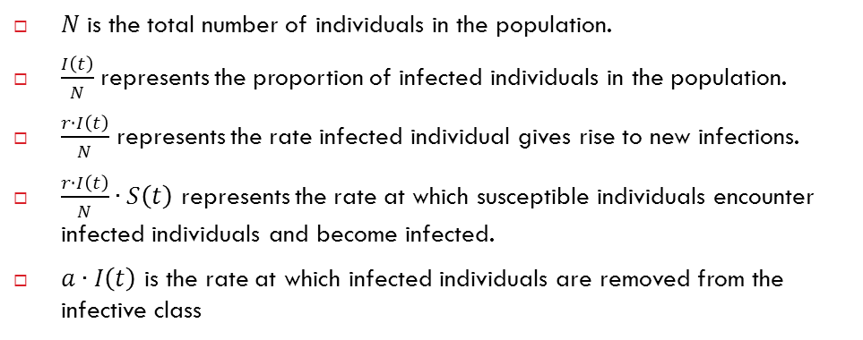
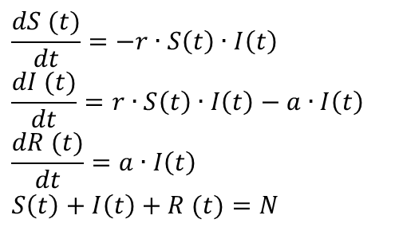
Epidemiology models - SIR
$N$ is the total number of individuals in the population.
$\frac{I\left(t\right)}{N}$ represents the proportion of infected individuals in the population.
$\frac{r∙I\left(t\right)}{N}$ represents the rate infected individual gives rise to new infections.
$\frac{r∙I\left(t\right)}{N}∙S\left(t\right)$ represents the rate at which susceptible individuals encounter infected individuals and become infected.
$a∙I\left(t\right)$ is the rate at which infected individuals are removed from the infective class
$$\frac{dS (t)}{dt}=−r∙S\left(t\right)∙I\left(t\right)$$
$$\frac{dI (t)}{dt}=r∙S\left(t\right)∙I\left(t\right)−a∙I\left(t\right)$$
$$\frac{dR (t)}{dt}=a∙I\left(t\right)$$
$$S\left(t\right)+I\left(t\right)+R (t)=N$$

Slide 6
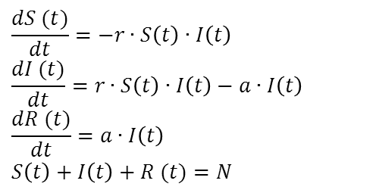

Epidemiology models - SIR
Equilibrium occurs
Before disease begins spreading $S(0)=N$ and $R(0)=0$
Disease begins to spread if $\frac{dI (t)}{dt}>0$
$r∙S\left(0\right)∙I\left(t\right)−a∙I\left(t\right)>0$
$\left(r∙S\left(0\right)∙−a\right)∙I\left(t\right)>0$
$r∙S\left(0\right)∙−a>0$
$\frac{r}{a}∙S\left(0\right)>1$
$\frac{r}{a}∙S\left(0\right)$ is the basic contact number
$\frac{r}{a}∙S\left(0\right)>1$: infection will be established in the population. Infection peaks and then disappears.
$\frac{r}{a}∙S\left(0\right)<1$: the infection dies out and there is no epidemic.
After disease has moved through the entire population $S=$0 and $R=N$
$$\frac{dS (t)}{dt}=−r∙S\left(t\right)∙I\left(t\right)$$
$$\frac{dI (t)}{dt}=r∙S\left(t\right)∙I\left(t\right)−a∙I\left(t\right)$$
$$\frac{dR (t)}{dt}=a∙I\left(t\right)$$
$$S\left(t\right)+I\left(t\right)+R (t)=N$$

Slide 7
Introduction to compartment models
Compartment models are often used to describe transport of material in biological systems
Material could be energy, substance, individuals of a population
Compartments can represent organs, species of animal and plants
Material can either
flow from one compartment to another,
or it can be added from the outside through a source
or it can be removed through a drain or a sink
We assume that
all material in the compartment is homogeneous
The system is closed in some sense. In other words the compartments may not include un-accounted for sources or sinks
All transport channels are known and the equation of mass balance can be applied

Slide 8
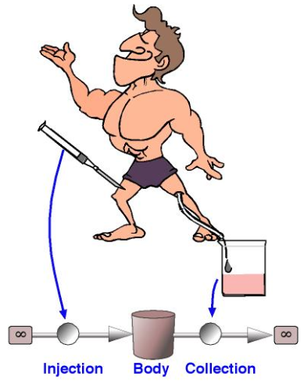
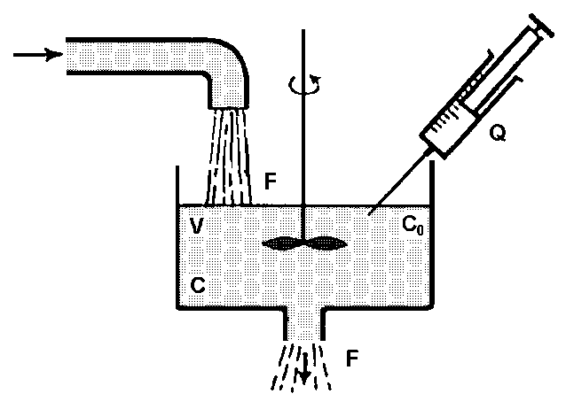
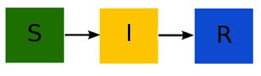
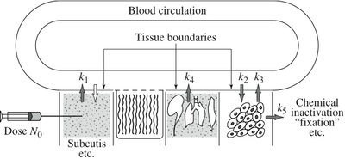
Example of compartment models

Slide 9
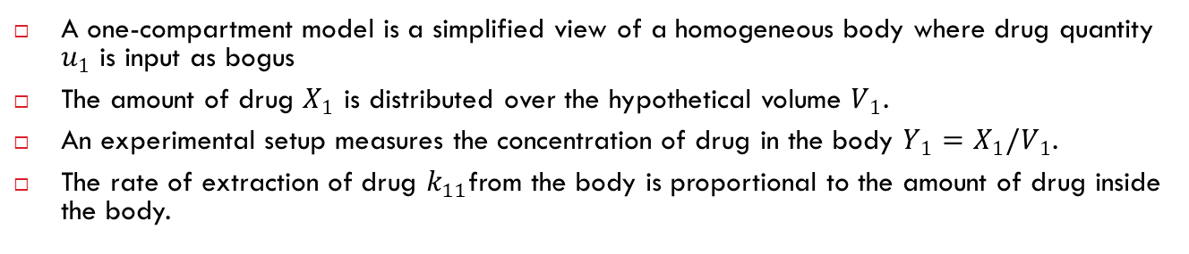
Pharmacokinetic model with 1 compartment
A one-compartment model is a simplified view of a homogeneous body where drug quantity $u_{1}$ is input as bogus
The amount of drug $X_{1}$ is distributed over the hypothetical volume $V_{1}$.
An experimental setup measures the concentration of drug in the body $Y_{1}=X_{1}/V_{1}$.
The rate of extraction of drug $k_{11}$from the body is proportional to the amount of drug inside the body.

Slide 10
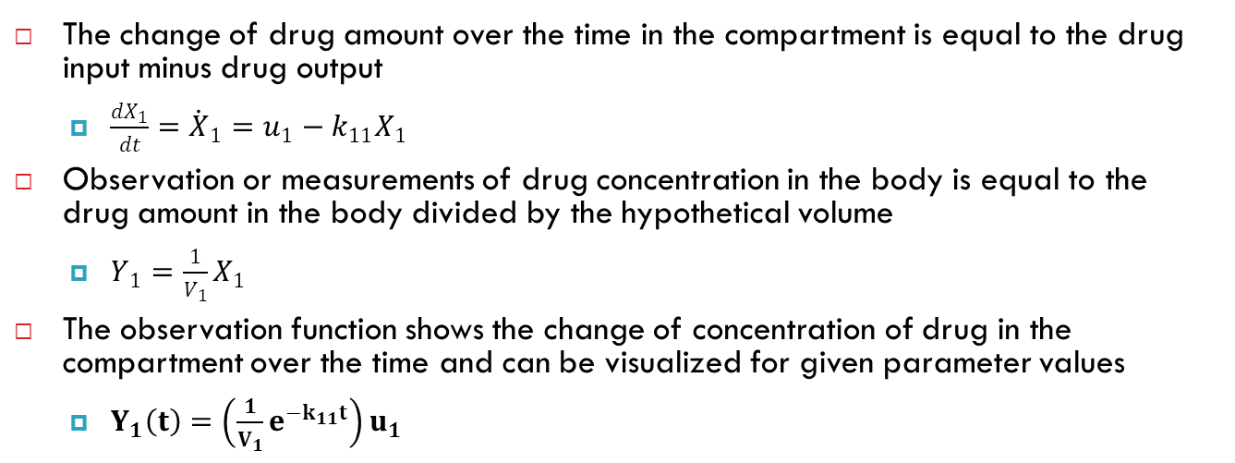
Pharmacokinetic model with 1 compartment
The change of drug amount over the time in the compartment is equal to the drug input minus drug output
$\frac{dX_{1}}{dt}={\dot{X}}_{1}=u_{1}−k_{11}X_{1}$
Observation or measurements of drug concentration in the body is equal to the drug amount in the body divided by the hypothetical volume
$Y_{1}=\frac{1}{V_{1}}X_{1}$
The observation function shows the change of concentration of drug in the compartment over the time and can be visualized for given parameter values
$Y_{1}\left(t\right)=\left(\frac{1}{V_{1}}e^{−k_{11}t}\right)u_{1}$

Slide 11
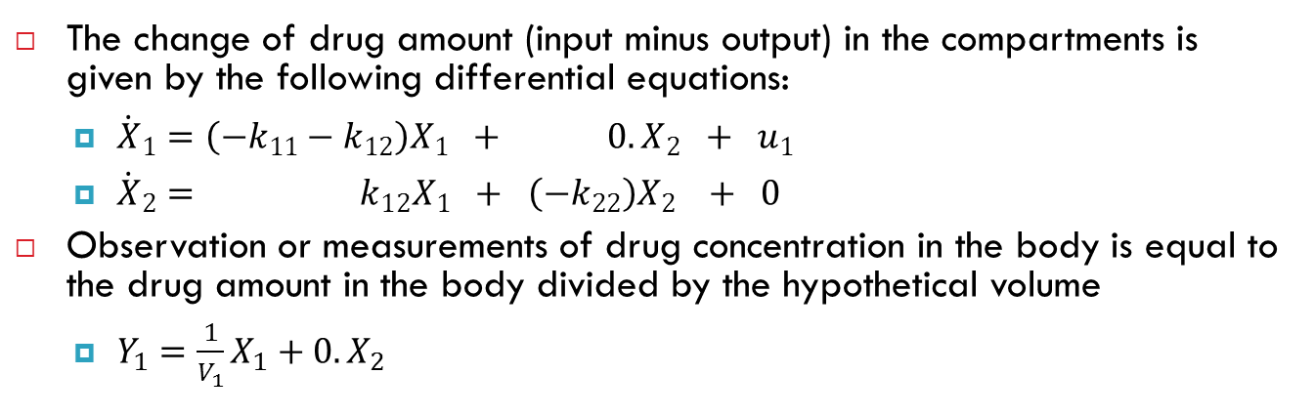
Pharmacokinetic model with 2 compartments
The change of drug amount (input minus output) in the compartments is given by the following differential equations:
${\dot{X}}_{1}=\left({−k}_{11}−k_{12}\right)X_{1} + 0.X_{2} + u_{1}$
${\dot{X}}_{2}= k_{12}X_{1} + \left(−k_{22}\right)X_{2} + 0$
Observation or measurements of drug concentration in the body is equal to the drug amount in the body divided by the hypothetical volume
$Y_{1}=\frac{1}{V_{1}}X_{1}+0.X_{2}$

Slide 12
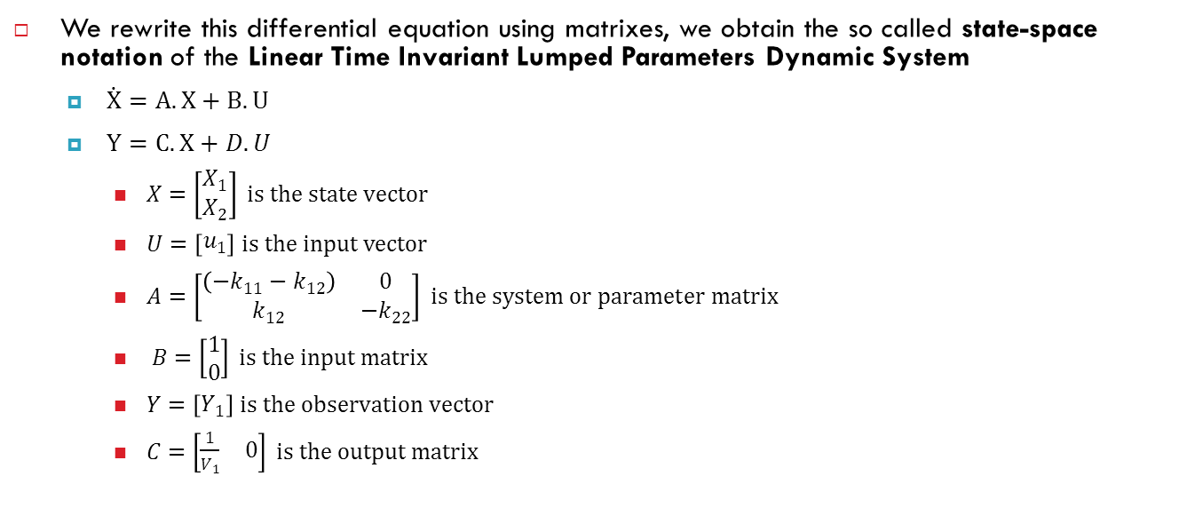
Pharmacokinetic model with 2 compartments
We rewrite this differential equation using matrixes, we obtain the so called state-space notation of the Linear Time Invariant Lumped Parameters Dynamic System
$\dot{X}=A.X+B.U$
$Y=C.X+D.U$
$X=\left[\begin{matrix}X_{1} \\ X_{2}\end{matrix}\right] is the state vector$
$U=\left[\begin{matrix}u_{1}\end{matrix}\right] is the input vector$
$A=\left[\begin{matrix}\begin{matrix}\left({−k}_{11}−k_{12}\right)\end{matrix} & 0 \\ k_{12} & −k_{22}\end{matrix}\right] is the system or parameter matrix$
$B=\left[\begin{matrix}1 \\ 0\end{matrix}\right] is the input matrix$
$Y=\left[\begin{matrix}\begin{matrix}Y_{1}\end{matrix}\end{matrix}\right] is the observation vector$
$C=\left[\begin{matrix}\begin{matrix}\frac{1}{V_{1}} & 0\end{matrix}\end{matrix}\right] is the output matrix$

Slide 13
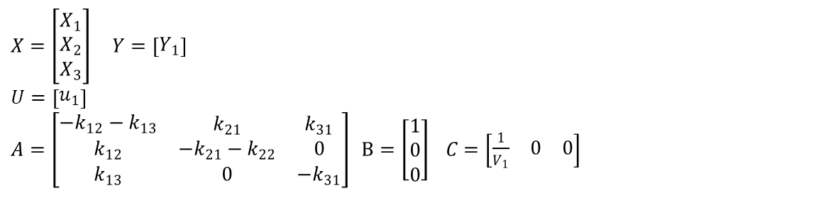
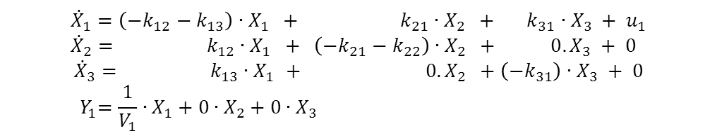
Pharmacokinetic model with 3 compartments
$${\dot{X}}_{1}=\left({−k}_{12}−k_{13}\right)∙X_{1} + k_{21}∙X_{2} + k_{31}∙X_{3} + u_{1} \\ {\dot{X}}_{2}= k_{12}∙X_{1} + \left(−k_{21}−k_{22}\right)∙X_{2} + 0.X_{3} + 0$$
$${\dot{X}}_{3}= k_{13}∙X_{1 }+ 0.X_{2} +\left(−k_{31}\right)∙X_{3} + 0$$
$${ Y}_{1}=\frac{1}{V_{1}}∙X_{1}+0∙X_{2}+0∙X_{3}$$
$$X=\left[\begin{matrix}X_{1} \\ X_{2} \\ X_{3}\end{matrix}\right] Y=\left[\begin{matrix}\begin{matrix}Y_{1}\end{matrix}\end{matrix}\right]$$
$$U=\left[\begin{matrix}u_{1}\end{matrix}\right]$$
$A=\left[\begin{matrix}\begin{matrix}{−k}_{12}−k_{13}\end{matrix} & k_{21} & k_{31} \\ k_{12} & −k_{21}−k_{22} & 0 \\ k_{13} & 0 & {−k}_{31}\end{matrix}\right]$ $B=\left[\begin{matrix}1 \\ 0 \\ 0\end{matrix}\right]$ $C=\left[\begin{matrix}\begin{matrix}\frac{1}{V_{1}} & 0 & 0\end{matrix}\end{matrix}\right]$

Slide 14
Summary of today's lesson
[Population models]
Epidemiology models
Pharmacokinetic models
[What is next?]
Pharmacokinetic model.

