Slide 1
Modelling and Simulation
Lesson 5- SS 2014 – Michel Kana

Slide 2
What do we do in today's lesson?
Summary of the previous practice
State-space notation of multi-compartmental models
Compartmental modeling of the cardiovascular system
Summary

Slide 3
Summary of the previous practice
Epidemiology models
Compartmental models

Slide 4

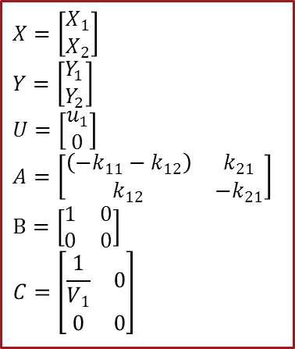
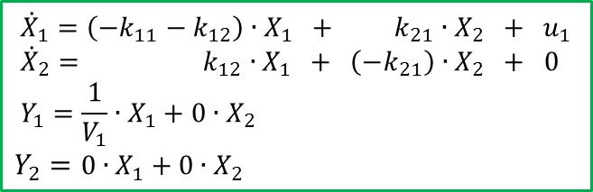
Example of compartmental model
$$\dot{X}=A.X+B.U$$
$$Y=C.X$$
$X=\left[\begin{matrix}X_{1} \\ X_{2}\end{matrix}\right]$
$Y=\left[\begin{matrix}\begin{matrix}\begin{matrix}Y_{1} \\ Y_{2}\end{matrix}\end{matrix}\end{matrix}\right]$
$$U=\left[\begin{matrix}u_{1} \\ 0\end{matrix}\right]$$
$$A=\left[\begin{matrix}\begin{matrix}\left({−k}_{11}−k_{12}\right)\end{matrix} & k_{21} \\ k_{12} & −k_{21}\end{matrix}\right]$$
$$B=\left[\begin{matrix}1 & 0 \\ 0 & 0\end{matrix}\right]$$
$$C=\left[\begin{matrix}\begin{matrix}\frac{1}{V_{1}} & 0 \\ 0 & 0\end{matrix}\end{matrix}\right]$$
$${\dot{X}}_{1}=\left({−k}_{11}−k_{12}\right)∙X_{1} + k_{21}∙X_{2} + u_{1} \\ {\dot{X}}_{2}= k_{12}∙X_{1} + \left(−k_{21}\right)∙X_{2} + 0$$
$$Y_{1}=\frac{1}{V_{1}}∙X_{1}+0∙X_{2}$$
$$Y_{2}=0∙X_{1}+0∙X_{2}$$

Slide 5
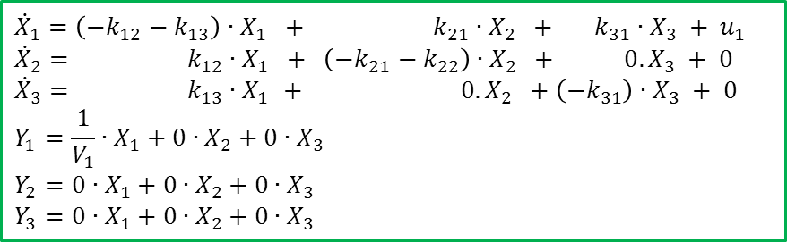
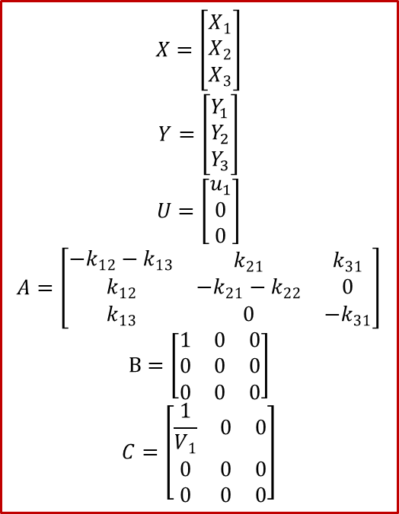
Example of compartmental model
$$X=\left[\begin{matrix}X_{1} \\ X_{2} \\ X_{3}\end{matrix}\right]$$
$$Y=\left[\begin{matrix}\begin{matrix}\begin{matrix}Y_{1} \\ Y_{2} \\ Y_{3}\end{matrix}\end{matrix}\end{matrix}\right]$$
$$U=\left[\begin{matrix}u_{1} \\ 0 \\ 0\end{matrix}\right]$$
$$A=\left[\begin{matrix}\begin{matrix}{−k}_{12}−k_{13}\end{matrix} & k_{21} & k_{31} \\ k_{12} & −k_{21}−k_{22} & 0 \\ k_{13} & 0 & {−k}_{31}\end{matrix}\right]$$
$$B=\left[\begin{matrix}1 & 0 & 0 \\ 0 & 0 & 0 \\ 0 & 0 & 0\end{matrix}\right]$$
$$C=\left[\begin{matrix}\begin{matrix}\frac{1}{V_{1}} & 0 & 0 \\ 0 & 0 & 0 \\ 0 & 0 & 0\end{matrix}\end{matrix}\right]$$
$${\dot{X}}_{1}=\left({−k}_{12}−k_{13}\right)∙X_{1} + k_{21}∙X_{2} + k_{31}∙X_{3} + u_{1} \\ {\dot{X}}_{2}= k_{12}∙X_{1} + \left(−k_{21}−k_{22}\right)∙X_{2} + 0.X_{3} + 0 \\ {\dot{X}}_{3}= k_{13}∙X_{1 }+ 0.X_{2} +\left(−k_{31}\right)∙X_{3} + 0$$
$$Y_{1}=\frac{1}{V_{1}}∙X_{1}+0∙X_{2}+0∙X_{3}$$
$$Y_{2}=0∙X_{1}+0∙X_{2}+0∙X_{3}$$
$$Y_{3}=0∙X_{1}+0∙X_{2}+0∙X_{3}$$

Slide 6

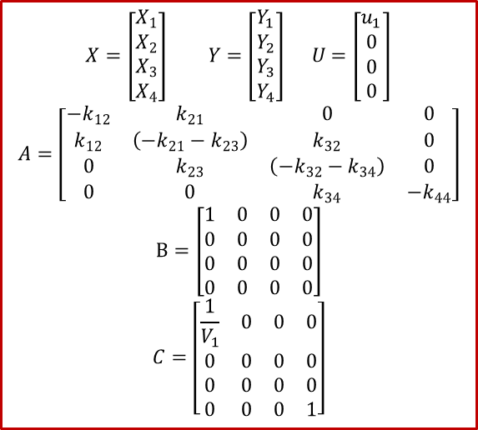
Example of compartmental model
$$X=\left[\begin{matrix}X_{1} \\ X_{2} \\ X_{3} \\ X_{4}\end{matrix}\right] Y=\left[\begin{matrix}\begin{matrix}\begin{matrix}Y_{1} \\ Y_{2} \\ Y_{3} \\ Y_{4}\end{matrix}\end{matrix}\end{matrix}\right] U=\left[\begin{matrix}u_{1} \\ 0 \\ 0 \\ 0\end{matrix}\right]$$
$$A=\left[\begin{matrix}{−k}_{12} & k_{21} & 0 & 0 \\ k_{12} & \left(−k_{21}−k_{23}\right) & k_{32} & 0 \\ 0 & k_{23} & \left(−k_{32}−k_{34}\right) & 0 \\ 0 & 0 & k_{34} & −k_{44}\end{matrix}\right]$$
$$B=\left[\begin{matrix}1 & 0 & 0 & 0 \\ 0 & 0 & 0 & 0 \\ 0 & 0 & 0 & 0 \\ 0 & 0 & 0 & 0\end{matrix}\right]$$
$$C=\left[\begin{matrix}\begin{matrix}\frac{1}{V_{1}} & 0 & 0 & 0 \\ 0 & 0 & 0 & 0 \\ 0 & 0 & 0 & 0 \\ 0 & 0 & 0 & 1\end{matrix}\end{matrix}\right]$$
$${\dot{X}}_{1}=\left({−k}_{12}\right)∙X_{1}+ k_{21}∙X_{2} + 0∙X_{3}+ 0∙X_{4} + u_{1} \\ {\dot{X}}_{2}= k_{12}∙X_{1}+\left(−k_{21}−k_{23}\right)∙X_{2} + k_{32}∙X_{3} + 0∙X_{4}+ 0 \\ {\dot{X}}_{3}= 0∙X_{1 }+ k_{23}∙X_{2} + \left(−k_{32}−k_{34}\right)∙X_{3} + 0∙X_{4}+ 0 \\ {\dot{X}}_{4}= 0∙X_{1 }+ 0∙X_{2} + k_{34}∙X_{3} +\left(−k_{44}\right)∙X_{4} +0$$
$$Y_{1}=\frac{1}{V_{1}}∙X_{1}+0∙X_{2}+0∙X_{3}+0∙X_{4}$$
$$Y_{2}=0∙X_{1}+0∙X_{2}+0∙X_{3}+0∙X_{4}$$
$$Y_{3}=0∙X_{1}+0∙X_{2}+0∙X_{3}+0∙X_{4}$$
$$Y_{4}=0∙X_{1}+0∙X_{2}+0∙X_{3}+1∙X_{4}$$

Slide 7
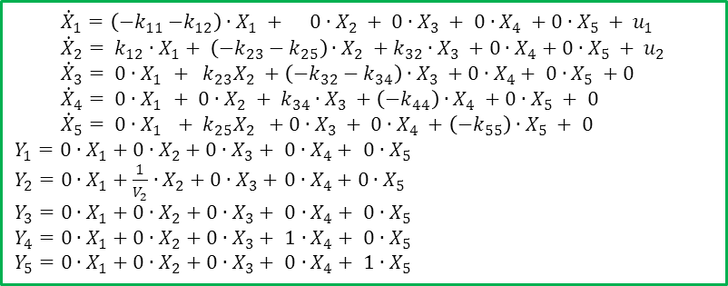
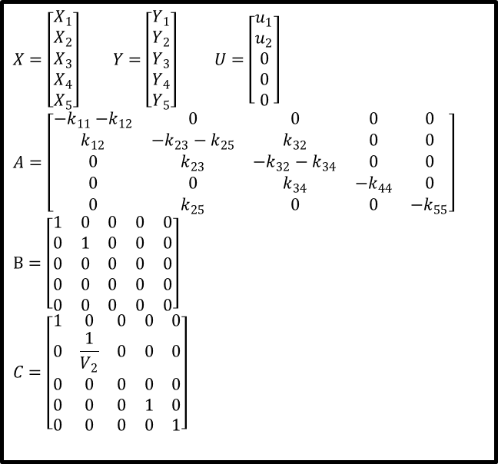
Example of compartmental model
$$X=\left[\begin{matrix}X_{1} \\ X_{2} \\ X_{3} \\ X_{4} \\ X_{5}\end{matrix}\right] Y=\left[\begin{matrix}Y_{1} \\ Y_{2} \\ Y_{3} \\ \begin{matrix}Y_{4} \\ Y_{5}\end{matrix}\end{matrix}\right] U=\left[\begin{matrix}\begin{matrix}u_{1} \\ u_{2} \\ 0 \\ 0 \\ 0\end{matrix}\end{matrix}\right]$$
$$A=\left[\begin{matrix}{−k}_{11}{−k}_{12} & 0 & 0 & 0 & 0 \\ k_{12} & −k_{23}−k_{25} & k_{32} & 0 & 0 \\ 0 & k_{23} & −k_{32}−k_{34} & 0 & 0 \\ 0 & 0 & k_{34} & −k_{44} & 0 \\ 0 & k_{25} & 0 & 0 & −k_{55}\end{matrix}\right]$$
$$B=\left[\begin{matrix}1 & 0 & 0 & 0 & 0 \\ 0 & 1 & 0 & 0 & 0 \\ 0 & 0 & 0 & 0 & 0 \\ 0 & 0 & 0 & 0 & 0 \\ 0 & 0 & 0 & 0 & 0\end{matrix}\right]$$
$$C=\left[\begin{matrix}1 & 0 & 0 & 0 & 0 \\ 0 & \frac{1}{V_{2}} & 0 & 0 & 0 \\ 0 & 0 & 0 & 0 & 0 \\ 0 & 0 & 0 & 1 & 0 \\ 0 & 0 & 0 & 0 & 1\end{matrix}\right]$$
$${\dot{X}}_{1}=\left({−k}_{11}{−k}_{12}\right)∙X_{1} + 0∙X_{2} + 0∙X_{3} + 0∙X_{4} +0∙X_{5} + u_{1} \\ {\dot{X}}_{2}= {k_{12}∙X}_{1}+ \left(−k_{23}−k_{25}\right)∙X_{2} +{k_{32}∙X}_{3} +0∙X_{4}+0∙X_{5} + u_{2} \\ {\dot{X}}_{3}= 0∙X_{1 }+ k_{23}X_{2} +\left(−k_{32}−k_{34}\right)∙X_{3} +0∙X_{4}+ 0∙X_{5} +0 \\ {\dot{X}}_{4}= 0∙X_{1 }+ 0∙X_{2} + k_{34}∙X_{3} +\left(−k_{44}\right)∙X_{4} +0∙X_{5} + 0 \\ {\dot{X}}_{5}= 0∙X_{1 } + k_{25}X_{2} +0∙X_{3} + 0∙X_{4} +\left(−k_{55}\right)∙X_{5} + 0$$
$$Y_{1}=0∙X_{1}+0∙X_{2}+0∙X_{3}+ 0∙X_{4}+ 0∙X_{5}$$
$Y_{2}=0∙X_{1}+\frac{1}{V_{2}}∙X_{2}+0∙X_{3}+$ $0∙X_{4}+$ $0∙X_{5}$
$$Y_{3}=0∙X_{1}+0∙X_{2}+0∙X_{3}+ 0∙X_{4}+ 0∙X_{5}$$
$$Y_{4}=0∙X_{1}+0∙X_{2}+0∙X_{3}+ 1∙X_{4}+ 0∙X_{5}$$
$$Y_{5}=0∙X_{1}+0∙X_{2}+0∙X_{3}+ 0∙X_{4}+ 1∙X_{5}$$

Slide 8
Compartmental model of cardiovascular system
The goal of this project is to describe the overall reaction of the cardiovascular system under a constant workload over a period of time of 15 minutes
We are interested only in the time behavior of the heart rate and the time course of the blood pressure

Slide 9
Compartmental model of cardiovascular system
Compartments of the cardiovascular system
Venous Systemic Compartment
Arterial Systemic Compartment
Venous Pulmonary Compartment
Arterial Pulmonary Compartment
Systemic Peripheral Compartment
Pulmonary Peripheral Compartment
Right Ventricle Compartment
Left Ventricle Compartment

Slide 10
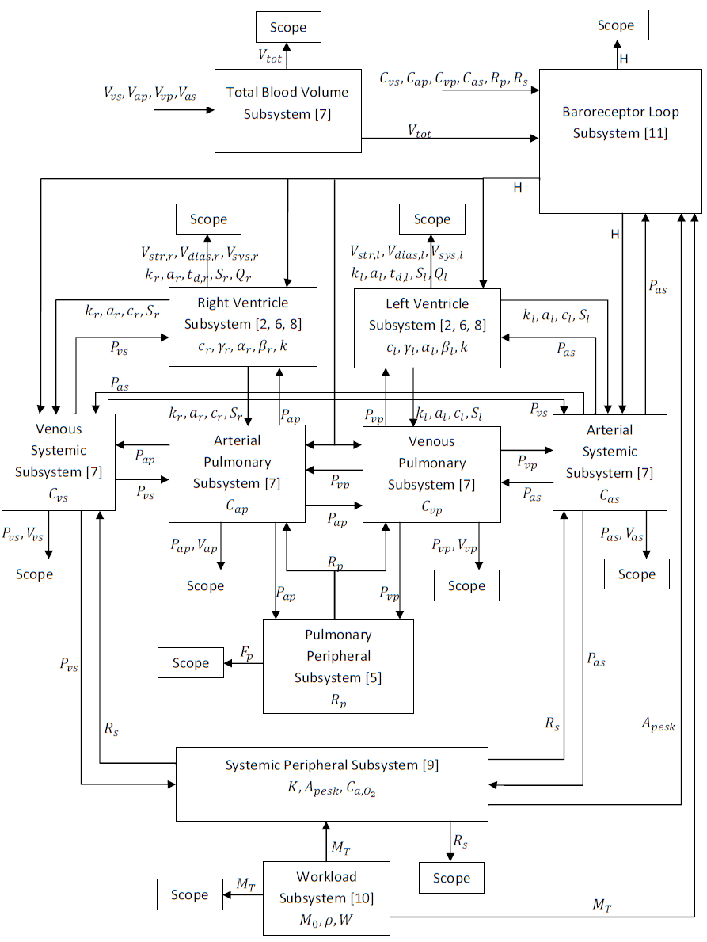
J. J. Bazel et. al., ‘Cardiovascular and Respiratory Systems – Modeling, Analysis, and Control’, ISBN-13: 978-0-898716-17-7, 2007

Slide 11
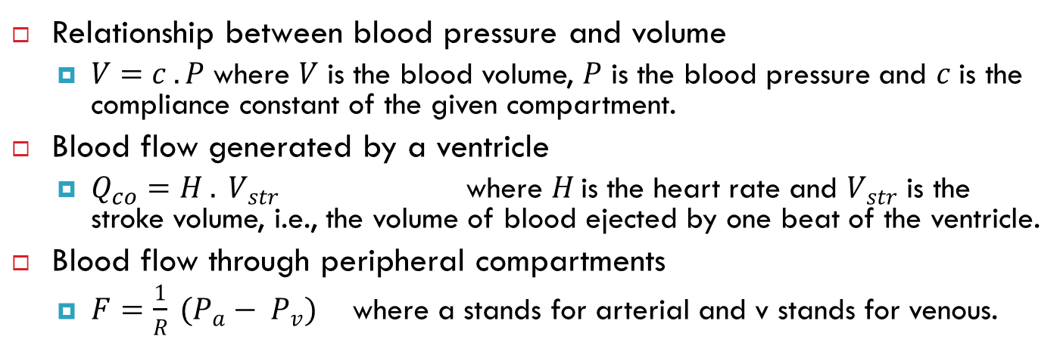
Basic equations
Relationship between blood pressure and volume
$V=c .P$ where $V$ is the blood volume, $P$ is the blood pressure and $c$ is the compliance constant of the given compartment.
Blood flow generated by a ventricle
$Q_{co}=H . V_{str}$ where $H$is the heart rate and $V_{str}$ is the stroke volume, i.e., the volume of blood ejected by one beat of the ventricle.
Blood flow through peripheral compartments
$F=\frac{1}{R} (P_{a}− P_{v})$ where a stands for arterial and v stands for venous.

Slide 12
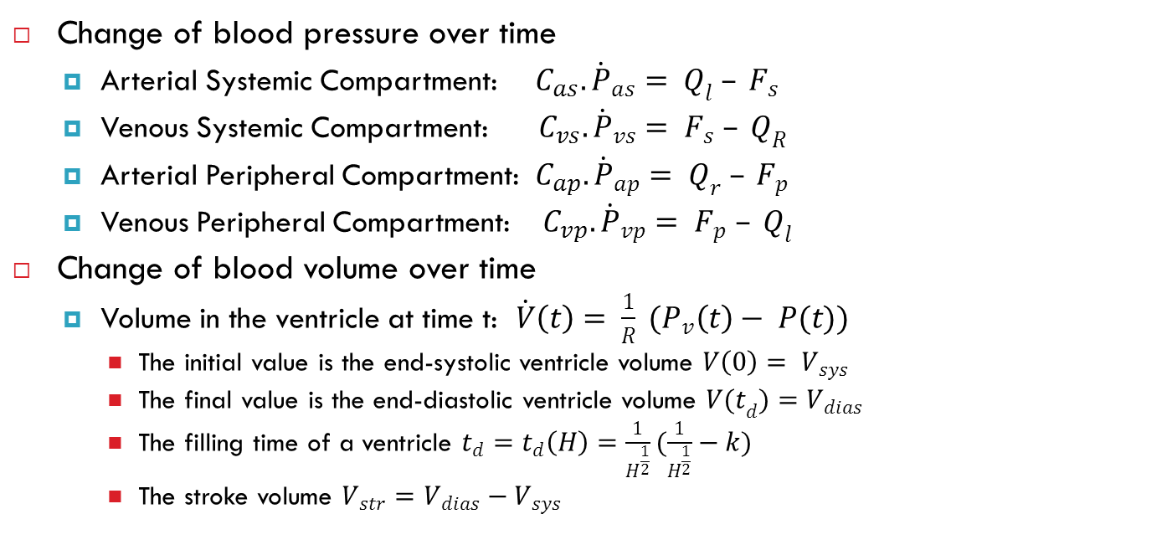
Equations for blood pressure and flow
Change of blood pressure over time
Arterial Systemic Compartment: $C_{as}.{\dot{P}}_{as}= Q_{l} – F_{s}$
Venous Systemic Compartment: $C_{vs}.{\dot{P}}_{vs}= F_{s} – Q_{R}$
Arterial Peripheral Compartment: $C_{ap}.{\dot{P}}_{ap}= Q_{r} – F_{p}$
Venous Peripheral Compartment: $C_{vp}.{\dot{P}}_{vp}= F_{p} – Q_{l}$
Change of blood volume over time
Volume in the ventricle at time t: $\dot{V}\left(t\right)= \frac{1}{R} (P_{v}\left(t\right)− P(t))$
The initial value is the end-systolic ventricle volume $V\left(0\right)= V_{sys}$
The final value is the end-diastolic ventricle volume ${V(t}_{d})=V_{dias}$
The filling time of a ventricle $t_{d}=t_{d}\left(H\right)=\frac{1}{H^{\frac{1}{2}}}(\frac{1}{H^{\frac{1}{2}}}−k)$
The stroke volume $V_{str}=V_{dias}−V_{sys}$

Slide 13
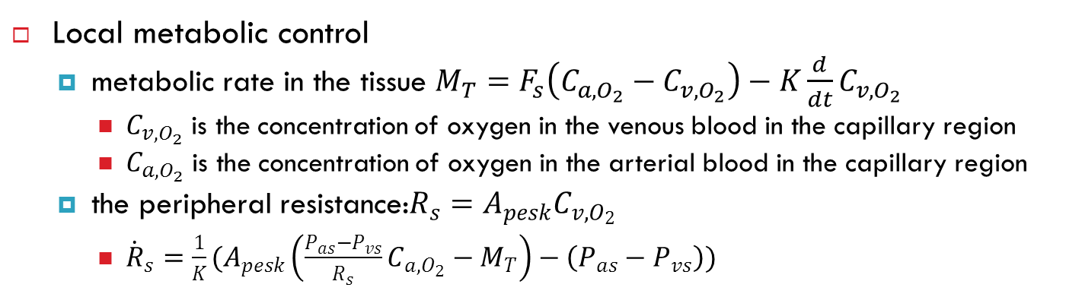
Equations for workload
Local metabolic control
metabolic rate in the tissue $M_{T}=F_{s}\left(C_{a,O_{2}}−C_{v,O_{2}}\right)−K\frac{d}{dt}C_{v,O_{2}}$
$C_{v,O_{2}}$ is the concentration of oxygen in the venous blood in the capillary region
$C_{a,O_{2}}$ is the concentration of oxygen in the arterial blood in the capillary region
the peripheral resistance:$R_{s}=A_{pesk}C_{v,O_{2}}$
${\dot{R}}_{s}=\frac{1}{K}(A_{pesk}\left(\frac{P_{as}−P_{vs}}{R_{s}}C_{a,O_{2}}−M_{T}\right)−\left(P_{as}−P_{vs}\right))$

Slide 14
Summary of today's lesson
Compartmental models
[What is next?]
Pharmacokinetic models.

