Slide 1
Modelling and Simulation
Lesson 7 - SS 2014 – Michel Kana

Slide 2
What do we do in today's lesson?
Summary of the previous practice
Pharmacokinetics
Projects
Summary

Slide 3
Summary of the previous practice
Compartmental models

Slide 4
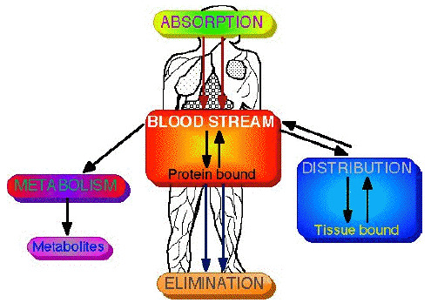
Introduction to pharmacokinetic modeling
Pharmacokinetics is the study of how drugs move around the body and how quickly this movement occurs.
Pharmacodynamics deal with interactions of drug molecules with targets involving receptors, enzymes, ion channels, carriers.
The four major processes involved in drug transport are: absorption, distribution, metabolism and ends with elimination.
Drug absorption can be oral, pulmonary, nasal, injection, transdermal, transmucousal
Drug distribution depends on pH, protein binding, fat storage.
Drug elimination is performed by the kidneys into urine for polar drugs

Slide 5
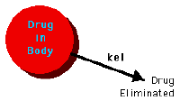
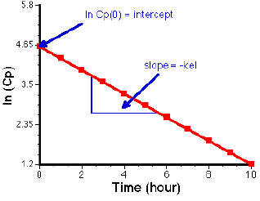
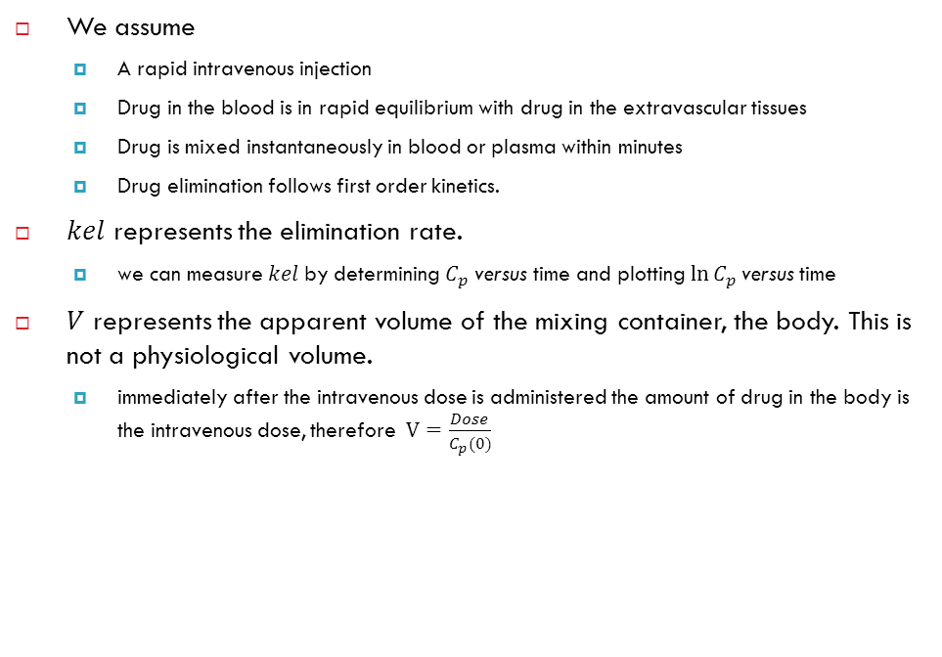
One compartment
We assume
A rapid intravenous injection
Drug in the blood is in rapid equilibrium with drug in the extravascular tissues
Drug is mixed instantaneously in blood or plasma within minutes
Drug elimination follows first order kinetics.
$kel$ represents the elimination rate.
we can measure $kel$by determining $C_{p}$ versus time and plotting$\ln{C_{p}}$versus time
$V$ represents the apparent volume of the mixing container, the body. This is not a physiological volume.
immediately after the intravenous dose is administered the amount of drug in the body is the intravenous dose, therefore $V=\frac{Dose}{C_{p}(0)}$
Notes:
First order kinetics means that the rate of change of drug concentration by any process is directly proportional to the drug concentration remaining to undertake that
process.

Slide 6
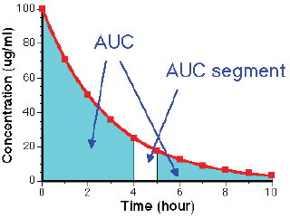
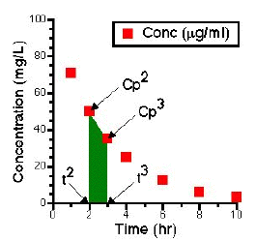
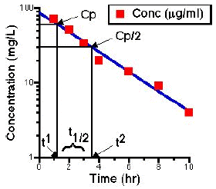
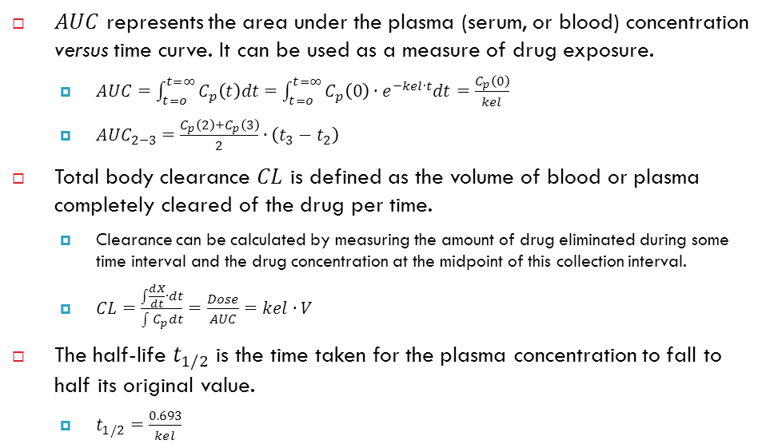
One compartment
$AUC$ represents the area under the plasma (serum, or blood) concentration versus time curve. It can be used as a measure of drug exposure.
$AUC=\int_{t=o}^{t=∞}{C_{p}\left(t\right)dt}=\int_{t=o}^{t=∞}{C_{p}\left(0\right)∙e^{−kel∙t}dt}=\frac{C_{p}\left(0\right)}{kel}$
${AUC}_{2−3}=\frac{C_{p}\left(2\right)+C_{p}\left(3\right)}{2}∙\left(t_{3}−t_{2}\right)$
Total body clearance $CL$ is defined as the volume of blood or plasma completely cleared of the drug per time.
Clearance can be calculated by measuring the amount of drug eliminated during some time interval and the drug concentration at the midpoint of this collection interval.
$CL=\frac{\int{\frac{dX}{dt}∙dt}}{\int{C_{p}dt}}=\frac{Dose}{AUC}=kel∙V$
The half-life $t_{1/2}$ is the time taken for the plasma concentration to fall to half its original value.
$t_{1/2}=\frac{0.693}{kel}$
Notes:
First order kinetics means that the rate of change of drug concentration by any process is directly proportional to the drug concentration remaining to undertake that
process.

Slide 7
Summary of today's lesson
[Population models]
Pharmacokinetics
Projects
[What is next?]
Identifiability analysis

