Slide 1
Modelling and Simulation
Lesson 9 - SS 2014 – Michel Kana

Slide 2
What do we do in today's lesson?
Summary of the previous practice
Identifiability Analysis
Projects
Summary

Slide 3
Summary of the previous practice
Pharmacokinetics modeling

Slide 4
Semester schedule
17ABBMS
Population models
Compartmental models
Advanced Topics
1th lecture
Introduction to Mathematical Modeling
5th lecture
1 - compartmental models
9th lecture Apr 15
Identifiability analysis
2nd lecture
Models for single specie populations
6th lecture
More - compartmental models
12th lecture May 6
Identifiability analysis
3rd lecture
Models for two species populations
7th lecture
More - compartmental models
13th lecture May 13
Identification of model parameters
14th lecture May 20
Sensitivity analysis
4th lecture
Epidemiology models
8th (Apr 8), 10th (Apr 22) and 11th (Apr 29) lessons are postponed
11th (May 1) and 12th (May 8) tutorials are postponed
May 27: final exam, May 29: correction of final exam June 1: final presentations and grades

Slide 5
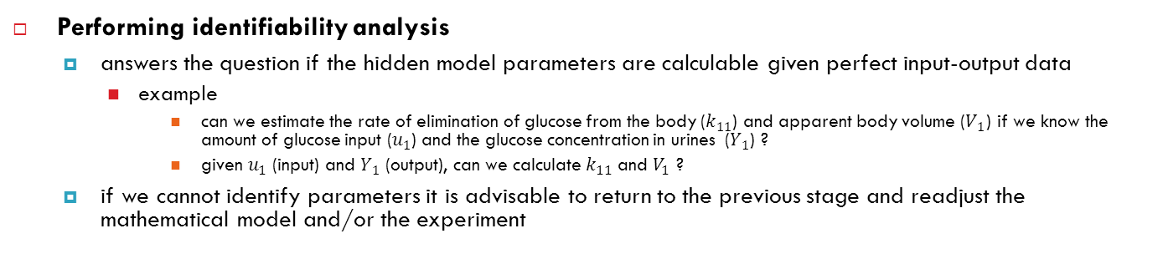
Purpose of identifiability analysis
Performing identifiability analysis
answers the question if the hidden model parameters are calculable given perfect input-output data
example
can we estimate the rate of elimination of glucose from the body ($k_{11}$) and apparent body volume ($V_{1}$) if we know the amount of glucose input ($u_{1}$) and the glucose concentration in urines ($Y_{1}$) ?
given $u_{1}$ (input) and $Y_{1}$ (output), can we calculate $k_{11}$ and $V_{1}$ ?
if we cannot identify parameters it is advisable to return to the previous stage and readjust the mathematical model and/or the experiment

Slide 6
Purpose of identifiability analysis
Goal is to find out if the experiment is valid and if the model can fit to the measured data and provide unique values for the model parameters, under the ideal circumstances of noiseless measurements gathered for an infinite amount of time
a priori model identifiability or structural identifiability analysis
the model structure is examined before simulating and fitting procedures.
posteriori model identifiability or practical identifiability analysis
non-identifiabilities are detected by fitting to data and investigating parameter estimates
If a model happens to be structurally non-identifiable then it is also practically non-identifiable.
If the model is structurally identifiable, it may nevertheless turn out to be practically non-identifiable.
practical identifiability tests can hardly suggest alternative experimental strategies to follow in order to obtain identifiability of the model.
Notes:
In fact, if the parameters of the postulated model are not a priori identifiable, then there is no way that the parameters could be uniquely identified in a real-life situation, with a fixed observed input function (perhaps not even sufficiently exciting), when noise in the data is inevitably present and possibly with insufficient data length.

Slide 7
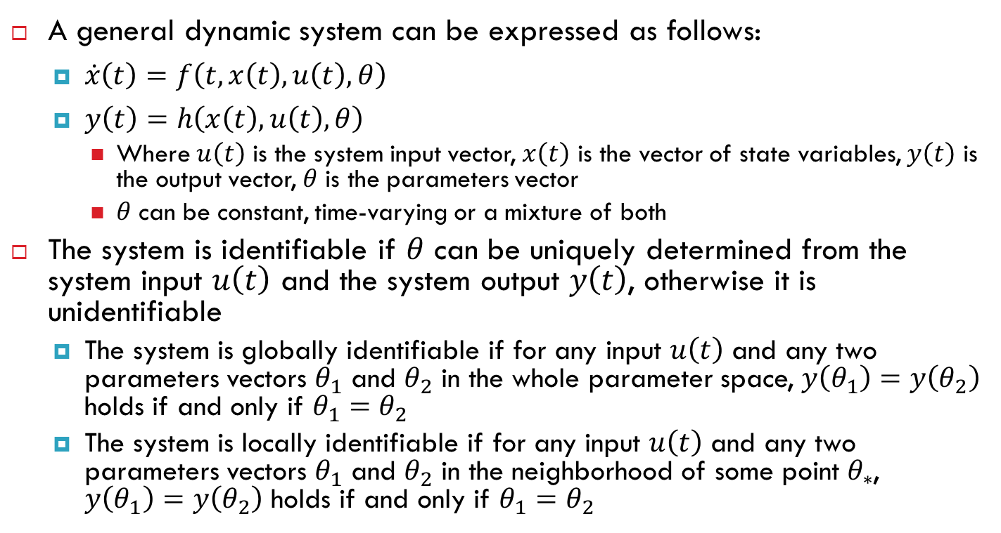
Formal definition of identifiability
A general dynamic system can be expressed as follows:
$\dot{x}\left(t\right)=f\left(t,x\left(t\right),u\left(t\right),θ\right)$
$y\left(t\right)=h\left(x\left(t\right),u\left(t\right),θ\right)$
Where $u\left(t\right)$ is the system input vector, $x\left(t\right)$ is the vector of state variables, $y\left(t\right)$ is the output vector, $θ$ is the parameters vector
$θ$ can be constant, time-varying or a mixture of both
The system is identifiable if $θ$ can be uniquely determined from the system input $u\left(t\right)$ and the system output $y\left(t\right)$, otherwise it is unidentifiable
The system is globally identifiable if for any input $u\left(t\right)$ and any two parameters vectors $θ_{1}$ and $θ_{2}$ in the whole parameter space, $y\left(θ_{1}\right)=y\left(θ_{2}\right)$ holds if and only if $θ_{1}=θ_{2}$
The system is locally identifiable if for any input $u\left(t\right)$ and any two parameters vectors $θ_{1}$ and $θ_{2}$ in the neighborhood of some point $θ_{∗}$, $y\left(θ_{1}\right)=y\left(θ_{2}\right)$ holds if and only if $θ_{1}=θ_{2}$

Slide 8
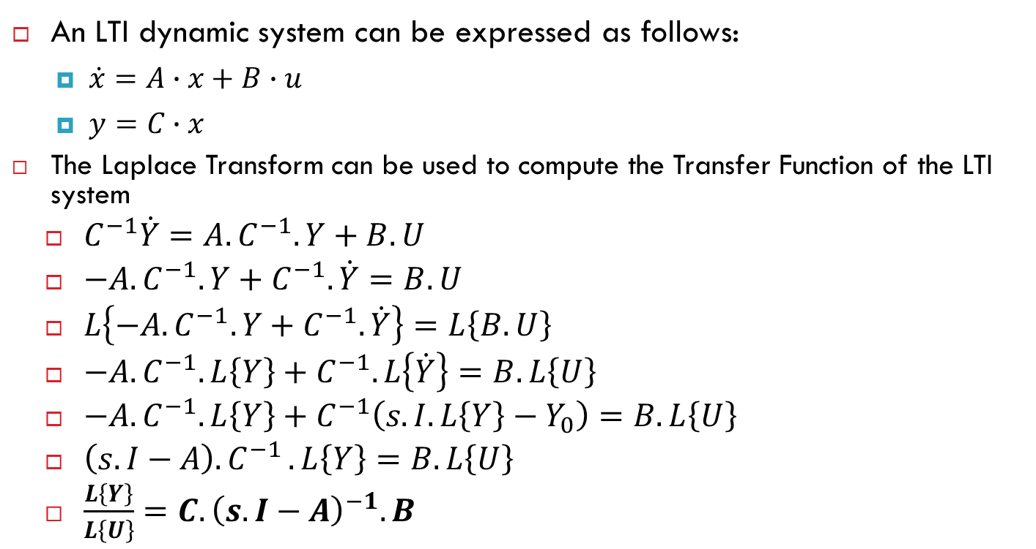
Structural identifiability with transfer function
An LTI dynamic system can be expressed as follows:
$\dot{x}=A∙x+B∙u$
$y=C∙x$
The Laplace Transform can be used to compute the Transfer Function of the LTI system
$C^{−1}\dot{Y}=A.C^{−1}.Y+B.U$
$−A.C^{−1}.Y+C^{−1}.\dot{Y}=B.U$
$L\left\{−A.C^{−1}.Y+C^{−1}.\dot{Y}\right\}=L\left\{B.U\right\}$
$−A.C^{−1}.L\left\{Y\right\}+C^{−1}.L\left\{\dot{Y}\right\}=B.L\left\{U\right\}$
$−A.C^{−1}.L\left\{Y\right\}+C^{−1}\left(s.I.L\left\{Y\right\}−Y_{0}\right)=B.L\left\{U\right\}$
$\left(s.I−A\right){.C}^{−1}.L\left\{Y\right\}=B.L\left\{U\right\}$
$\frac{L\left\{Y\right\}}{L\left\{U\right\}}=C.{\left(s.I−A\right)}^{−1}.B$

Slide 9
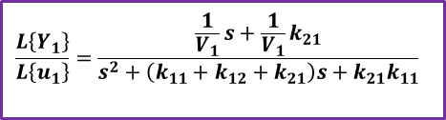
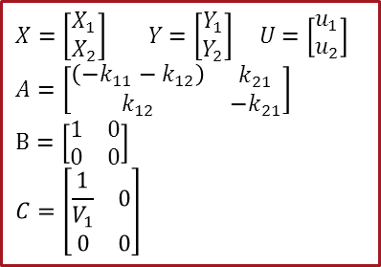
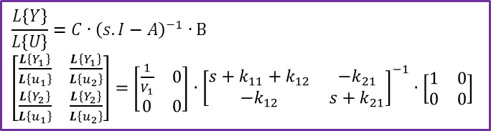
Structural identifiability with transfer function
$$X=\left[\begin{matrix}X_{1} \\ X_{2}\end{matrix}\right] Y=\left[\begin{matrix}\begin{matrix}\begin{matrix}Y_{1} \\ Y_{2}\end{matrix}\end{matrix}\end{matrix}\right] U=\left[\begin{matrix}u_{1} \\ u_{2}\end{matrix}\right]$$
$$A=\left[\begin{matrix}\begin{matrix}\left({−k}_{11}−k_{12}\right)\end{matrix} & k_{21} \\ k_{12} & −k_{21}\end{matrix}\right]$$
$$B=\left[\begin{matrix}1 & 0 \\ 0 & 0\end{matrix}\right]$$
$$C=\left[\begin{matrix}\begin{matrix}\frac{1}{V_{1}} & 0 \\ 0 & 0\end{matrix}\end{matrix}\right]$$
$$\frac{L\left\{Y\right\}}{L\left\{U\right\}}=C∙{\left(s.I−A\right)}^{−1}∙B$$
$\left[\begin{matrix}\frac{L\left\{Y_{1}\right\}}{L\left\{u_{1}\right\}} & \frac{L\left\{Y_{1}\right\}}{L\left\{u_{2}\right\}} \\ \frac{L\left\{Y_{2}\right\}}{L\left\{u_{1}\right\}} & \frac{L\left\{Y_{2}\right\}}{L\left\{u_{2}\right\}}\end{matrix}\right]=$ $\left[\begin{matrix}\begin{matrix}\frac{1}{V_{1}} & 0 \\ 0 & 0\end{matrix}\end{matrix}\right]$ $∙$ ${\left[\begin{matrix}s+k_{11}+k_{12} & {−k}_{21} \\ {−k}_{12} & s+k_{21}\end{matrix}\right]}^{−1}∙\left[\begin{matrix}1 & 0 \\ 0 & 0\end{matrix}\right]$
$$\frac{L\left\{Y_{1}\right\}}{L\left\{u_{1}\right\}}=\frac{\frac{1}{V_{1}}s+\frac{1}{V_{1}}k_{21}}{s^{2}+\left(k_{11}+k_{12}+k_{21}\right)s+k_{21}k_{11}}$$

Slide 10

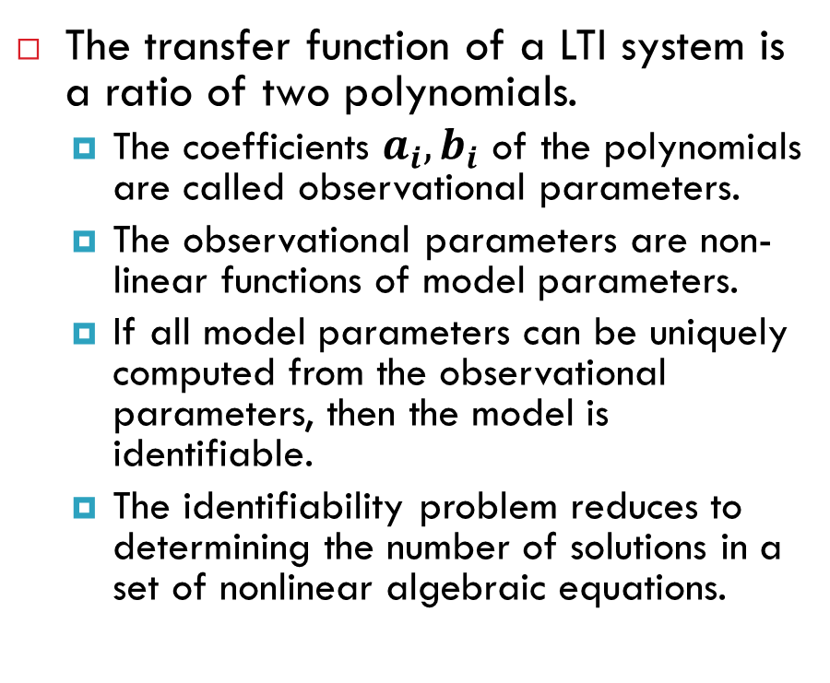


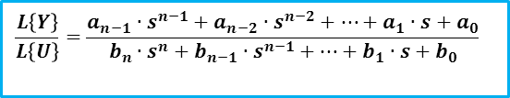
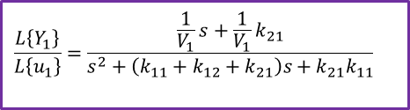
Structural identifiability with transfer function
The transfer function of a LTI system is a ratio of two polynomials.
The coefficients $a_{i},b_{i}$ of the polynomials are called observational parameters.
The observational parameters are non-linear functions of model parameters.
If all model parameters can be uniquely computed from the observational parameters, then the model is identifiable.
The identifiability problem reduces to determining the number of solutions in a set of nonlinear algebraic equations.
$$u_{1}$$
$$\frac{L\left\{Y_{1}\right\}}{L\left\{u_{1}\right\}}$$
$$Y_{1}$$
$$\frac{L\left\{Y_{1}\right\}}{L\left\{u_{1}\right\}}=\frac{\frac{1}{V_{1}}s+\frac{1}{V_{1}}k_{21}}{s^{2}+\left(k_{11}+k_{12}+k_{21}\right)s+k_{21}k_{11}}$$
$$\frac{L\left\{Y\right\}}{L\left\{U\right\}}=\frac{a_{n−1}∙s^{n−1}+a_{n−2}∙s^{n−2}+⋯+a_{1}∙s+a_{0}}{b_{n}∙s^{n}+b_{n−1}∙s^{n−1}+⋯+b_{1}∙s+b_{0}}$$

Slide 11
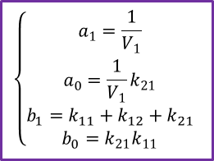
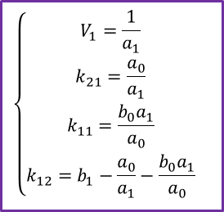
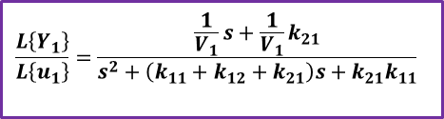
Structural identifiability with transfer function
$$\frac{L\left\{Y_{1}\right\}}{L\left\{u_{1}\right\}}=\frac{\frac{1}{V_{1}}s+\frac{1}{V_{1}}k_{21}}{s^{2}+\left(k_{11}+k_{12}+k_{21}\right)s+k_{21}k_{11}}$$
Transfer function
$$\left\{\begin{aligned}a_{1}=\frac{1}{V_{1}} \\ a_{0}=\frac{1}{V_{1}}k_{21} \\ b_{1}=k_{11}+k_{12}+k_{21} \\ b_{0}=k_{21}k_{11}\end{aligned}\right.$$
Observational parameters
all model parameters can be uniquely computed from the observational parameters
→ the model is identifiable
$$\left\{\begin{aligned}V_{1}=\frac{1}{a_{1}} \\ k_{21}=\frac{a_{0}}{a_{1}} \\ k_{11}=\frac{b_{0}a_{1}}{a_{0}} \\ k_{12}=b_{1}−\frac{a_{0}}{a_{1}}−\frac{b_{0}a_{1}}{a_{0}}\end{aligned}\right.$$
Solution to a system of non-linear equations

Slide 12
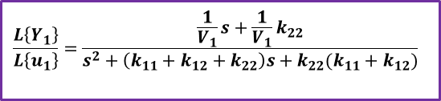

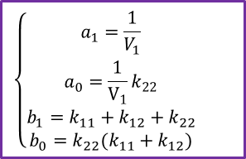
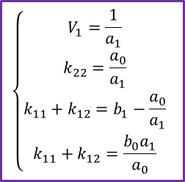
Structural identifiability with transfer function
$$\frac{L\left\{Y_{1}\right\}}{L\left\{u_{1}\right\}}=\frac{\frac{1}{V_{1}}s+\frac{1}{V_{1}}k_{22}}{s^{2}+\left(k_{11}+k_{12}+k_{22}\right)s+k_{22}(k_{11}+k_{12})}$$
Transfer function
$$\left\{\begin{aligned}a_{1}=\frac{1}{V_{1}} \\ a_{0}=\frac{1}{V_{1}}k_{22} \\ b_{1}=k_{11}+k_{12}+k_{22} \\ b_{0}=k_{22}(k_{11}+k_{12})\end{aligned}\right.$$
Observational parameters
Although $V_{1}$ and $k_{22}$ can be uniquely computed from the observational parameters, $k_{11}$ and $k_{12}$ cannot
→ the model is unidentifiable
$$\left\{\begin{aligned}V_{1}=\frac{1}{a_{1}} \\ k_{22}=\frac{a_{0}}{a_{1}} \\ k_{11}+k_{12}=b_{1}−\frac{a_{0}}{a_{1}} \\ k_{11}+k_{12}=\frac{b_{0}a_{1}}{a_{0}}\end{aligned}\right.$$
Solution to a system of non-linear equations

Slide 13
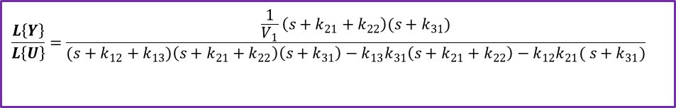
Structural identifiability with transfer function
$$\frac{L\left\{Y\right\}}{L\left\{U\right\}}=\frac{\frac{1}{V_{1}}\left(s+k_{21}+k_{22}\right)({s+k}_{31})}{({s+k}_{12}+k_{13})\left(s+k_{21}+k_{22}\right)\left({s+k}_{31}\right)−k_{13}k_{31}\left(s+k_{21}+k_{22}\right)−k_{12}k_{21}( {s+k}_{31})}$$

Slide 14
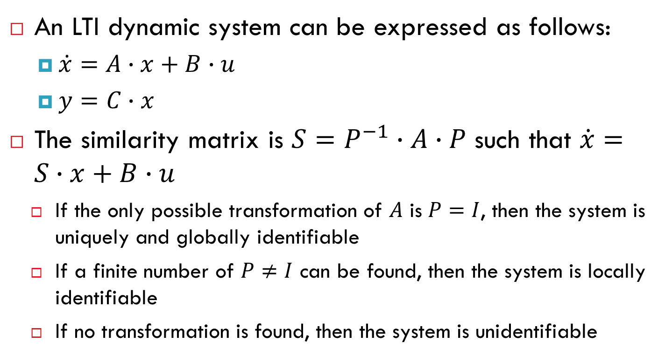
Structural identifiability with similarity transformation
An LTI dynamic system can be expressed as follows:
$\dot{x}=A∙x+B∙u$
$y=C∙x$
The similarity matrix is $S=P^{−1}∙A∙P$ such that $\dot{x}=S∙x+B∙u$
If the only possible transformation of $A$ is $P=I$, then the system is uniquely and globally identifiable
If a finite number of $P≠I$ can be found, then the system is locally identifiable
If no transformation is found, then the system is unidentifiable

Slide 15
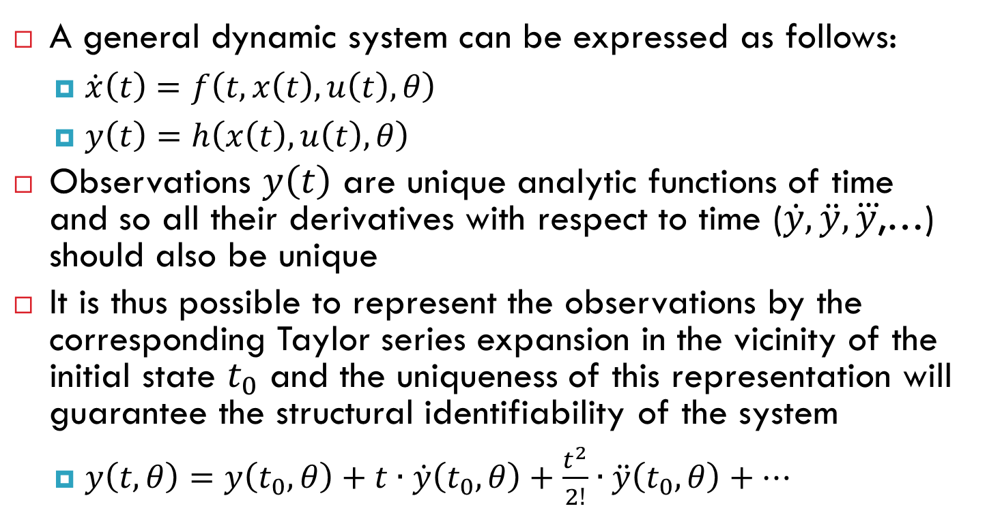
Structural identifiability with taylor series
A general dynamic system can be expressed as follows:
$\dot{x}\left(t\right)=f\left(t,x\left(t\right),u\left(t\right),θ\right)$
$y\left(t\right)=h\left(x\left(t\right),u\left(t\right),θ\right)$
Observations $y\left(t\right)$ are unique analytic functions of time and so all their derivatives with respect to time ($\dot{y},\ddot{y},\overset{⃛}{y}$,…) should also be unique
It is thus possible to represent the observations by the corresponding Taylor series expansion in the vicinity of the initial state $t_{0}$ and the uniqueness of this representation will guarantee the structural identifiability of the system
$y\left(t,θ\right)=y\left(t_{0},θ\right)+t∙\dot{y}\left(t_{0},θ\right)+\frac{t^{2}}{2!}∙\ddot{y}\left(t_{0},θ\right)+⋯$
Notes:
this involves expressing the system outputs and its derivatives in terms of the unknown parameters at time zero (t0)
+

Slide 16
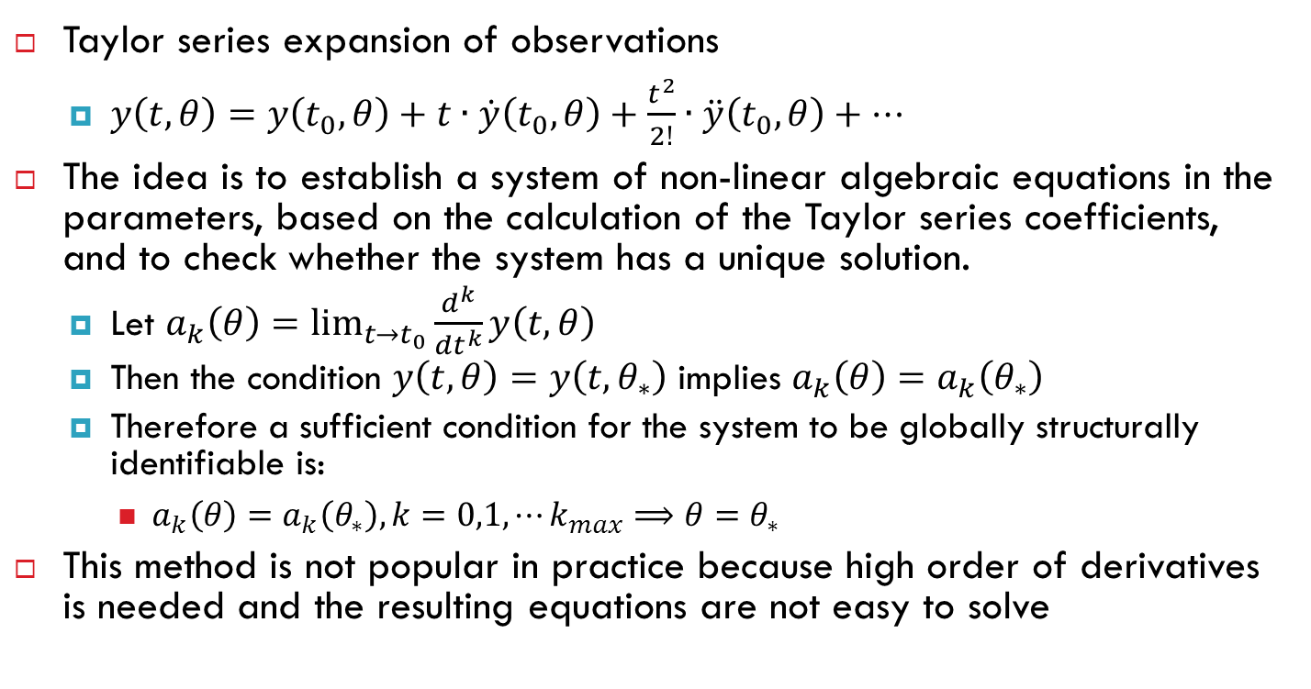
Structural identifiability with taylor series
Taylor series expansion of observations
$y\left(t,θ\right)=y\left(t_{0},θ\right)+t∙\dot{y}\left(t_{0},θ\right)+\frac{t^{2}}{2!}∙\ddot{y}\left(t_{0},θ\right)+⋯$
The idea is to establish a system of non-linear algebraic equations in the parameters, based on the calculation of the Taylor series coefficients, and to check whether the system has a unique solution.
Let $a_{k}\left(θ\right)=\lim_{t→t_{0}}{\frac{d^{k}}{dt^{k}}y\left(t,θ\right)}$
Then the condition $y\left(t,θ\right)=y\left(t,θ_{∗}\right)$ implies $a_{k}\left(θ\right)=a_{k}\left(θ_{∗}\right)$
Therefore a sufficient condition for the system to be globally structurally identifiable is:
$a_{k}\left(θ\right)=a_{k}\left(θ_{∗}\right),k=0,1,⋯k_{max}⟹θ=θ_{∗}$
This method is not popular in practice because high order of derivatives is needed and the resulting equations are not easy to solve

Slide 17
Homework - Practical identifiability analysis
Local analyses are based on the computation of local sensitivities, the Fisher Information Matrix, the covariance matrix, or the Hessian of the least-squares function
Taylor series method
generating series method
identifiability tableaus
similarity transformation approach
differential algebra based method
direct test method
implicit function theorem method
reaction networks

