Slide 1
EXERCISES – BIOLOGICAL SIGNALS
Exercise 1 - SS 2014 – Michel Kana

Slide 2
What will we do today?
Semester plan
Pre-test
The physiology behind ECG
Structure of the ECG Signal
ECG measurement with BIOPAC
Heart rate processing with Matlab
Summary

Slide 3
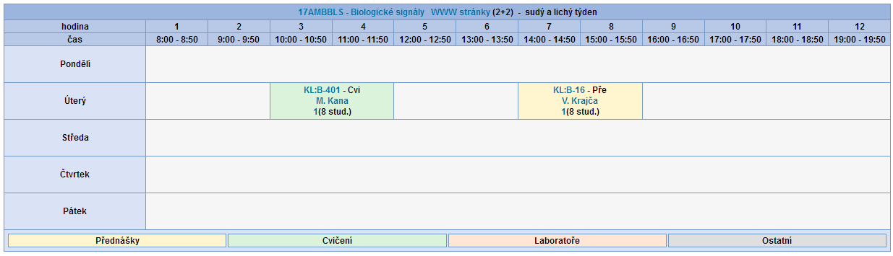
Semester plan
Biological Signals (17AMBBLS)
1 group
8 students
13 execises x 1.5 hours

Slide 4

Semester plan
Cardiovascular Signals
Other Biological Signals
Advanced Topics
Session 1
ECG measurement & analysis
Session 6
EMG measurement & analysis
Session 10
Fourier & Wavelet transform
Session 2
ECG measurement & analysis
Session 7
EEG measurement & analysis
Session 11
Mobile sensors
Session 3
PPG measurement & analysis
Session 12
Final Presentation
Session 8
EOG measurement & analysis
Session 4
GSR measurement & analysis
Session 13
Final Presentation
Session 5
Respiration measurement
Exercise grades
You can get max. 30 points out of the exercises:
10 points for your attendance
10 points for the test in session 9
10 points for the final presentation

Slide 5
Pre-test

Slide 6
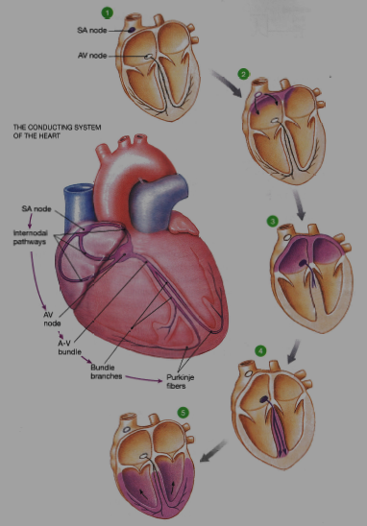
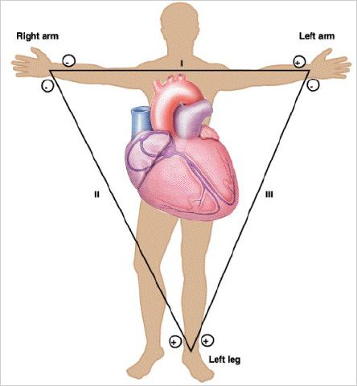
The physiology behind ECG
Electrical conduction in the heart
  The sinoatrial node (SA node) automatically depolarizes.
  Electrical activity goes rapidly to atrioventricular node (AV node) via internodal pathways.
  Depolarization spreads slowly across atria. Conduction slows through AV node.
  Depolarization moves rapidly through ventricular conducting system to the apex of the heart.
  Depolarization ware spreads upward from the apex.
The Electrocardiogram
  The ECG reflects the electrical activity of the heart.
  An ECG tracing shows the summed electrical potentials generated by all cells of the heart.
  The Einthoven‘s triangle defines electrodes position for 3-leads ECG measurement.
Ref.: D. Unglaub, Human Physiology

Slide 7
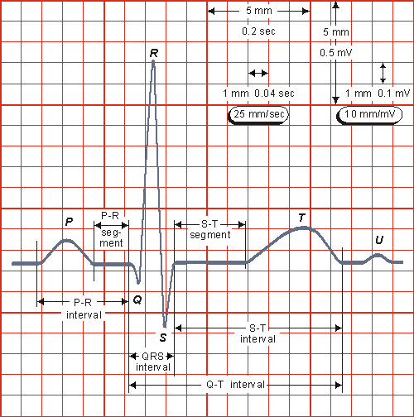
Structure of the ECG Signal
Waves in the ECG
  P wave: corresponds to the depolarization of atria. Duration 0.06 - 0.11 sec.
  QRS complex (Q, R and S waves): represents the progressive wave of ventricular depolorization. Duration 0.08 - 0.12 sec.
  T wave: represents the repolarization of ventricles.
  U wave: represents the repolarization of the papillary muscles or Purkinje fibers.
Intervals in the ECG
  P-R interval: begins at the onset of the P wave and ends at the onset of the QRS complex and represents the time the impulse takes to reach the ventricles from the sinus node. Duration 0.12 – 0.20 sec.
  Q-T internal: begins at the onset of the QRS complex and ends at the endpoint of the T wave and represents the duration from the depolarisation to the repolarisation of the ventricles. Duration 0.35 – 0.43 sec.
  R-R interval: time measurement between the R wave of one heartbeat and the R wave of the preceding heartbeat.
Segments in the ECG
  P-R segment: begins at the endpoint of the P wave and ends at the onset of the QRS complex and represents the duration of the conduction from the atrioventricular node, down the bundle of His and through the bundle branches to the muscle.
  S-T segment: begins at the endpoint of the S wave and ends at the onset of the T wave. During the ST segment, the atrial cells are relaxed and the ventricles are contracted so electrical activity is not visible.
Ref.: http://noodle.med.yale.edu

Slide 8
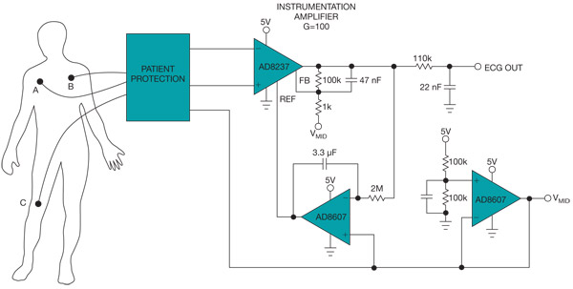
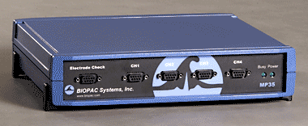
ECG Measurement
Electrodes and Connecting wires
  Electrolyte paste with chloride ions for better signal transmission
  Bipolar electrodes: record the voltage differential between the wrists and the legs.
  Unipolar electrodes: record the voltage difference between a reference electrode and the body surface.
  Plate electrodes: use metal disks held onto the skin with adhesive tape.
  Suction electrodes: use metal disks with a vacuum system to remain in place.
  Fluid column electrodes: designed to avoid direct contact with the skin
  Flexible electrodes: designed for infants with fine stainless steel or silver wire, attached to the skin like a small bandage.
Amplifier
  Converts the weak electrical signal from the body into a more readable signal.
  Includes optical isolators, preventing the possibility of accidental electric shock.
Storage and transmission device
  Includes built-in analog to digital converter.
Ref.: http://www.edn.com
Ref.: http://www.biopac.com

Slide 9
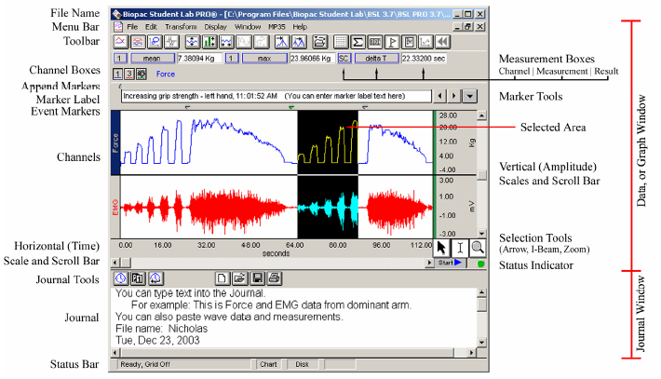
Biopac Student Lab PRO software

Slide 10
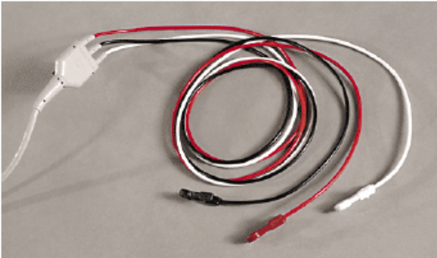
ECG measurement with BIOPAC
Biopac MP35 measurement system
  3 leads ECG is recorded using Biopac SS2L connecting wires plugsimonged in the first channel.
  Bipolar plate electrodes with electrolyte paste are used.
Biopac Student Lab PRO software
  The Biopac MP35 system is connected to a PC where the Biopac Student Lab PRO software is installed for continuous signal acquisition
  The acquisition is set up for Recording and Append into Memory at a sampling rate of 500 Hz. The total acquisition length can be set to 2 hours.
  In the Setup Channels menu, the check boxes Acquire Data, Plot on Screen, Enable Value Display are enabled for the first channel.
  Analog Channel CH1 should have the preset ECG (.5 - 35 Hz). The frequency range of an ECG signal is of 0.05–250 Hz and its dynamic range of 1–10 mV
  Calculation Channel C1 should have the preset R-R Interval
  Calculation Channel C2 should have the preset Heart Rate

Slide 11
Exercise 1
Sampling rate effect on the ECG
  MP menu > Set up Acquisition
  No significant statistical difference between 500 Hz and 250 Hz
  Undersampling (< 125 Hz) shows significant reductions in peak amplitude values
  512 Hz ensures that the QRS complex is fully digitized. 512 Hz = sampling period of approximately 1/512 = 2 ms, which captures at least 0.08 s / 2 ms = 40 samples are captured during the shortest QRS complex.
Hardware Settings for ECG
  MP menu > Set up Channels > View/Change Parameters
  Magnitude amplification from 1 – 2 mV to about 0.5 – 1 V with a total gain of about 500
  Add or subtract a constant to the signal in case the electrode has inherent offset
  AC Coupling is appropriate for ECG

Slide 12
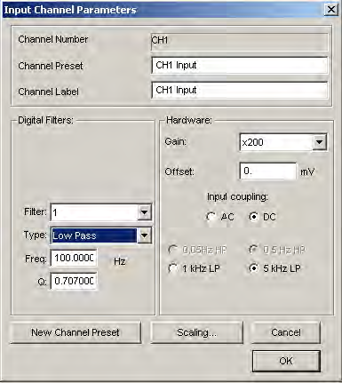
Exercise 2
Hardware-based filters in Biopac
  MP menu > Set up Channels > View/Change Parameters
  Within the MP35/30 hardware itself before the data is displayed on your computer
  Cannot be used to filter data below 30 Hz
  Three programmable digital second-order filters: low pass, high pass, band pass, band stop.
  Two selectable hardware filter: a switchable 0.05 Hz / 0.5 Hz only for AC coupled signals, a switchable1 kHz / 5 kHz low pass filter
Application: noise filtering in ECG
  Magnitude amplification from 1 – 2 mV to about 0.5 – 1 V with a total gain of about 500.
  High-pass filter (cut-off 0.03 to 5 Hz, usually 0.05 Hz) for the removal of low-frequency noise produced by respiration and electrode movement that results in a base line drift of the ECG signal
  Motionless subject to avoid EMG noise which has a wide frequency range (1 – 5000 Hz)
  Low-pass (cut-off 35 to 60 Hz) or notch filter for the removal of 60 Hz noise of power line interference
  Q setting: an optimally dampened filter has Q of 0.707 for low and high-pass filters, 5.000 for band pass and band stop filters

Slide 13
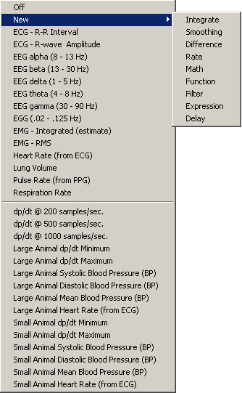
Exercise 3
Calculation Channel Presets
  Rate Calculation: extracts information about the interval between a series of peaks in a waveform.
    Function Interval for inter-beat interval calculation (i.e. RR interval durations)
    Function Rate (BPM) for beats per minutes calculation
    Function Peak Maximum for systolic blood pressure estimation from R-wave
    Function Peak Minimum for diastolic blood pressure estimation from R-wave
    Function Mean Rate Value for mean arterial pressure estimation from R-wave
  Filter Calculation: performs real-time digital filtering on Analog or Calculation channels.
    Low Pass filter: pass only frequencies below the cutoff point
    High Pass filter: pass only frequencies above the cutoff point
    Band Pass (low + high) filter: pass only frequencies in the range specified by a low and high cutoff
    Band Pass filter: pass only a narrow band of frequencies around a center cutoff
    Band Stop filter: pass only a wide band of frequencies except of those around a center cutoff. E.g. for removing 60 Hz power line noise from ECG.
    Band Stop – Line Freq filter: similar to Band Stop for 50 Hz or 60 Hz cutoff.

Slide 14
Exercise 4
Deep Breath Test
  Materials
    A chronometer to measure inspiration and expiration duration.
  Procedure
    The examiner explains to the subject how the test will be conducted: “subject will be taught to breathe at a rate of 6 respiration cycles per minute, which corresponds to 0.1 Hz: 5 seconds for each inhalation and 5 seconds for each exhalation. The examiner will pace the breathing with a chronometer and give a vocal signal for the start of each inhalation and exhalation”.
    Subject is instrumented by the examiner.
    Operator starts recording in Biopac Student Lab PRO software and observes heart rate. When both signals have stabilized for at least 60 seconds he informs the examiner to start with the test.
    Examiner gives a vocal signal to the subject to inhale and starts the chronometer.
    Operator adds a DEEP INHALATION event in Biopac Student Lab PRO software.
    Subject performs a 5 seconds inhalation.
    After the chronometer has run for 5 seconds, Examiner gives a vocal signal to the subject to exhale.
    Operator adds a DEEP EXHALATION event in Biopac Student Lab PRO software.
    Subject performs a 5 seconds exhalation.
    The previous steps are repeated 6 times.
    Operator continues recording in Biopac Student Lab PRO software and observes heart rate and respiration rate. When both signals have stabilized he stops recording after another 60 seconds.
    Operator exports the measurement File > Save As > *.TXT > Option.

Slide 15
Exercise 5
Deep Breath Test
  Data import from Biopac into Matlab
    Create a Matlab variables for the heart rate signal.
  Automated evaluation in Matlab
    Write a Matlab function for calculating the following values:
      The expiratory-to-inspiratory difference (E-I_{mean}) is calculated as the mean of differences between the maximal heart rate during inspiration and minimal heart rate during expiration for all six breathing cycles.
      The expiratory-to-inspiratory ratio (E/I_{mean}) is calculated as the mean of ratios of the maximal heart rate during inspiration divided by minimal heart rate during expiration for all six breathing cycles.

Slide 16


Summary
[Semester plan]
13 exercise sessions.
You can get 10 points for your attendance, 10 points from the first test and 10 points from the final presentation.
[ECG Physiology]
Electrical conduction in the heat and the origin of the electrocardiogram
[Structure of the ECG]
Waves, segments and waves in a normal electrocardiogram.
[ECG measurment and processing]
ECG recording with Biopac MP35. Hardware filters. Calculation and extraction of ECG parameters. Postprocessing in Matlab.
[Plan for the next week]
Photoplethysmogram, Galvanic skin response measurement & analysis. Experiments with active change of posture. Bring materials with you!

