Slide 1
cvičení Modelování a simulace
Cvičení 6 - LS 2014 – Michel Kana

Slide 2
Co uděláme ve dnešním cvičení?
Maticový popis kompartmentové modely
Přenosová funkce kompartmentové modely
Shrnuti

Slide 3

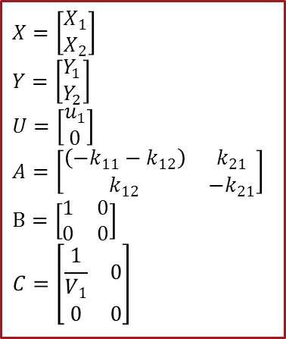
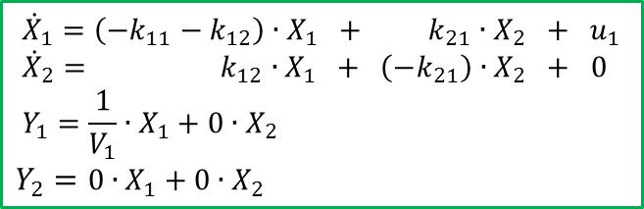
Maticový popis 2-Kompartmentové modely
$$\dot{X}=A.X+B.U$$
$$Y=C.X$$
$X=\left[\begin{matrix}X_{1} \\ X_{2}\end{matrix}\right]$
$Y=\left[\begin{matrix}\begin{matrix}\begin{matrix}Y_{1} \\ Y_{2}\end{matrix}\end{matrix}\end{matrix}\right]$
$$U=\left[\begin{matrix}u_{1} \\ 0\end{matrix}\right]$$
$$A=\left[\begin{matrix}\begin{matrix}\left({−k}_{11}−k_{12}\right)\end{matrix} & k_{21} \\ k_{12} & −k_{21}\end{matrix}\right]$$
$$B=\left[\begin{matrix}1 & 0 \\ 0 & 0\end{matrix}\right]$$
$$C=\left[\begin{matrix}\begin{matrix}\frac{1}{V_{1}} & 0 \\ 0 & 0\end{matrix}\end{matrix}\right]$$
$${\dot{X}}_{1}=\left({−k}_{11}−k_{12}\right)∙X_{1} + k_{21}∙X_{2} + u_{1} \\ {\dot{X}}_{2}= k_{12}∙X_{1} + \left(−k_{21}\right)∙X_{2} + 0$$
$$Y_{1}=\frac{1}{V_{1}}∙X_{1}+0∙X_{2}$$
$$Y_{2}=0∙X_{1}+0∙X_{2}$$

Slide 4
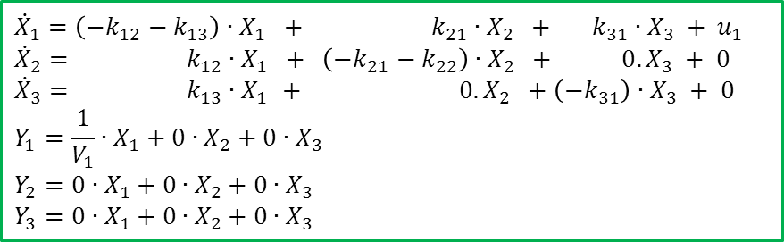
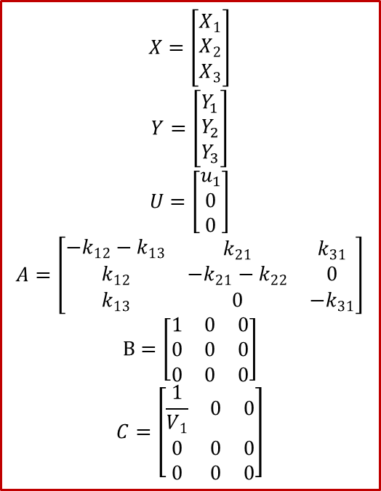
Maticový popis 3-Kompartmentové modely
$$X=\left[\begin{matrix}X_{1} \\ X_{2} \\ X_{3}\end{matrix}\right]$$
$$Y=\left[\begin{matrix}\begin{matrix}\begin{matrix}Y_{1} \\ Y_{2} \\ Y_{3}\end{matrix}\end{matrix}\end{matrix}\right]$$
$$U=\left[\begin{matrix}u_{1} \\ 0 \\ 0\end{matrix}\right]$$
$$A=\left[\begin{matrix}\begin{matrix}{−k}_{12}−k_{13}\end{matrix} & k_{21} & k_{31} \\ k_{12} & −k_{21}−k_{22} & 0 \\ k_{13} & 0 & {−k}_{31}\end{matrix}\right]$$
$$B=\left[\begin{matrix}1 & 0 & 0 \\ 0 & 0 & 0 \\ 0 & 0 & 0\end{matrix}\right]$$
$$C=\left[\begin{matrix}\begin{matrix}\frac{1}{V_{1}} & 0 & 0 \\ 0 & 0 & 0 \\ 0 & 0 & 0\end{matrix}\end{matrix}\right]$$
$${\dot{X}}_{1}=\left({−k}_{12}−k_{13}\right)∙X_{1} + k_{21}∙X_{2} + k_{31}∙X_{3} + u_{1} \\ {\dot{X}}_{2}= k_{12}∙X_{1} + \left(−k_{21}−k_{22}\right)∙X_{2} + 0.X_{3} + 0 \\ {\dot{X}}_{3}= k_{13}∙X_{1 }+ 0.X_{2} +\left(−k_{31}\right)∙X_{3} + 0$$
$$Y_{1}=\frac{1}{V_{1}}∙X_{1}+0∙X_{2}+0∙X_{3}$$
$$Y_{2}=0∙X_{1}+0∙X_{2}+0∙X_{3}$$
$$Y_{3}=0∙X_{1}+0∙X_{2}+0∙X_{3}$$

Slide 5

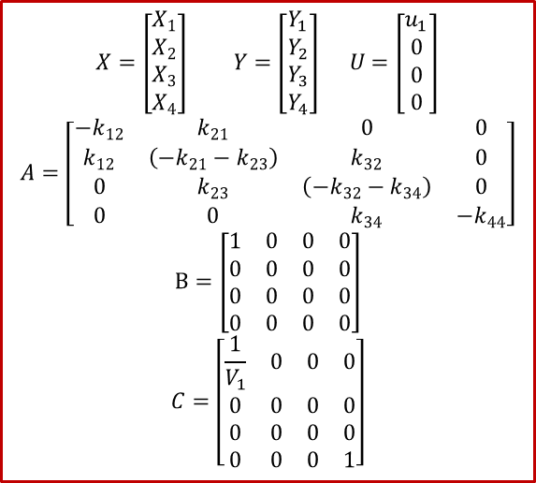
Maticový popis 4-Kompartmentové modely
$$X=\left[\begin{matrix}X_{1} \\ X_{2} \\ X_{3} \\ X_{4}\end{matrix}\right] Y=\left[\begin{matrix}\begin{matrix}\begin{matrix}Y_{1} \\ Y_{2} \\ Y_{3} \\ Y_{4}\end{matrix}\end{matrix}\end{matrix}\right] U=\left[\begin{matrix}u_{1} \\ 0 \\ 0 \\ 0\end{matrix}\right]$$
$$A=\left[\begin{matrix}{−k}_{12} & k_{21} & 0 & 0 \\ k_{12} & \left(−k_{21}−k_{23}\right) & k_{32} & 0 \\ 0 & k_{23} & \left(−k_{32}−k_{34}\right) & 0 \\ 0 & 0 & k_{34} & −k_{44}\end{matrix}\right]$$
$$B=\left[\begin{matrix}1 & 0 & 0 & 0 \\ 0 & 0 & 0 & 0 \\ 0 & 0 & 0 & 0 \\ 0 & 0 & 0 & 0\end{matrix}\right]$$
$$C=\left[\begin{matrix}\begin{matrix}\frac{1}{V_{1}} & 0 & 0 & 0 \\ 0 & 0 & 0 & 0 \\ 0 & 0 & 0 & 0 \\ 0 & 0 & 0 & 1\end{matrix}\end{matrix}\right]$$
$${\dot{X}}_{1}=\left({−k}_{12}\right)∙X_{1}+ k_{21}∙X_{2} + 0∙X_{3}+ 0∙X_{4} + u_{1} \\ {\dot{X}}_{2}= k_{12}∙X_{1}+\left(−k_{21}−k_{23}\right)∙X_{2} + k_{32}∙X_{3} + 0∙X_{4}+ 0 \\ {\dot{X}}_{3}= 0∙X_{1 }+ k_{23}∙X_{2} + \left(−k_{32}−k_{34}\right)∙X_{3} + 0∙X_{4}+ 0 \\ {\dot{X}}_{4}= 0∙X_{1 }+ 0∙X_{2} + k_{34}∙X_{3} +\left(−k_{44}\right)∙X_{4} +0$$
$$Y_{1}=\frac{1}{V_{1}}∙X_{1}+0∙X_{2}+0∙X_{3}+0∙X_{4}$$
$$Y_{2}=0∙X_{1}+0∙X_{2}+0∙X_{3}+0∙X_{4}$$
$$Y_{3}=0∙X_{1}+0∙X_{2}+0∙X_{3}+0∙X_{4}$$
$$Y_{4}=0∙X_{1}+0∙X_{2}+0∙X_{3}+1∙X_{4}$$

Slide 6
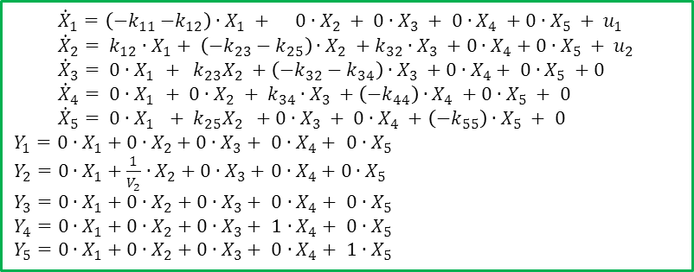
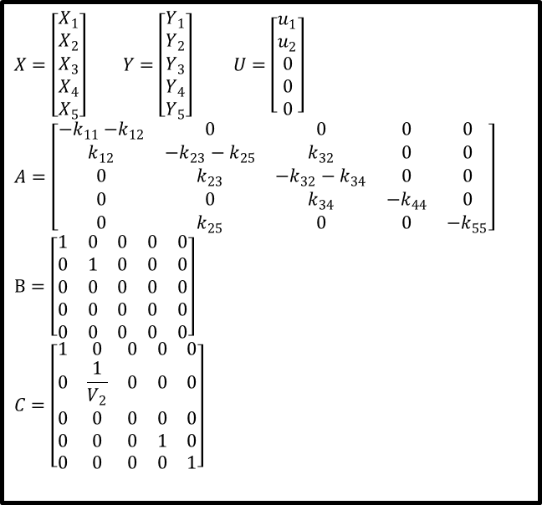
Maticový popis 5-Kompartmentové modely
$$X=\left[\begin{matrix}X_{1} \\ X_{2} \\ X_{3} \\ X_{4} \\ X_{5}\end{matrix}\right] Y=\left[\begin{matrix}Y_{1} \\ Y_{2} \\ Y_{3} \\ \begin{matrix}Y_{4} \\ Y_{5}\end{matrix}\end{matrix}\right] U=\left[\begin{matrix}\begin{matrix}u_{1} \\ u_{2} \\ 0 \\ 0 \\ 0\end{matrix}\end{matrix}\right]$$
$$A=\left[\begin{matrix}{−k}_{11}{−k}_{12} & 0 & 0 & 0 & 0 \\ k_{12} & −k_{23}−k_{25} & k_{32} & 0 & 0 \\ 0 & k_{23} & −k_{32}−k_{34} & 0 & 0 \\ 0 & 0 & k_{34} & −k_{44} & 0 \\ 0 & k_{25} & 0 & 0 & −k_{55}\end{matrix}\right]$$
$$B=\left[\begin{matrix}1 & 0 & 0 & 0 & 0 \\ 0 & 1 & 0 & 0 & 0 \\ 0 & 0 & 0 & 0 & 0 \\ 0 & 0 & 0 & 0 & 0 \\ 0 & 0 & 0 & 0 & 0\end{matrix}\right]$$
$$C=\left[\begin{matrix}1 & 0 & 0 & 0 & 0 \\ 0 & \frac{1}{V_{2}} & 0 & 0 & 0 \\ 0 & 0 & 0 & 0 & 0 \\ 0 & 0 & 0 & 1 & 0 \\ 0 & 0 & 0 & 0 & 1\end{matrix}\right]$$
$${\dot{X}}_{1}=\left({−k}_{11}{−k}_{12}\right)∙X_{1} + 0∙X_{2} + 0∙X_{3} + 0∙X_{4} +0∙X_{5} + u_{1} \\ {\dot{X}}_{2}= {k_{12}∙X}_{1}+ \left(−k_{23}−k_{25}\right)∙X_{2} +{k_{32}∙X}_{3} +0∙X_{4}+0∙X_{5} + u_{2} \\ {\dot{X}}_{3}= 0∙X_{1 }+ k_{23}X_{2} +\left(−k_{32}−k_{34}\right)∙X_{3} +0∙X_{4}+ 0∙X_{5} +0 \\ {\dot{X}}_{4}= 0∙X_{1 }+ 0∙X_{2} + k_{34}∙X_{3} +\left(−k_{44}\right)∙X_{4} +0∙X_{5} + 0 \\ {\dot{X}}_{5}= 0∙X_{1 } + k_{25}X_{2} +0∙X_{3} + 0∙X_{4} +\left(−k_{55}\right)∙X_{5} + 0$$
$$Y_{1}=0∙X_{1}+0∙X_{2}+0∙X_{3}+ 0∙X_{4}+ 0∙X_{5}$$
$Y_{2}=0∙X_{1}+\frac{1}{V_{2}}∙X_{2}+0∙X_{3}+$ $0∙X_{4}+$ $0∙X_{5}$
$$Y_{3}=0∙X_{1}+0∙X_{2}+0∙X_{3}+ 0∙X_{4}+ 0∙X_{5}$$
$$Y_{4}=0∙X_{1}+0∙X_{2}+0∙X_{3}+ 1∙X_{4}+ 0∙X_{5}$$
$$Y_{5}=0∙X_{1}+0∙X_{2}+0∙X_{3}+ 0∙X_{4}+ 1∙X_{5}$$

Slide 7

Kompartmentové modely jako LTI systém
$$\dot{X}=A.X+B.U$$
$$Y=C.X$$
lineární t-invariantní dynamický systém
LTI systém
$$\frac{L\left\{Y\right\}}{L\left\{U\right\}}=C.{\left(s.I−A\right)}^{−1}.B$$
Přenosová funkce je závislost mezi výstupem a vstupem LTI systému

Slide 8
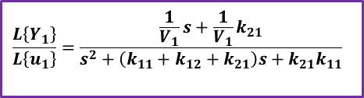
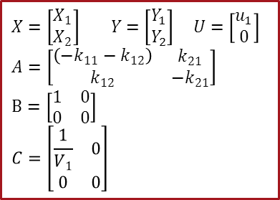
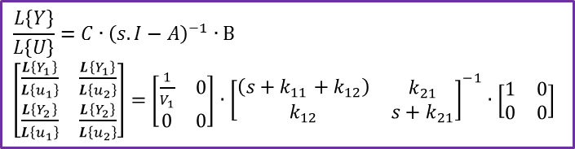
Přenosová funkce 2-Kompartmentové modely
$$X=\left[\begin{matrix}X_{1} \\ X_{2}\end{matrix}\right] Y=\left[\begin{matrix}\begin{matrix}\begin{matrix}Y_{1} \\ Y_{2}\end{matrix}\end{matrix}\end{matrix}\right] U=\left[\begin{matrix}u_{1} \\ 0\end{matrix}\right]$$
$$A=\left[\begin{matrix}\begin{matrix}\left({−k}_{11}−k_{12}\right)\end{matrix} & k_{21} \\ k_{12} & −k_{21}\end{matrix}\right]$$
$$B=\left[\begin{matrix}1 & 0 \\ 0 & 0\end{matrix}\right]$$
$$C=\left[\begin{matrix}\begin{matrix}\frac{1}{V_{1}} & 0 \\ 0 & 0\end{matrix}\end{matrix}\right]$$
syms s k11 k12 k21 v1;
A=[-k11-k12 k21; k12 –k21];
B=[1 0; 0 0];
C=[1/v1 0; 0 0];
I=eye(2);
TF=C*inv(s*I-A)*B;
Collect(TF(1,1),s);
$$\frac{L\left\{Y\right\}}{L\left\{U\right\}}=C∙{\left(s.I−A\right)}^{−1}∙B$$
$\left[\begin{matrix}\frac{L\left\{Y_{1}\right\}}{L\left\{u_{1}\right\}} & \frac{L\left\{Y_{1}\right\}}{L\left\{u_{2}\right\}} \\ \frac{L\left\{Y_{2}\right\}}{L\left\{u_{1}\right\}} & \frac{L\left\{Y_{2}\right\}}{L\left\{u_{2}\right\}}\end{matrix}\right]=$ $\left[\begin{matrix}\begin{matrix}\frac{1}{V_{1}} & 0 \\ 0 & 0\end{matrix}\end{matrix}\right]$ $∙$ ${\left[\begin{matrix}\begin{matrix}\left({s+k}_{11}+k_{12}\right)\end{matrix} & k_{21} \\ k_{12} & s+k_{21}\end{matrix}\right]}^{−1}∙\left[\begin{matrix}1 & 0 \\ 0 & 0\end{matrix}\right]$
$$\frac{L\left\{Y_{1}\right\}}{L\left\{u_{1}\right\}}=\frac{\frac{1}{V_{1}}s+\frac{1}{V_{1}}k_{21}}{s^{2}+\left(k_{11}+k_{12}+k_{21}\right)s+k_{21}k_{11}}$$

Slide 9
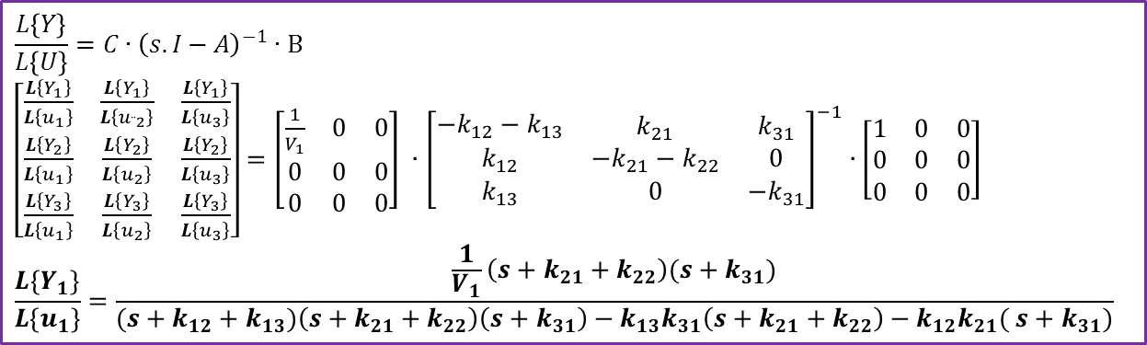
Přenosová funkce 3-Kompartmentové modely
$$\frac{L\left\{Y\right\}}{L\left\{U\right\}}=C∙{\left(s.I−A\right)}^{−1}∙B$$
$\left[\begin{matrix}\frac{L\left\{Y_{1}\right\}}{L\left\{u_{1}\right\}} & \frac{L\left\{Y_{1}\right\}}{L\left\{u_{¨2}\right\}} & \frac{L\left\{Y_{1}\right\}}{L\left\{u_{3}\right\}} \\ \frac{L\left\{Y_{2}\right\}}{L\left\{u_{1}\right\}} & \frac{L\left\{Y_{2}\right\}}{L\left\{u_{2}\right\}} & \frac{L\left\{Y_{2}\right\}}{L\left\{u_{3}\right\}} \\ \frac{L\left\{Y_{3}\right\}}{L\left\{u_{1}\right\}} & \frac{L\left\{Y_{3}\right\}}{L\left\{u_{2}\right\}} & \frac{L\left\{Y_{3}\right\}}{L\left\{u_{3}\right\}}\end{matrix}\right]=$ $\left[\begin{matrix}\begin{matrix}\frac{1}{V_{1}} & 0 & 0 \\ 0 & 0 & 0 \\ 0 & 0 & 0\end{matrix}\end{matrix}\right] ∙$ ${\left[\begin{matrix}\begin{matrix}{−k}_{12}−k_{13}\end{matrix} & k_{21} & k_{31} \\ k_{12} & −k_{21}−k_{22} & 0 \\ k_{13} & 0 & {−k}_{31}\end{matrix}\right]}^{−1}∙\left[\begin{matrix}1 & 0 & 0 \\ 0 & 0 & 0 \\ 0 & 0 & 0\end{matrix}\right]$
$$\frac{L\left\{Y_{1}\right\}}{L\left\{u_{1}\right\}}=\frac{\frac{1}{V_{1}}\left(s+k_{21}+k_{22}\right)({s+k}_{31})}{({s+k}_{12}+k_{13})\left(s+k_{21}+k_{22}\right)\left({s+k}_{31}\right)−k_{13}k_{31}\left(s+k_{21}+k_{22}\right)−k_{12}k_{21}( {s+k}_{31})}$$

Slide 10
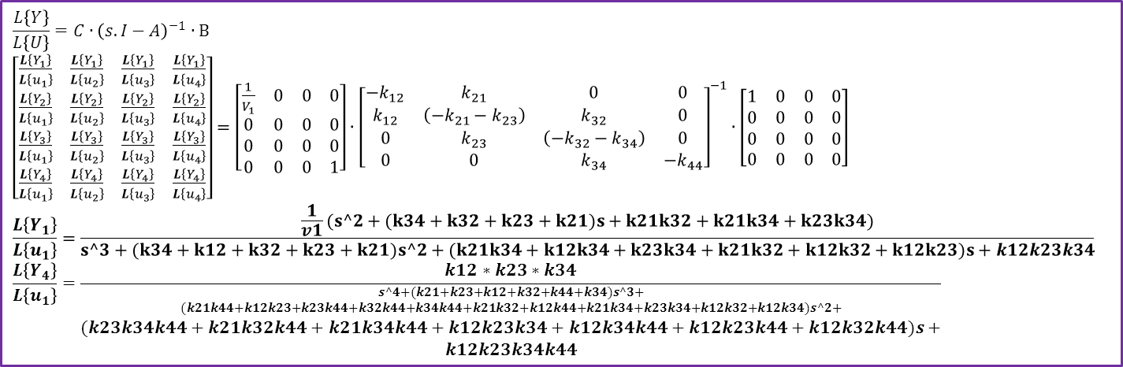
Přenosová funkce 4-Kompartmentové modely
$$\frac{L\left\{Y\right\}}{L\left\{U\right\}}=C∙{\left(s.I−A\right)}^{−1}∙B$$
$\left[\begin{matrix}\frac{L\left\{Y_{1}\right\}}{L\left\{u_{1}\right\}} & \frac{L\left\{Y_{1}\right\}}{L\left\{u_{2}\right\}} & \frac{L\left\{Y_{1}\right\}}{L\left\{u_{3}\right\}} & \frac{L\left\{Y_{1}\right\}}{L\left\{u_{4}\right\}} \\ \frac{L\left\{Y_{2}\right\}}{L\left\{u_{1}\right\}} & \frac{L\left\{Y_{2}\right\}}{L\left\{u_{2}\right\}} & \frac{L\left\{Y_{2}\right\}}{L\left\{u_{3}\right\}} & \frac{L\left\{Y_{2}\right\}}{L\left\{u_{4}\right\}} \\ \frac{L\left\{Y_{3}\right\}}{L\left\{u_{1}\right\}} & \frac{L\left\{Y_{3}\right\}}{L\left\{u_{2}\right\}} & \frac{L\left\{Y_{3}\right\}}{L\left\{u_{3}\right\}} & \frac{L\left\{Y_{3}\right\}}{L\left\{u_{4}\right\}} \\ \frac{L\left\{Y_{4}\right\}}{L\left\{u_{1}\right\}} & \frac{L\left\{Y_{4}\right\}}{L\left\{u_{2}\right\}} & \frac{L\left\{Y_{4}\right\}}{L\left\{u_{3}\right\}} & \frac{L\left\{Y_{4}\right\}}{L\left\{u_{4}\right\}}\end{matrix}\right]=\left[\begin{matrix}\begin{matrix}\frac{1}{V_{1}} & 0 & 0 & 0 \\ 0 & 0 & 0 & 0 \\ 0 & 0 & 0 & 0 \\ 0 & 0 & 0 & 1\end{matrix}\end{matrix}\right]∙$ ${\left[\begin{matrix}{−k}_{12} & k_{21} & 0 & 0 \\ k_{12} & \left(−k_{21}−k_{23}\right) & k_{32} & 0 \\ 0 & k_{23} & \left(−k_{32}−k_{34}\right) & 0 \\ 0 & 0 & k_{34} & −k_{44}\end{matrix}\right]}^{−1}∙\left[\begin{matrix}1 & 0 & 0 & 0 \\ 0 & 0 & 0 & 0 \\ 0 & 0 & 0 & 0 \\ 0 & 0 & 0 & 0\end{matrix}\right]$
$$\frac{L\left\{Y_{1}\right\}}{L\left\{u_{1}\right\}}=\frac{\frac{1}{v1}(s^2+(k34+k32+k23+k21)s+k21k32+k21k34+k23k34)}{s^3+(k34+k12+k32+k23+k21)s^2+(k21k34+k12k34+k23k34+k21k32+k12k32+k12k23)s+k12k23k34}$$
$$\frac{L\left\{Y_{4}\right\}}{L\left\{u_{1}\right\}}=\frac{k12∗k23∗k34}{\begin{matrix}{s^4+(k21+k23+k12+k32+k44+k34)s^3+ \atop (k21k44+k12k23+k23k44+k32k44+k34k44+k21k32+k12k44+k21k34+k23k34+k12k32+k12k34)s^2+} \\ (k23k34k44+k21k32k44+k21k34k44+k12k23k34+k12k34k44+k12k23k44+k12k32k44)s+ \\ k12k23k34k44\end{matrix}}$$

Slide 11
Shrnutí dnešního cvičení
[Modely populací]
Maticový popis kompartmentové modely
[Co bude dál?]
analýza identifikovatelnosti kompartmentové modely.

