Slide 1
Quotation Management
Michell Correia

Slide 2

Interactions
Quotation-Management
Stock-Manager

Slide 3

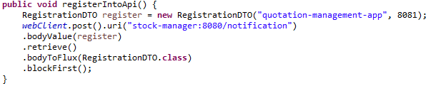
Registering into Stock-Manager
On startup, the application will register itself into Stock-Manager API to be able to receive notifications from it.
These notifications will be useful to warn our application of the necessity to erase cache.
A notification of the registration will be sent to the main app console.
Stock-Manager API is accessed trough the port 8080 of its container

Slide 4
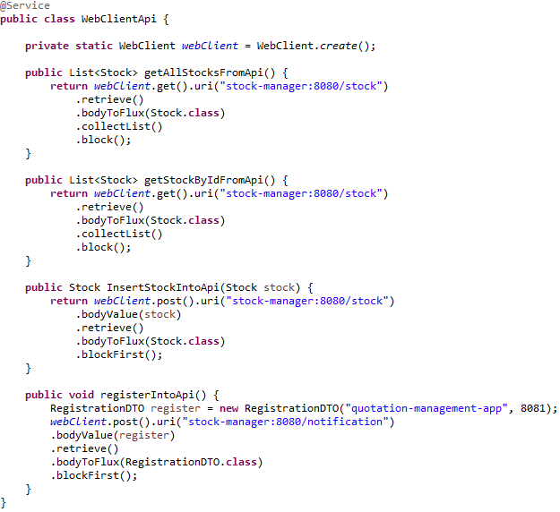
WebClientApi class
It communicates directly with the Stock-Manager application by retrieving or sending information.
It works like a “Repository” class, but the application itself don’t need to know anything about it.
The WebClientApi class works very detached from the main application
That class is vital for any interactions between the two applications.

Slide 5



Quotation-Management App Structure
Mysql8
Stock
Stock-Manager
1
1
Quotation
1
*
Quote

Slide 6

Stock class
Stock class is the simplest one, it only has his id and description, both in string format.
The id will store the actual stock “name”, for example: “vale5”.
It works like a DTO, since the actual database is inside the Stock-Manager application
It transports data from the user to the consumed API, and vice versa.

Slide 7
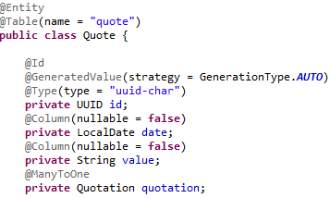
Quote Class
The quote class has its Id, date and value
His relationship with the Quotation class is bidirectional
It uses a QuoteDTO to show only “date” and “value” on response.
The quote objects are stored inside of the mysql8 container (db container)

Slide 8
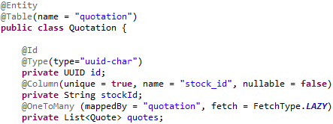

Quotation class
Quotation has its id (UUID type), stockId (String type), and a List of quotes.
“quotes” has the ManyToOne relationship between Quotation and Quote (Fetchtype Lazy).
There is a method to load all quotes from a quotation based on its stockId, that method belongs to the QuoteService class.
That class is the heart of the application, it will attach the Stock (from stock-manager API) to que Quotes, all inside a single object.

Slide 9

Quotation class
stockId must be Unique, because there can only be one quotation per stockId.
stockId must exist inside the stock-manager API for it to be created.
When comes the time to return the information to the user in JSON form, we will use a QuotationDTO class with a Map instead of a List.
QuotationDTO has a method to convert a List<Quote> to a Map<LocalDate, String>, for the DTO return.

Slide 10

Functionalities
MySQL8
Stock-Manager
Quotation-Management

Slide 11
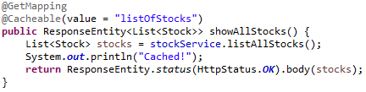
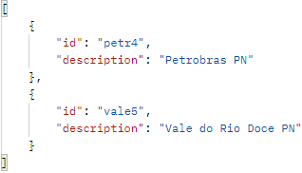
Read all Stocks
That functionality is triggered trough the “/stock” GET method, it uses the WebClientApi class to send the request to the consumed API and get its response.
The response is stored in cache, labeled “listOfStocks” and will be used when the method is called, that will happen until the cache is wiped for any reason.
The method will display a information on the console to inform that the information is now in cache.
An code 200:ok status will be returned along with the response’s body.

Slide 12
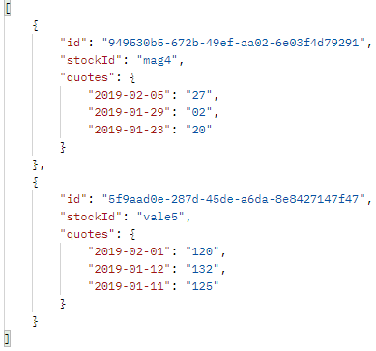
Read all Stock Quotations
That functionality is triggered trough the “/quotation” GET method. It retrieves information from the mysql8 container (db container).
It returns a list with all the quotations and all their respective quotes.
The quotes are shown sorting by date, where the most recent dates are on top.
That response is passed using a QuotationDTO, and the “quotes” field is a Map<LocalDate, String>

Slide 13
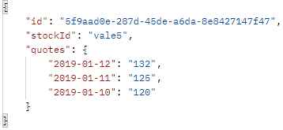
Read a Stock Quotation by stockId
Request GET localhost:8081/quotation/{stockId}
If the “stockId” belongs to any existent Quotation, it will retrieve it from the consumed API and return it inside an 200:ok code response.
If there is no Quotation with requested stockId, then it will return a 404:not found response with an empty body.
The stockId passed on the uri doesn’t mind with case sensitive, it works with any variation of upper or lower case.
The dates “key” will be shown starting with the most recent on the top.

Slide 14
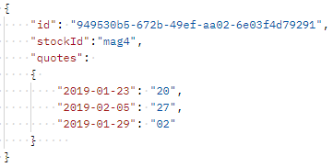
Create a Stock Quote
Request POST “/quotation” with a JSON body following the example
Id cannot be different from UUID pattern, cannot be in use and cannot be null.
stockId must be present on the Stock-Manager API, and cannot be in use, null or empty.
stockId is not case sensitive, it will be trimmed and toLowerCased to follow the pattern of the other stocks.
All data will be persisted on the mysql8 (database) container.

Slide 15
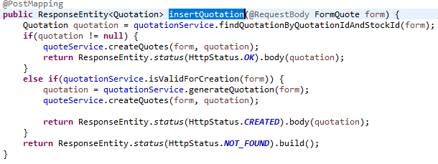
Create a Stock Quote
Doing a POST /quotation, many verifications are made:
It is verified if the quotation already exists, searching for quotation id AND stockId at the same time.
If the quotation already exists, the quotes are inserted/overridden.
If the quotation does not exist, it is checked if it can be created.

Slide 16
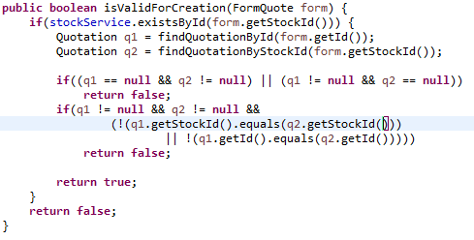
Create a Stock Quote
The quotation is valid for creation when:
His stockId isn’t in use yet, not empty and not null.
His quotation id isn’t in use yet, not empty and not null.
StockId MUST exist inside the stock-manager API.

Slide 17
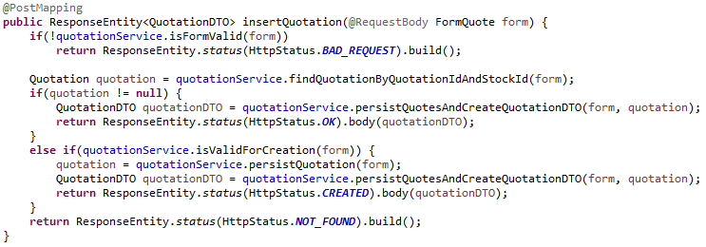
Create a Stock Quote
If the quotation already exists, the quotes will be added/overridden, and it will return a code 200 OK with the body
If the quotation doesn’t exist, but it can be created, both the quotation and its quotes will be created, and it will return a code 201:created along with the body
Otherwise, it will return 404:not found, due to not being able to find an existing quotation id, or StockId with discrepant data.

Slide 18

Cleaning the Cache
Every time a new Stock is added inside the stock-manager API, it will send a notification to our main application trough a DELETE “/stockcache”
Inside a controller, we have a method listening that request, ang it is configured to wipe all data from our “listOfStocks” cache.
It will also display on console that the operation was executed.

Slide 19



Tests
Every service class and controller class was tested (unit test) to verify if the methods are doing their work properly.
The methods who should only call a repository method were tested by simply verifying if the call was made.
QuotationController class and QuotationService class is where most of the business logic is, so they were tested a bit more carefully.

Slide 20
Thank You!!!

