Slide 1

Michelle Herman
Daniella Mayoral
Darrell Horich
Samantha Perez
Automotive Trends in the USA

Slide 2

Overview
Over the past three decades, supply chains have become increasingly global. This change has been driven by the dramatic increase in the number of goods and services that are tradable. The main factors in tradability are transportation costs and product perishability.
As a group we had decided to gather data that has impact in today supply chain for the auto industry.
We contain the scope of project by focusing on
Vehicle sales
Gas Prices
Steel Prices
Unemployment

Slide 3
Questions
Did any of these factors contribute to the sales of vehicles?
Did low gas prices increase sales?
Did low unemployment rates increase sales?
Did low steel prices increase sales?
Did low vehicle prices increase sales?
To answer these questions, we will represent our data in scatter plots to show correlation coefficients for each factor against sales of vehicles to see if any of these factors influence sales and which factor influences sales the most

Slide 4
Project Data Sources
Auto Sales (expressed in Units Sold by Month from 2005-2021)
https://www.goodcarbadcar.net/usa-auto-industry-total-sales-figures / Source: U.S. Bureau of Economic Analysis
Gas Prices (expressed in Dollars per Gallon for U.S. Regular All Formulations Retail Gasoline Prices by Month from 1992-2021)
https://www.eia.gov/dnav/pet/hist/ / Source: U.S. Energy Information Administration
Steel Prices (expressed as Producer Price Index for Steel by Month from Jan 1926-June 2021)
https://fred.stlouisfed.org / Source: Federal Reserve Bank of St. Louis Economic Research Resources
Producer Price Index (PPI) is a measure of average prices received by producers of domestically produced goods and services.
New & Used Auto Prices (separate dataset for each expressed as Consumer Price Index by Month from 1953-2021)
https://fred.stlouisfed.org / Source: Federal Reserve Bank of St. Louis Economic Research Resources
Consumer Price Index (CPI) is a measure of average prices paid by urban customers
Unemployment Rates (expressed as percent by Month from 2001-2021)
https://fred.stlouisfed.org / Source: Federal Reserve Bank of St. Louis Economic Research Resources

Slide 5
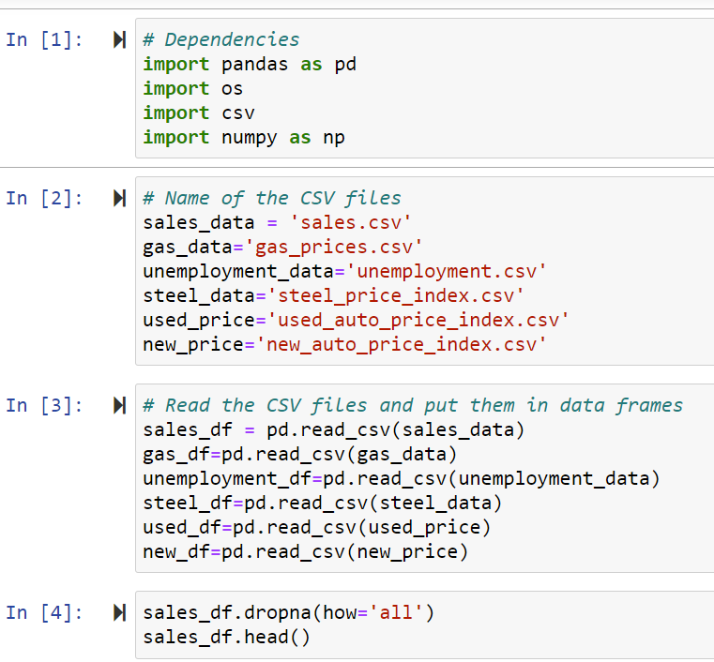
Data Clean Up
Downloaded each set to a CSV
For Vehicle Sales, we had to copy & paste a table into a CSV and manipulate it into the format we needed using Python
Luckily, our other datasets were in the month and year breakdown that we wanted

Slide 6
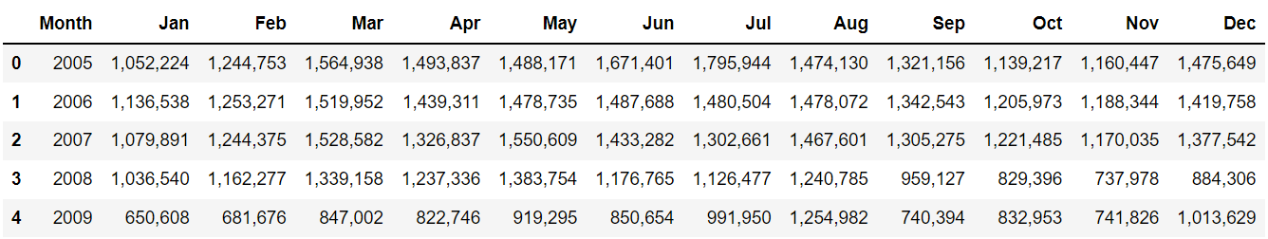
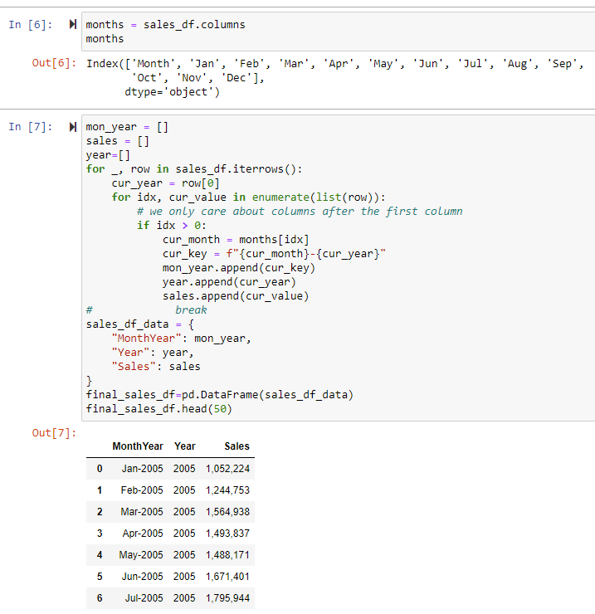
Data Clean Up (continued)
Hooray for
Nested For Loops!

Slide 7
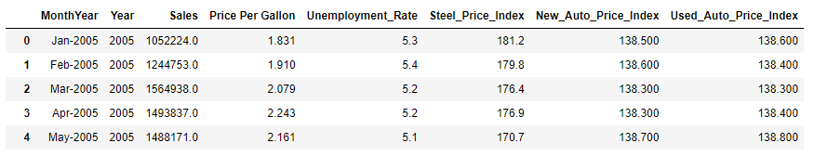
Final Clean CSV
Within Jupyter we merged each CSV file one at a time into our final data frame
We had to remove the commas from the Sales column to transform it to a Float
We ended up with a full set of data on monthly basis from January 2005 through June 2021
Finally, we used the CSV panda to output the final data frame into a clean CSV file

Slide 8
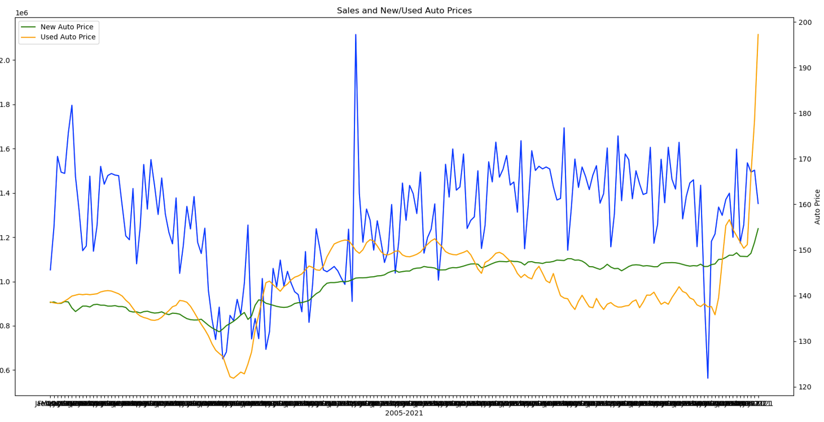

Let the Exploration Begin!
Next, we set out on an adventure to look at our data
We created bar graphs and line charts to look at the patterns

Slide 9
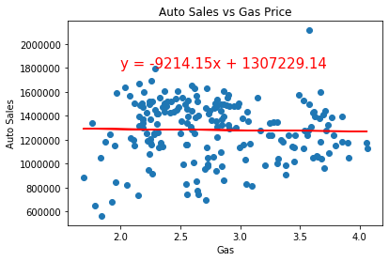
Gas Price vs. Auto Sales
R-squared: 0.000444
Correlation Coefficient: -0.02
Model accounts for hardly any of the data and the correlation is weak.

Slide 10
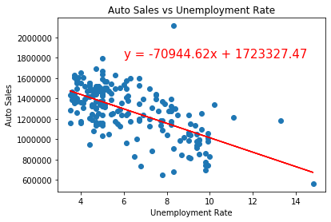
Unemployment Rate
R-squared: 0.378
Correlation Coefficient: -0.62
This model accounts for roughly 37% of the data
and the correlation is Moderate.

Slide 11
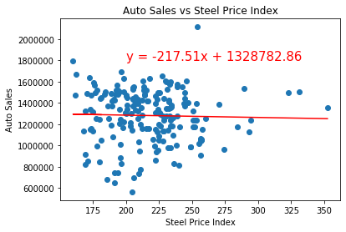
Steel Price vs Auto Sales
R-squared: 0.000751
Correlation Coefficient: -0.03
Accounts for a very small percentage of the data and there is weak correlation.

Slide 12
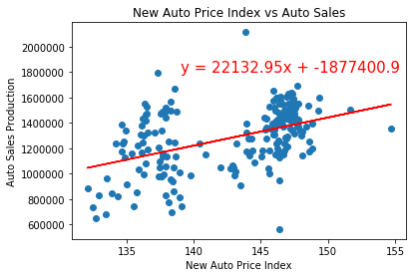
New Vehicle Price Index
R-squared: 0.2047394
Correlation Coefficient: 0.45
Accounts for roughly 20% of the data and there is a moderate correlation.

Slide 13
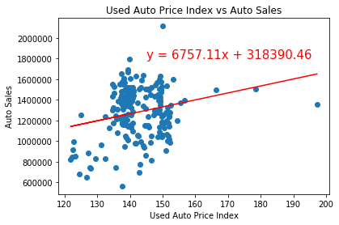
Used Vehicle Price Index
R-squared: 0.0553622
Correlation Coefficient: 0.24
Accounts for less than 5% of the data and there is a weak correlation.

Slide 14

Conclusion
Summary Findings
-Gas Prices
-Unemployment
-Steel Prices
-Vehicle Prices
Inferences ?
New Questions ?

Slide 15


Discussion
Difficulties
Obtaining Data
Cleaning/Formatting Data
GitHub
COMMUNICATION IS THE KEY !!!

Slide 16
Questions?

