Slide 1

Michelle Herman
Daniella Mayoral
Darrell Horich
Samantha Perez
Automobile Trends in the USA

Slide 2

Overview
Over the past three decades, supply chains have become increasingly global. This change has been driven by the dramatic increase in the number of goods and services that are tradable. The main factors in tradability are transportation costs and product perishability.
As a group we had decided to gather data that has impact in today supply chain for the auto industry.
We contain the scope of project by focusing on
Vehicle sales
Gas Prices
Steel Prices
Unemployment

Slide 3
Questions
Did any of these factors contribute to the sales of vehicles?
Did low gas prices increase sales?
Did low unemployment rates increase sales?
Did low steel prices increase sales?
Did low vehicle prices increase sales?
To answer these questions, we will represent our data in scatter plots to show correlation coefficients for each factor against sales of vehicles to see if any of these factors influence sales and which factor influences sales the most

Slide 4
Project Data Sources
Auto Sales (expressed in Units Sold by Month from 2005-2021)
https://www.goodcarbadcar.net/usa-auto-industry-total-sales-figures / Source: U.S. Bureau of Economic Analysis
Gas Prices (expressed in Dollars per Gallon for U.S. Regular All Formulations Retail Gasoline Prices by Month from 1992-2021)
https://www.eia.gov/dnav/pet/hist/ / Source: U.S. Energy Information Administration
Steel Prices (expressed as Producer Price Index for Steel by Month from Jan 1926-June 2021)
https://fred.stlouisfed.org / Source: Federal Reserve Bank of St. Louis Economic Research Resources
Producer Price Index (PPI) is a measure of average prices received by producers of domestically produced goods and services.
New & Used Auto Prices (separate dataset for each expressed as Consumer Price Index by Month from 1953-2021)
https://fred.stlouisfed.org / Source: Federal Reserve Bank of St. Louis Economic Research Resources
Consumer Price Index (CPI) is a measure of average prices paid by urban customers
Unemployment Rates (expressed as percent by Month from 2001-2021)
https://fred.stlouisfed.org / Source: Federal Reserve Bank of St. Louis Economic Research Resources

Slide 5
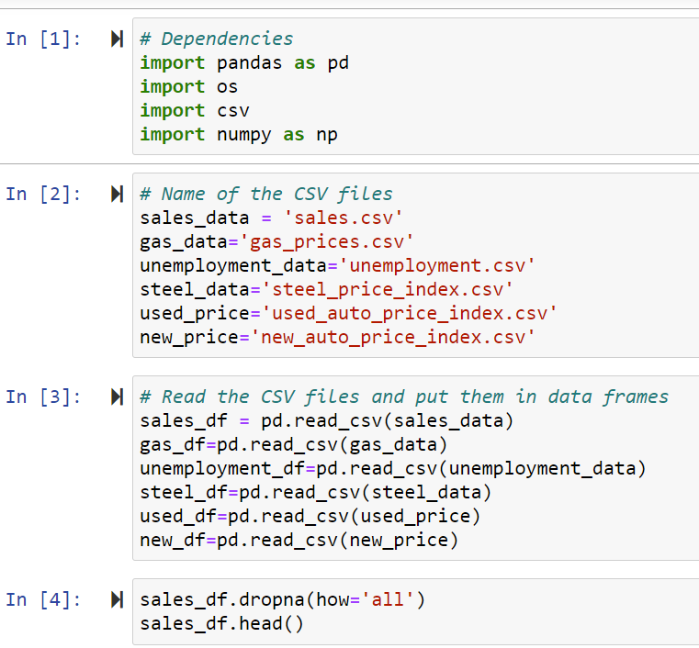
Data Clean Up
Downloaded each set to a CSV
For Vehicle Sales, we had to copy & paste a table into a CSV and manipulate it into the format we needed using Python
Luckily, our other datasets were in the month and year breakdown that we wanted

Slide 6
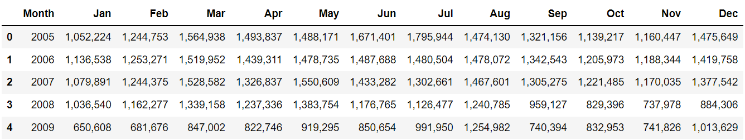
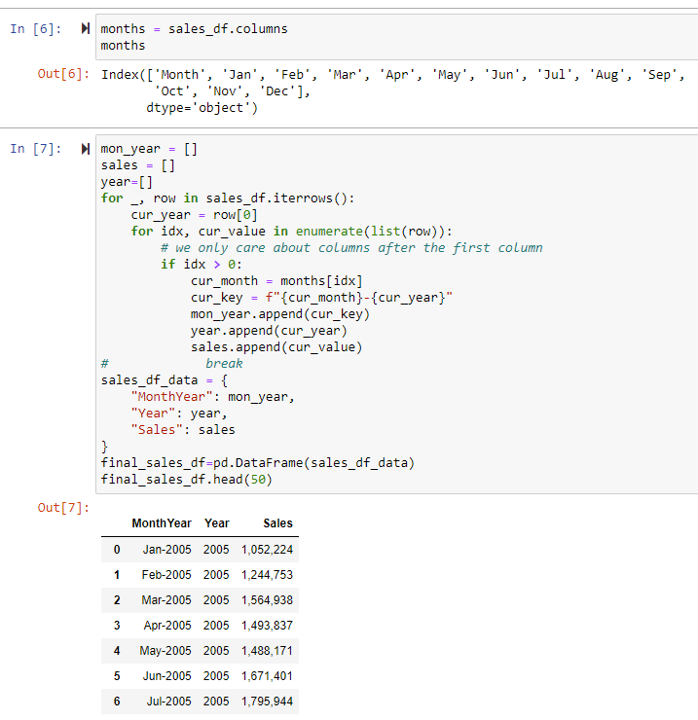
Data Clean Up (continued)
Hooray for
Nested For Loops!

Slide 7
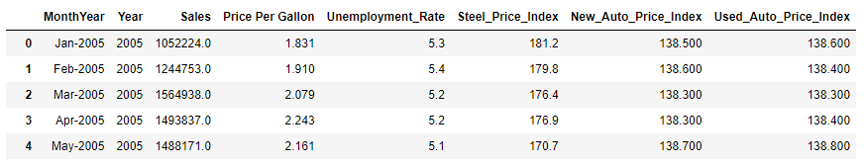
Final Clean CSV
Within Jupyter we merged each CSV file one at a time into our final data frame
We had to remove the commas from the Sales column to transform it to a Float
We ended up with a full set of data on monthly basis from January 2005 through June 2021
Finally, we used the CSV panda to output the final data frame into a clean CSV file

Slide 8
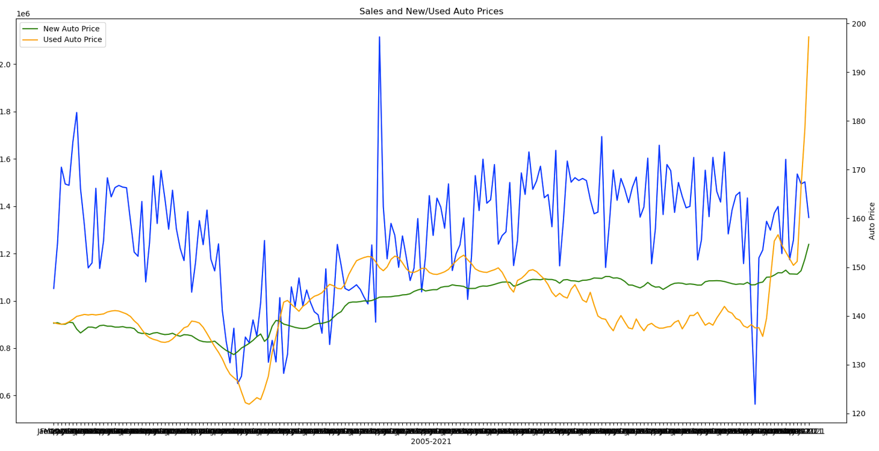

Let the Exploration Begin!
Next, we set out on an adventure to look at our data
We created bar graphs and line charts to look at the patterns

Slide 9
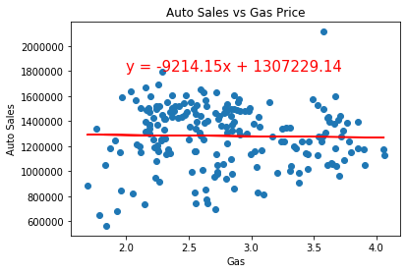
Gas Price vs. Auto Sales
Correlation Coefficient: -0.02
R-squared: 0.000444
P-Value: 0.768033294

Slide 10
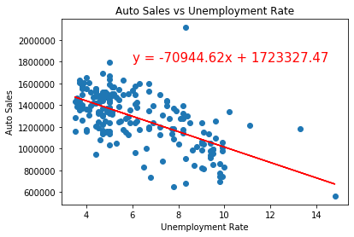
Unemployment Rate
Correlation Coefficient: -0.62
R-squared: 0.378
P-Value: 5.09817E-22

Slide 11
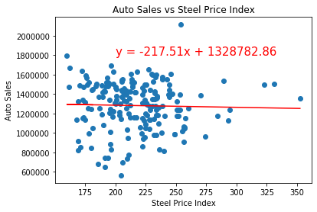
Steel Price vs Auto Sales
Correlation Coefficient: -0.03
R-squared: 0.000751
P-Value: 0.701366116

Slide 12
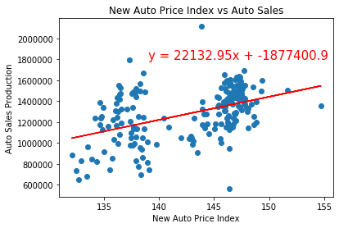
New Vehicle Price Index
Correlation Coefficient: 0.45
R-squared: 0.2047394
P-Value: 2.19503E-11

Slide 13
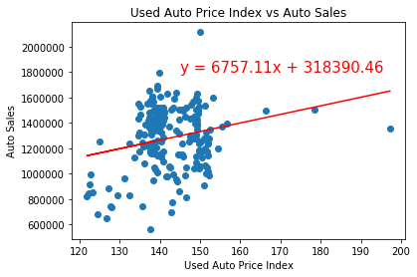
Used Vehicle Price Index
Correlation Coefficient: 0.24
R-squared: 0.0553622
P-Value: 0.00084731

Slide 14

Results
Absolute Value of r | Strength of Correlation
r < 0.3 | None or very weak
0.3 ≤ r < 0.5 | Weak
0.5 ≤ r < 0.7 | Moderate
r ≥ 0.7 | Strong
Relationship | R² | Pearson's r | P Value | Meaning
Auto Sales v Gas Price | 0.000444 | -0.02 | 0.768033294 | Accounts for hardly any of the data: Correlation: None or very weak
Auto Sales v Unemployment | 0.378681 | -0.62 | 5.09817E-22 | Accounts for roughly 38% of the data: Correlation: Moderate
Auto Sales v Steel Price Index | 0.000751 | -0.03 | 0.701366116 | Accounts for hardly any of the data: Correlation: None, or very Weak
Auto Sales v New Vehicle Price Index | 0.204739 | 0.45 | 2.19503E-11 | Accounts for roughly 20% of the data: Correlation: Weak
Auto Sales v Used Vehicle Price Index | 0.055362 | 0.24 | 0.00084731 | Accounts for less than 5% of the data-Correlation: Weak

Slide 15
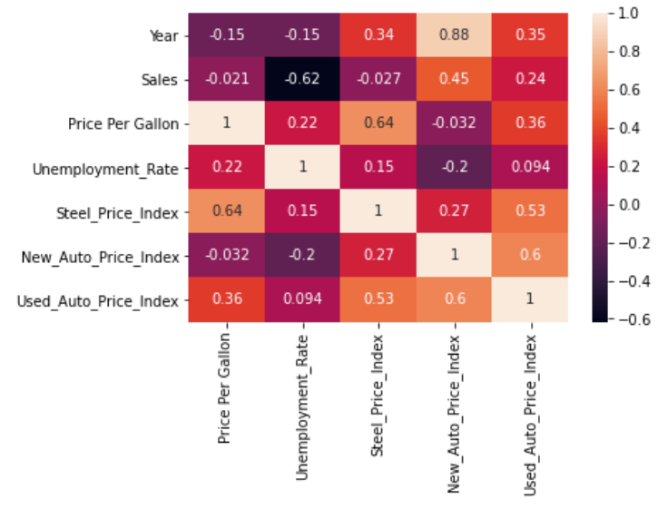
Correlation Matrix (Other Observations)
New Auto Prices tend to increase every year
New & Used Auto Prices tend to increase together
Steel Price is positively correlated to Gas Price with a tendency to increase together
Steel Price & the price of Used Vehicles also may have a tendency to increase together

Slide 16
Conclusion
* Discuss any difficulties that arose, and how you dealt with them
* Discuss any additional questions that came up, but which you didn't have time to answer: What would you research next, if you had two more weeks?

Slide 17

Discussion
Discuss your findings. Did you find what you expected to find? If not, why not? What inferences or general conclusions can you draw from your analysis?

Slide 18
Questions?
Open-floor Q&A with the audience

