Slide 1

Michelle Herman
Danielle Mayoral
Darrell Horich
Samantha Perez
Automobile Trends in the USA

Slide 2

Motivation
[What we wanted to do initially and how it evolved]
We decided to gather data online to perform an analysis of vehicles sold in the U.S. and the factors that increase or decrease sales

Slide 3
Questions
After finding what data was available and free to us online, we came up with factors we wanted to use to test relativity
Did any of these factors contribute to the sales of vehicles?
Did low gas prices increase sales?
Did low unemployment rates increase sales?
Did low steel prices increase sales?
Did low vehicle prices increase sales?
To answer these questions, we will represent our data in scatter plots to show correlation coefficients for each factor against sales of vehicles to see if any of these factors influence sales and which factor influences sales the most

Slide 4
Project Data Sources
Auto Sales (expressed in Units Sold by Month from 2005-2021)
https://www.goodcarbadcar.net/usa-auto-industry-total-sales-figures / Source: U.S. Bureau of Economic Analysis
Gas Prices (expressed in Dollars per Gallon for U.S. Regular All Formulations Retail Gasoline Prices by Month from 1992-2021)
https://www.eia.gov/dnav/pet/hist/ / Source: U.S. Energy Information Administration
Steel Prices (expressed as Producer Price Index for Steel by Month from Jan 1926-June 2021)
https://fred.stlouisfed.org / Source: Federal Reserve Bank of St. Louis Economic Research Resources
Producer Price Index (PPI) is a measure of average prices received by producers of domestically produced goods and services.
New & Used Auto Prices (separate dataset for each expressed as Consumer Price Index by Month from 1953-2021)
https://fred.stlouisfed.org / Source: Federal Reserve Bank of St. Louis Economic Research Resources
Consumer Price Index (CPI) is a measure of average prices paid by urban customers
Unemployment Rates (expressed as percent by Month from 2001-2021)
https://fred.stlouisfed.org / Source: Federal Reserve Bank of St. Louis Economic Research Resources

Slide 5
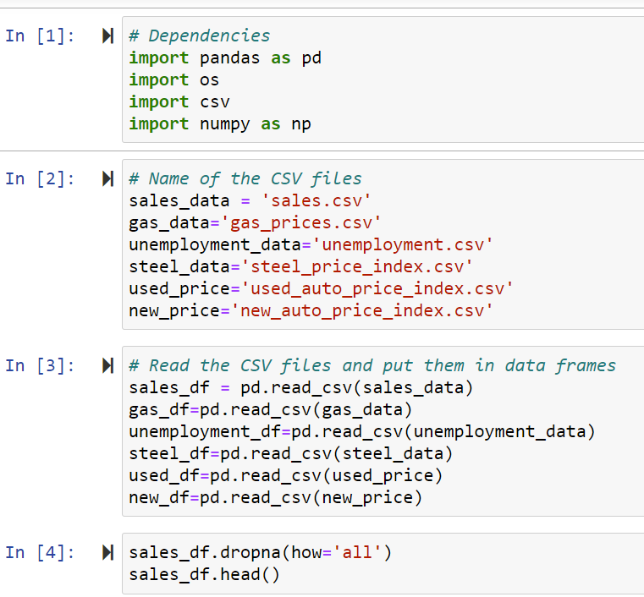
Data Clean Up
Downloaded each set to a CSV
For Vehicle Sales, we had to copy & paste a table into a CSV and manipulate it into the format we needed using Python
Luckily, our other datasets were in the month and year breakdown that we wanted

Slide 6
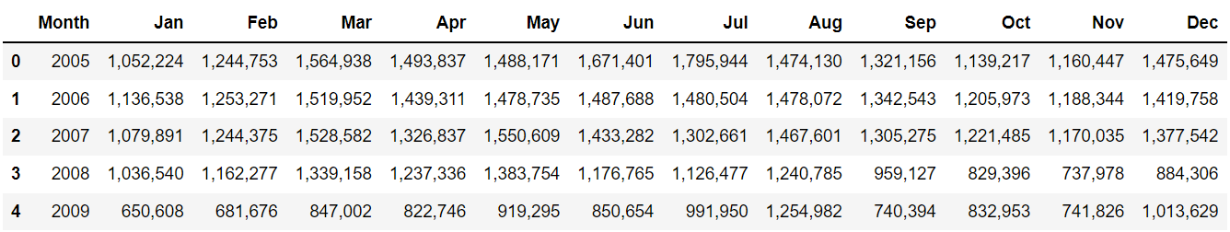
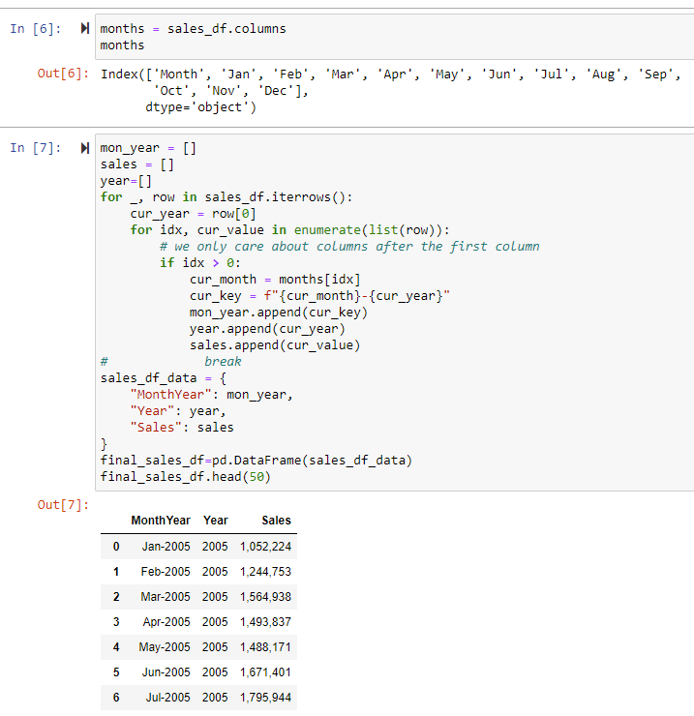
Data Clean Up (continued)
Hooray for
Nested For Loops!

Slide 7
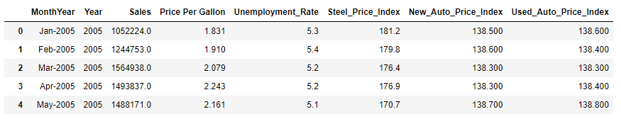
Final Clean CSV
Within Jupyter we merged each CSV file one at a time into our final data frame
We had to remove the commas from the Sales column to transform it to a Float
We ended up with a full set of data on monthly basis from January 2005 through June 2021
Finally, we used the CSV panda to output the final data frame into a clean CSV file

Slide 8
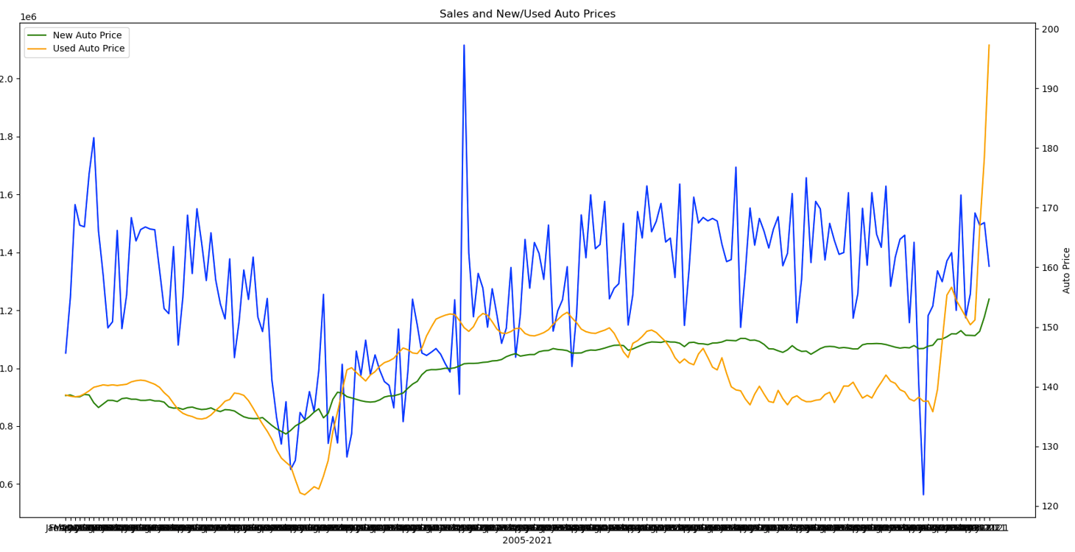

Let the Exploration Begin!
Next, we set out on an adventure to look at our data
We created bar graphs and line charts to look at the patterns

Slide 9
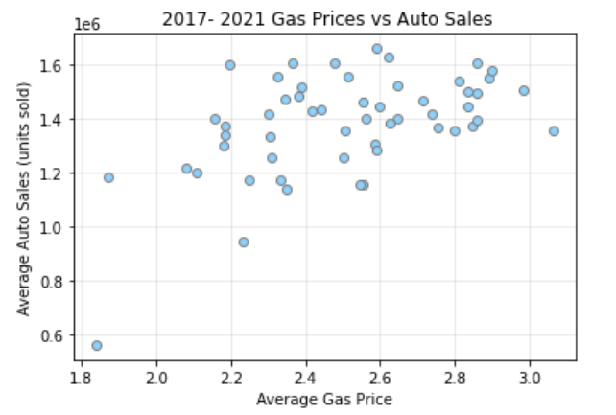
Gas Price vs. Auto Sales
[Placeholder for linear regression plot]
Correlation Coefficient
R-squared
P-value

Slide 10
Steel Price vs Auto Sales

Slide 11
Unemployment Rate

Slide 12
New Vehicle Price Index

Slide 13
Used Vehicle Price Index

Slide 14
Results

Slide 15
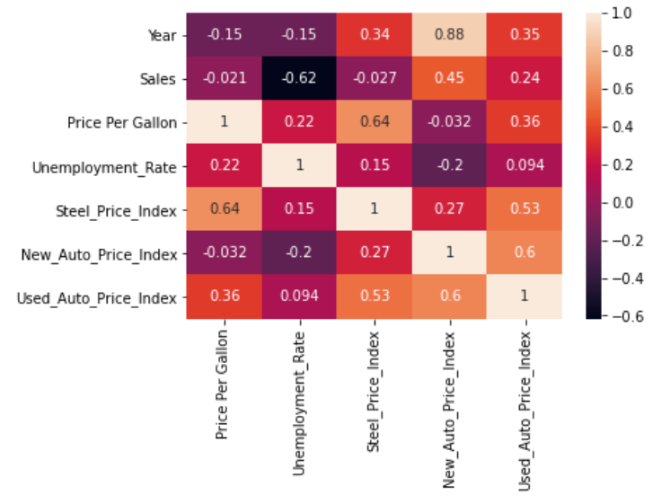
Correlation Matrix (Other Observations)
New Auto Prices tend to increase every year
New & Used Auto Prices tend to increase together
Steel Price is positively correlated to Gas Price with a tendency to increase together
Steel Price & the price of Used Vehicles also may have a tendency to increase together

Slide 16


Discussion
Summary Findings
-Gas Prices
-Unemployment
-Steel Prices
-Vehicle Prices
Difficulties
Obtaining Data
Cleaning/Formatting Data
GitHub

Slide 17

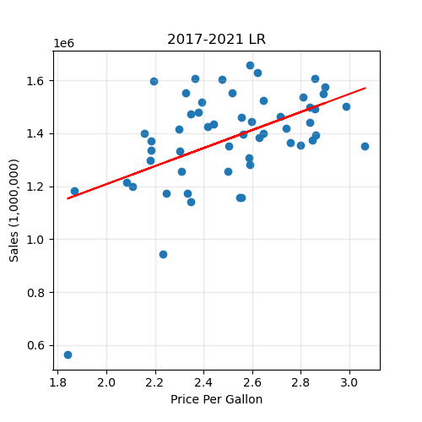
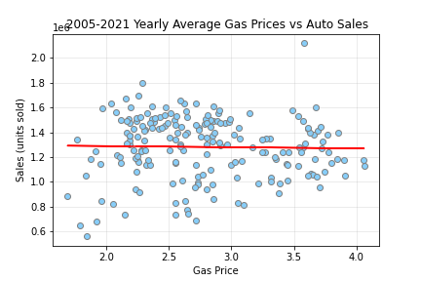

Conclusion
New Questions ?
The correlation coefficient between gas price and auto sales is 0.51
The r-squared is: 0.25751172565618313
The correlation coefficient between gas price and auto sales is -0.02
The r-squared is: 0.00044488448267310574

Slide 18
Questions?

