Slide 1
Claude Code isn’t a coding tool—
it’s a design partner that happens to code.
Michelle Hirsch · MathWorks
What does it mean for AI to be a design partner — not a code generator?
Notes:
• Introduce yourself: Michelle Hirsch, MathWorks — you work on MATLAB tooling
• Frame the surprise: most of what you'll hear about AI in engineering is code generation
• Your experience was different — it was design collaboration
• Two concrete projects as evidence — not theory, not demos, actual work products
• This is a practitioner report: honest, specific, no hype

Slide 2
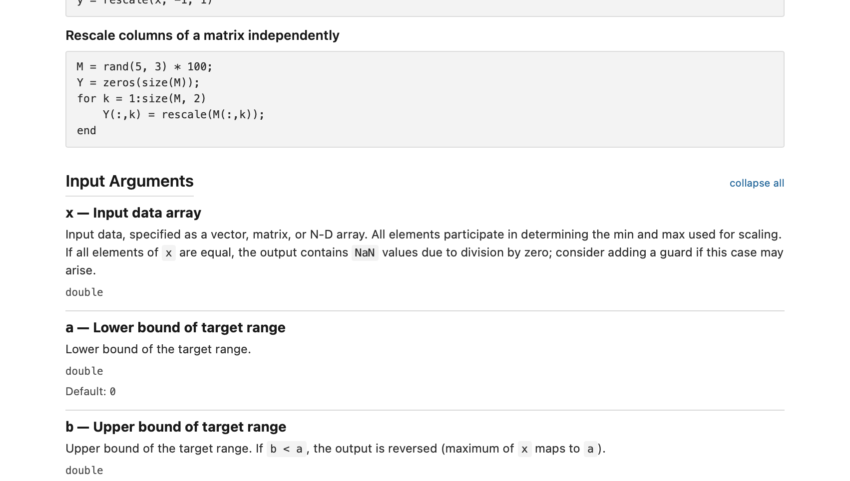
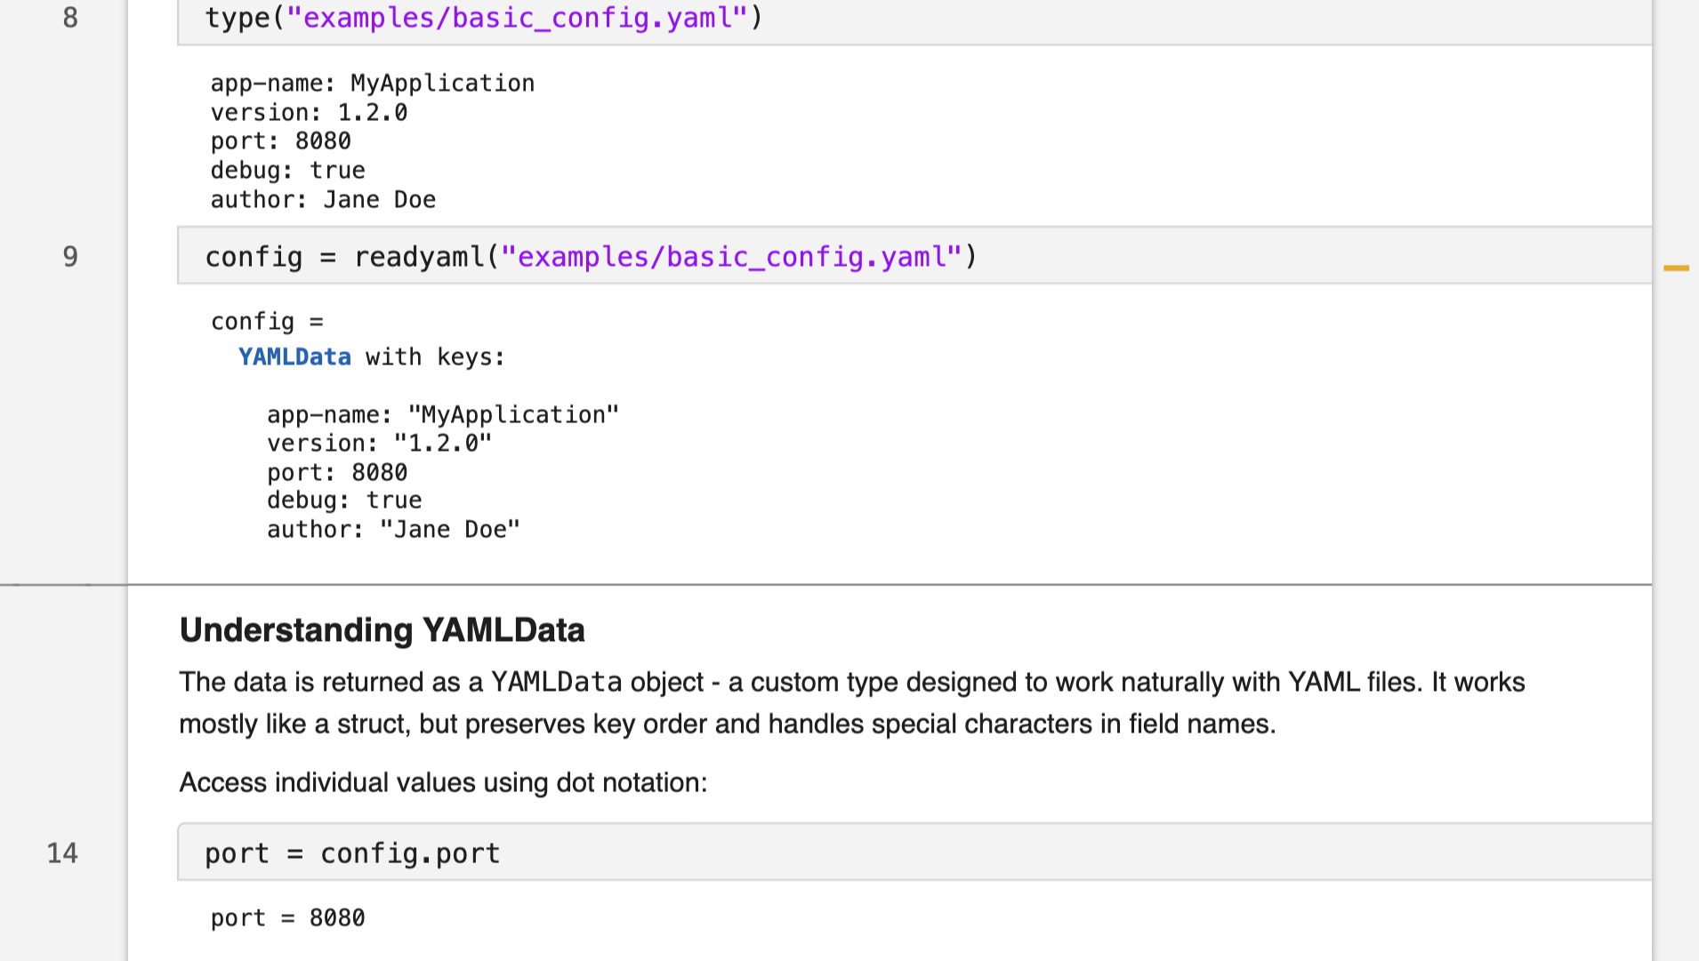
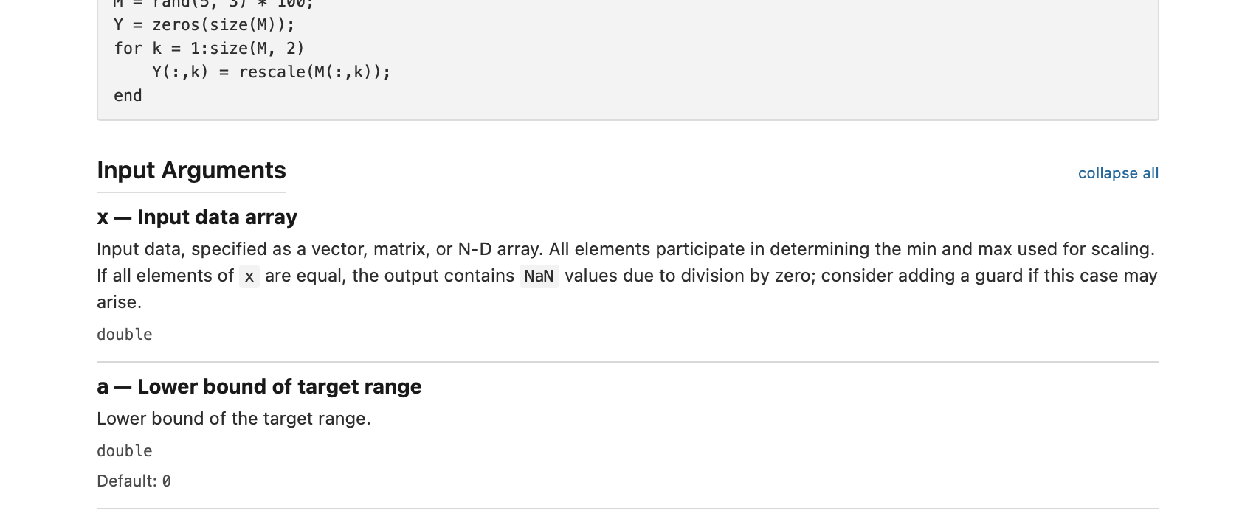
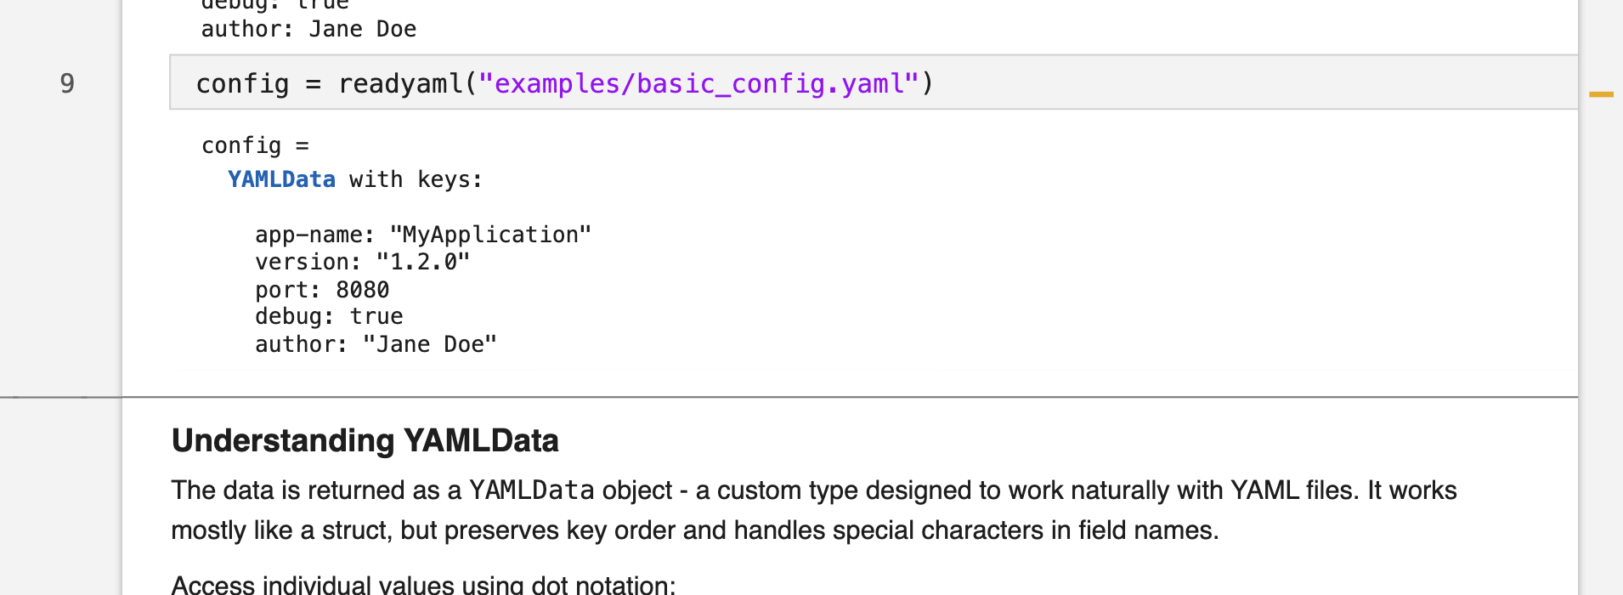
Two concrete projects
MATLAB Documentation Framework
Config File Readers & Writers for MATLAB
Notes:
• Project 1: The MATLAB documentation framework
- The idea: .m help comments should render as rich HTML when you call doc()
- Like what mkdocstrings does for Python — but for MATLAB
- The design challenge: what grammar? what sections? how do arguments get documented?
- Work products: 720-line living spec, 40+ sample .m files (7 versions of rescale, 6 of Sensor class), working prototype
- This was almost entirely design work — grammar design, tradeoff analysis, decision records
• Project 2: Config file I/O for MATLAB
- YAML, TOML, INI, JSON readers and writers
- The interesting design decisions: should config data be struct (easy but weak) or typed classes?
- Went with typed classes: YAMLData, TOMLData, INIData, JSONData
- Discovered they share structure → extracted shared ConfigData base class
- Designed all 4 simultaneously → forced consistent API across formats
• Neither project was primarily about code — they were design collaborations

Slide 3
Benchmarking no longer interrupts the design conversation
THE OLD WAY
“How much do the most popular Python tools let users customize the format when writing TOML?” → ask a developer → developer does research → comes back in a week → (or a month)
THE NEW WAY
Same question — plus: “Here are our design standards.” Claude comes back with: → benchmarks across popular tools → recommended options to add → suggested names → immediately
➡
Notes:
• The old way: any benchmarking required leaving the conversation
- Open browser, read docs, come back — broke the design flow
- "I'll look that up later" often meant never
- Context switch is expensive
• The new way: ask inline, get answer, continue
- No interruption to the design conversation
- Benchmarking became part of the conversation, not a detour
• Concrete example from the doc framework:
- Decision: how should argument short-descriptions work in our grammar?
- Immediately checked how Sphinx, mkdocstrings, and Javadoc handle it
- Compared approaches, chose the best for our use case, moved on
- The whole thing took maybe 3 minutes inside the existing conversation
• Config format examples:
- TOML spec edge cases (e.g., how does multiline string escaping work?)
- How Python's tomllib handles ambiguous cases
- What options real users actually need vs. rarely use
- All checked while designing the API — zero context switch
• The point: Benchmarking is no longer a separate research phase.
It's integrated into the design conversation.

Slide 4
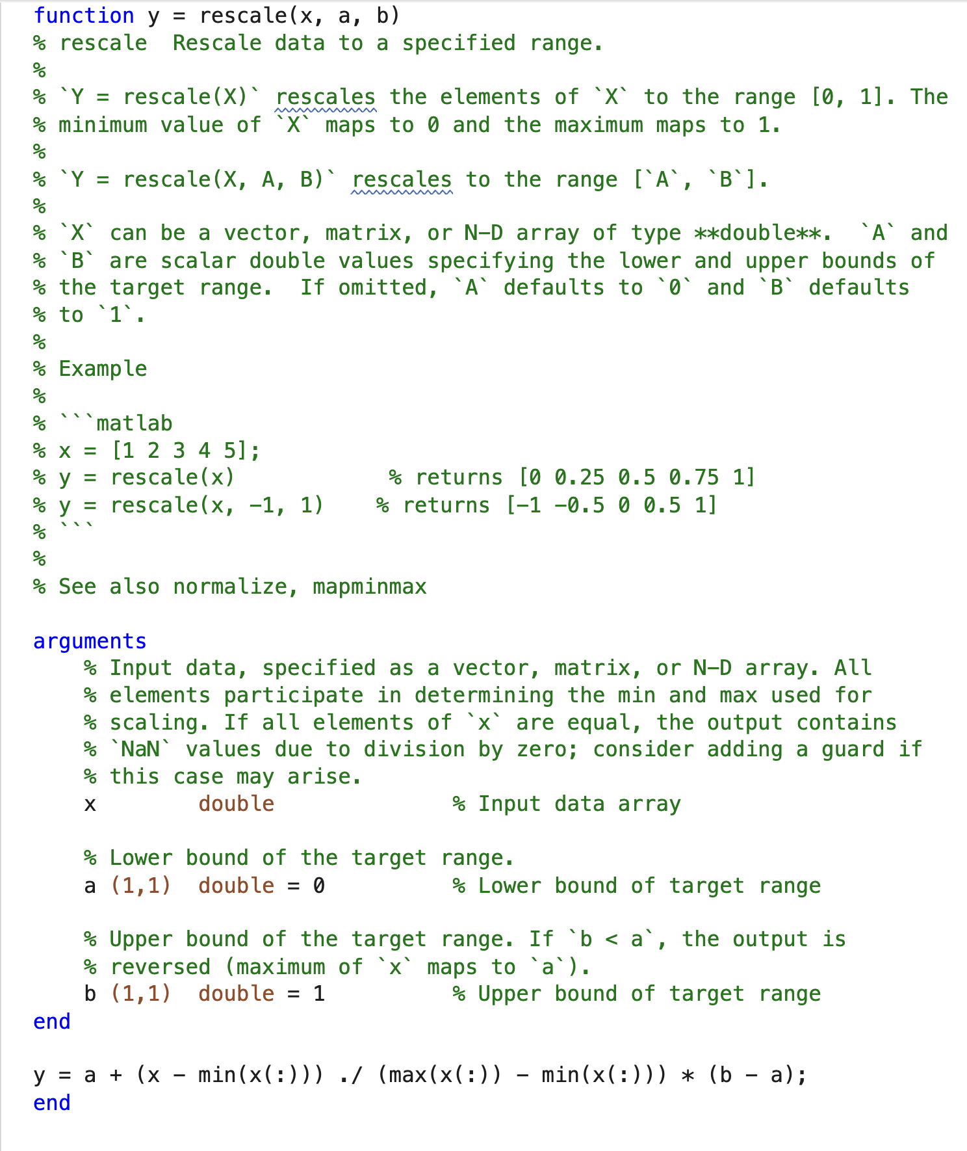
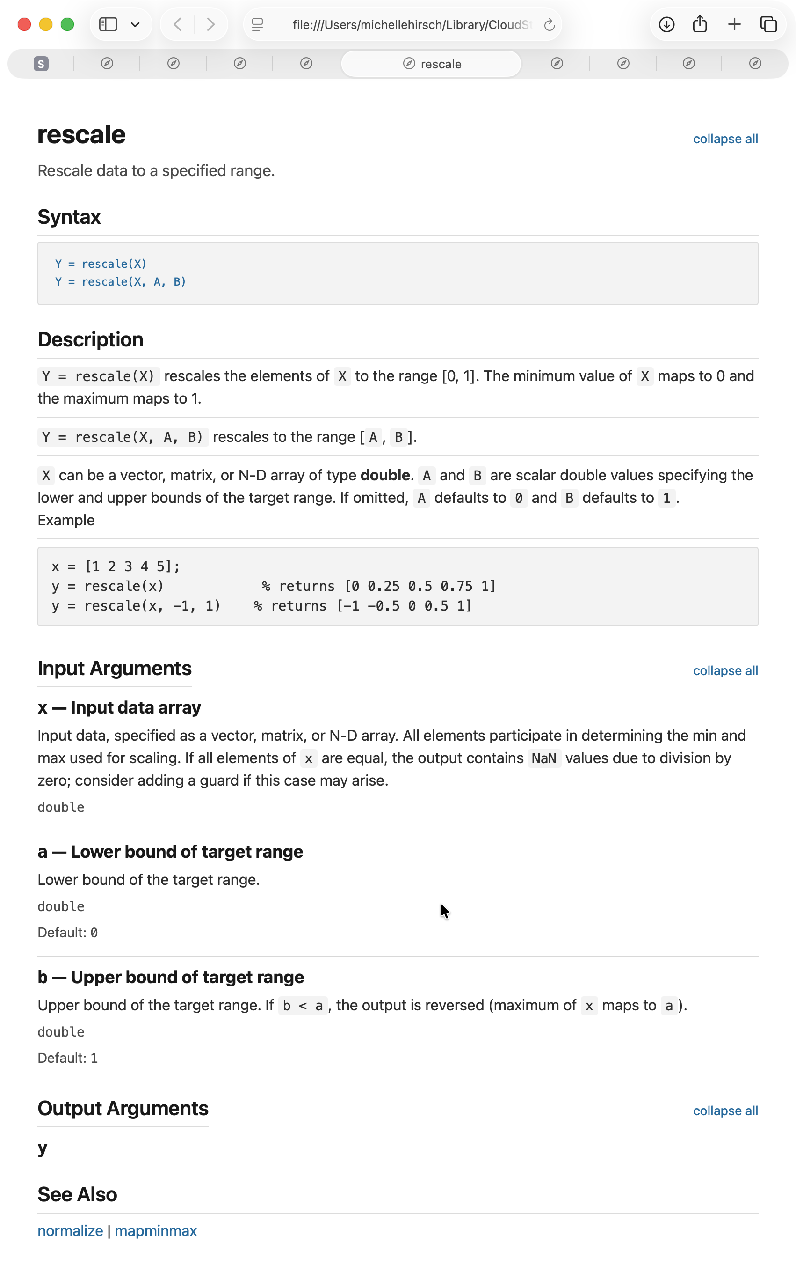
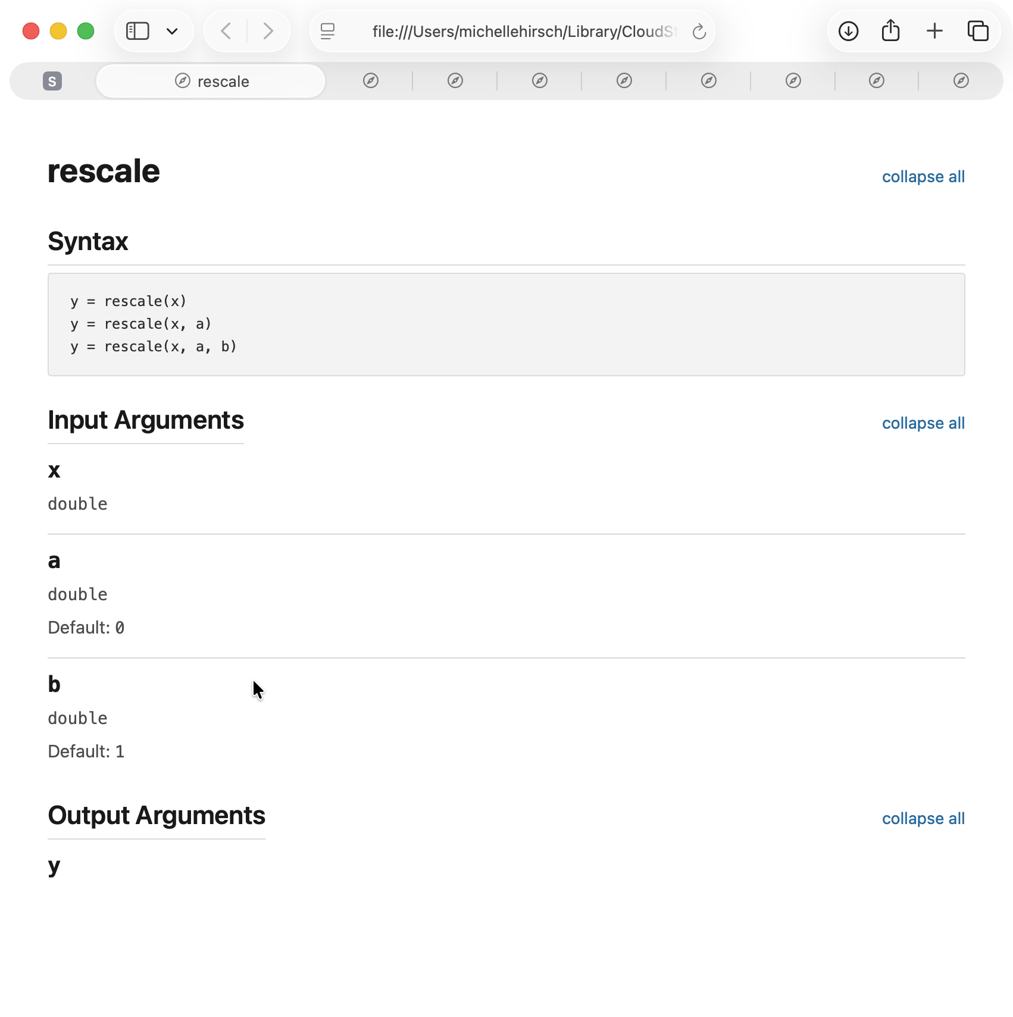
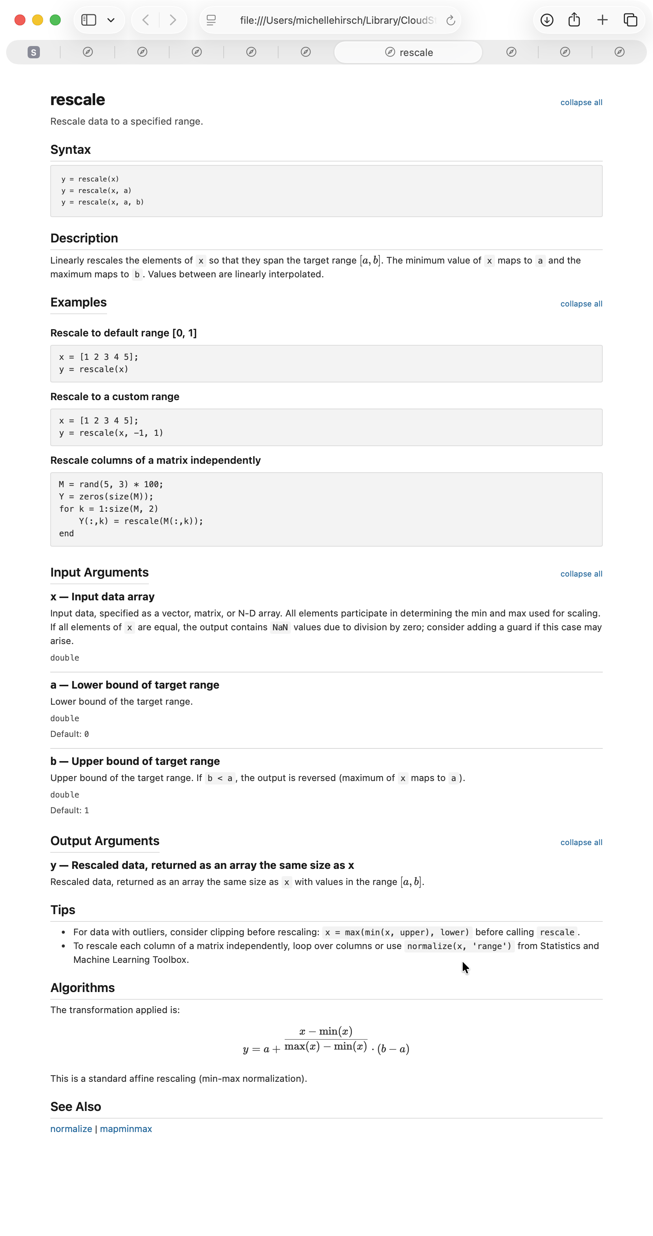
Designs get better through usage, not by staring at specs
Notes:
• The grammar was validated by building real examples, not by reviewing the spec
• 7 progressively documented versions of rescale():
- v0: bare function, just the arguments block (auto-generated minimal page)
- v1: add first-line synopsis only
- v2: add trailing comments on argument lines (short descriptions)
- v3: add block comments before argument lines (longer descriptions)
- v4: add a full ## Input Arguments section
- v5: full documentation with Examples and Tips
- v6/v7: testing edge cases and class documentation
• Also 6 versions of a Sensor class — validating class-specific features
(properties, methods, events)
• All of these were actually rendered as HTML using the working prototype
• Key insight: things that look fine in a spec become obviously wrong
when you see real rendered output
- Visual hierarchy issues
- Awkward section headings
- Cases where "section wins" vs "merge" matters
• For the config formats: working implementations meant design decisions
were validated against real YAML/TOML/INI/JSON files, not hypothetical ones
• The point: rapid prototyping at low cost changes what you're willing to try.
You don't just design differently — you validate differently.

Slide 5
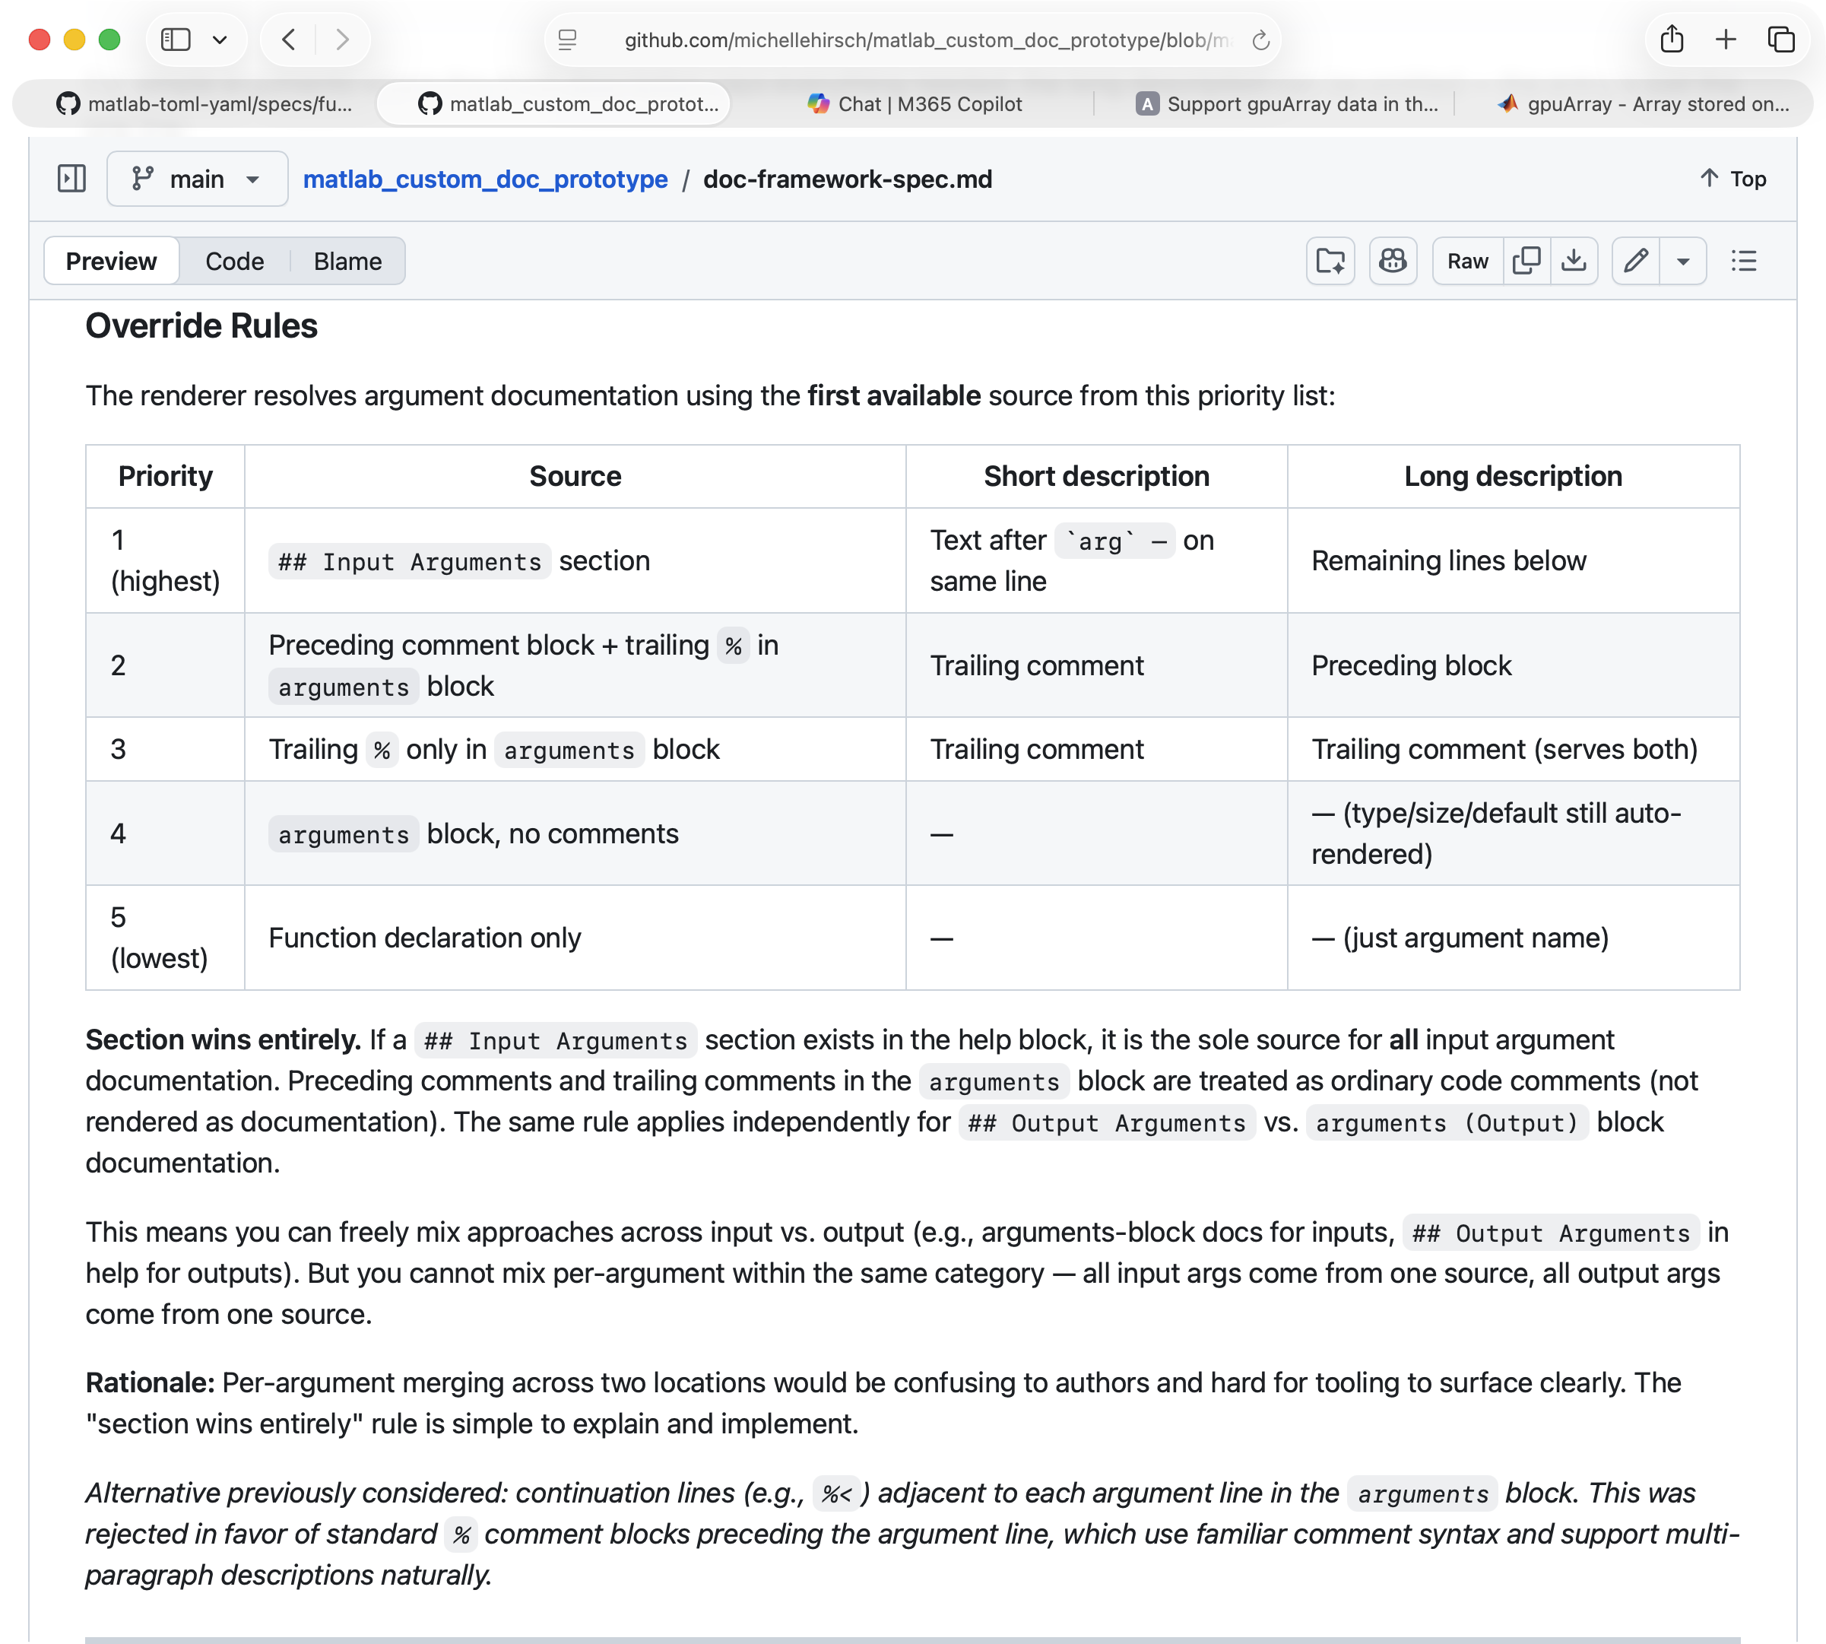
The spec captures not just decisions—but why
Example: The Syntax Description Gap
A structural tension: if you add descriptions to calling forms, you implicitly take full ownership of the syntax list. Documented: why “section wins entirely” instead of a merge model.
Design reasoning is normally lost. Engineers inherit decisions with no context. Here, the rationale lives in the document — alongside the decision.
Notes:
• The spec has explicit "Rationale" and "Alternatives considered" sections throughout — not just decisions
• Specific example: The "Syntax Description Gap"
- Structural tension in the grammar design
- If you want to add descriptions to individual calling forms (syntax variants),
you implicitly take ownership of listing ALL calling forms
- The auto-generated list from the arguments block can't be merged with a user-defined list
- Decision: "section wins entirely" — if you define a ## Syntax section, it completely
replaces the auto-generated one
- Rationale: documented in the spec with the tradeoffs explicitly stated
• Why does this matter?
- Normally, design reasoning is lost the moment the meeting ends
- Engineers who come later have no idea WHY things are the way they are
- They either reverse decisions accidentally, or fear changing anything
- Having the rationale documented changes what future maintainers can do
• Having AI in the loop made capturing rationale feel natural, not overhead
- Articulating "here's why we chose this" became part of the conversation
- The AI would sometimes surface considerations I hadn't thought of, which made
the rationale richer
• The point: AI doesn't just help you make decisions — it helps you articulate
and document the reasoning behind them.

Slide 6
Lower cost changed what I was willing to attempt
Without AI:
struct (plain dict)
← too daunting to design proper types
With AI:
YAMLData
TOMLData
INIData
JSONData
Shared structure discovered → extracted base class
↓
ConfigurationData (shared base class)
Designing all 4 formats simultaneously drove cross-format consistency that would never have happened if each was designed in isolation.
AI doesn’t just lower effort per task — it changes what you’re willing to attempt.
Notes:
• Without AI: I would have represented config data as plain struct
- MATLAB struct is familiar, easy, zero design effort
- Designing custom types felt too daunting: too many decisions, too much work
- The result would have been: functional but weak
• With AI: We designed proper typed classes
- YAMLData, TOMLData, INIData, JSONData — each a proper typed class
- Conversations: what fields? what methods? what do you do with nested structures?
- Prototyped quickly enough that we could try things and see if they worked
• Discovered shared structure → extracted ConfigData base class
- All 4 types had common fields and methods
- Natural refactoring: extract to a shared base class
- This wouldn't have happened if types started as structs
• The cross-format consistency point:
- Working on all 4 simultaneously meant decisions had to be consistent
- "How should YAML handle nested maps?" → immediately applied the same pattern to TOML, INI, JSON
- The result: a consistent, coherent API across 4 formats
- Isolation would have produced 4 slightly inconsistent designs
• This is the "activation energy" insight:
- Not just "it's faster to do the same thing"
- It changes WHAT you attempt
- Better designs emerge when the cost of ambition is lower

Slide 7
Why design with Claude Code?
Instant benchmarking
“What would change about your design process if your AI could do these things for you?”
Rapid prototyping
Keep track of decision-making
Tackle the big challenges
Notes:
• This is the meta-lesson: you are building AI tools for scientists who do design work
• The things that changed my design process are the things scientists need:
1. Instant benchmarking
- Literature access, precedent checking, tool comparisons — in-context, while designing
- Not a separate research phase
2. Rapid prototyping
- Try ideas with their actual data and tools
- Low cost = willing to try things that might not work
3. Help articulating reasoning
- Not just "give me the answer"
- Help saying WHY — designing better, documenting better
4. Support for ambitious designs
- Lower activation energy for harder problems
- Better designs emerge when the cost of ambition is lower
5. Memory and continuity
- Long projects don't restart from scratch each session
- The context lives in the artifacts, not in human memory
• Turn the question back to the audience:
- You've heard what changed for me
- What would change for your users?
- What would change for YOU, as designers of these tools?
• The prompt at the end is for reflection — let it land

Slide 8
Claude Code isn’t a coding tool—
it’s a design partner that happens to code.
What changed for me:
• No browser tabs — benchmarking happened inline, mid-conversation
• Bigger bets — designing all 4 config formats in parallel revealed shared structure I’d have missed
• Reasoning preserved — the spec captures why decisions were made, not just what they were
→ Try it on a design challenge—not your next coding task.
Notes:
• Close on the single sentence: "The quality bar is different when you have a design partner."
• Not because AI does the work for you
• But because you attempt things you wouldn't attempt alone
• You validate assumptions you'd otherwise skip
• You document reasoning you'd otherwise lose
• You work on 4 formats instead of 1
• The invitation is genuine: try it on a design problem, not a coding task
- Pick a real design decision you're facing
- Use it to benchmark options, prototype quickly, articulate the rationale
- See what changes
• If you've been using AI for code generation, this is a different mode
- It requires treating the AI as a collaborator, not a tool
- The spec/artifact becomes the shared memory
- The conversation drives the design
• Thank you

