Slide 1

Choosing the Right Modality for Impactful Learning
Needs = Modality
Different Needs call for Different Modalities
Knowledge needs
self-paced or digital learning (e.g., eLearning, microlearning)
Sometimes, the solution isn’t formal learning at all
Skill building
Practice and feedback environments ( workshops, coaching, or simulations)
Behavioral or mindset shifts
Social and experiential learning (peer discussions, role-play, mentorship)
Notes:
I want to highlight how choosing the right learning modality — the what of learning — can make or break impact.
The modality we choose isn’t random — it’s determined after a needs assessment, once we understand the real learning goal and the context learners are operating in.
While L&D will ultimately provide a recommendation on the best-fit modality, it’s helpful to see why that choice matters. It’s not always about building a full eLearning course or hosting a live session — sometimes the most effective solution is much simpler.
In fact, the most impactful learning experience might be a quick job aid, a short communication, or a one-minute walkthrough that helps someone perform better in the moment they need it.
Or sometimes the right solution isn’t learning at all.
Different Needs, Different Methods
Not all learning needs are equal.
Knowledge needs are best met through self-paced or digital learning (e.g., eLearning, microlearning). But sometimes, the solution isn’t formal learning at all — strong knowledge management or clear communication can be just as effective depending on what the goal is.
If the goal is for your learner to KNOW a thing, we should be asking: “have we told them?”
Skill building thrives in practice and feedback environments like workshops, coaching, or simulations.
Behavioral or mindset shifts require social and experiential learning—things like peer discussions, role-play, or mentorship.
The key is matching the learning need with the right experience rather than defaulting to a single format.

Slide 2
Designing for Impact
Tell → Show → Try → Reflect
When we map modalities to needs, we get:
Efficiency: content delivered in the most scalable, accessible way.
Engagement: learners stay active and connected.
Sustainability: behaviors stick because learning becomes part of how people work, not just a one-time event.
Notes:
The most effective programs blend modalities:
Tell → Show → Try → Reflect
For example: an eLearning module introduces a skill, a live session practices it, and follow-ups reinforce it through peer feedback or manager coaching.
This approach ensures both understanding and application, bridging the gap between “I know” and “I can do.”
When we map modalities to needs, we get:
Efficiency — content delivered in the most scalable, accessible way.
Engagement — learners stay active and connected.
Sustainability — behaviors stick because learning becomes part of how people work, not just a one-time event.
Impactful learning isn’t about more content — it’s about designing smarter experiences that meet people where they are and guide them where they need to go.

Slide 3
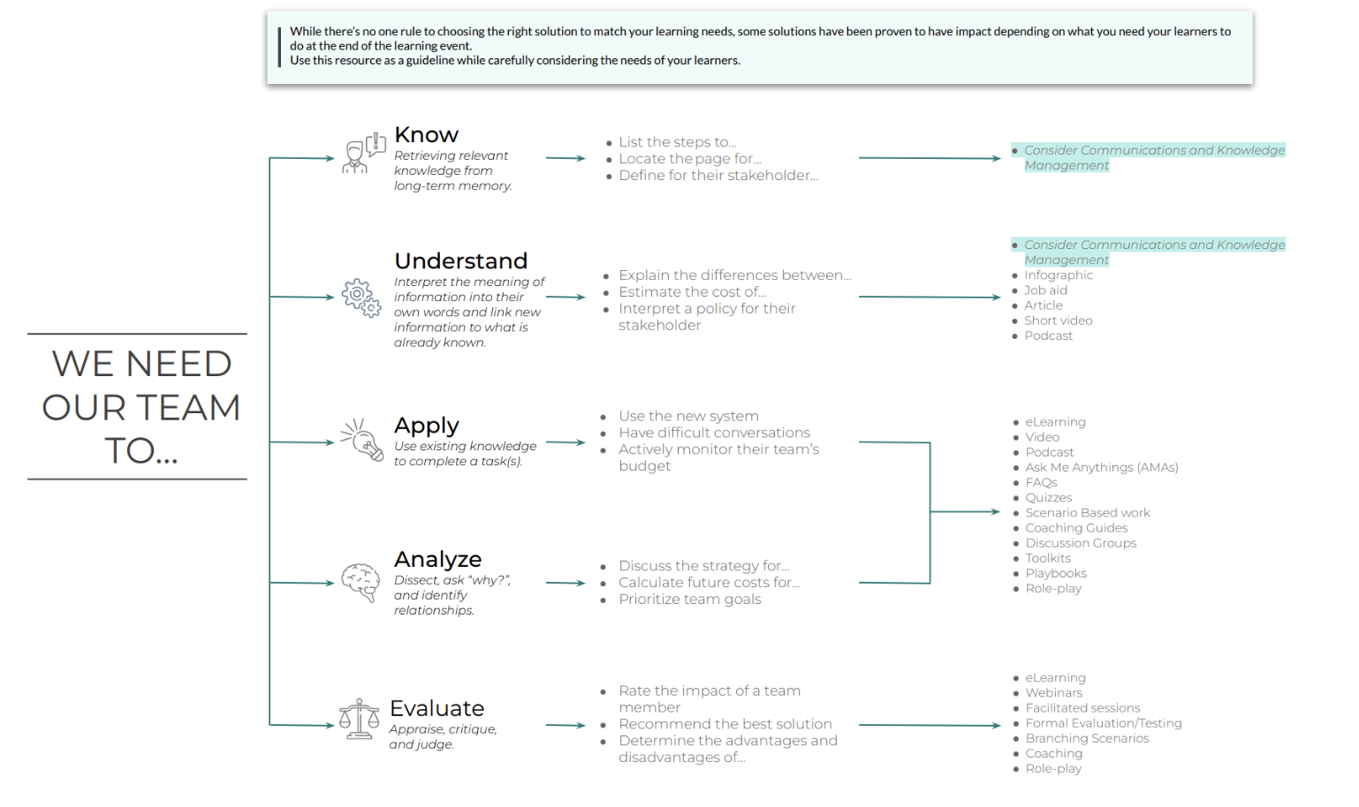
Notes:
The purpose of “Learning Needs & Modalities” is to illustrate how different learning goals require different delivery methods — and that selecting the right modality (e.g., eLearning, workshop, coaching, or communication) determines learning impact and retention.
The L&D team partners with you and SMEs to assess needs and recommend the best modality path forward, ensuring every learning experience is purposeful, scalable, and designed for measurable impact.
You can find this guide on our Talent Development Notion Page for a closer look. https://furtive-production-d9e.notion.site/Talent-Development-2402257078668027b89cdc1c1d6f9c42

