Slide 1
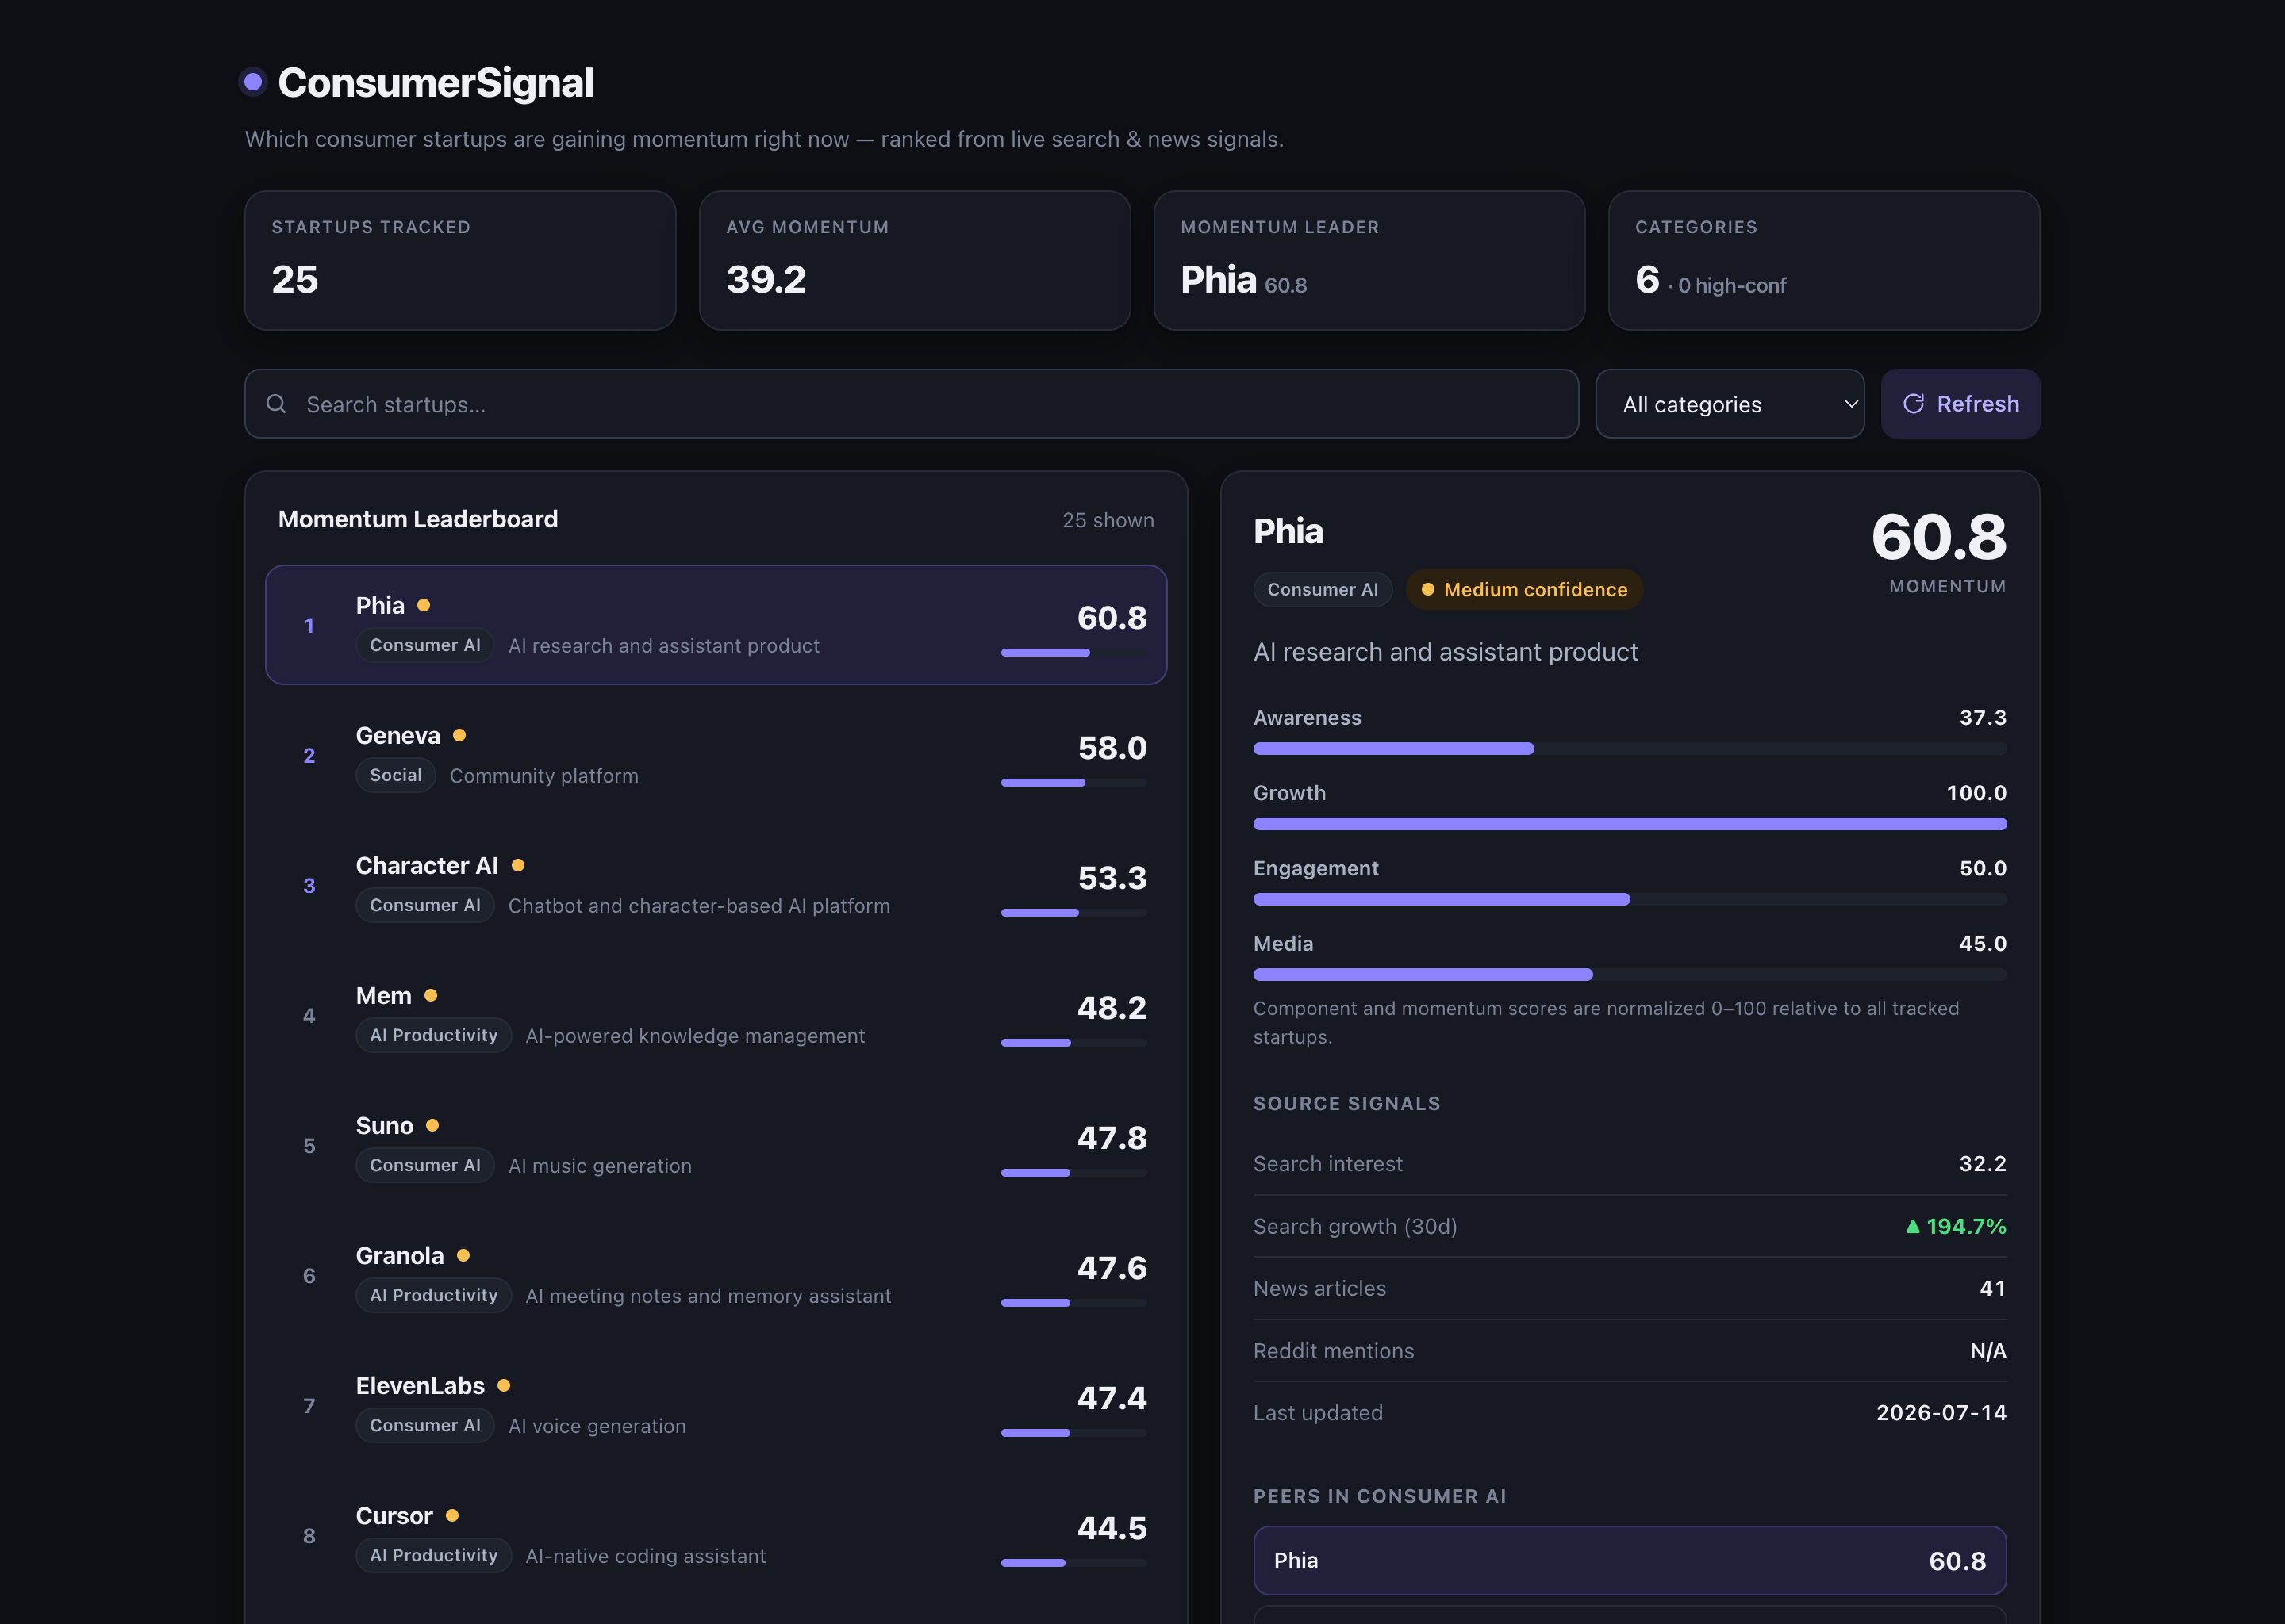
ConsumerSignal
A momentum signal engine for consumer startups
Which early-stage consumer startups are gaining momentum right now — quantified from live search and news signals, ranked into one comparable score.
Michelle Mai
Product · Data case study

Slide 2
PROBLEM
Spotting breakout consumer startups is hard
1
Fragmented signals
2
Virality is fuzzy
Early traction is scattered across search, news, and social — no single view.
“Buzz” is hard to quantify reliably or compare across companies.
3
Intuition-driven
4
No standard metric
Investors lean on gut feel and noisy, anecdotal signals.
There’s no common way to measure early-stage momentum.
ConsumerSignal · Michelle Mai
02

Slide 3
APPROACH
A momentum signal engine, in four stages
01
02
03
04
Data Collection
Signal Engineering
Scoring Model
Output
Search interest (news / search proxies)
Media coverage (news volume)
Curated startup dataset
Awareness — relative attention
Growth — rate of change
Media — recent mentions
Engagement — baseline (placeholder)
Blend signals into one score
Normalize across startups
Confidence flags by data quality
Ranked momentum leaderboard
Surface breakout candidates early
Per-startup signal breakdown
ConsumerSignal · Michelle Mai
03

Slide 4
ARCHITECTURE
The data pipeline, end to end
›
›
›
›
›
CSV
Ingest
SQLite
Score
Flask API
Dashboard
Startup dataset
Fetch signals
Store
Normalize + weight
Serve ranked JSON
Ranked UI
startups.csv
fetch_news.py
fetch_trends.py
startups
trend_signals
news_signals
compute_scores.py
/api/startups
index.html
Momentum = 0.30·Growth + 0.25·Awareness + 0.25·Engagement + 0.20·Media
ConsumerSignal · Michelle Mai
04

Slide 5
THE PRODUCT
A live, ranked momentum dashboard
Momentum leaderboard
25 consumer startups ranked by a single 0–100 score.
KPI summary
Avg momentum, current leader, and category spread at a glance.
Per-startup breakdown
Four score components as bars, plus the raw source signals.
Built for sharing
Light / dark, responsive, one-click deploy.
ConsumerSignal · Michelle Mai
05

Slide 6
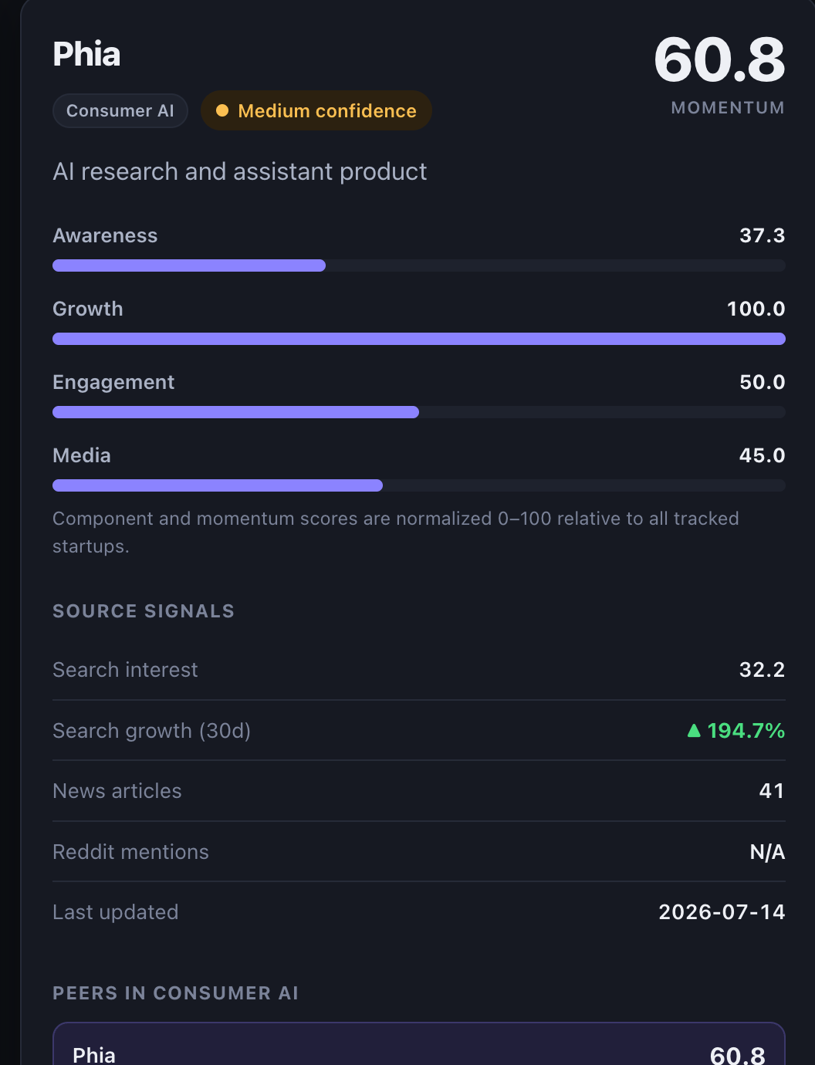
METHODOLOGY
How the Momentum Score works
Growth
rate of change in attention
30%
Awareness
relative search interest
25%
Engagement
social baseline (placeholder)
25%
Media
recent news volume
20%
Normalized 0–100: (x − min) / (max − min) × 100
Every score is relative to the tracked set, so companies of very different sizes stay comparable.
Live score breakdown — Phia
ConsumerSignal · Michelle Mai
06

Slide 7
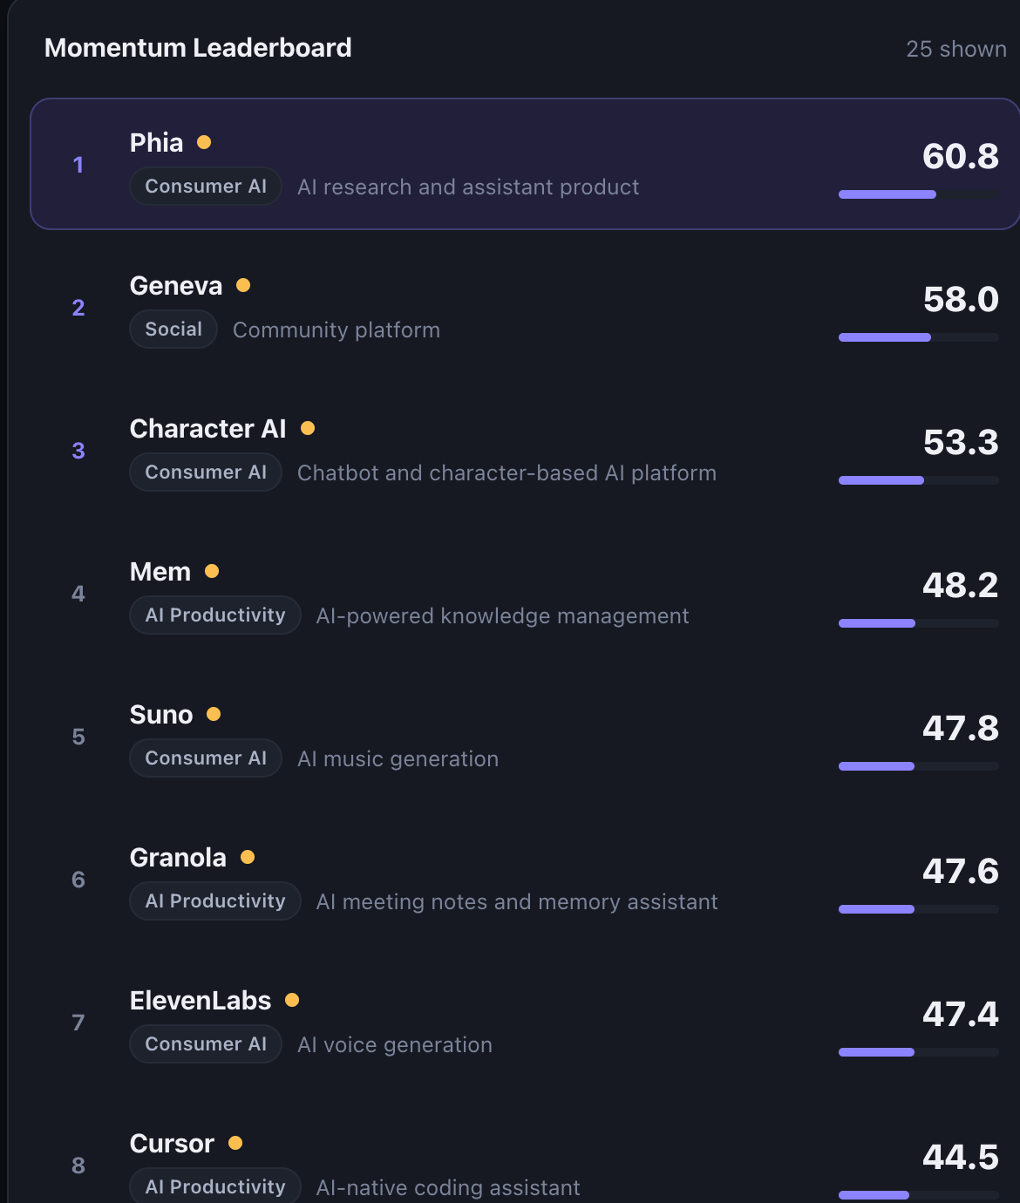
LIVE DEMO
See it running
25
startups tracked
Phia · 60.8
current momentum leader
6
consumer categories
4
signal components per startup
→ Deploy on Render · add your live URL here
ConsumerSignal · Michelle Mai
07

Slide 8
INSIGHTS
What the signals reveal
▲
Growth ≠ awareness
▲
Emerging breakouts
Geneva shows high awareness but modest growth; Phia has moderate awareness yet the fastest growth in the set.
Phia and Suno pair high growth with lower awareness — the classic early-traction profile, before peak visibility.
▲
Media ≠ traction
▲
A visible data gap
Heavy news volume doesn’t always mean real momentum; some names are over-represented in coverage without growth.
Engagement is held at 50 (no social API), which is exactly why no startup can yet reach “High” confidence.
ConsumerSignal · Michelle Mai
08

Slide 9
LIMITATIONS
Known constraints — stated plainly
!
Engagement is a placeholder
Fixed at 50 — no accessible social / media APIs yet.
!
Proxy signals, not direct data
Google News & Trends approximate attention, not usage.
!
Snapshot, not history
No day-over-day tracking of momentum yet.
!
Relative, not absolute
Scores are normalized within the current 25-startup set.
Entity ambiguity
Single-word names (“Friend”, “Pie”, “Bolt”) pull unrelated news — real data measuring the wrong thing. Fixed with disambiguated queries.
!
ConsumerSignal · Michelle Mai
09

Slide 10
ROADMAP
From tracking momentum → predicting breakouts
→
→
1
2
3
Data expansion
Smarter signals (AI)
Predictive modeling
Social APIs (Reddit, TikTok, X)
Real engagement: likes, shares, comments
Unlocks “High” confidence
Sentiment: hype vs. real traction
Entity resolution for brand names
Detect early viral patterns
Historical trend tracking
Momentum → breakout prediction
Spot trends before mainstream
ConsumerSignal · Michelle Mai
10

Slide 11
CONCLUSION
A data-driven momentum engine
Aggregates awareness, growth, and media into one comparable score
Ranks 25 consumer startups and surfaces early breakout candidates
Separates real acceleration from hype and visibility
Key takeaway Momentum is driven by growth, not just visibility.
GitHub github.com/you/consumersignal Live demo your Render URL

