Slide 1

AMAD: Adversarial Multiscale Anomaly Detection on High-Dimensional and Time-Evolving Categorical Data
Zheng Gao
Ph.D. at Indiana University Bloomington

Slide 2
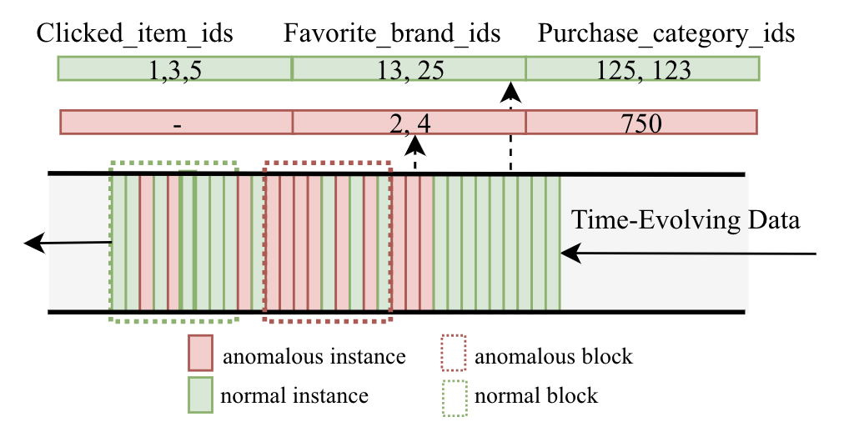
Motivation
ILS IUB
Anomaly detection can provide a wide range of applications, from capturing rare events or unusual observations to protecting a complex system against failures or attacks.
It can benefit model training on downstream tasks, i.e. cyber security, online recommendation and advertising.
It requires to be applied in more complex scenarios.

Slide 3
Research Goal
ILS IUB
Goal
Design an unsupervised framework to detect Two level (instance & block) anomaly on high dimensional data.
Assumption
Normal data should have concordant patterns in their representations, while anomaly data should be different.
Data reconstruction error in Adversarial Autoencoder can be used as the indicator for anomaly detection. In this paper, it is taken as cutoff threshold.
Challenge
Data changes across time
Labelling is expensive
Data format is complex, i.e. high dimensional
Require anomaly detection at multiscale

Slide 4
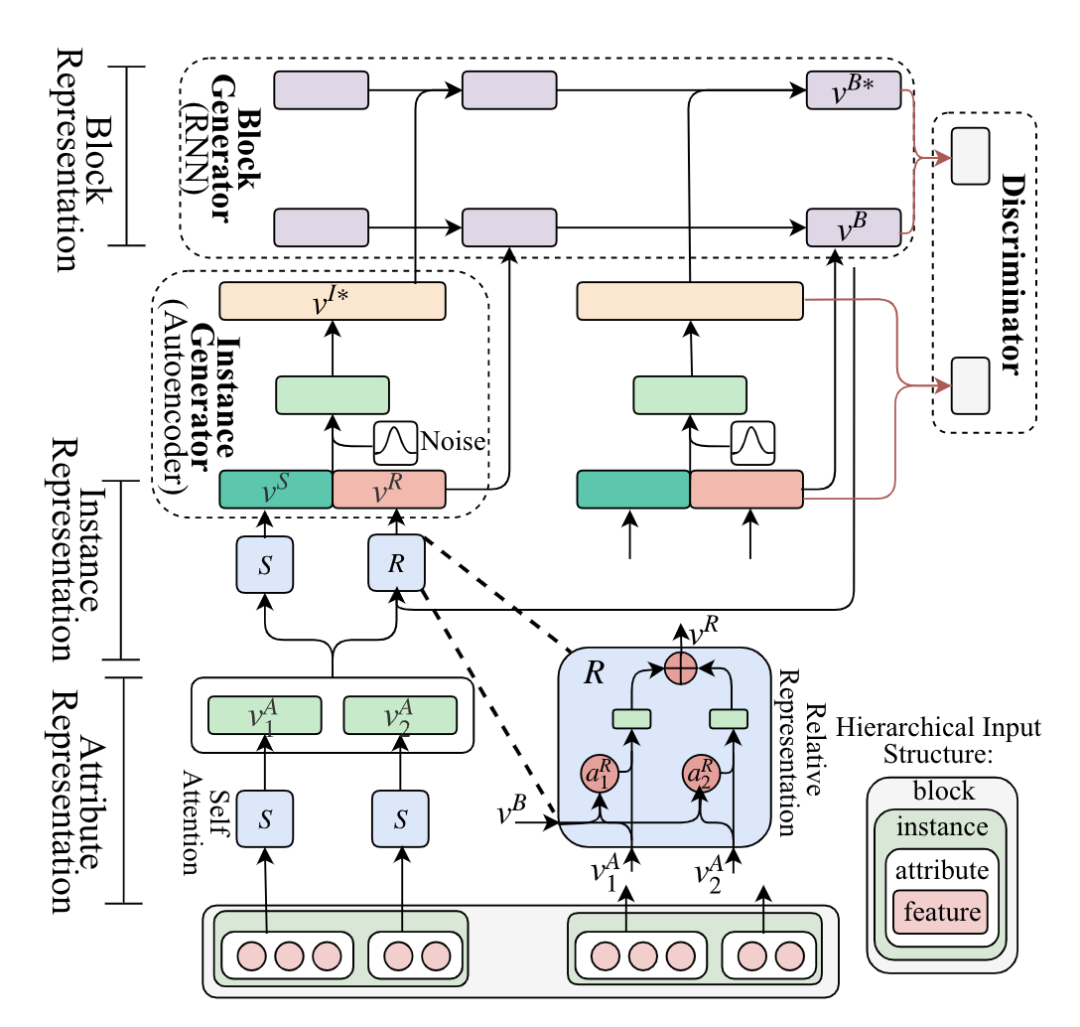
Method
ILS IUB
Multiscale Representation Learning
Feature and Attribute Representation
Instance Representation
Block Representation
Adversarial Learning
Instance Generator
Block Generator
Discriminator
Training and Inference

Slide 5
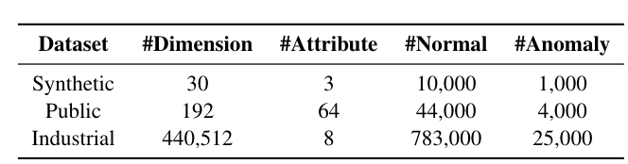
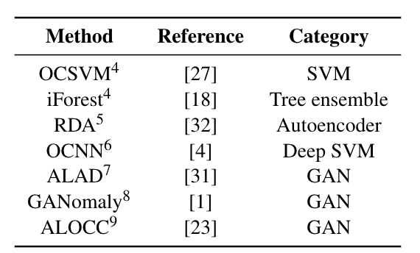
Dataset & Baseline
ILS IUB

Slide 6
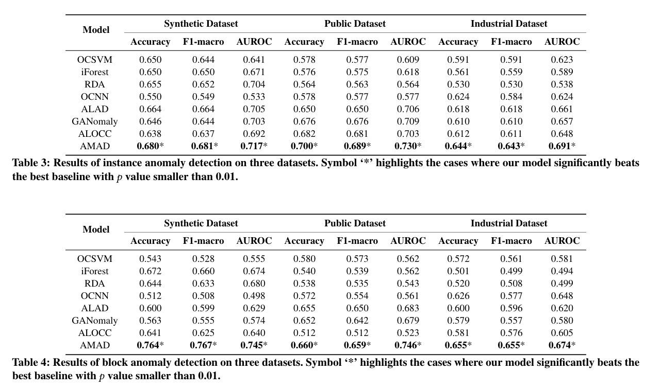
Experiment
ILS IUB

Slide 7
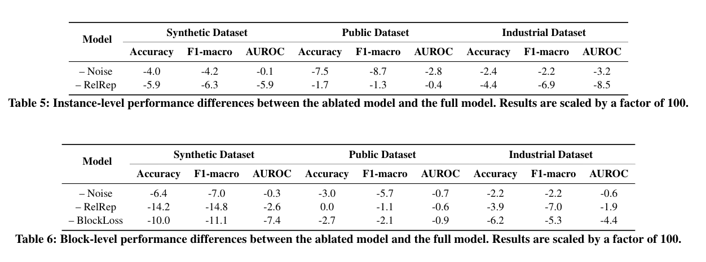
Experiment
ILS IUB

Slide 8
Findings
ILS IUB
GAN-based models perform best among the baselines.
Our model displays larger advantages for block-level. detection. Clearly, the block-level anomaly detection gets more benefits from our unified multiscale approach.
Adding noise clearly improves the generalization performance.
Relative Representation of Instance enriches the information extracted at high level.
The block loss adds detection of the collective patterns to our model, which is of great importance for detecting block-level anomaly.

Slide 9
Future Work
ILS IUB
Online incremental learning to deal with streaming data.
Large-scale distributed data process.
Anomaly detection on more complex data, i.e. on hour / day level.

Slide 10
Thanks!!
Email: gao27@indiana.edu!

