Slide 1
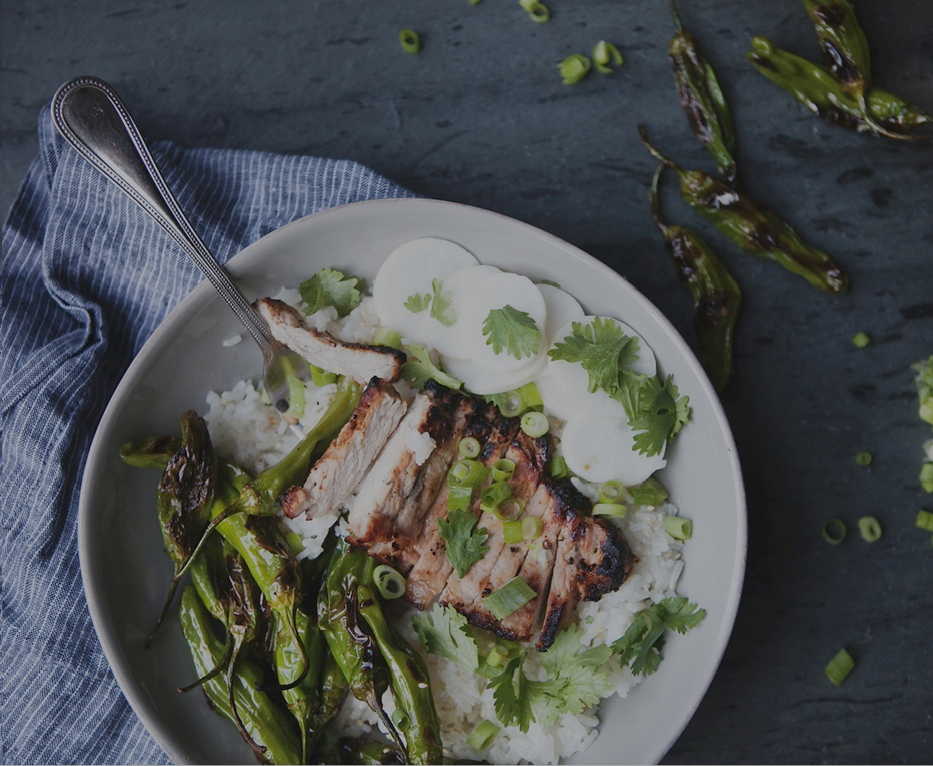
Recipe2Go
Developers: LeeAnna Misterek, Sherry Bao, Michelle Ryan

Slide 2
Recipe2Go Concept vs. Actual
Concept: Integrated recipe search and grocery list with estimated cost application
Search recipes
Select the recipe(s)
Add to the Grocery List
Estimate cost of grocery list based on Walmart prices
Actual: Recipe search with estimated cost for 1 recipe selected
Search recipes
Select a recipe
Add to Walmart Cart

Slide 3
High Level Process Flow

Slide 4
Technologies
2 API’s: recipepuppy API, Walmart API
Recipepuppy API: Retrieves 10 recipe objects from various recipe web sites base on a list of ingredients and/or recipe type
Object contains: title, url, ingredients, thumbnail
Walmart API: Retrieved product information in the form of an object, used in the Recipe2Go app to get the prices of the ingredients list
Libraries: bootstrap, google fonts, animate.css, ajax, scrollreveal, jquery, firebase
Firebase DB: Used to keep track of the last 3 searches and display to user

Slide 5
Key Learnings
If you have having trouble using an API or library, find another one to use
Started with a vision but had to make it much simpler to stay on track
Ask advice of Teachers and TA’s often for help and guidance
Break features down to the smallest task to get working and then build from there
Fun to work in a group, paired programming was really useful
GIT version control can be confusing, frustrating, make you want to throw your computer at the wall – it takes practice
Bootstrap can conflict with other styling libraries you are trying to use
There are important differences between jQuery and Javascript
Had to use Javascript ‘CreateElement’ to ensure it would create a brand new div and not append to previous div’s created
Firebase is tricky – database structure is important

Slide 6
Future additions
Grocery List
Saving of Recipes
User Login
Ability to get ingredient portions from recipes
Filtering of price results returned for an item – currently just taking the lowest price to display for user

