Slide 1
Figures: Modified Poisson Boltzmann Model

Slide 2
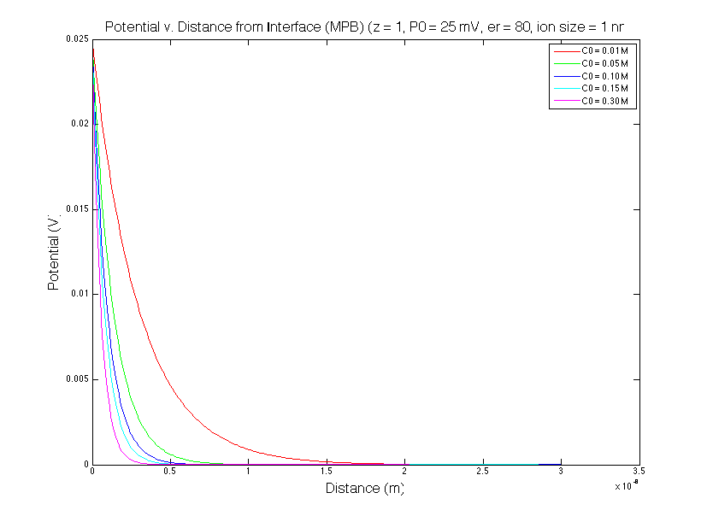
Potential | Bulk Concentration

Slide 3
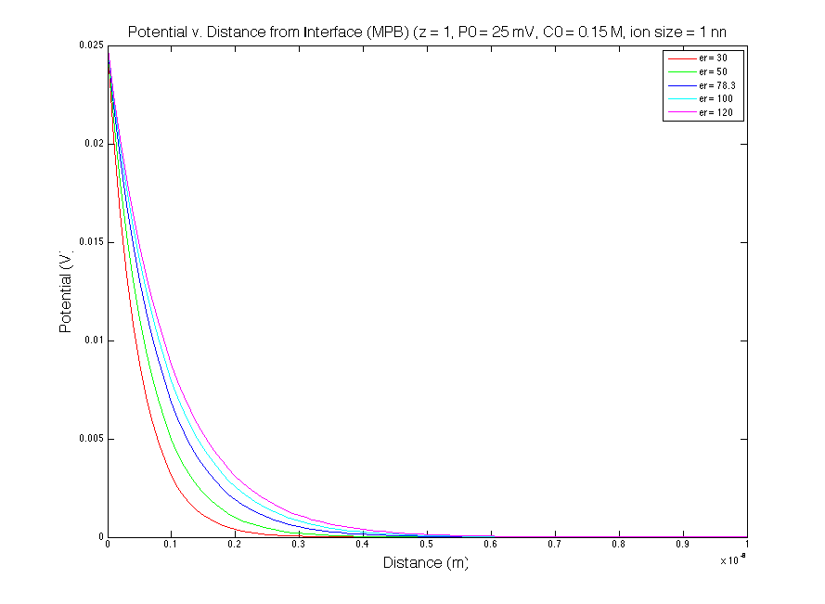
Potential | Relative Permittivity

Slide 4
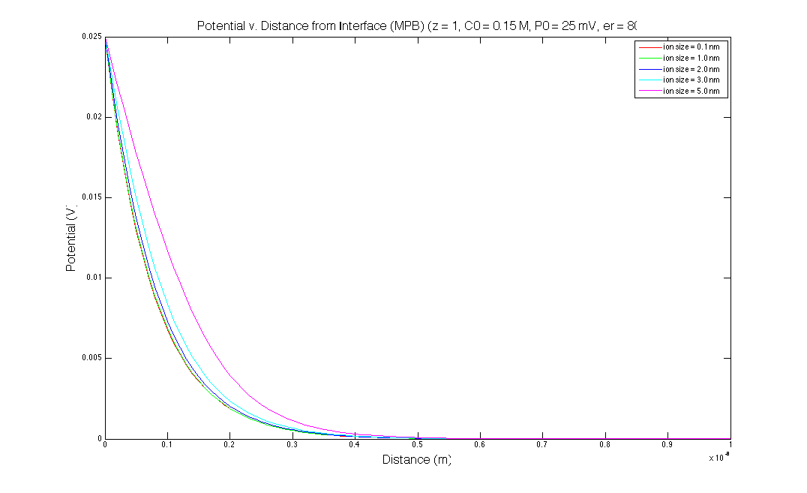
Potential | Effective Ion Size

Slide 5
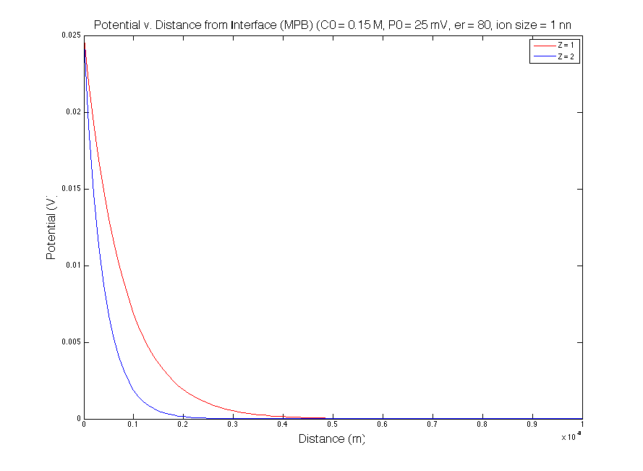
Potential | Valence

Slide 6
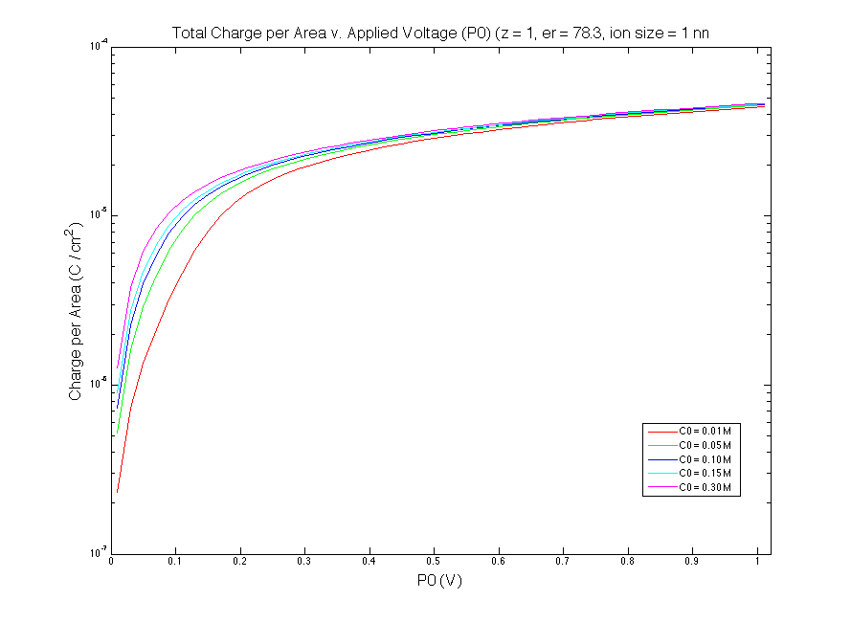
Total Charge | Bulk Concentration

Slide 7
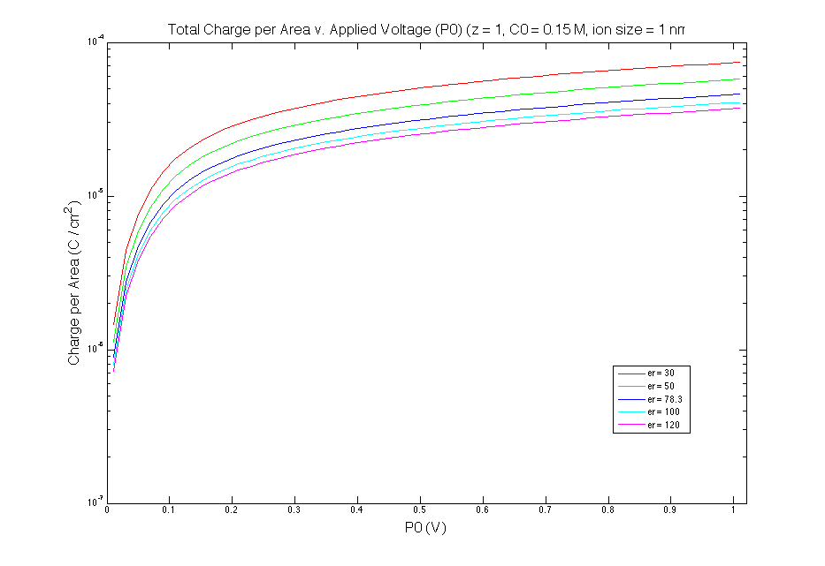
Total Charge | Relative Permittivity

Slide 8
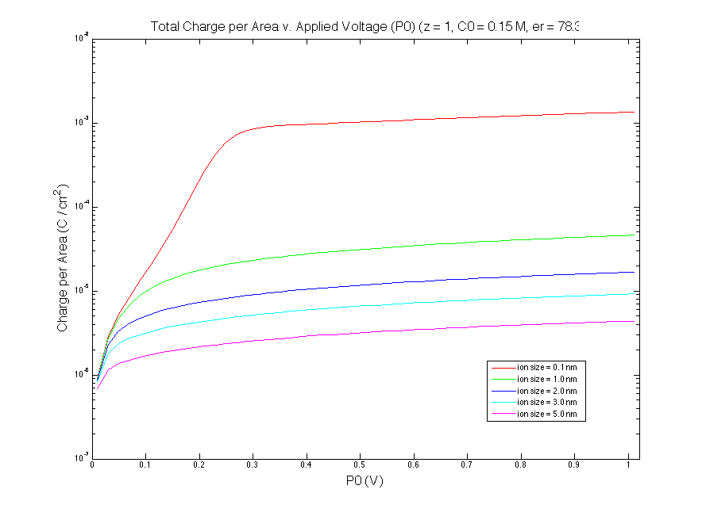
Total Charge | Effective Ion Size

Slide 9
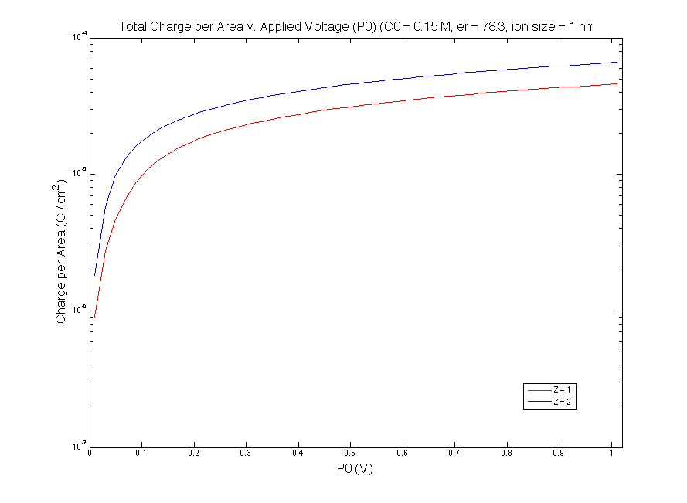
Total Charge | Valence

Slide 10
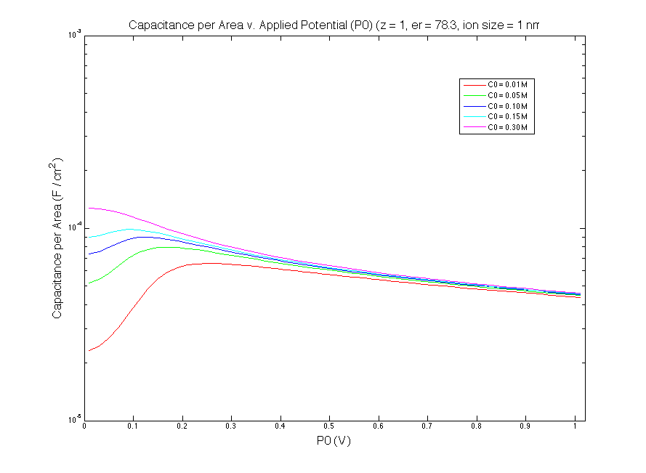
Capacitance | Bulk Concentration

Slide 11
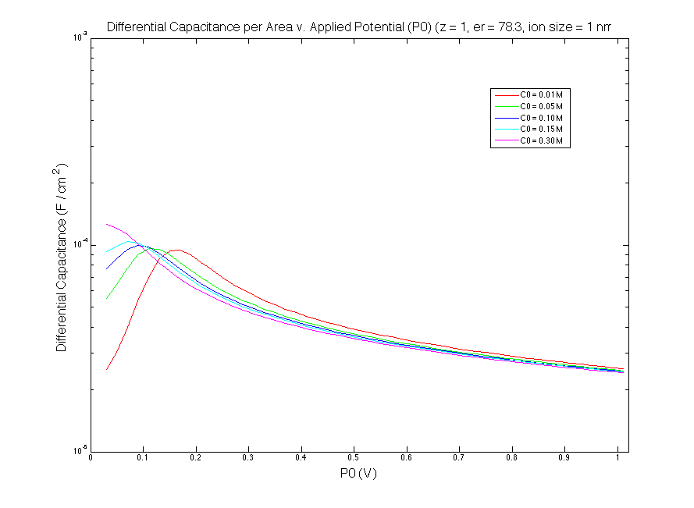
Differential Capacitance | Bulk Concentration

Slide 12
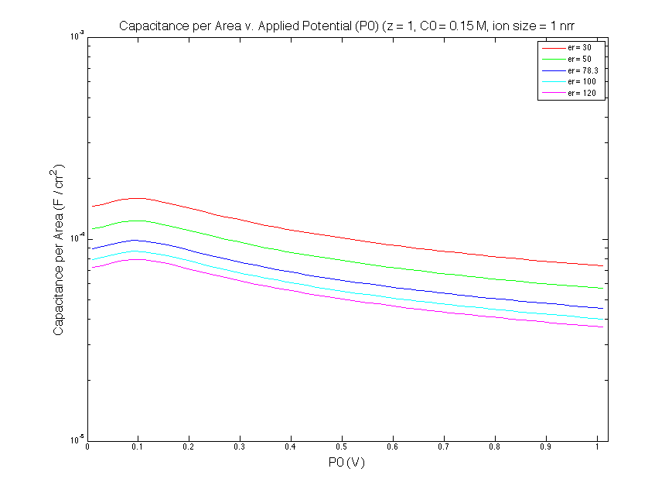
Capacitance | Relative Permittivity

Slide 13
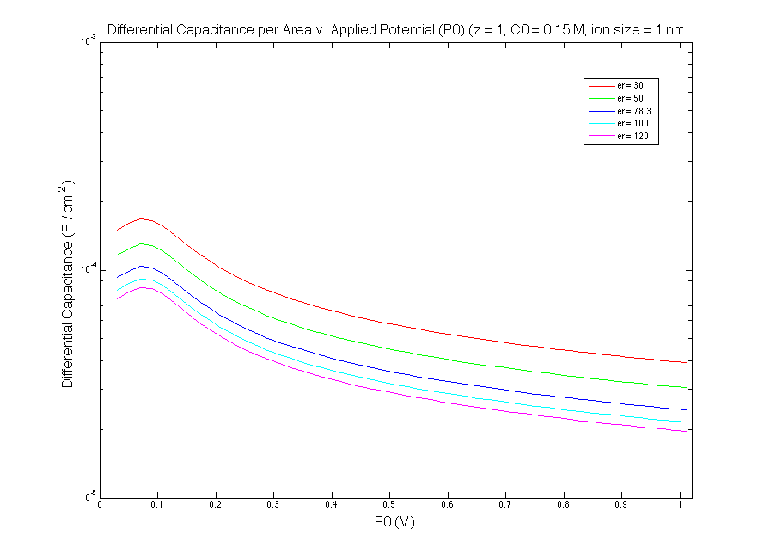
Differential Capacitance | Relative Permittivity

Slide 14
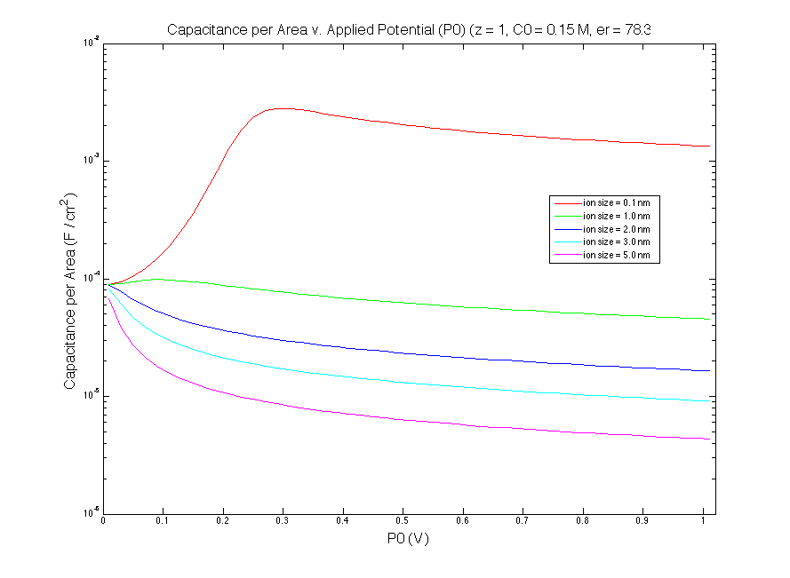
Capacitance | Effective Ion Size

Slide 15
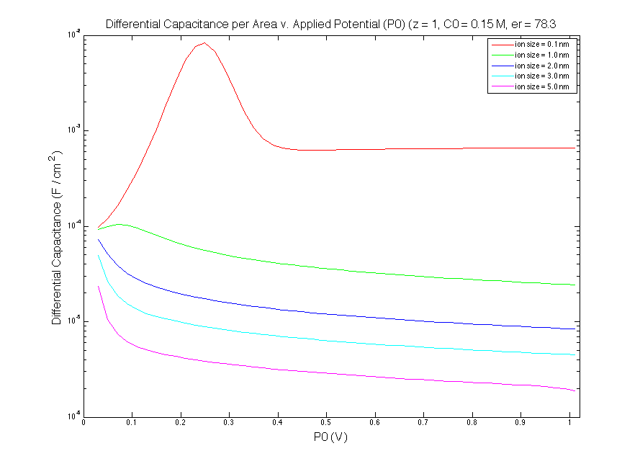
Differential Capacitance | Effective Ion Size

Slide 16
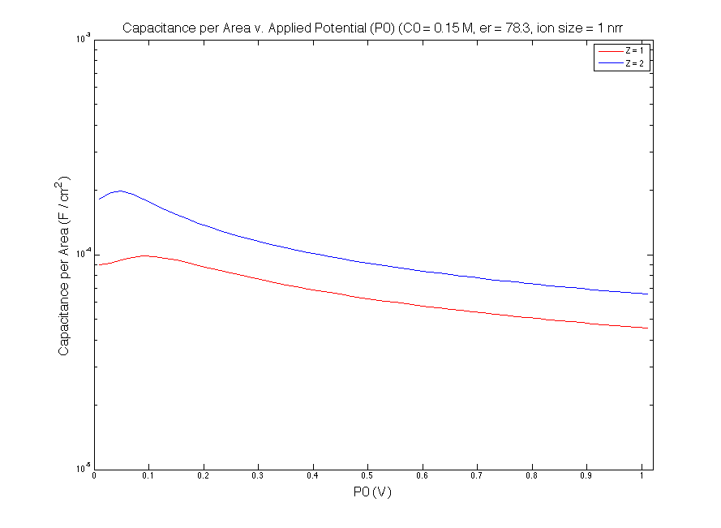
Capacitance | Valence

Slide 17
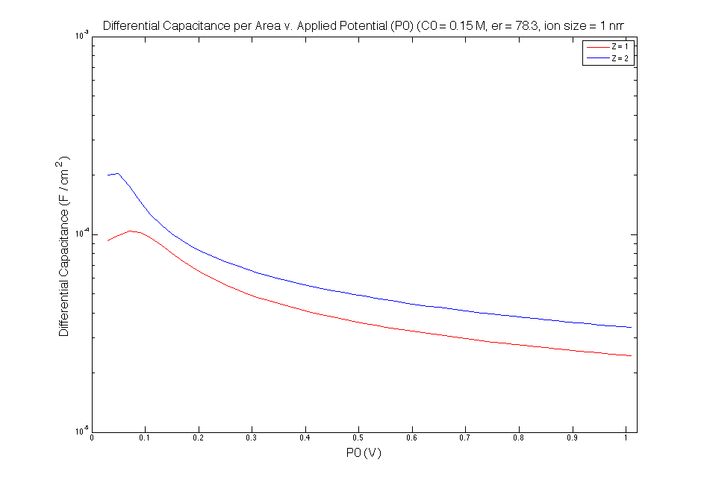
Differential Capacitance | Valence

