Slide 1
Figures: Modified Poisson Boltzmann Model

Slide 2
Part I: Electric Potential and Ion Concentration along Distance from Interface Applied Potential (P0) = 25 mV (PB and MPB values are roughly the same at this voltage)

Slide 3
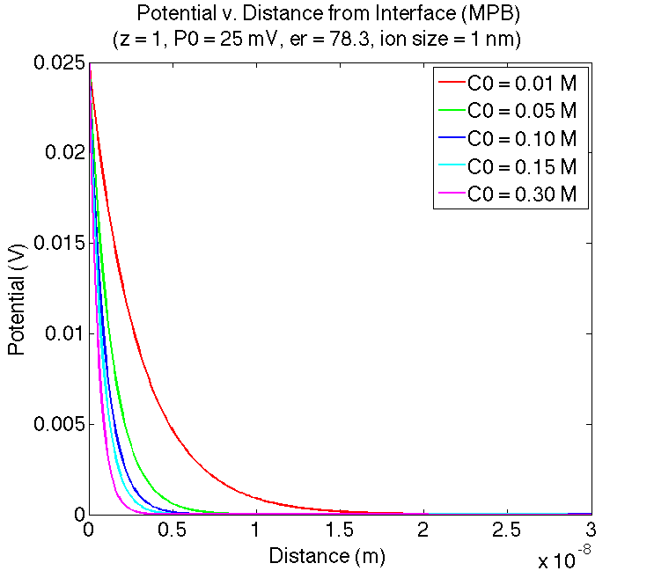
Potential | Bulk Concentration

Slide 4
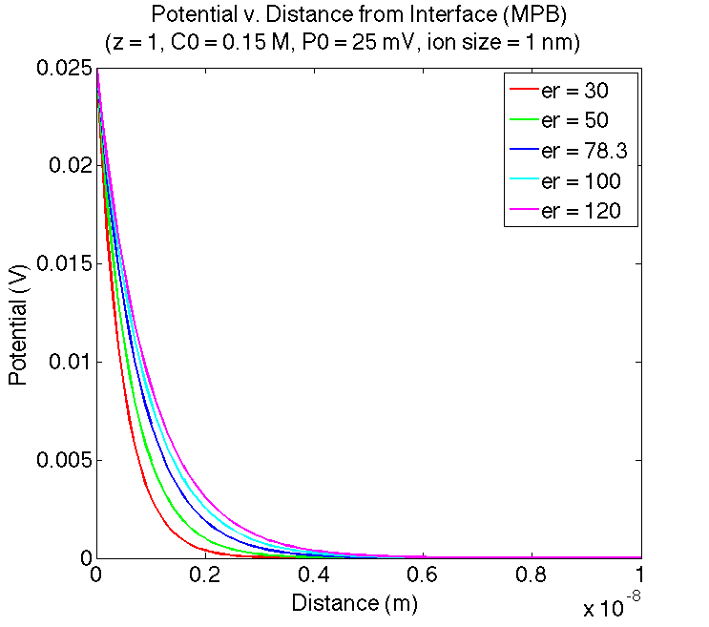
Potential | Relative Permittivity

Slide 5
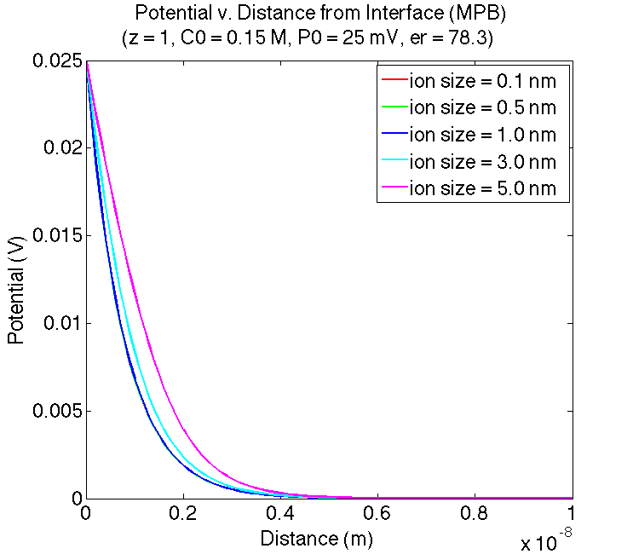
Potential | Effective Ion Size

Slide 6
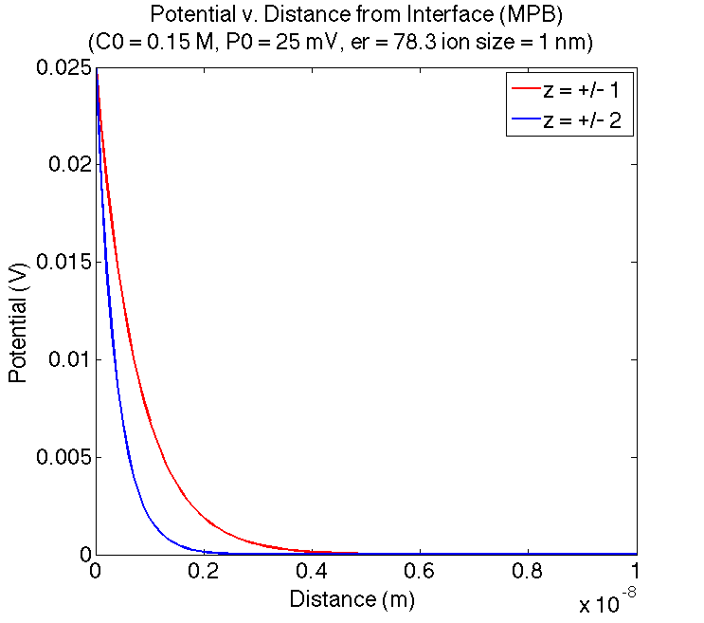
Potential | Valence

Slide 7
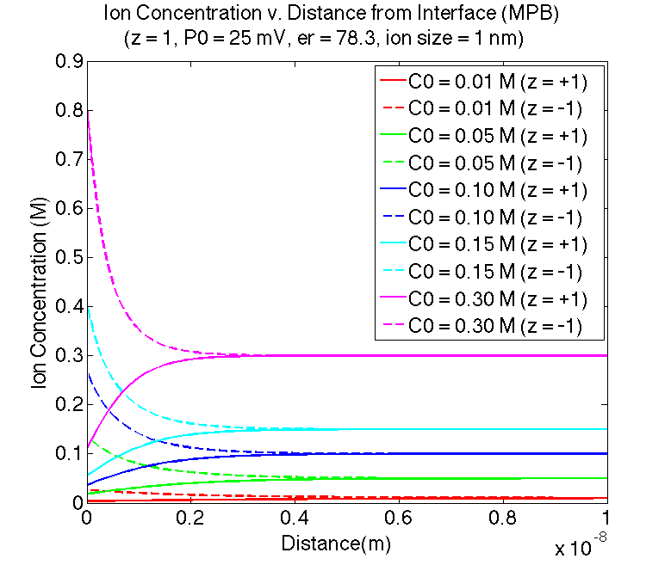
Ion Concentration | Bulk Concentration

Slide 8
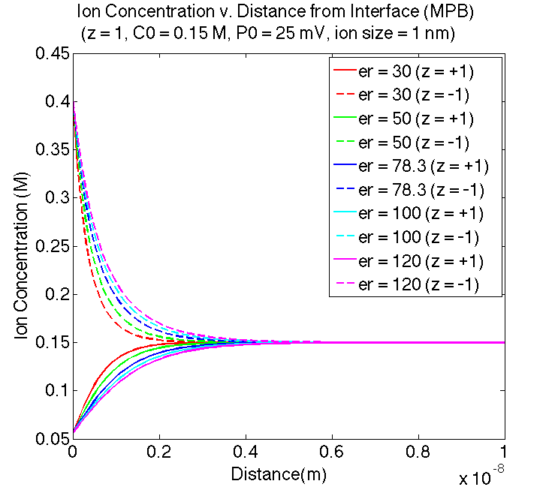
Ion Concentration | Relative Permittivity

Slide 9
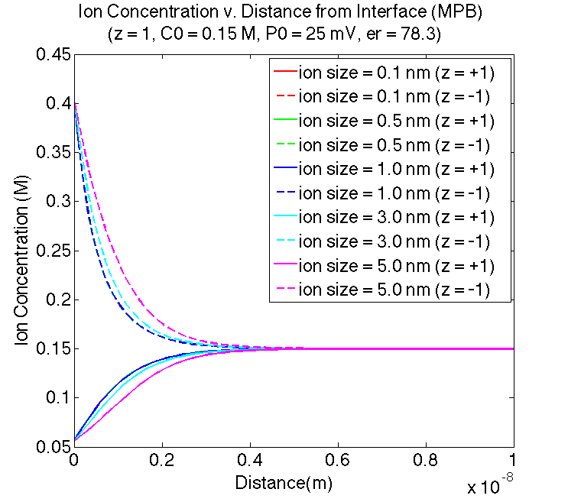
Ion Concentration | Effective Ion Size

Slide 10
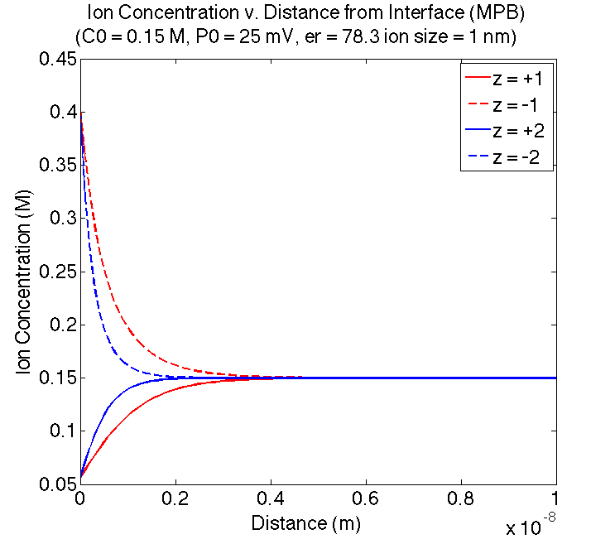
Ion Concentration | Valence

Slide 11
Part II: Total Charge and Capacitance of EDL at Varying Applied Potentials

Slide 12
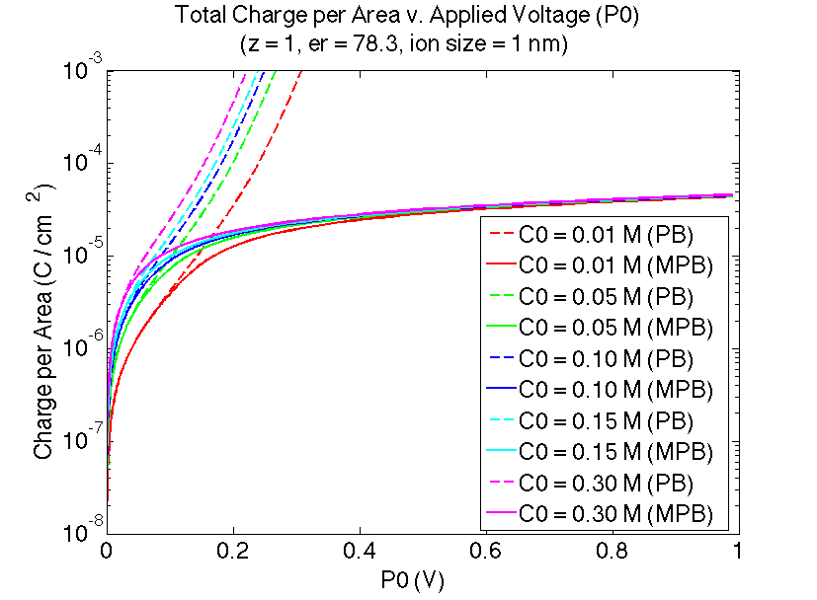
Total Charge | Bulk Concentration

Slide 13
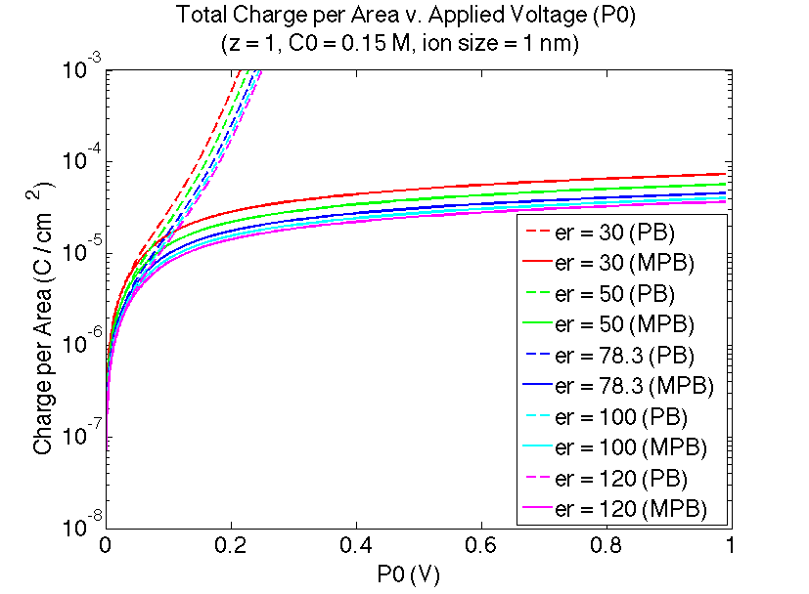
Total Charge | Relative Permittivity

Slide 14
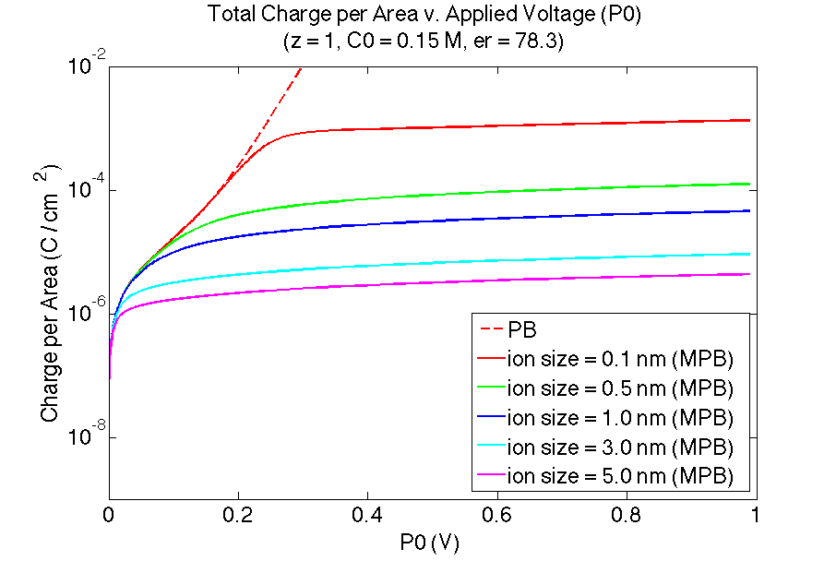
Total Charge | Effective Ion Size

Slide 15
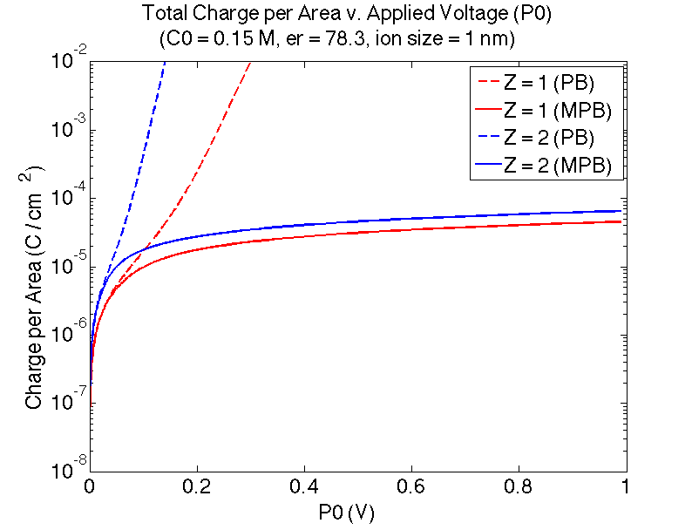
Total Charge | Valence

Slide 16
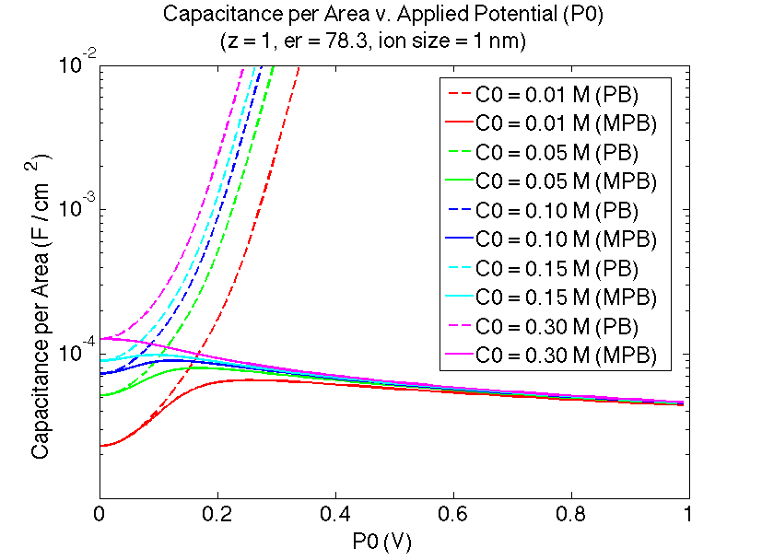
Capacitance | Bulk Concentration

Slide 17
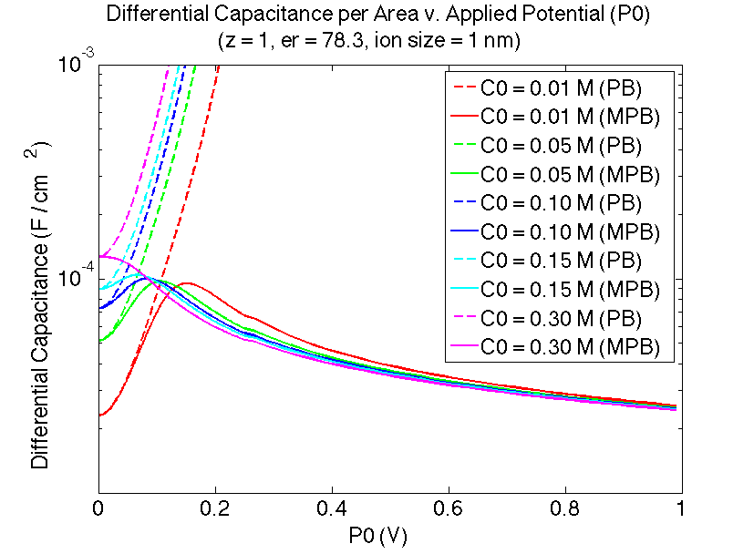
Differential Capacitance | Bulk Concentration

Slide 18
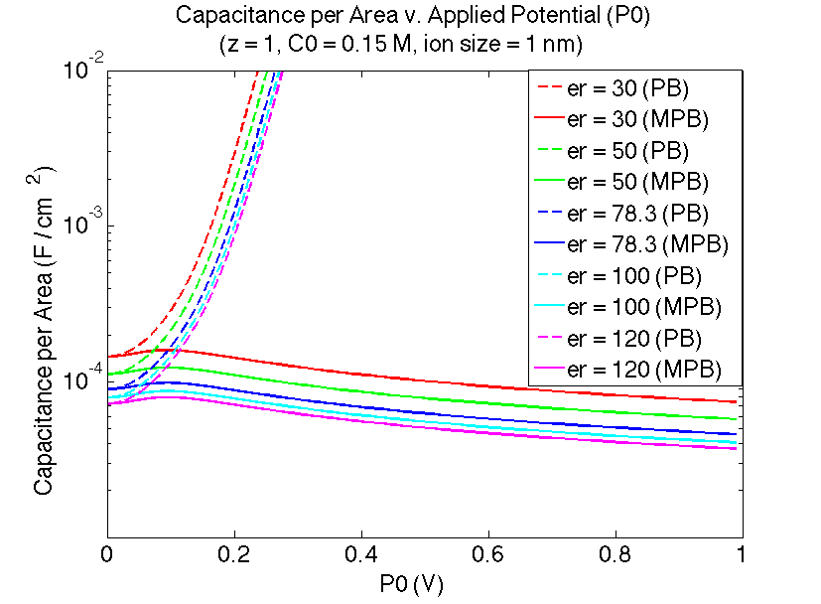
Capacitance | Relative Permittivity

Slide 19
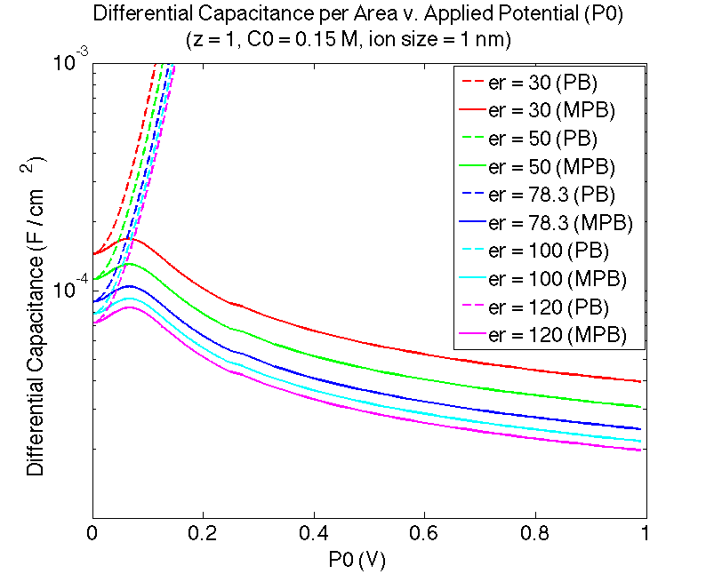
Differential Capacitance | Relative Permittivity

Slide 20
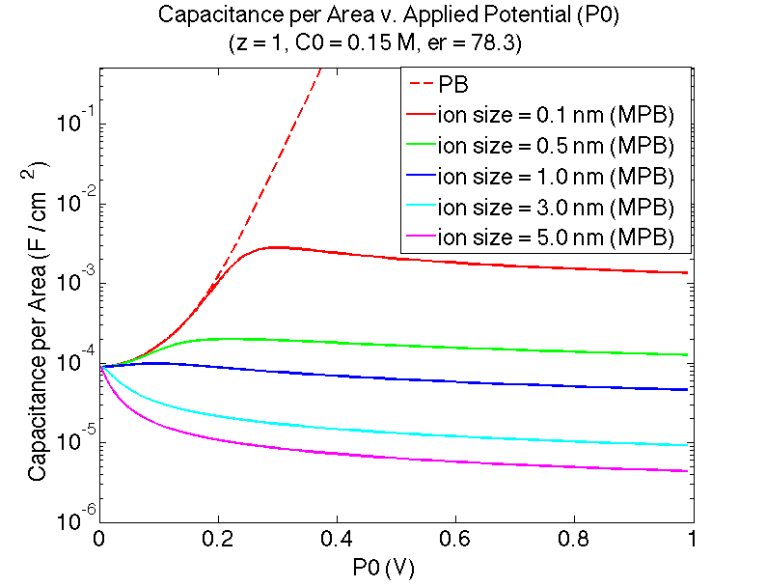
Capacitance | Effective Ion Size

Slide 21
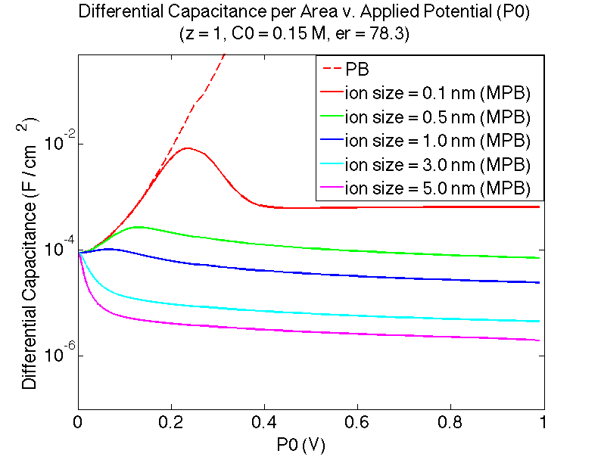
Differential Capacitance | Effective Ion Size

Slide 22
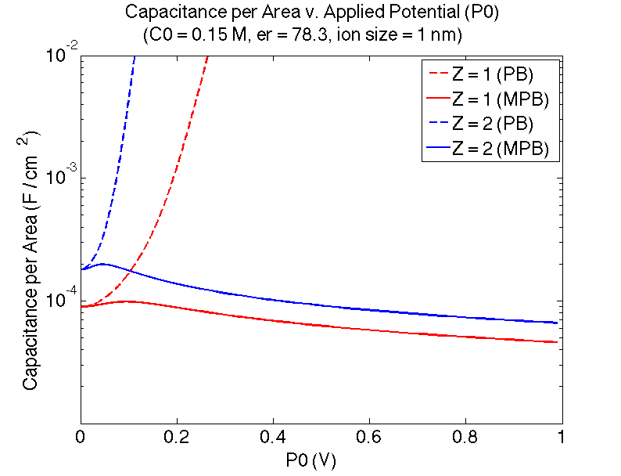
Capacitance | Valence

Slide 23
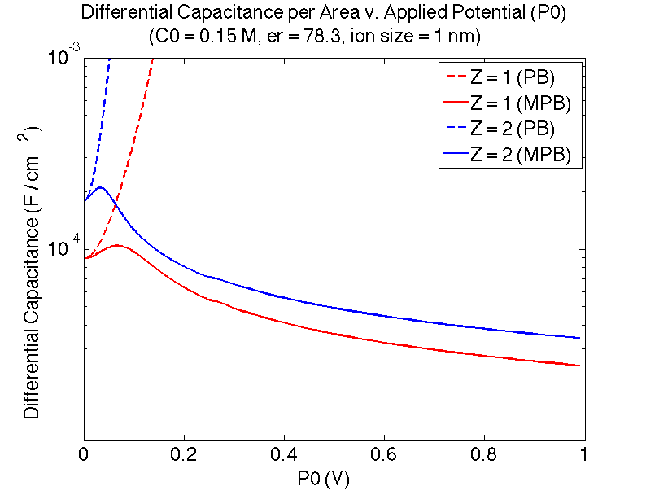
Differential Capacitance | Valence

