Slide 1
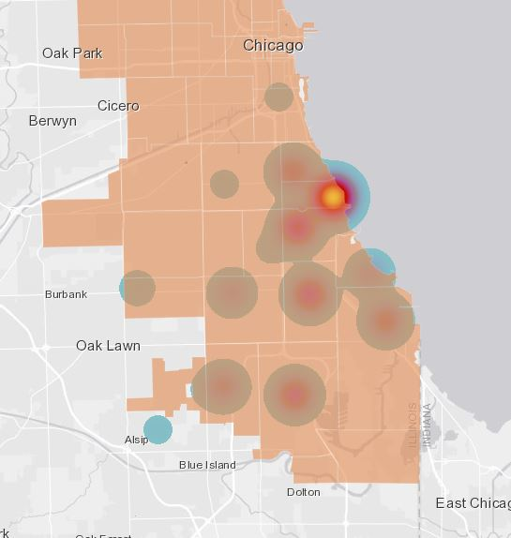
Potholes In My Data
Use the dropdown to filter by year
Chicago Pothole Data: 2011 - 2021
Click a Zip Code to filter dashboard

