Slide 1


Panther Professors
CPSC 408
Michelle Yoon

Slide 2
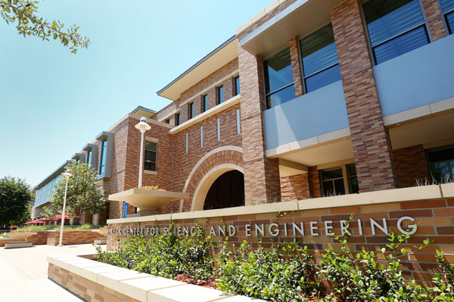
Problem
Inspiration: This was inspired by Rate My Professor. I wanted to tailor the application to the Fowler School of Engineering.
Problem: Rate my professor isn’t always updated. For example, the professor is no longer teaching, the course name is changed, etc.

Slide 3

Solution
Solution: I wanted to create an application that would accommodate the Fowler School of Engineering and help any students who would like to know more about the professor and the student experiences in those classes.

Slide 4
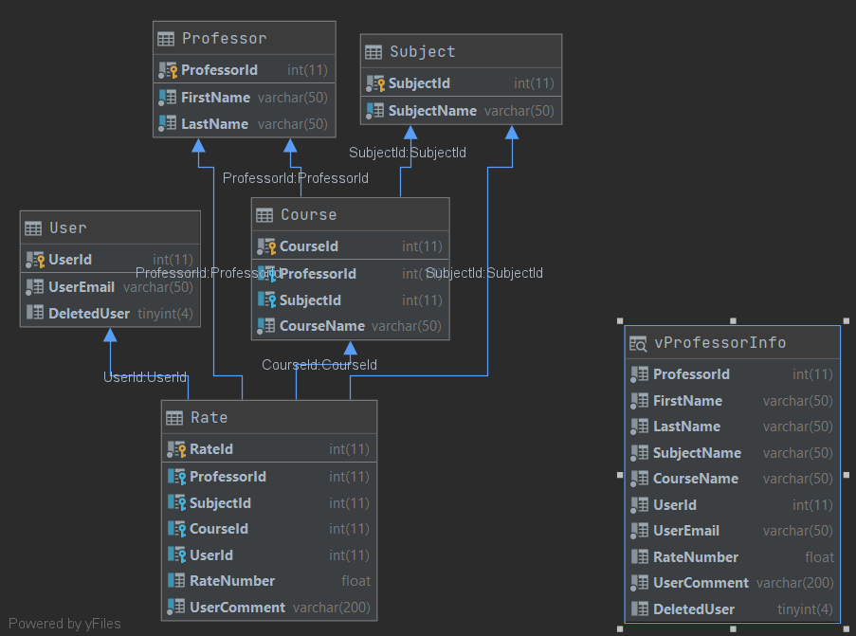
Schema
Diagram

Slide 5

Demo Time

