Slide 1
Final Project Report (Week 18) PE06
Student 1 Tan Jia Wei(2202129I)(20)
Student 2 Lim Kim Ze Michell(2201198E)(11)
P03 – Grocery Sales System

Slide 2
Demo Flow
Demo Tasks | By Who
Introduction | Student 1
Work Distributions | Student 2
Final Class Diagram | Student 2
Final Story Board | Student 1
Project Demo Part 1 | Student 2
Project Demo Part 2 | Student 1
Conclusion | Student 2

Slide 3
Introduction
Project Objectives:
Develop a Java application that helps cashier staff at Joy Minimart to capture customer purchase transactions. The system should allow staff to login to record purchased items of the customers, edit and delete the orders entered and save the item details into a data storage.
The manager should also be able to login to create grocery items with price, edit and delete the grocery items in the menu and save the created items and their details into the data storage.
In addition, the manager should also be able to view the sale summary and item details of each order, calculate total sales and keep track of items in the inventory.

Slide 4
Tasks Allocation/Work Distribution
Tasks | Done by (who) | Completion(Y/N) | By When
PPT/Objective | Michell | Y | 16/08/2023
PPT/Conclusion | Jia Wei | Y | 16/08/2023
PPT/Work Distribution | Michell | Y | 16/08/2023
Use Case Diagram (1a) | Jia Wei | Y | 16/08/2023
Use Case Diagram (1b, 2) | Michell | Y | 16/08/2023
Domain Class Diagram (Staff, Order) | Jia Wei | Y | 16/08/2023
Domain Class Diagram (Manager, GroceryItem) | Michell | Y | 16/08/2023
GUI Design/Code for 1a | Jia Wei | Y | 16/08/2023
GUI Design/Code for 1b | Michell | Y | 16/08/2023
GUI Design/Code for 2b, 2d | Jia Wei | Y | 16/08/2023
GUI Design/Code for 2a, 2c | Michell | Y | 16/08/2023
TEST Grocery Sales System Code | Michell | Y | 16/08/2023
PPT for Use Case Diagram | Michell | Y | 16/08/2023
PPT for Final Class Diagram | Jia Wei | Y | 16/08/2023
PPT for Final Storyboard | Michell | Y | 16/08/2023
PPT/Project Demo 1a, 2a, 2c | Jia Wei | Y | 16/08/2023
PPT/Project Demo 1b, 2a, 2c | Michell | Y | 16/08/2023
Submission of Report | Michell | Y | 16/08/2023
Submission of PPT(Powerpoint) | Michell | N | 16/08/2023

Slide 5
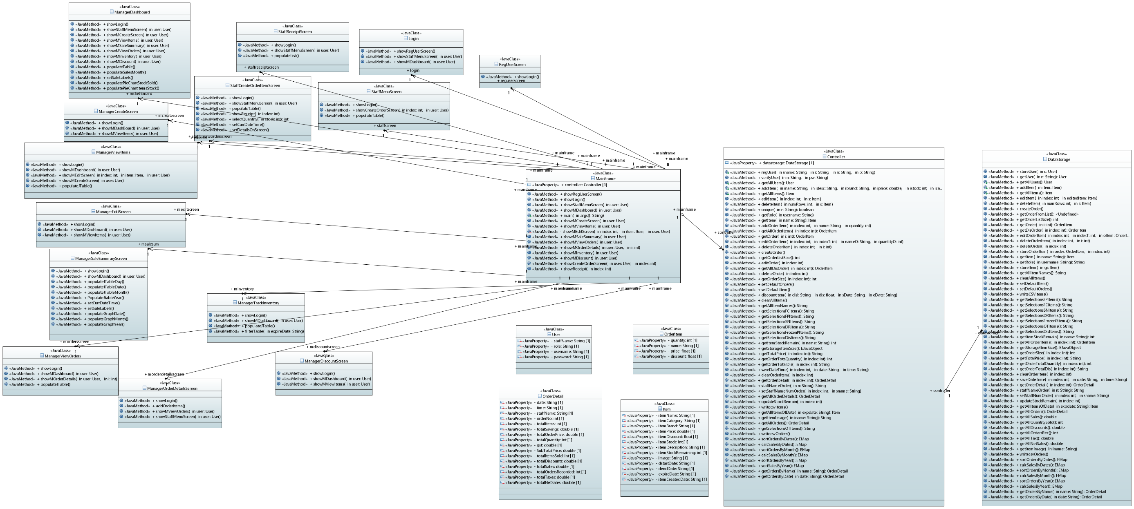
Final Class Diagram

Slide 6
Model : 5 View: 14 Controller: 2

Slide 7
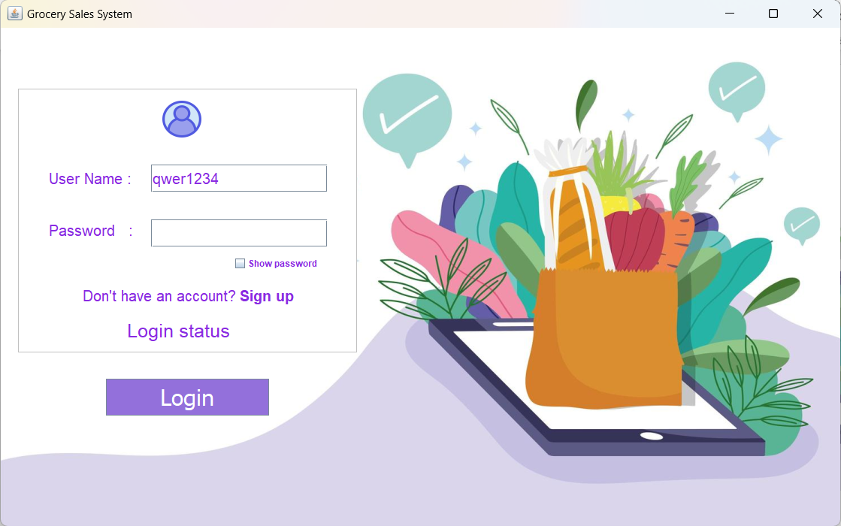
Final Story Board (Project Screenshots)
Login Screen
Username is shown in string and unique.
Password is hidden.
When login is pressed, if an account is already made, user will be directed to either a manager dashboard screen or staff menu screen based on role. Otherwise, login status will display “Invalid”.
User can then click on “Sign up” to bring them to registration page.

Slide 8
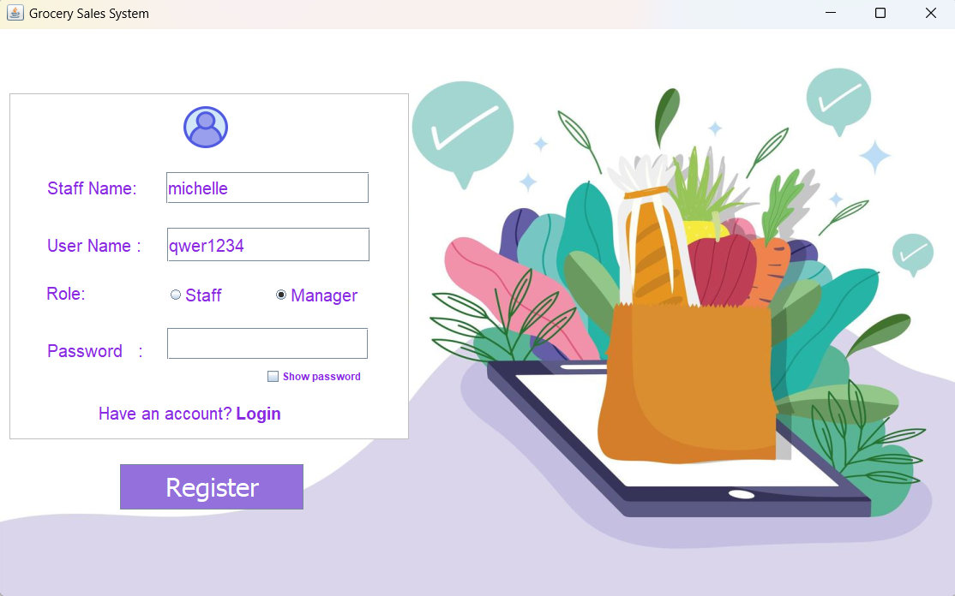
Register User Screen
Staff name is entered in string.
Only 1 role can be selected during registration .
Username is entered in string and is unique.
Password is hidden when entered.
If user already has an account, clicking on “Login” can bring user to login screen. Otherwise, clicking on register button will register the new user’s account and automatically bring them to the login page.

Slide 9
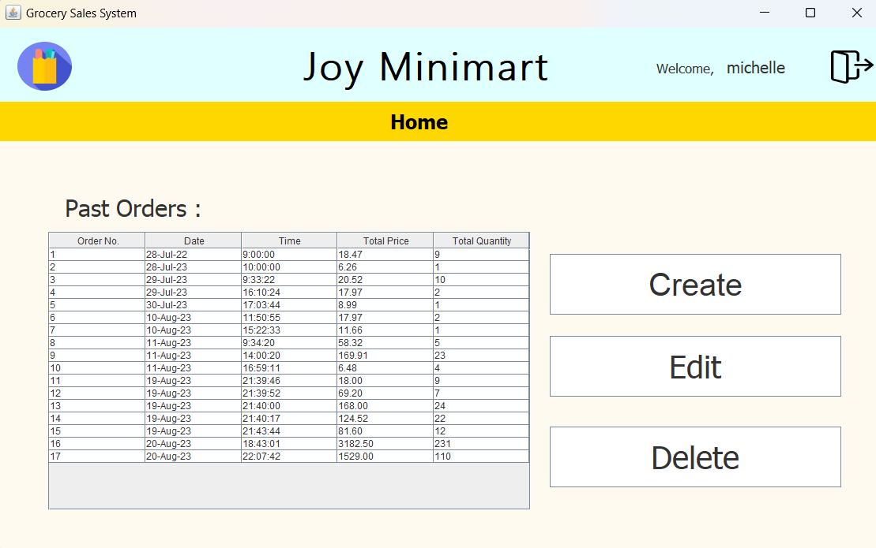
Staff Menu Screen
Past orders is shown in the Jtable below. When create button is selected, staff create order screen is shown. When edit button is selected, staff edit order screen is shown. When delete button is selected, the row in the jtable that is selected by the user is deleted.
Only from Staff Menu Screen, clicking on the top left blue icon, if user’s role is manager, user will be directed to Manager Dashboard, otherwise, user will remain on same screen.

Slide 10
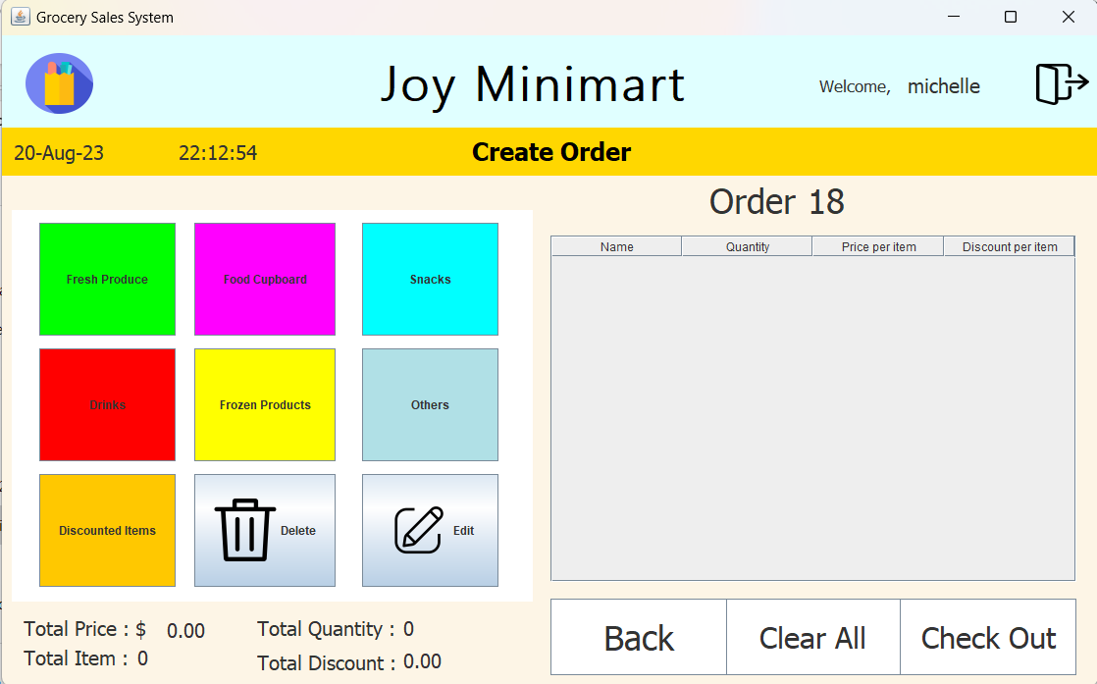
Create Orders Screen
To record items in the order, the cashier select the category of item they want then obtain the item to be recorded in the jtable.
When delete button is pressed, selected item in jtable is deleted. When edit button is pressed, edited orders can be saved.
Back will bring cashier to the staff menu screen. Clear all button will clear all items in jtable. When checkout is pressed, staff receipt screen is shown
Clicking on the top left blue icon will direct user back to Staff Menu Screen. This is applied to all staff screens(yellow) except for Staff Menu Screen.

Slide 11
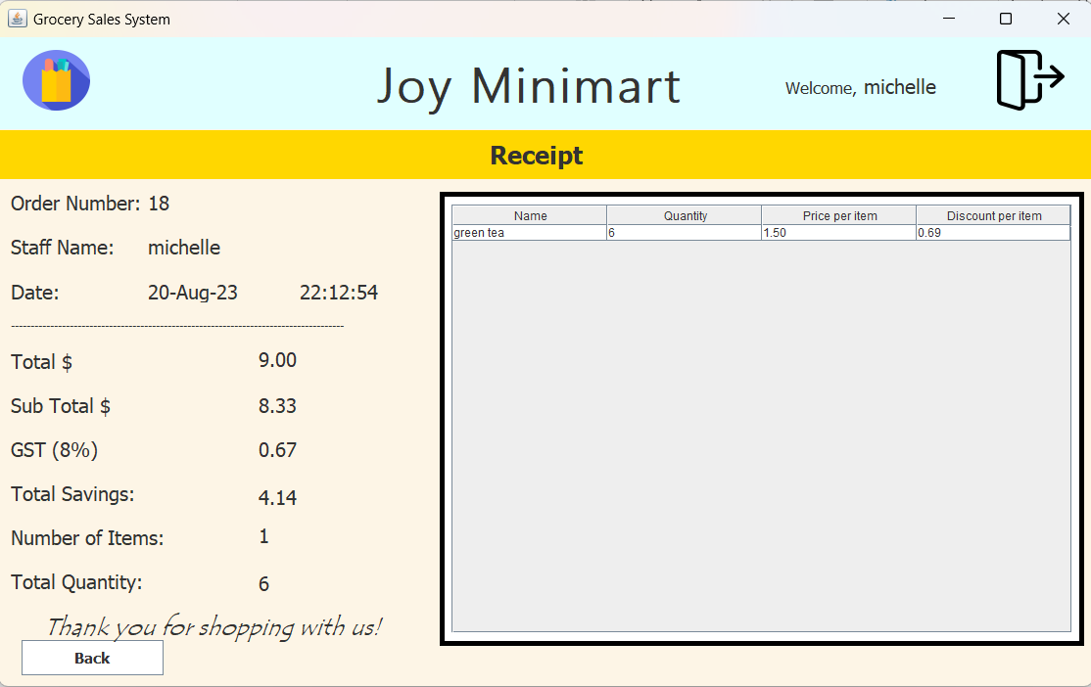
Receipt
Order details is calculated in the datastorage and populated in the labels. This is to display order’s Item(s) and the order details.

Slide 12
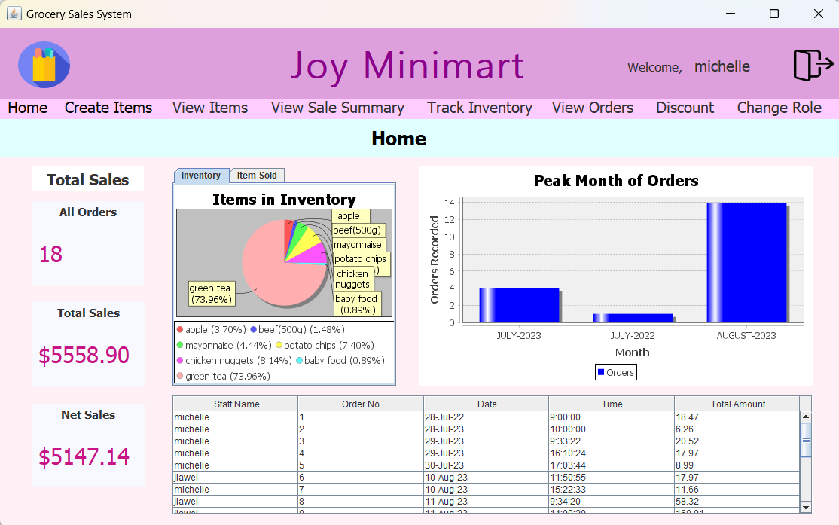
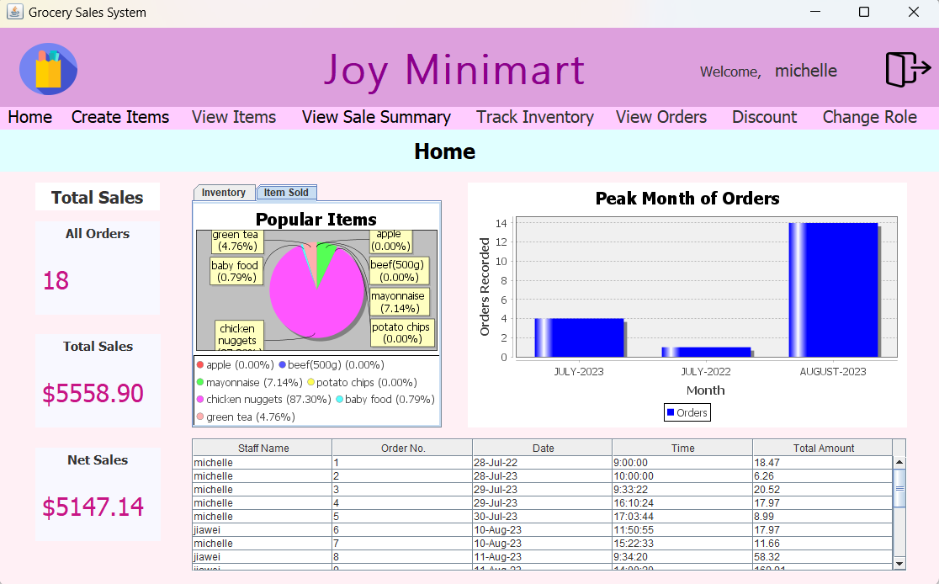
Manager Dashboard Screen
When user with a manager’s role logins, user will be directed to manager’s dashboard. The total sales displays the sum of all orders recorded, total sales of all orders, and net sales of all orders in a year.
The tabbed pane displays a pie chart for items in inventory and another pie chart for most popular items sold after staff creates order.
The bar chart shows the peak month of all orders recorded. The table shows recent orders which can direct user to view order details when clicked.
Clicking on the top left blue icon will direct user back to Manager Dashboard Screen. This is applied to all staff screens(yellow). Clicking on change role for manager can direct user to staff menu screen.

Slide 13
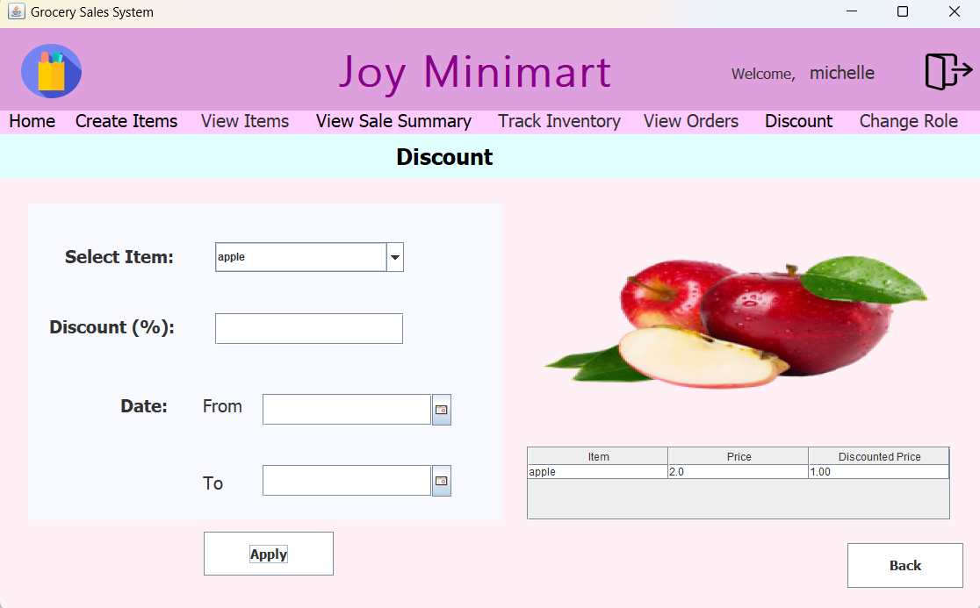
Discount Items Screen
Select item is a combobox will all the items in the datastorage – manager is able to select the item to apply discount on. Actionlistener is used when the manager select an item from the combobox and the item’s image is shown on the Jlabel for imageIcon.
Discount(%) is to allow manager to enter the percentage of discount for the item.
Using Jcalendar’s datechooser to get the date of ‘From’ and ‘To’.
When button for apply discount is pressed, a confirm message will appear to ask user to confirm. If user selects yes, discount is applied for selected item. If no, then discount is not applied.

Slide 14
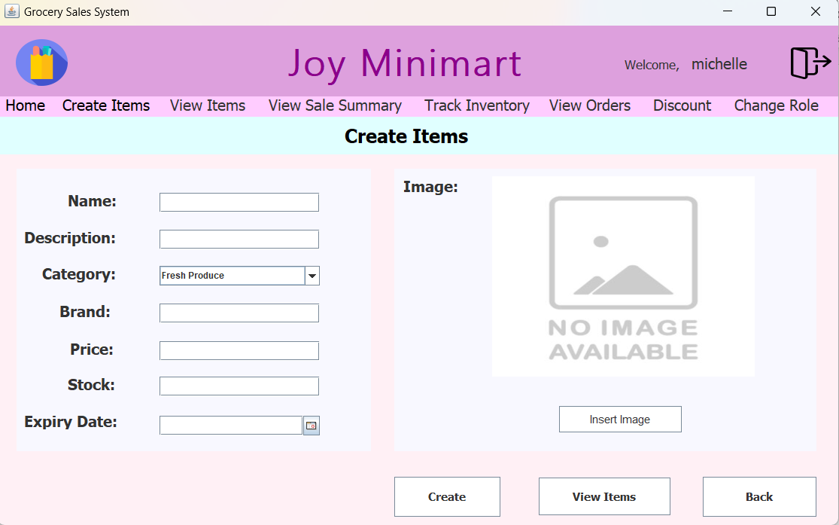
Create Items Screen
Manager will enter the item’s details.
When insert image button is pressed, the window will pop up to prompt the use to select the image file. After selecting the file path, the no image available is replaced with the image.
When “Create” is pressed, the textFields will be cleared and the category is set back to ‘Fresh Produce’.
When “View Items” is pressed, it will bring manager to the viewItem Screen.
When “Back” is pressed, manager’s screen will be brought to the manager’s dashboard.

Slide 15
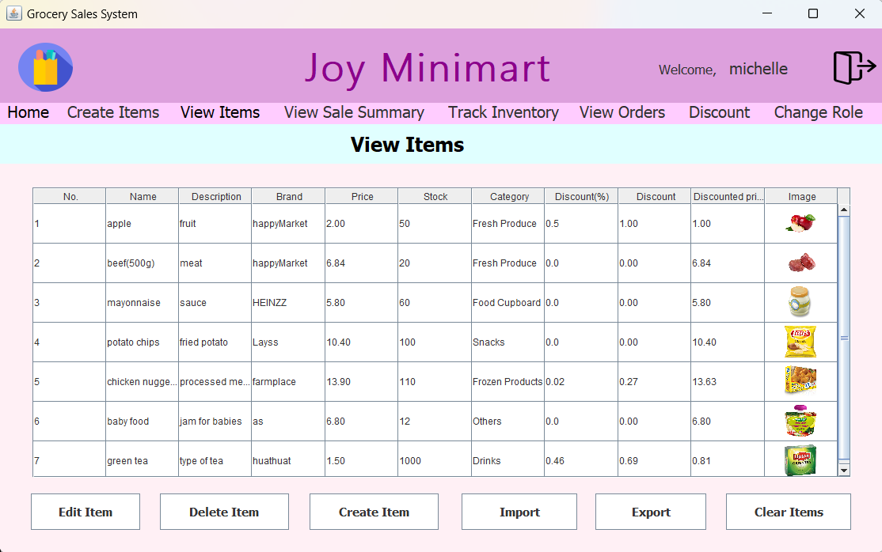
View Items Screen
The Jtable will display all the items in datastorage.
When,
“Edit Item” is pressed, bring manager to editItem Screen. However, if no row is selected, JOptionPane will pop up a message to prompt manager to select a row to edit.
“Delete Item” is pressed, the selected row ‘s item will be removed from the dataStorage. However, if no row is selected, JOptionPane will pop up a message to prompt manager to select a row to delete.
“Clear Items” will clear all the items in the dataStorage using the removeAllElement().
“Import File” will read the file containing default values and saved in dataStorage.
“Export File” will take all the items stored in datastorage and write in the same file as the file use for import file. A confirmation message will show to confirm manager to export all orders

Slide 16
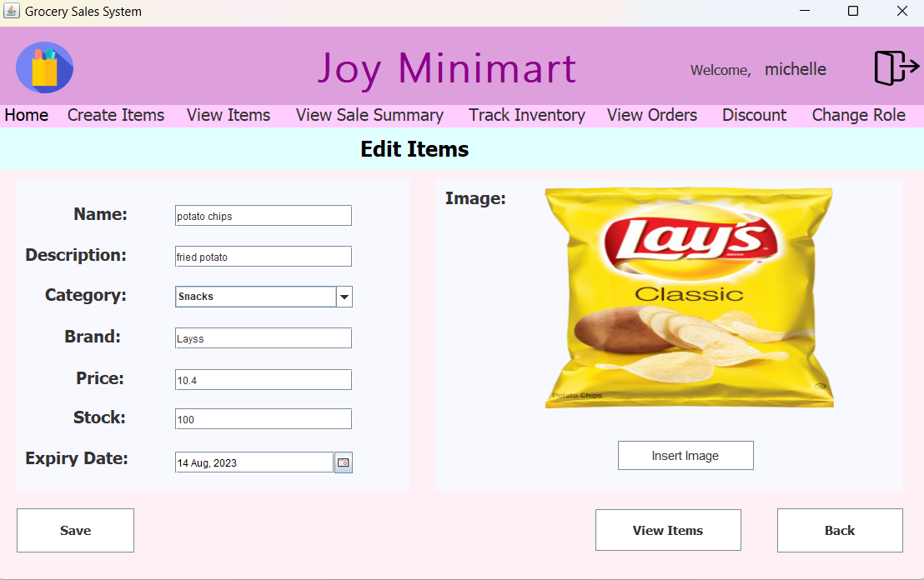
Edit Items Screen
After row is selected from Jtable in view items, edit item screen for the row will be displayed. Items can be edited similar to create item screen and saved.

Slide 17
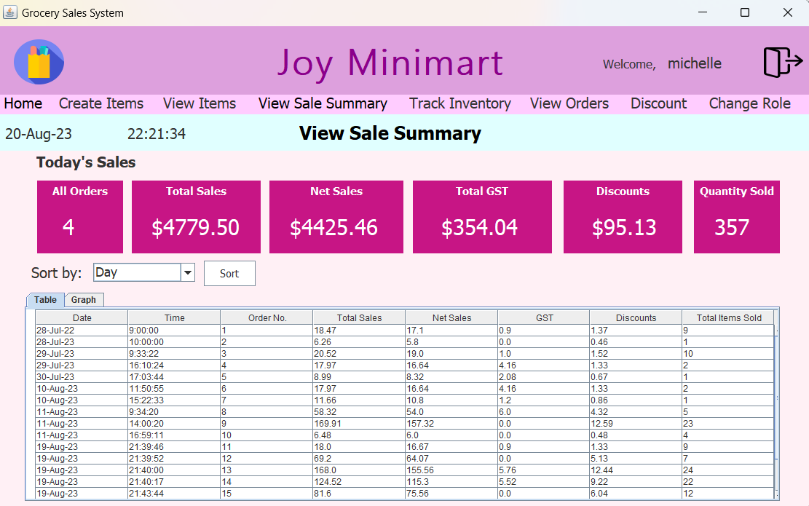
View Sales Summary Screen
tabbedPane is used to allow manager to view Jtable or graph.
Hashmap is used to sort out orders by day, date, month and year. It is also used to sum up orderdetails in the sorted orders together to be used as datasets for the table and graph. Graph also uses Jfreechart library to display line graph.
LocalDate is used to get current date and time, and to display values for today’s sales.
When table is clicked, user will be directed to view orders page for further order details viewing.

Slide 18
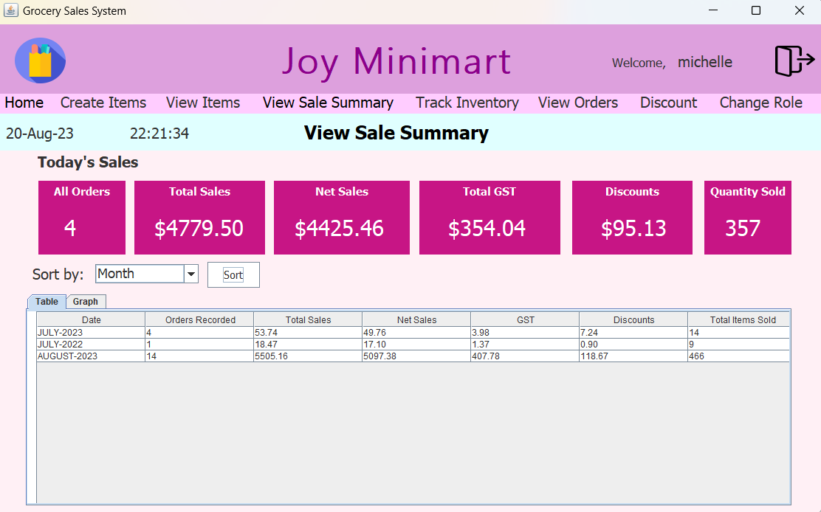
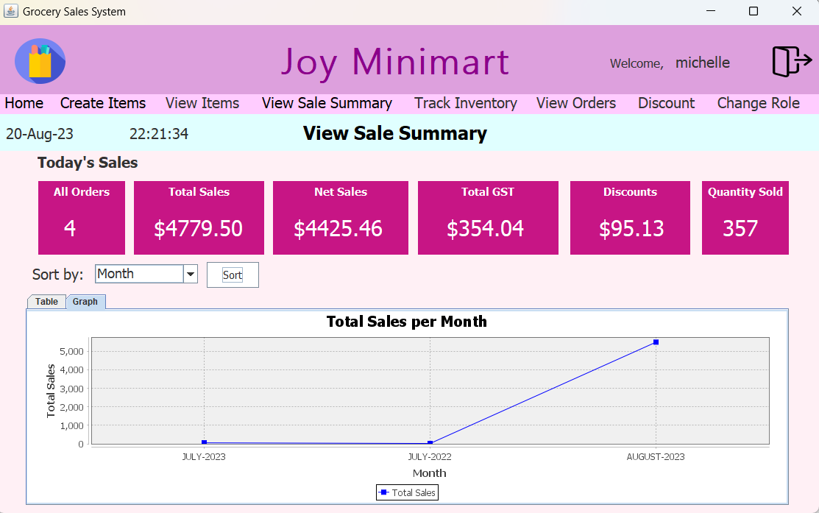
Under the today's sales, it will show the total sales for today.
User can select how user wants to sort the orders then click on sort button. The following sorted jTable and line graph will be displayed in the tabbedPane.

Slide 19
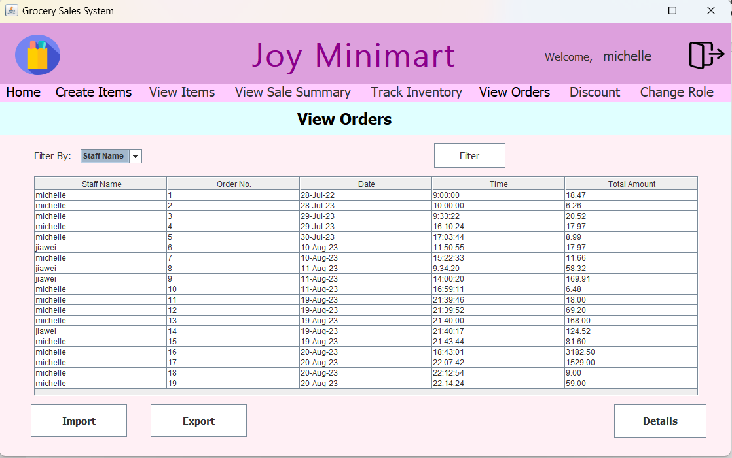
View Orders Screen
Jtable is populated by all orders in orderDList data. When a row is selected and detail button is pressed, the user will be brought to a screen to display order details.
"Import " button is pressed, setDefaultOrders is
called which will read from the csv file.
"Export " button is pressed, it will write all the orders in the orderList (store order items) and orderDList (store order details) into the csv file.
A confirm message will show when export button is pressed; only when Yes is selected, export will happen.

Slide 20
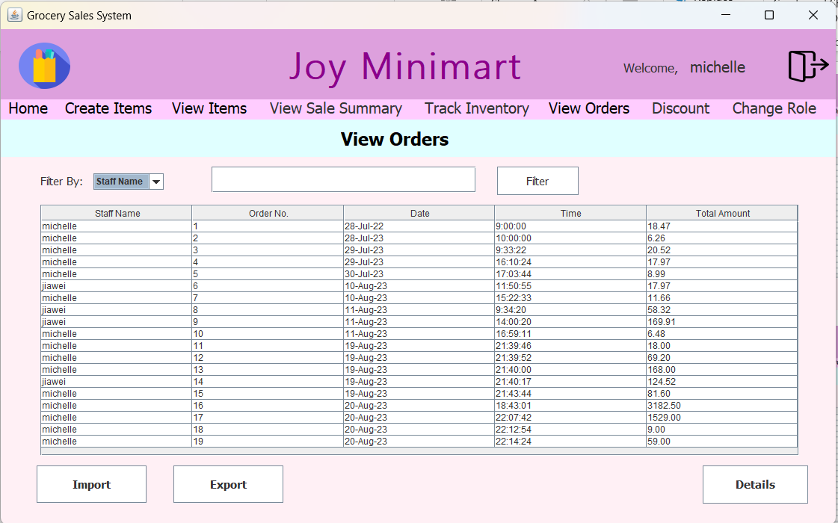
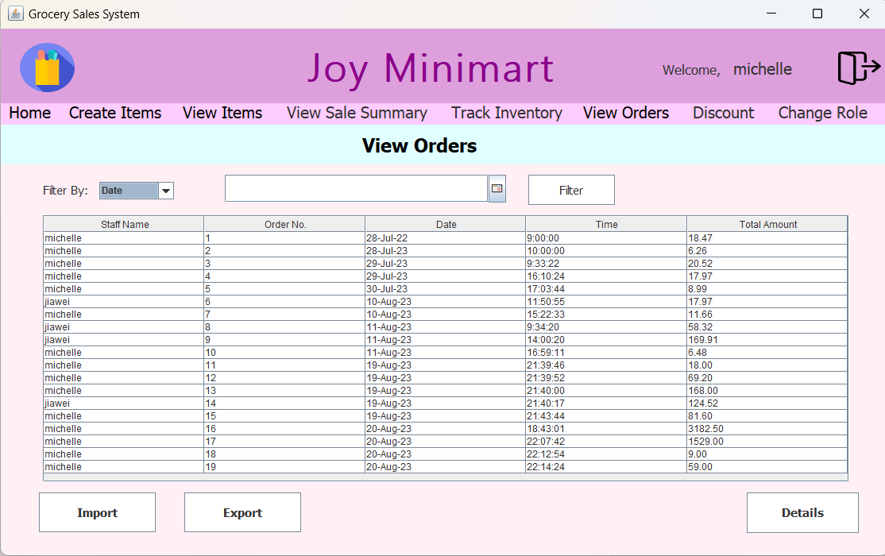
When "staff name " is selected, the textfield will show to allow manager to enter the staff name to filter the table.
When "Date" is selected, the datechooser will show to allow manager to enter the date to filter the table.

Slide 21
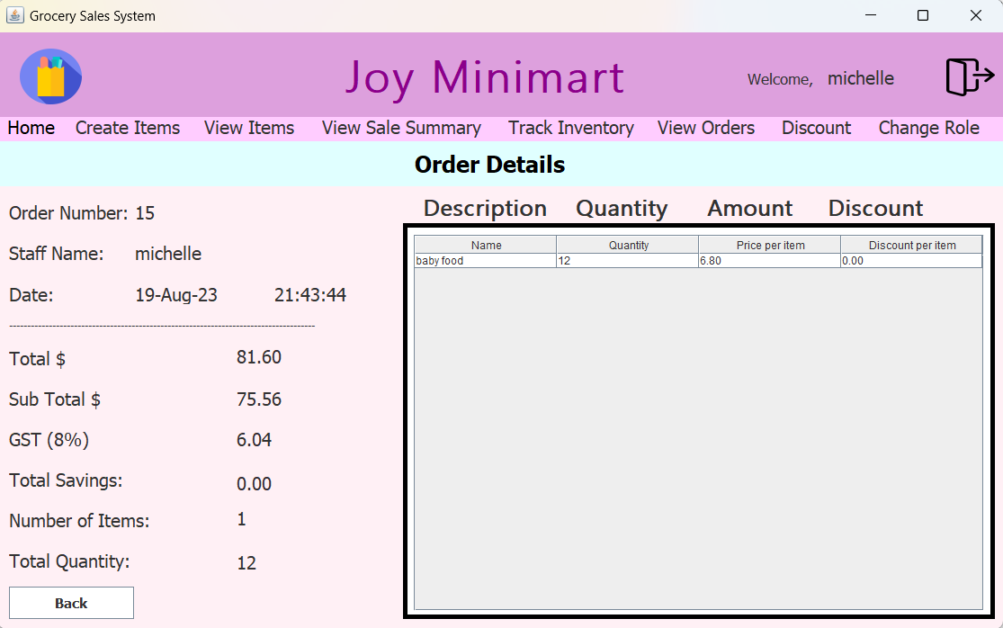
Order Details Screen
After viewing the selected order, manager can go back to the view orders screen by clicking the 'back' button.

Slide 22
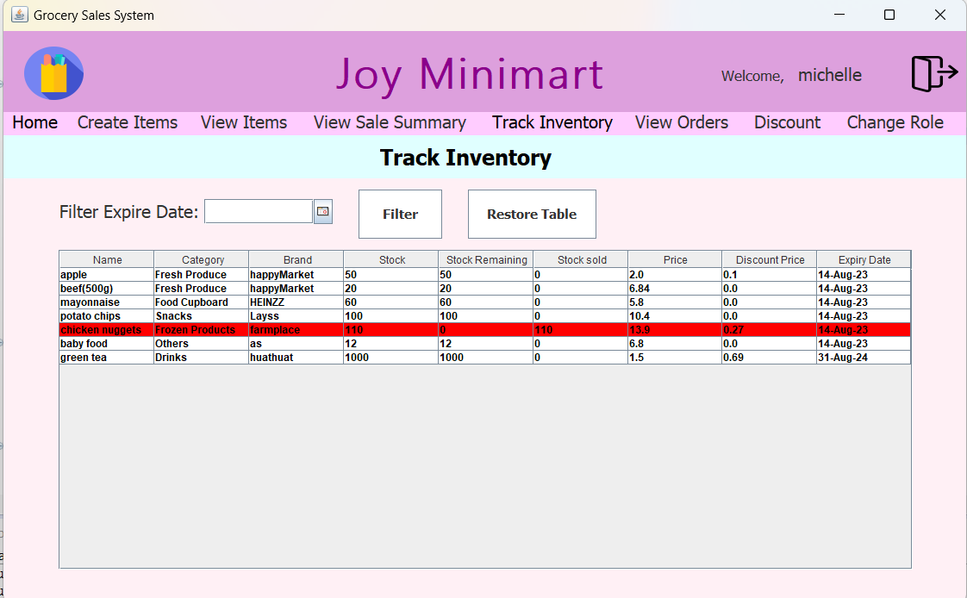
Track Inventory Screen
Jtable is automatically populated by item details from storageItem data. User can select an expiry date using the Jdatechooser, then pressing filter button to filter the expiry date of items. When restore table button is pressed, the jtable refreshes to populate all items again.
When an item have stock remaining of 0, the row will highlight in red.

Slide 23
Project Demo (Demo Starts here)
Student 1 to Demo Project
Student 2 to Demo Project

Slide 24
Conclusion
State two most important things you learned about OOP in this project.
Yes, we managed to meet all the objectives. There are a few limitations in our programs. Firstly, the graph does not look very visible and it only displays total sales per date. Secondly, the gui does not fit real world context of a minimart. Thirdly, order details cannot be viewed in View Order Screen.
Michell: I learned how to create an object-oriented program using java. I realised how convenient it was to focus coding around objects rather than logic. I also learned how to troubleshoot by using if-loops, try-catch, different exception errors, and printing statements.
JiaWei: I learnt how wonderful the java library can provide, from writing and reading files to using jcalendar and other libraries. I had fun playing around with the charts as well. I learn to customise the table, like color the row based on the value of the cell.

Slide 25
Instructions for Submission
Report Power Point filename: PE0x_Pyy_FinalReport.pptx
Zip the Project Workspace together with the pptx. Filename: PE0x_Pyy.zip (eg: PE01_P08.zip).
Upload to LMS ->Project -> Final Project Submission-> Zip file only.
Note
Java file codes should be properly documented with comments and headings.
Only one (member) submission per group in the LMS.

