Slide 1

JAVA PROGRAMMING
TEAM 9

Slide 2
MEMBERS
1
Nguyễn Đức Hiếu (Team Leader)
2
Trần Quang Phúc
3
Lương Trường Giang
4
Phạm Quang Dũng
5
Lê Hoàng Châu
6
Lê Gia Bảo

Slide 3
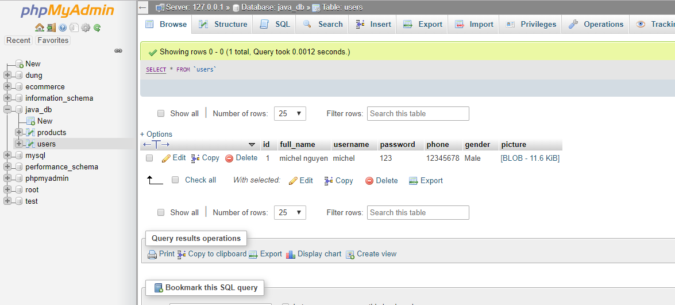
DATABASE

Slide 4

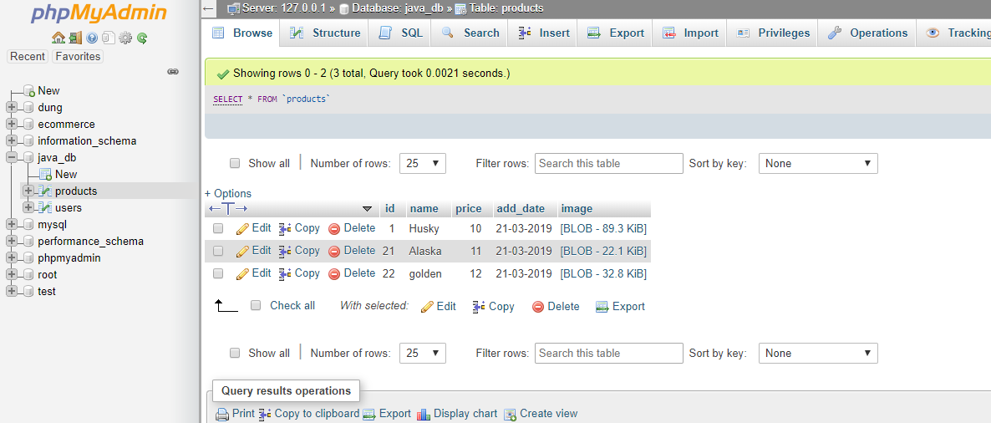
DATABASE

Slide 5
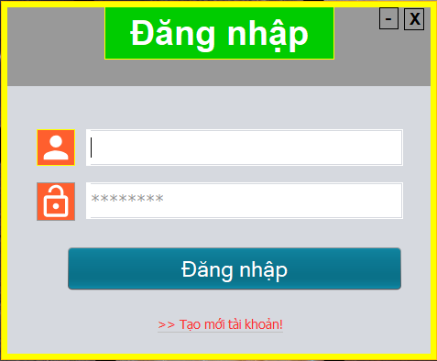
I.INTERFACE
Login:

Slide 6
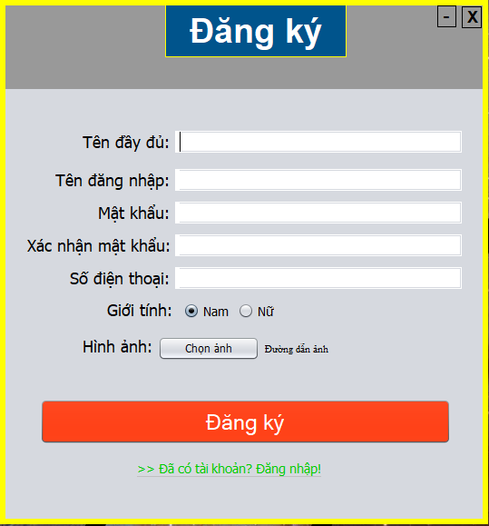
I.USER INTERFACE
REGISTER:

Slide 7
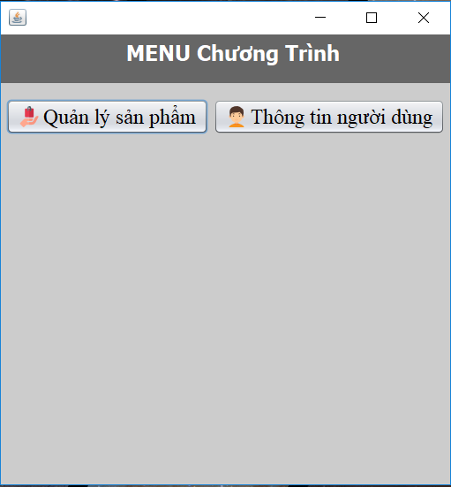
I.INTERFACE
MENU:

Slide 8
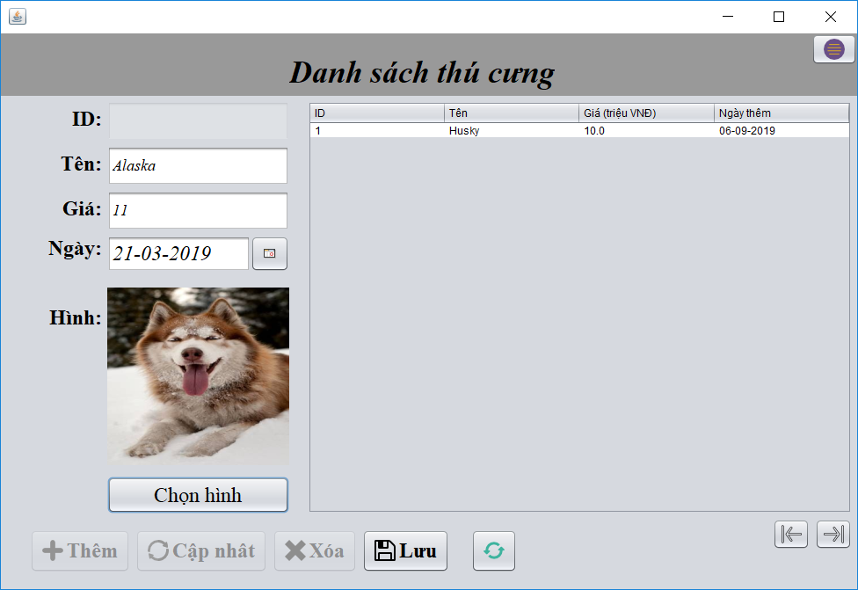
I.INTERFACE
ADD PET:

Slide 9
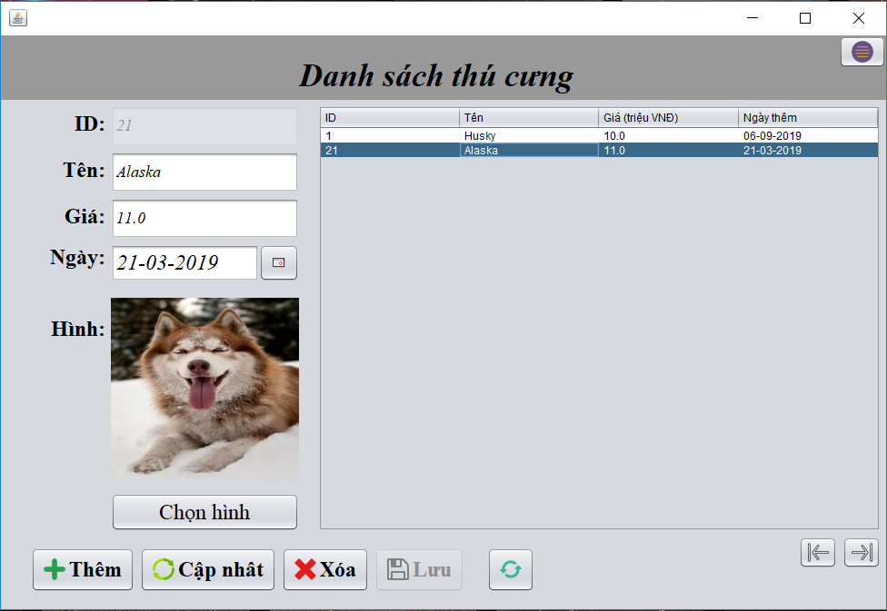
I.INTERFACE
ADD PET:

Slide 10
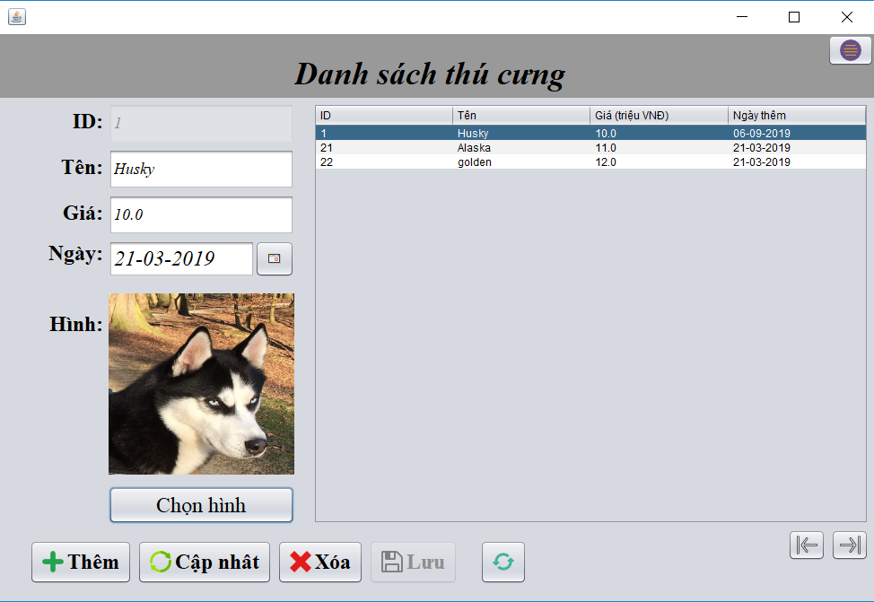
I.INTERFACE
UPDATE PET:

Slide 11
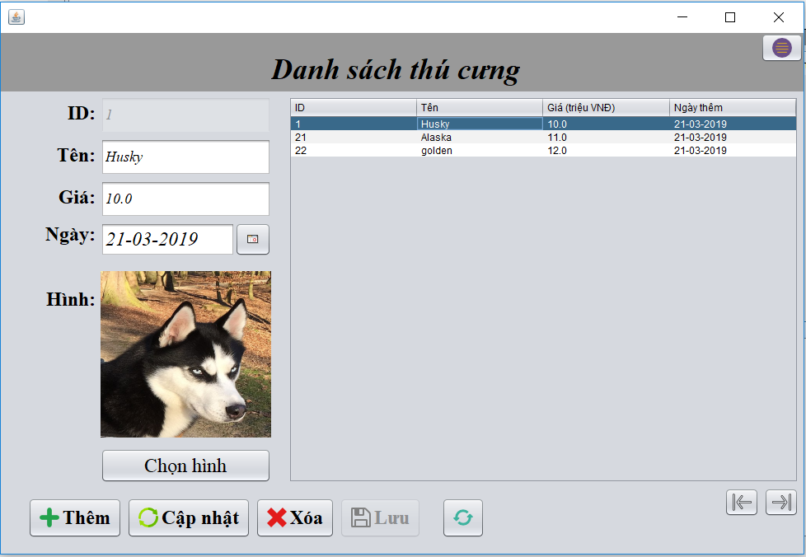
I.INTERFACE
UPDATE PET:

Slide 12
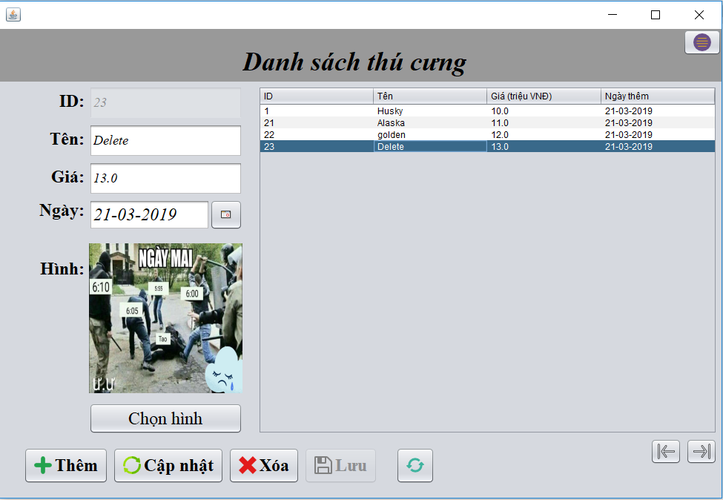
I.INTERFACE
DELETE PET:

Slide 13
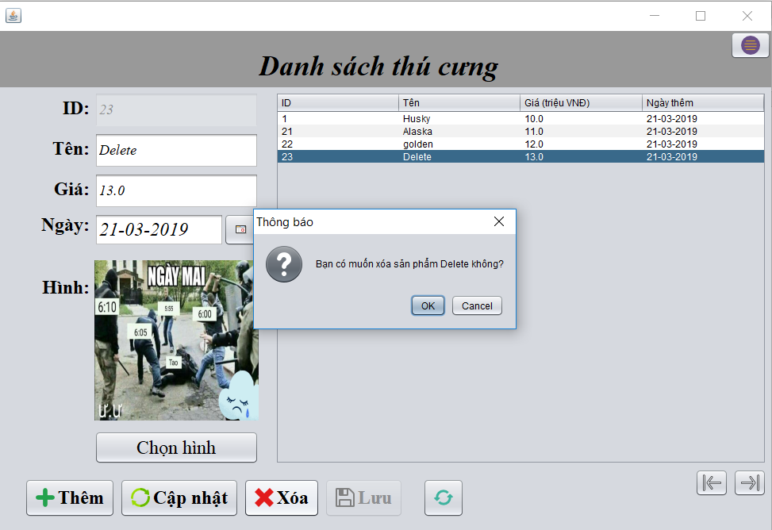
I.INTERFACE
DELETE PET:

Slide 14
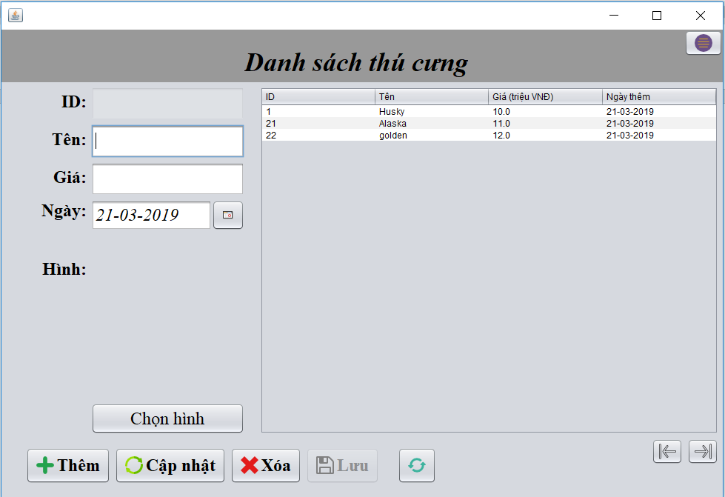
I.INTERFACE
DELETE PET:

Slide 15
www.themegallery.com
Thank You !
FOR YOUR LISTENING !!!

