Slide 1
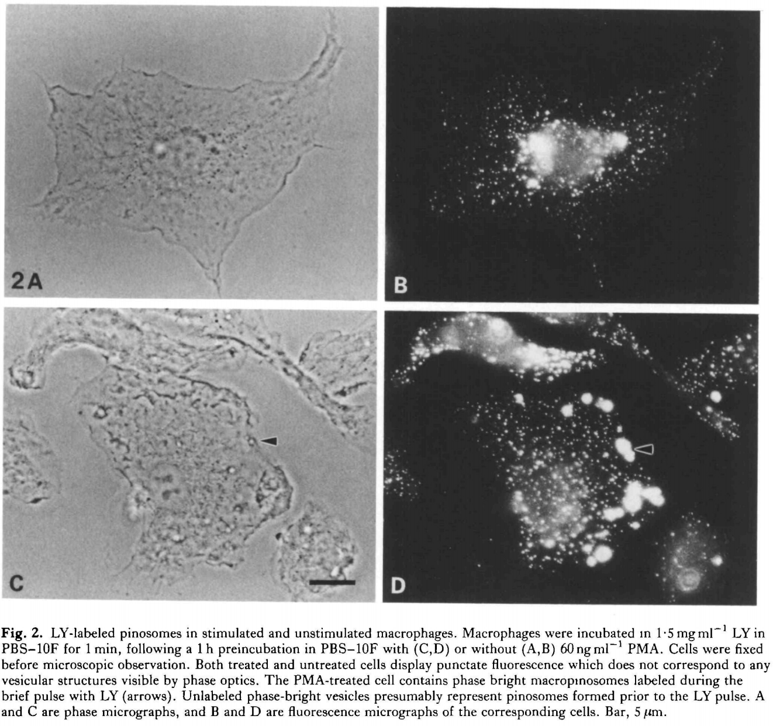
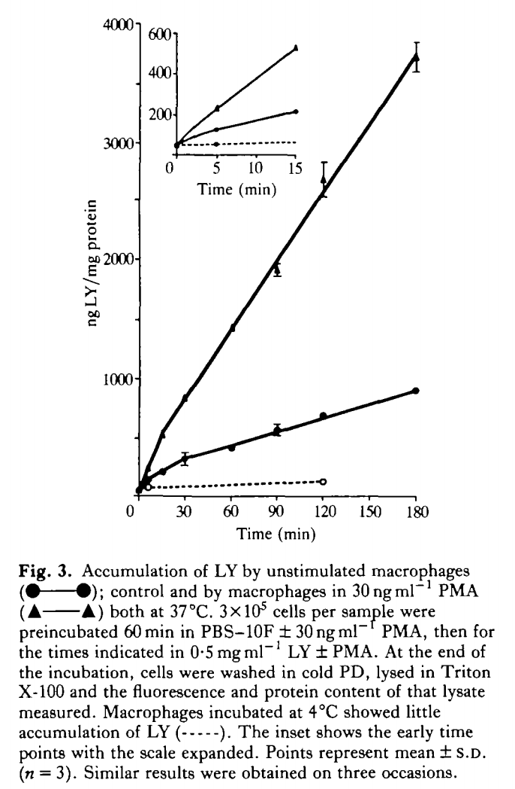
Background: Phorbol esters stimulate macropinocytosis in macrophages
unstimulated
+Phorbol ester
Assay: uptake of LY (Lucifer Yellow)
Joel Swanson, 1989

Slide 2
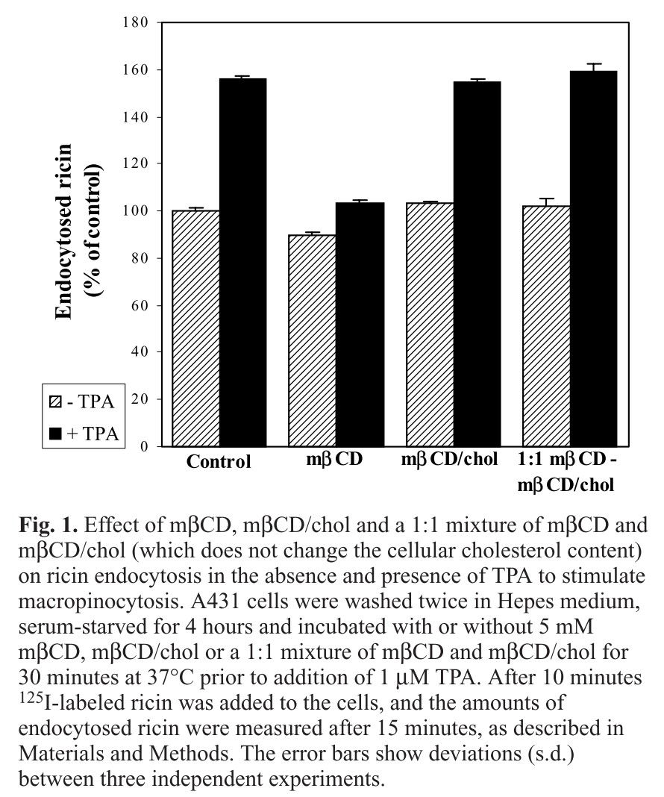
Background: Phorbol esters stimulate macropinocytosis in A431 cells (epidermoid carcinoma)
TPA is phorbol ester
Just focus on Control
Grimmer et al, 2002

Slide 3
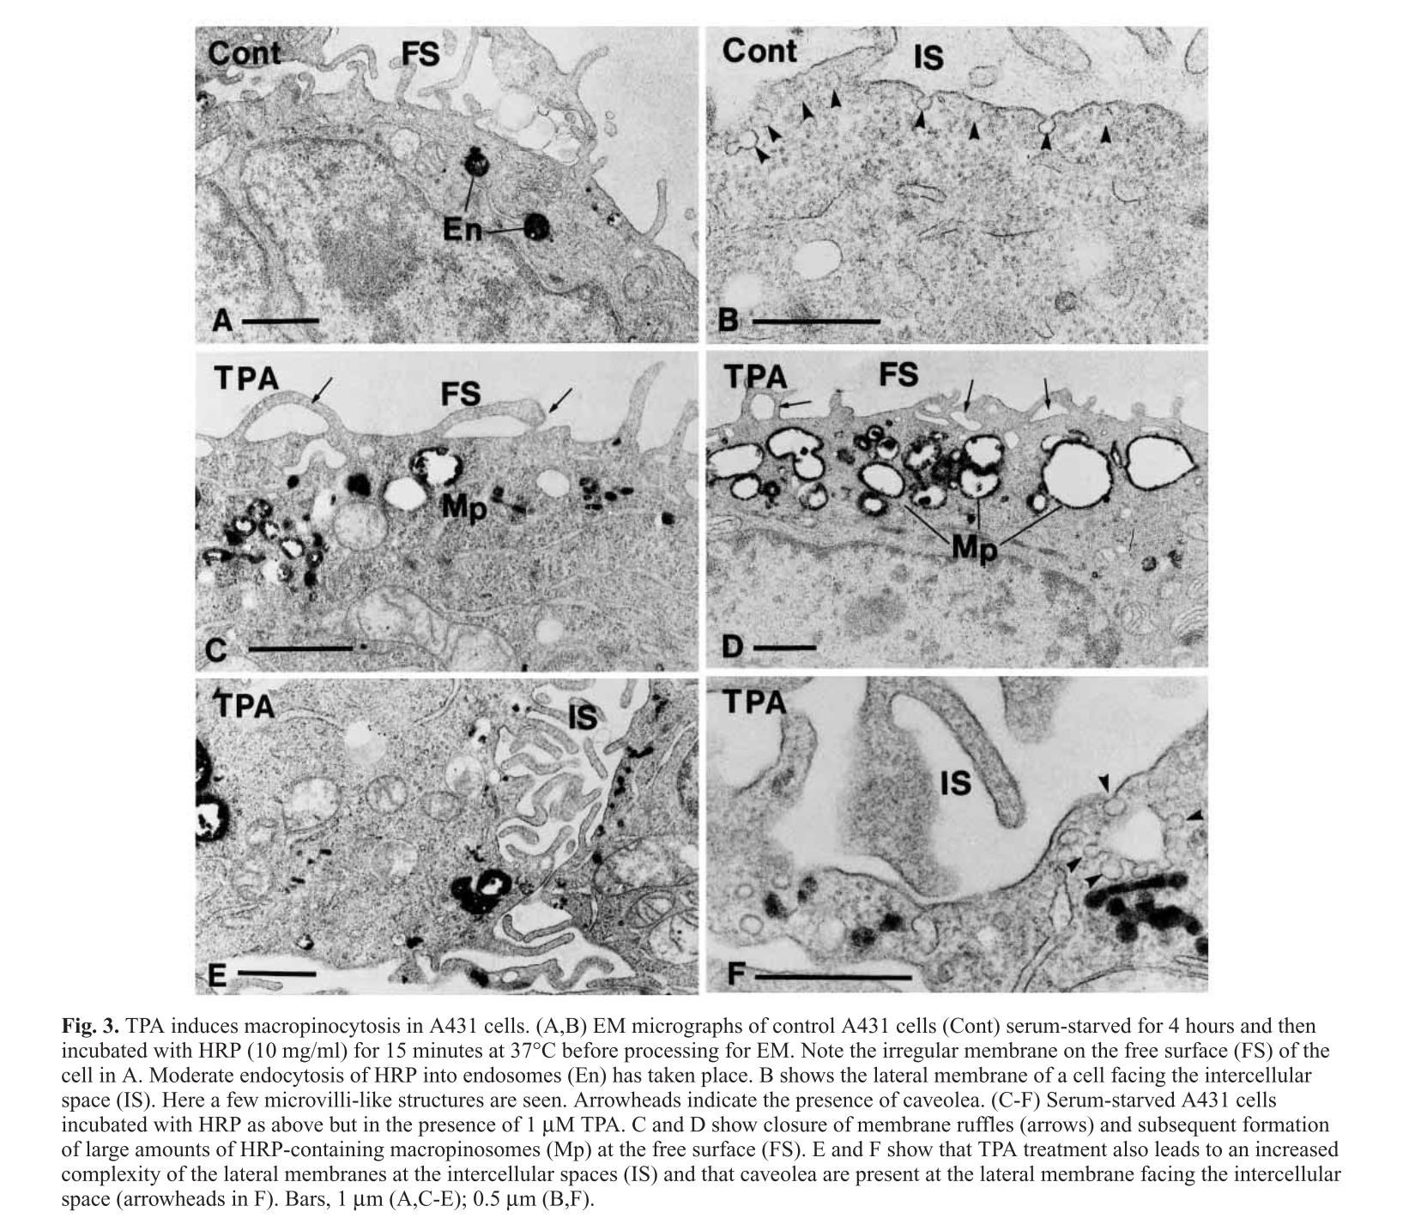
Background: Phorbol esters stimulate macropinocytosis in A431 cells (epidermoid carcinoma)
Grimmer et al, 2002

Slide 4
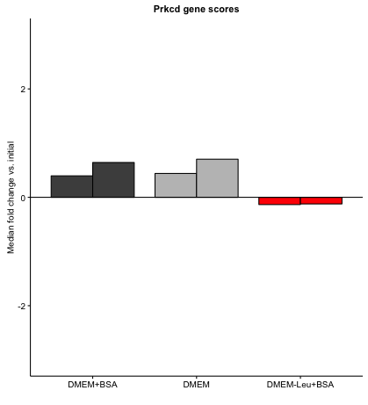
Protein kinase C
Protein kinase c
15 independently functioning isozymes
Prkcd essential in leu-free medium relative to rich medium

Slide 5
Forskolin-treated cells abruptly stopped growing after ~16h
Increase in PCV from 0 to 16h, but not 16h to 24h

Slide 6
Data from KRPCa cells
Forskolin data not trustworthy.. Apparently, cells stopped growing after 16h,
But continued taking up AA…

Slide 7
MEFs
These measurements were problematic… the cells stopped growing during pre-labeling, and the labeled medium during the experiment had contaminating unlabeled amino acids which are inflating the estimates in a way that depends on how many cells there were
(There were fewer KRas MEFs than MEFs, and there were fewer Torin-treated cells than non-treated)

Slide 8
MEFs

