Slide 1



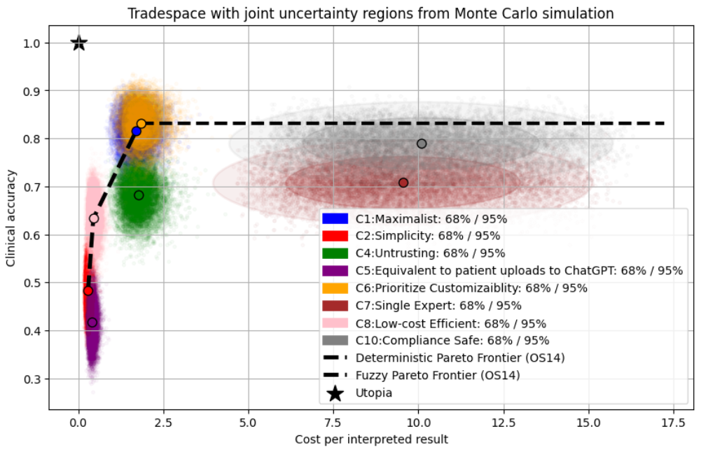










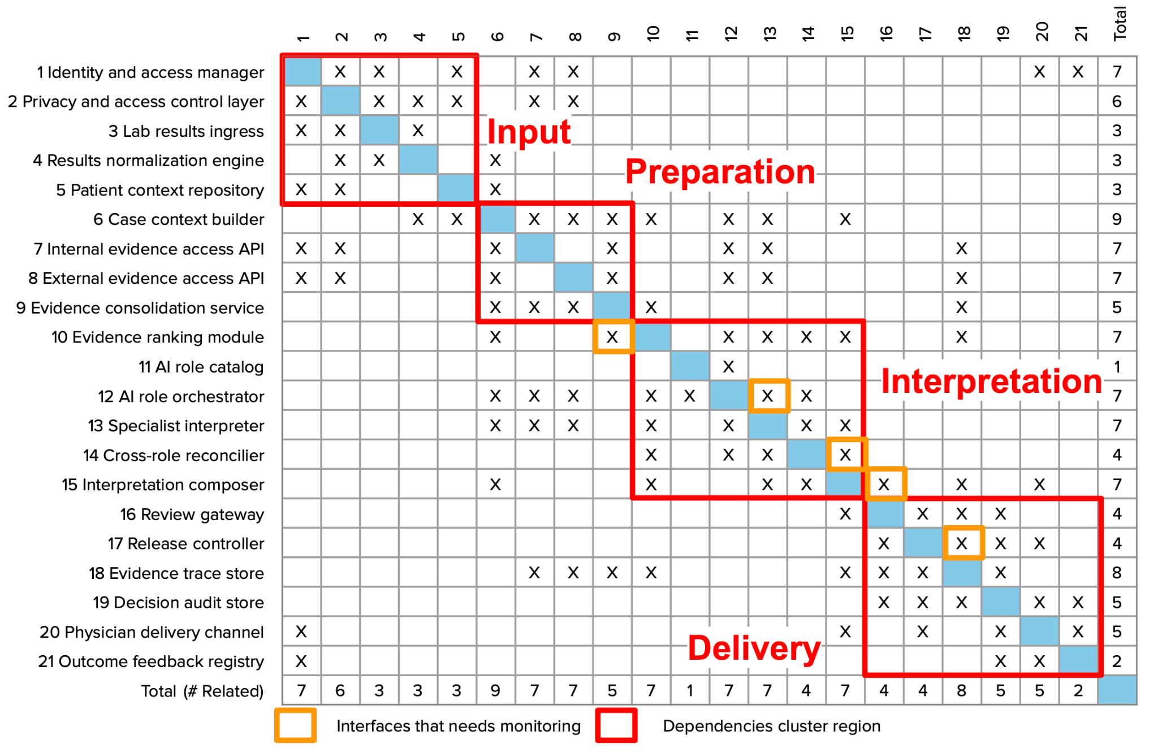
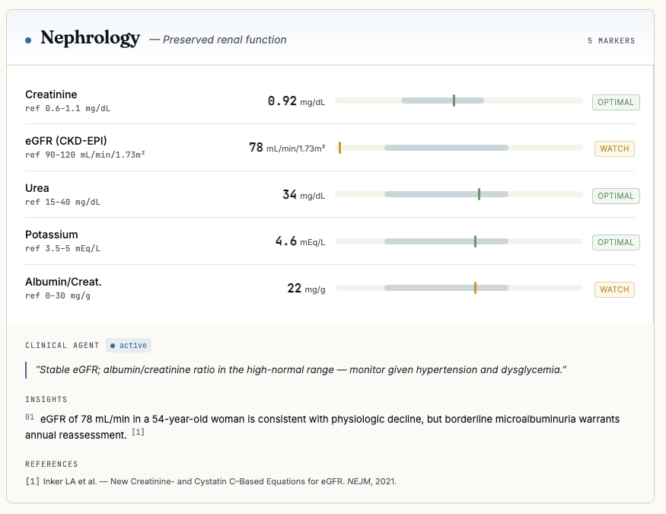
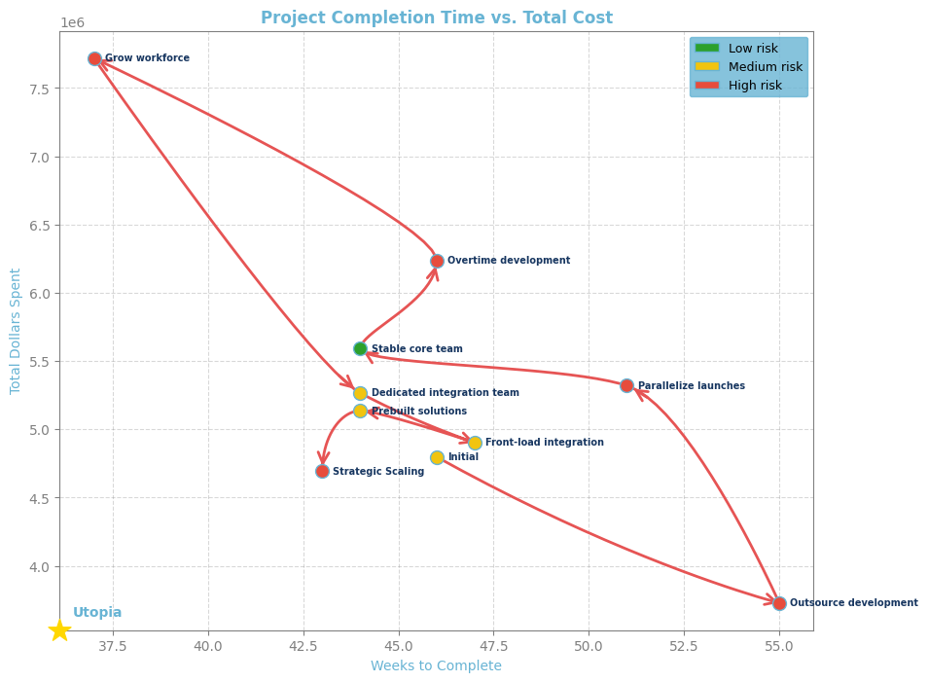
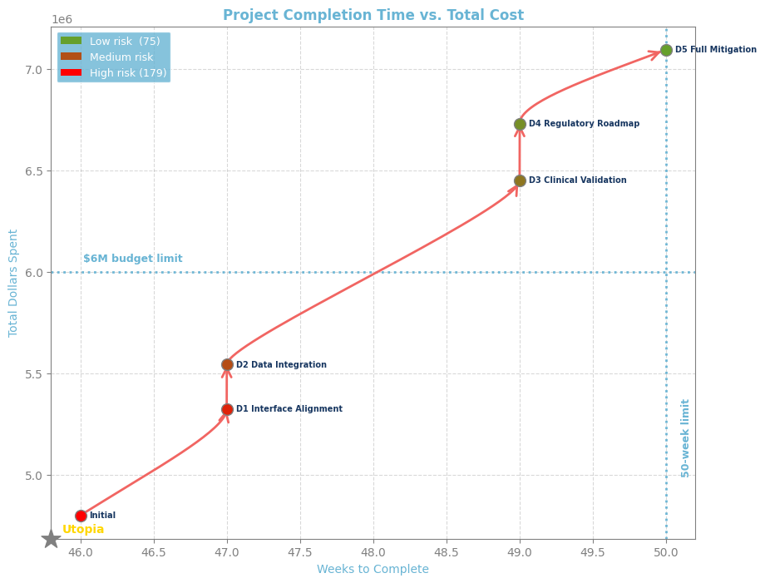
Concept Search
Recommended Concept: Maximalist
Team 14A: Camden Ramsay, David Ricardo, Michel Fernandes, Nora Alshareef
Mayo Clinic Model of Care
To improve Mayo Clinic lab patient care outcomes at scale
By augmenting physician-facing test results with relevant research
Using an agentic AI clinical librarian
Gemini model family
Multiple internal and external sources
Large specialized group
Multimodal, higher cost model
RAG and fine-tuning
Tiered release
The selected concept prioritizes clinical accuracy, traceability, and safe deployment over minimum cost. Its added complexity is intentional: stronger models, richer evidence sources, specialized AI roles, and tiered release controls create a more reliable physician-facing interpretation system.
LabCorp
Epic MyChart
Example Output
Architectural hotspots and change propagation
This mockup shows clinical research references added to the output of an uncommon test. With these references, the physician can now interpret the test in the context of the patient’s healthcare journey.
Lab result interpretation workflow
Patient
Physician
External Laboratory
Mayo Clinic Labs
(Tests Execution)
Patient Record
Mayo Clinic Knowledge & Research
Sanguine Librarian Layer
Medical consultation
Exam request
Exam schedule
Collecs and send samples
Analyses and store results
Test raw results
Request patient context
Send patient clinical context
Request clinical references
Risk exposure mitigation strategy
Send clinical references
Notification
Notification of results interpretation complete
The selected mitigation reduces riskiness from 179 to 102, removing 43% of baseline risk. It increases cost to $6.45M and schedule to 49 weeks, exceeding the $6M target but staying within the 50-week limit. The tradeoff is justified because it targets integration failure, hallucination risk, and late rework before clinical validation.
Deliver personalized interpretation
Notification
Access test interpretation
Iron Triangle
Risks mitigation design walk
Scope
Mitigation | Commentary
Data Integration | Early proof-of-concept to expose EHR/lab integration blockers before they cascade. Reduces probability from 50% to 20%.
Clinical Validation Readiness | Physician review board before shadow mode to reduce hallucination and clinical accuracy risk. Reduces probability from 40% to 15%.
Early Integration & Interface Testing | Early interface testing across the data pipeline, retrieval layer, agentic AI core, physician workflow, and validation workflow. Reduces probability from 40% to 20%.
Schedule
Budget
Health care is sensitive to risk. Prioritize scope of risk mitigations over schedule and budget.
Acknowledgements: Dr. Chris Garcia, Angela Tomczik, Molly Brenner, SDM staff

Slide 2
Ignore all slides after the first
They are prior drafts

Slide 3

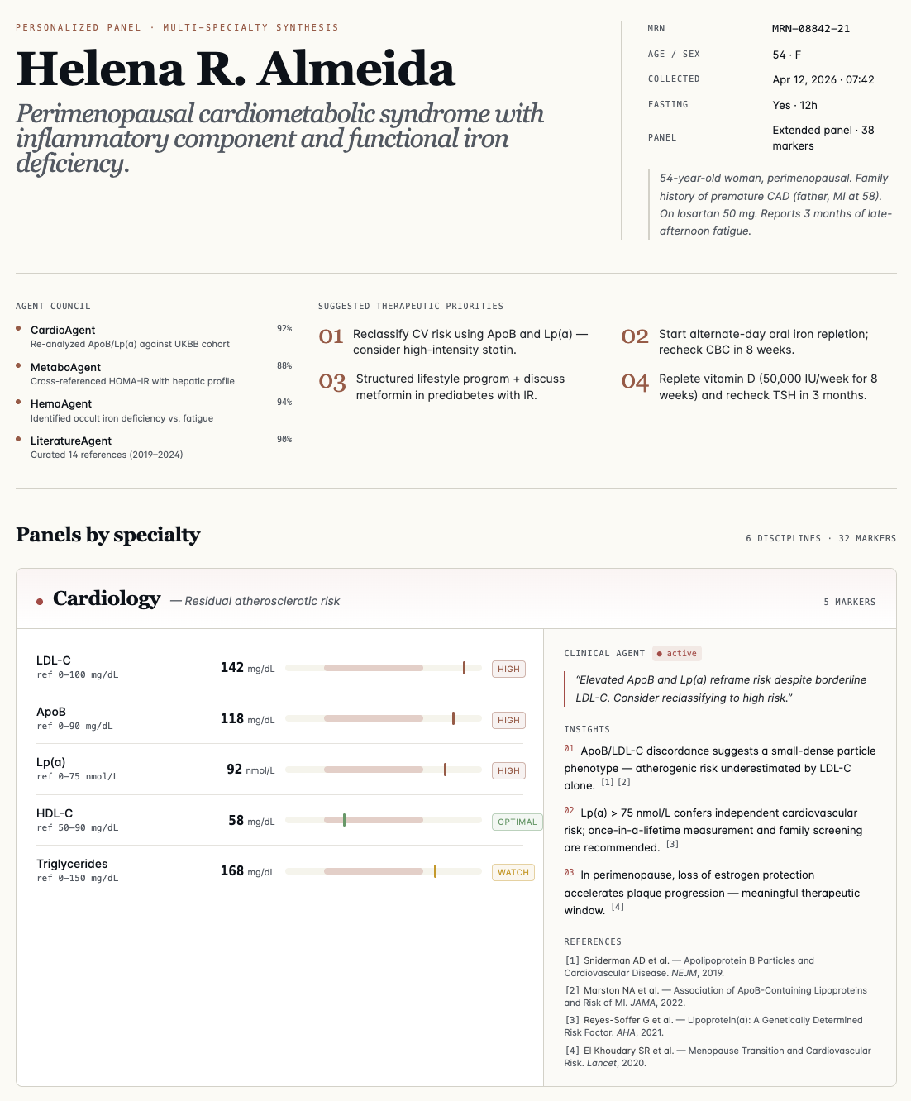
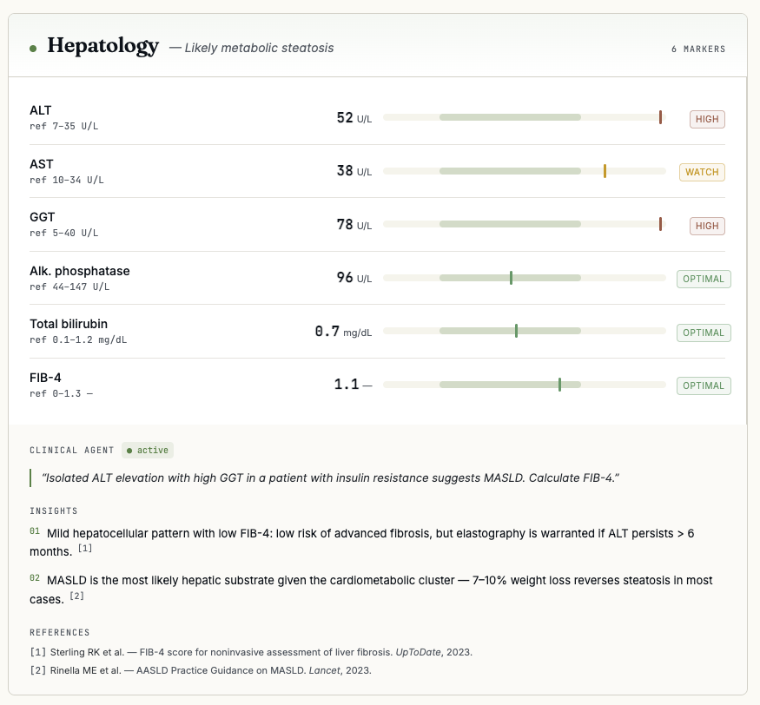
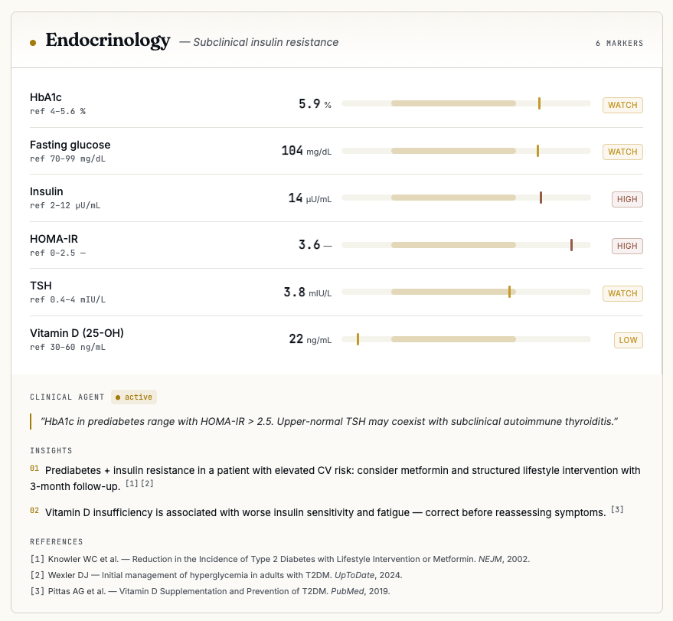
Selecting the preferred concept
ID | Name | Model Origin | Research Paradigm | # AI Roles | Data | Release | Model Spec
C1 | Maximalist |  | RAG+FT | L (5–10) | MIE | TR | MM‑P
C2 | Simplicity |  | PreTrain | 1 | MI | RB | TXT‑F
C3 | Max Internal |  | RAG+FT | L | MI | HITL | MM‑P
C4 | Untrusting | Own | PreTrain | S (2–5) | MI | TR | MM‑P
C5 | ChatGPT‑Eq | OCS | PreTrain | 1 | OI | RB | TXT‑F
C6 | Customizable | Own | RAG+FT | L | MIE | TR | Mix
C7 | Single Expert | OCS | RAG+FT | 1 | MI | HITL | MM‑P
C8 | Low‑Cost | OCS | RAG+FT | 1 | MI | RB | Mix
C9 | Embedded Know. | Own | PreTrain | 1 | MIE | TR | MM‑P
C10 | Compliance Safe | Own | RAG | L | MI | HITL | MM‑P
Final recommendations
An agentic AI clinical librarian for laboratory results interpretation.
Product concept
Design Decision | Preferred Choice
Selected Concept | C1 — Maximalist
Model Family | Gemini family only
Research Paradigm | RAG + fine-tuning
AI Role Structure | Large specialized group, approximately 5–10 roles
Clinical Sources | Multiple internal and external sources
Release Control | Tiered release
Model Specification | Multimodal, powerful, higher-cost model, such as Gemini 3 Pro
Standard lab results
General ranges
Generic flags
Limited context
Patient context
Evidence grounded
Specialist informed
Mayo Model of Care interpretation
Clinically reviewed
Traceable
Interpretation Layer
Architectural hotspots and change propagation
Lab result interpretation workflow
Patient
Physician
External Laboratory
Mayo Clinic Labs
(Tests Execution)
Patient Record
Mayo Clinic Knowledge & Research
Sanguine Librarian Layer
Medical consultation
Exam request
Exam schedule
Collecs and send samples
Analyses and store results
Test raw results
Request patient context
Send patient clinical context
Request clinical references
Send clinical references
Notification
Notification of results interpretation complete
Risk exposure mitigation strategy
Deliver personalized interpretation
Notification
Access test interpretation
The selected mitigation reduces riskiness from 179 to 102, removing 43% of baseline risk. It increases cost to $6.45M and schedule to 49 weeks, exceeding the $6M target but staying within the 50-week limit. The tradeoff is justified because it targets integration failure, hallucination risk, and late rework before clinical validation.
Clinical librarian architecture
Risks mitigation design walk
Identity
Private Health Information
Trust Boundary
Mitigation | Commentary
Data Integration | Early proof-of-concept to expose EHR/lab integration blockers before they cascade. Reduces probability from 50% to 20%.
Clinical Validation Readiness | Physician review board before shadow mode to reduce hallucination and clinical accuracy risk. Reduces probability from 40% to 15%.
Early Integration & Interface Testing | Early interface testing across the data pipeline, retrieval layer, agentic AI core, physician workflow, and validation workflow. Reduces probability from 40% to 20%.
Result
Patient Context
Prior History
Abnormal Patterns
Case Framing
Mayo Clinical Knowledge
Research Evidence
Guidelines
Evidence Base
Specialist Roles
Synthesis
Prior Reconciliation
Interpretation Core
Traceability
Safety Gates
Approval Rules
Escalation
Clinical Review
Workflow Delivery
Feedback
Physician Delivery
Team 14A: Camden Ramsay, David Ricardo, Michel Fernandes and Nora Alshareef

Slide 4

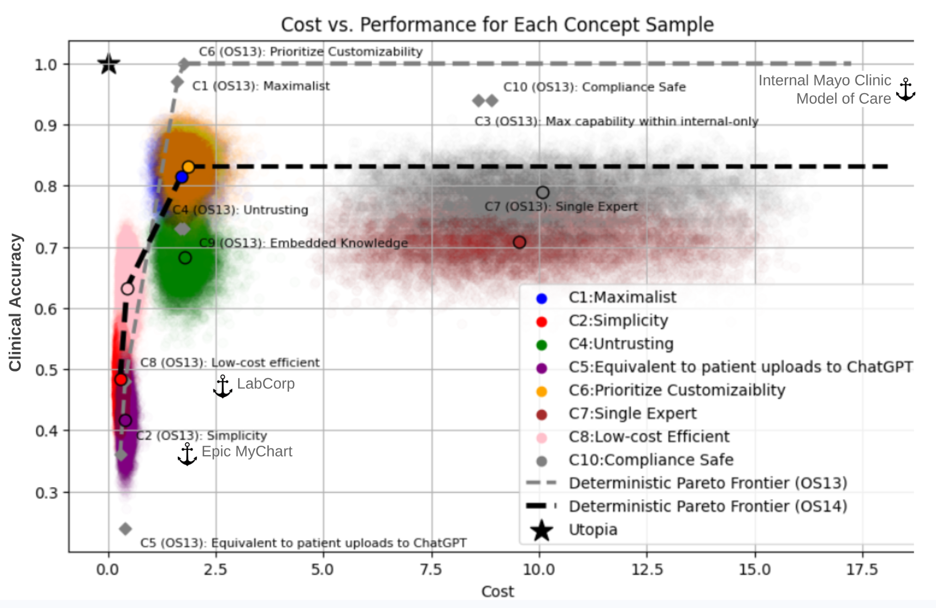
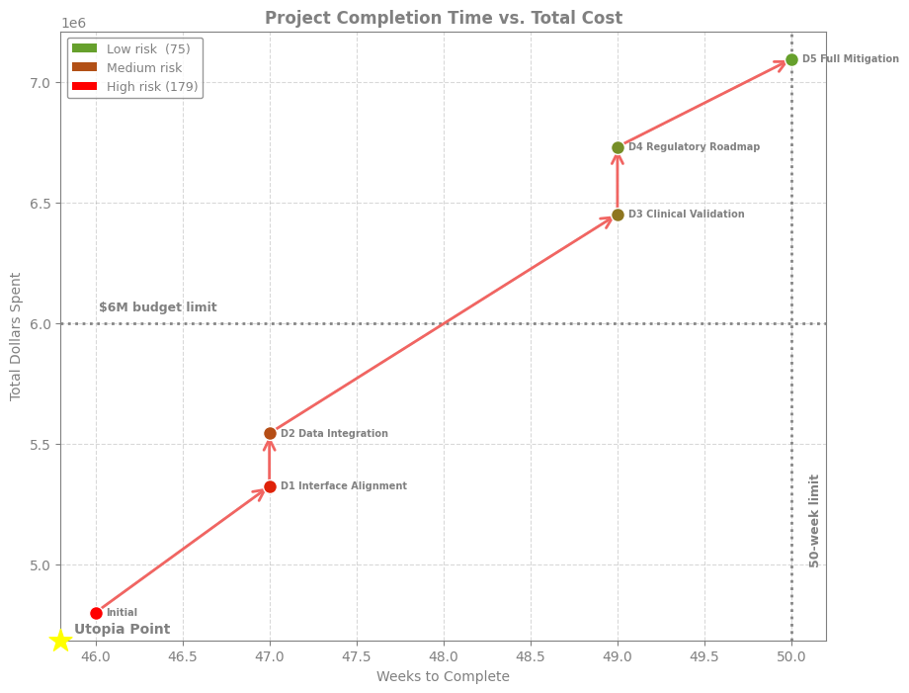
An agentic AI clinical librarian for laboratory results interpretation.
Team: Camden Ramsay, David Ricardo, Michel Fernandes and Nora Alshareef
Mentors: Angela Tomczik and Eric Rebentisch
From generic lab results to physician-ready interpretation
Selecting the preferred concept
Standard lab results
General ranges
Generic flags
Limited context
The tradespace maps current alternatives against cost and clinical accuracy. Epic Systems sits in the low-cost, lower-accuracy region; Labcorp sits in the moderate-cost, moderate-accuracy region; and the current Mayo Clinic model sits in the high-accuracy, high-cost region. The selected Sanguine design aims to move closer to Mayo-level clinical quality while improving scalability through evidence grounding, specialized AI roles, traceability, and clinical review.
Mayo Model of Care interpretation
Patient context
Evidence grounded
Specialist informed
Clinically reviewed
Traceable
Interpretation Layer
Architectural hotspots and change propagation
1
2
3
4
5
6
7
8
9
10
11
12
13
14
15
16
17
18
19
20
Total
Sanguine is a physician-facing clinical interpretation layer for Mayo Clinic laboratory results. It aims to improve Mayo Clinic lab patient care outcomes at scale by augmenting physician-facing test results with relevant research using an agentic AI clinical librarian.
The DSM reveals that Sanguine’s main architectural risk is concentrated in the interpretation core. Evidence ranking, AI role orchestration, specialist interpretation, reconciliation, and release control are tightly coupled, making them the key interfaces to monitor for change propagation, clinical accuracy, and reliable physician delivery.
1 Identity and access manager
 | X | X |  | X |  | X | X |  |  |  |  |  |  |  |  |  |  |  | X | X | 7
X |  | X | X | X |  | X | X |  |  |  |  |  |  |  |  |  |  |  |  |  | 6
X | X |  | X |  |  |  |  |  |  |  |  |  |  |  |  |  |  |  |  |  | 3
 | X | X |  |  | X |  |  |  |  |  |  |  |  |  |  |  |  |  |  |  | 3
X | X |  |  |  | X |  |  |  |  |  |  |  |  |  |  |  |  |  |  |  | 3
 |  |  | X | X |  | X | X | X | X |  | X | X |  | X |  |  |  |  |  |  | 9
X | X |  |  |  | X |  |  | X |  |  | X | X |  |  |  |  | X |  |  |  | 7
X | X |  |  |  | X |  |  | X |  |  | X | X |  |  |  |  | X |  |  |  | 7
 |  |  |  |  | X | X | X |  | X |  |  |  |  |  |  |  | X |  |  |  | 5
 |  |  |  |  | X |  |  | X |  |  | X | X | X | X |  |  | X |  |  |  | 7
 |  |  |  |  |  |  |  |  |  |  | X |  |  |  |  |  |  |  |  |  | 1
 |  |  |  |  | X | X | X |  | X | X |  | X | X |  |  |  |  |  |  |  | 7
 |  |  |  |  | X | X | X |  | X |  | X |  | X | X |  |  |  |  |  |  | 7
 |  |  |  |  |  |  |  |  | X |  | X | X |  | X |  |  |  |  |  |  | 4
 |  |  |  |  | X |  |  |  | X |  |  | X | X |  | X |  | X |  | X |  | 7
 |  |  |  |  |  |  |  |  |  |  |  |  |  | X |  | X | X | X |  |  | 4
 |  |  |  |  |  |  |  |  |  |  |  |  |  |  | X |  | X | X | X |  | 4
 |  |  |  |  |  | X | X | X | X |  |  |  |  | X | X | X |  | X |  |  | 8
 |  |  |  |  |  |  |  |  |  |  |  |  |  |  | X | X | X |  | X | X | 5
X |  |  |  |  |  |  |  |  |  |  |  |  |  | X |  | X |  | X |  | X | 5
X |  |  |  |  |  |  |  |  |  |  |  |  |  |  |  |  |  | X | X |  | 2
7 | 6 | 3 | 3 | 3 | 9 | 7 | 7 | 5 | 7 | 1 | 7 | 7 | 4 | 7 | 4 | 4 | 8 | 5 | 5 | 2
21
2 Privacy and access control layer
Input
3 Lab results ingress
Preparation
4 Results normalization engine
5 Patient context repository
6 Case context builder
Clinical librarian architecture
7 Internal evidence access API
8 External evidence access API
9 Evidence consolidation service
10 Evidence ranking module
Interpretation
Lab result interpretation workflow
11 AI role catalog
Identity
Private Health Information
Trust Boundary
12 AI role orchestrator
13 Specialist interpreter
14 Cross-role reconcilier
Patient
Physician
External Laboratory
Mayo Clinic Labs
(Tests Execution)
Patient Record
Mayo Clinic Knowledge & Research
Sanguine Librarian Layer
15 Interpretation composer
16 Review gateway
17 Release controller
Result
Patient Context
Prior History
Abnormal Patterns
Case Framing
Medical consultation
18 Evidence trace store
19 Decision audit store
Delivery
20 Physician delivery channel
21 Outcome feedback registry
Mayo Clinical Knowledge
Research Evidence
Guidelines
Evidence Base
Exam request
Total (# Related)
Interfaces that needs monitoring
Dependencies cluster region
Exam schedule
Collecs and send samples
Analyses and store results
Test raw results
Risks mitigation design walk
Specialist Roles
Synthesis
Prior Reconciliation
Interpretation Core
Request patient context
Send patient clinical context
Request clinical references
Traceability
Safety Gates
Approval Rules
Escalation
Clinical Review
Send clinical references
Notification
Notification of results interpretation complete
Workflow Delivery
Feedback
Physician Delivery
Deliver personalized interpretation
Notification
The architecture protects patient data, frames lab results with patient context from the EHR, retrieves Mayo and external clinical evidence, and uses specialized AI roles to synthesize a physician-facing interpretation. Before delivery, the output is checked for traceability, escalated for clinical review when needed, and then returned to the physician workflow with feedback captured for continuous improvement.
Access test interpretation
The sequence diagram shows how the clinical librarian fits into the existing lab workflow. After a physician requests an exam, Mayo Clinic Labs runs the test and stores the result in the EHR. The clinical librarian then combines the result with patient context and Mayo research-backed clinical knowledge to generate a traceable interpretation for physician review and use.
Product & project recommendation
The selected mitigation reduces riskiness from 179 to 102, removing 43% of baseline risk. It increases cost to $6.45M and schedule to 49 weeks, exceeding the $6M target but staying within the 50-week limit. The tradeoff is justified because it targets integration failure, hallucination risk, and late rework before clinical validation.
Design Decision | Preferred Choice
Selected Concept | C1 — Maximalist
Model Family | Gemini family only
Research Paradigm | RAG + fine-tuning
AI Role Structure | Large specialized group, approximately 5–10 roles
Clinical Sources | Multiple internal and external sources
Release Control | Tiered release
Model Specification | Multimodal, powerful, higher-cost model, such as Gemini 3 Pro
Mitigation | Commentary
Data Integration | Early proof-of-concept to expose EHR/lab integration blockers before they cascade. Reduces probability from 50% to 20%.
Clinical Validation Readiness | Physician review board before shadow mode to reduce hallucination and clinical accuracy risk. Reduces probability from 40% to 15%.
Early Integration & Interface Testing | Early interface testing across the data pipeline, retrieval layer, agentic AI core, physician workflow, and validation workflow. Reduces probability from 40% to 20%.
The mitigation walk shows two risk-reduction clusters. The technical feasibility cluster reduces integration and interface risks while staying closer to the original cost and schedule envelope. Adding clinical validation creates a larger risk reduction, but pushes the selected design above the $6M budget target while still remaining inside the 50-week schedule limit. This tradeoff was accepted because hallucination and clinical accuracy risks are more critical to physician trust and safe clinical use.
Preferred Architecture
Architectural Complexity
Value Metrics
Development Strategy: Risk-Driven Delivery
Recommendation
Sanguine is a physician-facing clinical interpretation layer designed to scale the Mayo Clinic Model of Care by augmenting laboratory results with grounded, traceable, and clinically reviewed AI-generated interpretation.

Slide 5
Risks mitigation design walk
An agentic AI clinical librarian for laboratory results interpretation.
Mentors: Angela Tomczik and Eric Rebentisch
From generic lab results to physician-ready interpretation
Architectural hotspots and change propagation
Sanguine is a physician-facing clinical interpretation layer for Mayo Clinic laboratory results. It aims to improve Mayo Clinic lab patient care outcomes at scale by augmenting physician-facing test results with relevant research using an agentic AI clinical librarian.
1
2
3
4
5
6
7
8
9
10
11
12
13
14
15
16
17
18
19
20
Total
1 Identity and access manager
 | X | X |  | X |  | X | X |  |  |  |  |  |  |  |  |  |  |  | X | X | 7
X |  | X | X | X |  | X | X |  |  |  |  |  |  |  |  |  |  |  |  |  | 6
X | X |  | X |  |  |  |  |  |  |  |  |  |  |  |  |  |  |  |  |  | 3
 | X | X |  |  | X |  |  |  |  |  |  |  |  |  |  |  |  |  |  |  | 3
X | X |  |  |  | X |  |  |  |  |  |  |  |  |  |  |  |  |  |  |  | 3
 |  |  | X | X |  | X | X | X | X |  | X | X |  | X |  |  |  |  |  |  | 9
X | X |  |  |  | X |  |  | X |  |  | X | X |  |  |  |  | X |  |  |  | 7
X | X |  |  |  | X |  |  | X |  |  | X | X |  |  |  |  | X |  |  |  | 7
 |  |  |  |  | X | X | X |  | X |  |  |  |  |  |  |  | X |  |  |  | 5
 |  |  |  |  | X |  |  | X |  |  | X | X | X | X |  |  | X |  |  |  | 7
 |  |  |  |  |  |  |  |  |  |  | X |  |  |  |  |  |  |  |  |  | 1
 |  |  |  |  | X | X | X |  | X | X |  | X | X |  |  |  |  |  |  |  | 7
 |  |  |  |  | X | X | X |  | X |  | X |  | X | X |  |  |  |  |  |  | 7
 |  |  |  |  |  |  |  |  | X |  | X | X |  | X |  |  |  |  |  |  | 4
 |  |  |  |  | X |  |  |  | X |  |  | X | X |  | X |  | X |  | X |  | 7
 |  |  |  |  |  |  |  |  |  |  |  |  |  | X |  | X | X | X |  |  | 4
 |  |  |  |  |  |  |  |  |  |  |  |  |  |  | X |  | X | X | X |  | 4
 |  |  |  |  |  | X | X | X | X |  |  |  |  | X | X | X |  | X |  |  | 8
 |  |  |  |  |  |  |  |  |  |  |  |  |  |  | X | X | X |  | X | X | 5
X |  |  |  |  |  |  |  |  |  |  |  |  |  | X |  | X |  | X |  | X | 5
X |  |  |  |  |  |  |  |  |  |  |  |  |  |  |  |  |  | X | X |  | 2
7 | 6 | 3 | 3 | 3 | 9 | 7 | 7 | 5 | 7 | 1 | 7 | 7 | 4 | 7 | 4 | 4 | 8 | 5 | 5 | 2
21
2 Privacy and access control layer
Input
3 Lab results ingress
Preparation
The mitigation walk shows two risk-reduction clusters. The technical feasibility cluster reduces integration and interface risks while staying closer to the original cost and schedule envelope. Adding clinical validation creates a larger risk reduction, but pushes the selected design above the $6M budget target while still remaining inside the 50-week schedule limit. This tradeoff was accepted because hallucination and clinical accuracy risks are more critical to physician trust and safe clinical use.
4 Results normalization engine
Clinical librarian architecture
5 Patient context repository
6 Case context builder
7 Internal evidence access API
Lab result interpretation workflow
8 External evidence access API
9 Evidence consolidation service
Identity
Private Health Information
Trust Boundary
10 Evidence ranking module
Interpretation
11 AI role catalog
Patient
Physician
External Laboratory
Mayo Clinic Labs
(Tests Execution)
Patient Record
Mayo Clinic Knowledge & Research
Sanguine Librarian Layer
12 AI role orchestrator
13 Specialist interpreter
14 Cross-role reconcilier
Medical consultation
Result
Patient Context
Prior History
Abnormal Patterns
15 Interpretation composer
Case Framing
16 Review gateway
17 Release controller
18 Evidence trace store
19 Decision audit store
Delivery
Exam request
20 Physician delivery channel
Exam schedule
Collecs and send samples
Analyses and store results
Test raw results
Mayo Clinical Knowledge
Research Evidence
Guidelines
Evidence Base
21 Outcome feedback registry
Total (# Related)
Interfaces that needs monitoring
Dependencies cluster region
Request patient context
Specialist Roles
Synthesis
Prior Reconciliation
Interpretation Core
The DSM reveals that Sanguine’s main architectural risk is concentrated in the interpretation core. Evidence ranking, AI role orchestration, specialist interpretation, reconciliation, and release control are tightly coupled, making them the key interfaces to monitor for change propagation, clinical accuracy, and reliable physician delivery.
Send patient clinical context
Request clinical references
Send clinical references
Traceability
Safety Gates
Approval Rules
Escalation
Clinical Review
Notification
Notification of results interpretation complete
Selecting the preferred concept
Deliver personalized interpretation
Notification
Workflow Delivery
Feedback
Physician Delivery
Access test interpretation
The sequence diagram shows how the clinical librarian fits into the existing lab workflow. After a physician requests an exam, Mayo Clinic Labs runs the test and stores the result in the EHR. The clinical librarian then combines the result with patient context and Mayo research-backed clinical knowledge to generate a traceable interpretation for physician review and use.
The architecture protects patient data, frames lab results with patient context from the EHR, retrieves Mayo and external clinical evidence, and uses specialized AI roles to synthesize a physician-facing interpretation. Before delivery, the output is checked for traceability, escalated for clinical review when needed, and then returned to the physician workflow with feedback captured for continuous improvement.
Product & project recommendation
The selected mitigation reduces riskiness from 179 to 102, removing 43% of baseline risk. It increases cost to $6.45M and schedule to 49 weeks, exceeding the $6M target but staying within the 50-week limit. The tradeoff is justified because it targets integration failure, hallucination risk, and late rework before clinical validation.
Design Decision | Preferred Choice
Selected Concept | C1 — Maximalist
Model Family | Gemini family only
Research Paradigm | RAG + fine-tuning
AI Role Structure | Large specialized group, approximately 5–10 roles
Clinical Sources | Multiple internal and external sources
Release Control | Tiered release
Model Specification | Multimodal, powerful, higher-cost model, such as Gemini 3 Pro
Mitigation | Commentary
Data Integration | Early proof-of-concept to expose EHR/lab integration blockers before they cascade. Reduces probability from 50% to 20%.
Clinical Validation Readiness | Physician review board before shadow mode to reduce hallucination and clinical accuracy risk. Reduces probability from 40% to 15%.
Early Integration & Interface Testing | Early interface testing across the data pipeline, retrieval layer, agentic AI core, physician workflow, and validation workflow. Reduces probability from 40% to 20%.
The tradespace maps current alternatives against cost and clinical accuracy. Epic Systems sits in the low-cost, lower-accuracy region; Labcorp sits in the moderate-cost, moderate-accuracy region; and the current Mayo Clinic model sits in the high-accuracy, high-cost region. The selected Sanguine design aims to move closer to Mayo-level clinical quality while improving scalability through evidence grounding, specialized AI roles, traceability, and clinical review.
Preferred Architecture
Architectural Complexity
Value Metrics
Development Strategy: Risk-Driven Delivery
Recommendation
Sanguine is a physician-facing clinical interpretation layer designed to scale the Mayo Clinic Model of Care by augmenting laboratory results with grounded, traceable, and clinically reviewed AI-generated interpretation.

Slide 6
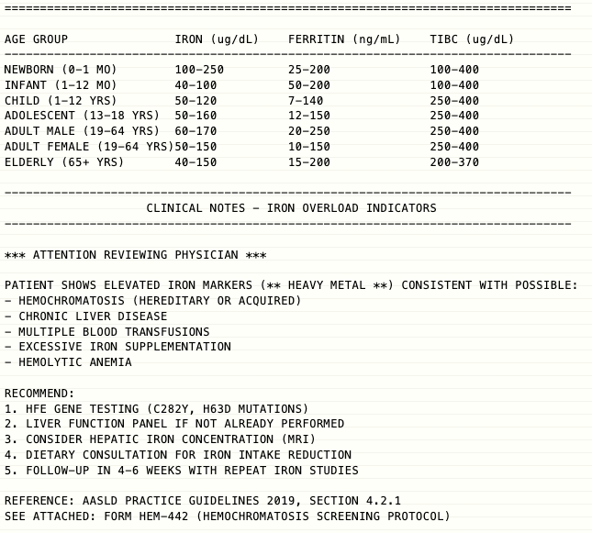
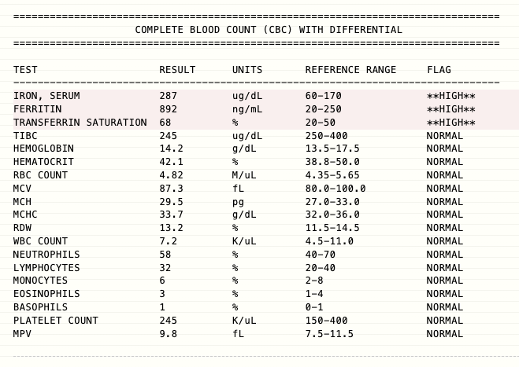
An agentic AI clinical librarian for laboratory results interpretation.
Team: Camden Ramsay, David Ricardo, Michel Fernandes and Nora Alshareef
Mentors: Angela Tomczik and Eric Rebentisch
From generic lab results to physician-ready interpretation
Selecting the preferred concept
The tradespace maps current alternatives against cost and clinical accuracy. Epic Systems sits in the low-cost, lower-accuracy region; Labcorp sits in the moderate-cost, moderate-accuracy region; and the current Mayo Clinic model sits in the high-accuracy, high-cost region. The selected Sanguine design aims to move closer to Mayo-level clinical quality while improving scalability through evidence grounding, specialized AI roles, traceability, and clinical review.
Architectural hotspots and change propagation
1
2
3
4
5
6
7
8
9
10
11
12
13
14
15
16
17
18
19
20
Total
Sanguine is a physician-facing clinical interpretation layer for Mayo Clinic laboratory results. It aims to improve Mayo Clinic lab patient care outcomes at scale by augmenting physician-facing test results with relevant research using an agentic AI clinical librarian.
The DSM reveals that Sanguine’s main architectural risk is concentrated in the interpretation core. Evidence ranking, AI role orchestration, specialist interpretation, reconciliation, and release control are tightly coupled, making them the key interfaces to monitor for change propagation, clinical accuracy, and reliable physician delivery.
1 Identity and access manager
 | X | X |  | X |  | X | X |  |  |  |  |  |  |  |  |  |  |  | X | X | 7
X |  | X | X | X |  | X | X |  |  |  |  |  |  |  |  |  |  |  |  |  | 6
X | X |  | X |  |  |  |  |  |  |  |  |  |  |  |  |  |  |  |  |  | 3
 | X | X |  |  | X |  |  |  |  |  |  |  |  |  |  |  |  |  |  |  | 3
X | X |  |  |  | X |  |  |  |  |  |  |  |  |  |  |  |  |  |  |  | 3
 |  |  | X | X |  | X | X | X | X |  | X | X |  | X |  |  |  |  |  |  | 9
X | X |  |  |  | X |  |  | X |  |  | X | X |  |  |  |  | X |  |  |  | 7
X | X |  |  |  | X |  |  | X |  |  | X | X |  |  |  |  | X |  |  |  | 7
 |  |  |  |  | X | X | X |  | X |  |  |  |  |  |  |  | X |  |  |  | 5
 |  |  |  |  | X |  |  | X |  |  | X | X | X | X |  |  | X |  |  |  | 7
 |  |  |  |  |  |  |  |  |  |  | X |  |  |  |  |  |  |  |  |  | 1
 |  |  |  |  | X | X | X |  | X | X |  | X | X |  |  |  |  |  |  |  | 7
 |  |  |  |  | X | X | X |  | X |  | X |  | X | X |  |  |  |  |  |  | 7
 |  |  |  |  |  |  |  |  | X |  | X | X |  | X |  |  |  |  |  |  | 4
 |  |  |  |  | X |  |  |  | X |  |  | X | X |  | X |  | X |  | X |  | 7
 |  |  |  |  |  |  |  |  |  |  |  |  |  | X |  | X | X | X |  |  | 4
 |  |  |  |  |  |  |  |  |  |  |  |  |  |  | X |  | X | X | X |  | 4
 |  |  |  |  |  | X | X | X | X |  |  |  |  | X | X | X |  | X |  |  | 8
 |  |  |  |  |  |  |  |  |  |  |  |  |  |  | X | X | X |  | X | X | 5
X |  |  |  |  |  |  |  |  |  |  |  |  |  | X |  | X |  | X |  | X | 5
X |  |  |  |  |  |  |  |  |  |  |  |  |  |  |  |  |  | X | X |  | 2
7 | 6 | 3 | 3 | 3 | 9 | 7 | 7 | 5 | 7 | 1 | 7 | 7 | 4 | 7 | 4 | 4 | 8 | 5 | 5 | 2
21
2 Privacy and access control layer
Input
3 Lab results ingress
Preparation
4 Results normalization engine
5 Patient context repository
6 Case context builder
Clinical librarian architecture
7 Internal evidence access API
8 External evidence access API
9 Evidence consolidation service
10 Evidence ranking module
Interpretation
Lab result interpretation workflow
11 AI role catalog
Identity
Private Health Information
12 AI role orchestrator
Trust Boundary
13 Specialist interpreter
14 Cross-role reconcilier
Patient
Physician
External Laboratory
Mayo Clinic Labs
(Tests Execution)
Patient Record
Mayo Clinic Knowledge & Research
Sanguine Librarian Layer
15 Interpretation composer
16 Review gateway
17 Release controller
Result
Patient Context
Prior History
Abnormal Patterns
Case Framing
Medical consultation
18 Evidence trace store
19 Decision audit store
Delivery
20 Physician delivery channel
21 Outcome feedback registry
Mayo Clinical Knowledge
Research Evidence
Guidelines
Evidence Base
Exam request
Total (# Related)
Interfaces that needs monitoring
Dependencies cluster region
Exam schedule
Collecs and send samples
Analyses and store results
Test raw results
Risks mitigation design walk
Specialist Roles
Synthesis
Prior Reconciliation
Interpretation Core
Request patient context
Send patient clinical context
Request clinical references
Traceability
Safety Gates
Approval Rules
Escalation
Clinical Review
Send clinical references
Notification
Notification of results interpretation complete
Workflow Delivery
Feedback
Physician Delivery
Deliver personalized interpretation
Notification
The architecture protects patient data, frames lab results with patient context from the EHR, retrieves Mayo and external clinical evidence, and uses specialized AI roles to synthesize a physician-facing interpretation. Before delivery, the output is checked for traceability, escalated for clinical review when needed, and then returned to the physician workflow with feedback captured for continuous improvement.
Access test interpretation
The sequence diagram shows how the clinical librarian fits into the existing lab workflow. After a physician requests an exam, Mayo Clinic Labs runs the test and stores the result in the EHR. The clinical librarian then combines the result with patient context and Mayo research-backed clinical knowledge to generate a traceable interpretation for physician review and use.
Product & project recommendation
The selected mitigation reduces riskiness from 179 to 102, removing 43% of baseline risk. It increases cost to $6.45M and schedule to 49 weeks, exceeding the $6M target but staying within the 50-week limit. The tradeoff is justified because it targets integration failure, hallucination risk, and late rework before clinical validation.
Design Decision | Preferred Choice
Selected Concept | C1 — Maximalist
Model Family | Gemini family only
Research Paradigm | RAG + fine-tuning
AI Role Structure | Large specialized group, approximately 5–10 roles
Clinical Sources | Multiple internal and external sources
Release Control | Tiered release
Model Specification | Multimodal, powerful, higher-cost model, such as Gemini 3 Pro
Mitigation | Commentary
Data Integration | Early proof-of-concept to expose EHR/lab integration blockers before they cascade. Reduces probability from 50% to 20%.
Clinical Validation Readiness | Physician review board before shadow mode to reduce hallucination and clinical accuracy risk. Reduces probability from 40% to 15%.
Early Integration & Interface Testing | Early interface testing across the data pipeline, retrieval layer, agentic AI core, physician workflow, and validation workflow. Reduces probability from 40% to 20%.
The mitigation walk shows two risk-reduction clusters. The technical feasibility cluster reduces integration and interface risks while staying closer to the original cost and schedule envelope. Adding clinical validation creates a larger risk reduction, but pushes the selected design above the $6M budget target while still remaining inside the 50-week schedule limit. This tradeoff was accepted because hallucination and clinical accuracy risks are more critical to physician trust and safe clinical use.
Preferred Architecture
Architectural Complexity
Value Metrics
Development Strategy: Risk-Driven Delivery
Recommendation
Sanguine is a physician-facing clinical interpretation layer designed to scale the Mayo Clinic Model of Care by augmenting laboratory results with grounded, traceable, and clinically reviewed AI-generated interpretation.

Slide 7
An agentic AI clinical librarian for laboratory results interpretation.
Team: Camden Ramsay, David Ricardo, Michel Fernandes and Nora Alshareef
Mentors: Angela Tomczik and Eric Rebentisch
1 From generic lab results to physician-ready interpretation
4 Selecting the preferred concept
Standard lab results
General ranges
Generic flags
Limited context
The tradespace maps current alternatives against cost and clinical accuracy. Epic Systems sits in the low-cost, lower-accuracy region; Labcorp sits in the moderate-cost, moderate-accuracy region; and the current Mayo Clinic model sits in the high-accuracy, high-cost region. The selected Sanguine design aims to move closer to Mayo-level clinical quality while improving scalability through evidence grounding, specialized AI roles, traceability, and clinical review.
Mayo Model of Care interpretation
Patient context
Evidence grounded
Specialist informed
Clinically reviewed
Traceable
Interpretation Layer
5 Architectural hotspots and change propagation
1
2
3
4
5
6
7
8
9
10
11
12
13
14
15
16
17
18
19
20
Total
The DSM reveals that Sanguine’s main architectural risk is concentrated in the interpretation core. Evidence ranking, AI role orchestration, specialist interpretation, reconciliation, and release control are tightly coupled, making them the key interfaces to monitor for change propagation, clinical accuracy, and reliable physician delivery.
1 Identity and access manager
 | X | X |  | X |  | X | X |  |  |  |  |  |  |  |  |  |  |  | X | X | 7
X |  | X | X | X |  | X | X |  |  |  |  |  |  |  |  |  |  |  |  |  | 6
X | X |  | X |  |  |  |  |  |  |  |  |  |  |  |  |  |  |  |  |  | 3
 | X | X |  |  | X |  |  |  |  |  |  |  |  |  |  |  |  |  |  |  | 3
X | X |  |  |  | X |  |  |  |  |  |  |  |  |  |  |  |  |  |  |  | 3
 |  |  | X | X |  | X | X | X | X |  | X | X |  | X |  |  |  |  |  |  | 9
X | X |  |  |  | X |  |  | X |  |  | X | X |  |  |  |  | X |  |  |  | 7
X | X |  |  |  | X |  |  | X |  |  | X | X |  |  |  |  | X |  |  |  | 7
 |  |  |  |  | X | X | X |  | X |  |  |  |  |  |  |  | X |  |  |  | 5
 |  |  |  |  | X |  |  | X |  |  | X | X | X | X |  |  | X |  |  |  | 7
 |  |  |  |  |  |  |  |  |  |  | X |  |  |  |  |  |  |  |  |  | 1
 |  |  |  |  | X | X | X |  | X | X |  | X | X |  |  |  |  |  |  |  | 7
 |  |  |  |  | X | X | X |  | X |  | X |  | X | X |  |  |  |  |  |  | 7
 |  |  |  |  |  |  |  |  | X |  | X | X |  | X |  |  |  |  |  |  | 4
 |  |  |  |  | X |  |  |  | X |  |  | X | X |  | X |  | X |  | X |  | 7
 |  |  |  |  |  |  |  |  |  |  |  |  |  | X |  | X | X | X |  |  | 4
 |  |  |  |  |  |  |  |  |  |  |  |  |  |  | X |  | X | X | X |  | 4
 |  |  |  |  |  | X | X | X | X |  |  |  |  | X | X | X |  | X |  |  | 8
 |  |  |  |  |  |  |  |  |  |  |  |  |  |  | X | X | X |  | X | X | 5
X |  |  |  |  |  |  |  |  |  |  |  |  |  | X |  | X |  | X |  | X | 5
X |  |  |  |  |  |  |  |  |  |  |  |  |  |  |  |  |  | X | X |  | 2
7 | 6 | 3 | 3 | 3 | 9 | 7 | 7 | 5 | 7 | 1 | 7 | 7 | 4 | 7 | 4 | 4 | 8 | 5 | 5 | 2
21
2 Privacy and access control layer
Input
3 Lab results ingress
Preparation
4 Results normalization engine
5 Patient context repository
6 Case context builder
3 Clinical librarian architecture
7 Internal evidence access API
8 External evidence access API
9 Evidence consolidation service
10 Evidence ranking module
Interpretation
2 Lab result interpretation workflow
11 AI role catalog
Identity
Private Health Information
Trust Boundary
12 AI role orchestrator
13 Specialist interpreter
14 Cross-role reconcilier
Patient
Physician
External Laboratory
Mayo Clinic Labs
(Tests Execution)
Patient Record
Mayo Clinic Knowledge & Research
Sanguine Librarian Layer
15 Interpretation composer
16 Review gateway
17 Release controller
Result
Patient Context
Prior History
Abnormal Patterns
Case Framing
Medical consultation
18 Evidence trace store
19 Decision audit store
Delivery
20 Physician delivery channel
21 Outcome feedback registry
Mayo Clinical Knowledge
Research Evidence
Guidelines
Evidence Base
Exam request
Total (# Related)
Interfaces that needs monitoring
Dependencies cluster region
Exam schedule
Collecs and send samples
Analyses and store results
Test raw results
6 Risks mitigation design walk
Specialist Roles
Synthesis
Prior Reconciliation
Interpretation Core
Request patient context
Send patient clinical context
Request clinical references
Traceability
Safety Gates
Approval Rules
Escalation
Clinical Review
Send clinical references
Notification
Notification of results interpretation complete
Workflow Delivery
Feedback
Physician Delivery
Deliver personalized interpretation
Notification
The architecture protects patient data, frames lab results with patient context from the EHR, retrieves Mayo and external clinical evidence, and uses specialized AI roles to synthesize a physician-facing interpretation. Before delivery, the output is checked for traceability, escalated for clinical review when needed, and then returned to the physician workflow with feedback captured for continuous improvement.
Access test interpretation
The sequence diagram shows how the clinical librarian fits into the existing lab workflow. After a physician requests an exam, Mayo Clinic Labs runs the test and stores the result in the EHR. The clinical librarian then combines the result with patient context and Mayo research-backed clinical knowledge to generate a traceable interpretation for physician review and use.
7 Product & project recommendation
The selected mitigation reduces riskiness from 179 to 102, removing 43% of baseline risk. It increases cost to $6.45M and schedule to 49 weeks, exceeding the $6M target but staying within the 50-week limit. The tradeoff is justified because it targets integration failure, hallucination risk, and late rework before clinical validation.
Design Decision | Preferred Choice
Selected Concept | C1 — Maximalist
Model Family | Gemini family only
Research Paradigm | RAG + fine-tuning
AI Role Structure | Large specialized group, approximately 5–10 roles
Clinical Sources | Multiple internal and external sources
Release Control | Tiered release
Model Specification | Multimodal, powerful, higher-cost model, such as Gemini 3 Pro
Mitigation | Commentary
Data Integration | Early proof-of-concept to expose EHR/lab integration blockers before they cascade. Reduces probability from 50% to 20%.
Clinical Validation Readiness | Physician review board before shadow mode to reduce hallucination and clinical accuracy risk. Reduces probability from 40% to 15%.
Early Integration & Interface Testing | Early interface testing across the data pipeline, retrieval layer, agentic AI core, physician workflow, and validation workflow. Reduces probability from 40% to 20%.
The mitigation walk shows two risk-reduction clusters. The technical feasibility cluster reduces integration and interface risks while staying closer to the original cost and schedule envelope. Adding clinical validation creates a larger risk reduction, but pushes the selected design above the $6M budget target while still remaining inside the 50-week schedule limit. This tradeoff was accepted because hallucination and clinical accuracy risks are more critical to physician trust and safe clinical use.
Preferred Architecture
Architectural Complexity
Value Metrics
Development Strategy: Risk-Driven Delivery
Recommendation
Sanguine is a physician-facing clinical interpretation layer designed to scale the Mayo Clinic Model of Care by augmenting laboratory results with grounded, traceable, and clinically reviewed AI-generated interpretation.

