Slide 1
Machine Learning Introduction
Dario Piga
SUPSI - Scuola Universitaria Professionale della Svizzera Italiana
IDSIA – Dalle Molle Institute for Artificial Intelligence
dario.piga@supsi.ch
Machine Learning

Slide 2
Artificial Intelligence
Machine learning
Artificial Intelligence (AI) is “the science and engineering of making intelligent machines” (John McCarthy, 1956)
Development of computer systems able to perform tasks that normally require human intelligence (e.g., game playing, driving a car, walking, recognize a face, a digit or a sound, detect an anomalous behaviour, etc.)
Two main approaches for AI:
program the machine to perform a specific task
let the machine learn from experience (machine learning)

Slide 3

Traditional Programming
Traditional Programming
Machine
Learning
Program
Program
Output
Output
Data
Data
Data
Data
Output
Program
Output
Program

Slide 4
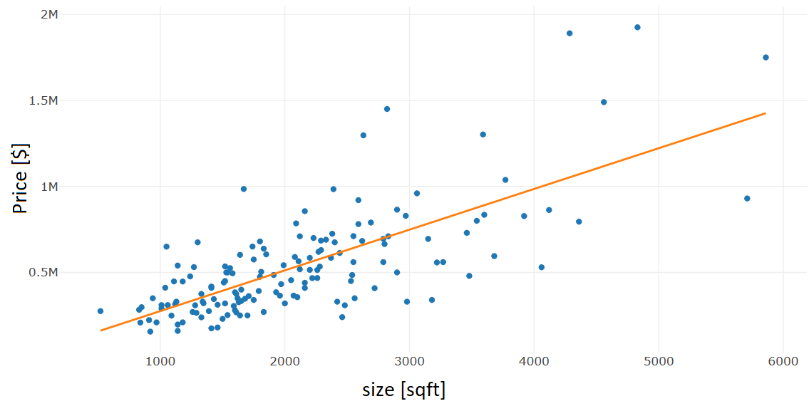
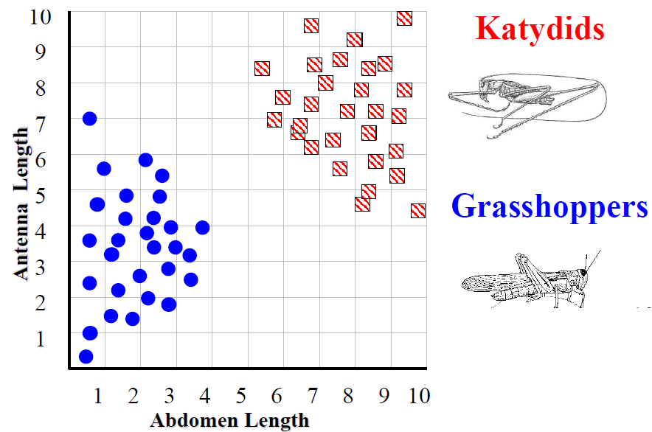
Supervised learning
Machine learning
Information: set of input-output data is given
Goal: discover relation between input and output
Utility: given a new input, predict the output
Regression
Classification
Continuous-value output
Discrete-value output

Slide 5
Classification: Illustrative task
Machine learning

Slide 6
Examples of classification
Machine learning
Image recognition
Predicting tumor cells as benign or malignant (extract features from cells images)
Detecting faults (unbalanced problem)
Predicting level of affinity (low/high ) between a protein and a ligand

Slide 7
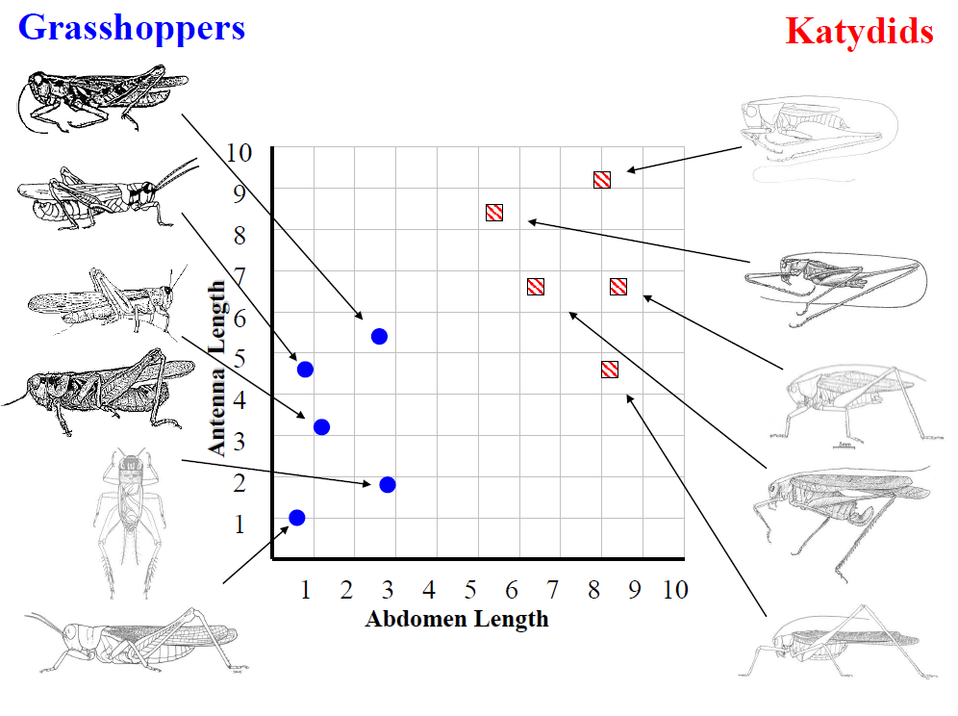
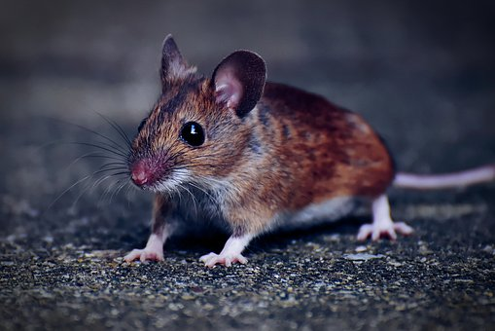
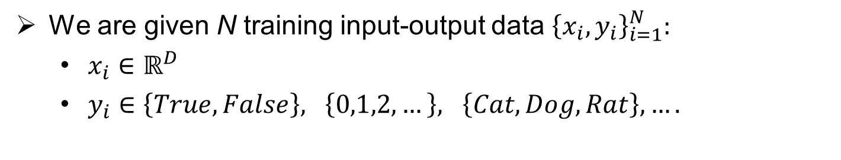
Classification: notation
Machine learning
We are given N training input-output data ${\left\{x_{i},y_{i}\right\}}_{i=1}^{N}:$
$x_{i}∈ℝ^{D}$
$y_{i}∈\left\{True, False\right\}, \left\{0,1,2,…\right\}, \left\{Cat, Dog, Rat\right\}, ….$
x: image, y:rat
D=64x64x3=12’288
D=2

Slide 8
Classification: parametric approach
Machine learning
Unknown weights
x: image, y:rat
f(x,W)
Score for each possible class
D=64x64x3=12’288
s=f(x,W) = W x + b
3x1
12’288x1
Assume 3 classes

Slide 9
Classification: parametric approach
Machine learning
x: image, y:rat
-10
cat
f(x,W)
9.1
dog
4.2
rat
D=64x64x3=12’288
Are the chosen values of the weights W good or bad?
How to choose W?

Slide 10
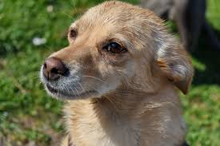
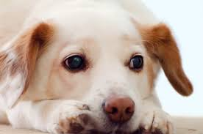
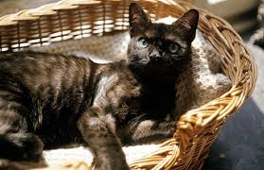
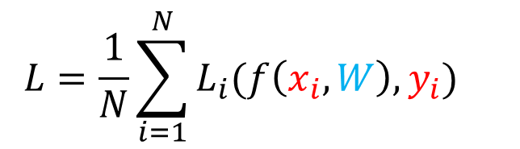
Loss function
Machine learning
How to quantify goodness of W?
Suppose 4 training examples ${\left\{x_{i},y_{i}\right\}}_{i=1}^{N=4}$ and 3 classes (cat, dog, rat)
cat | -10 | 1 | -0.2 | 1
dog | 9.1 | 15 | 3 | 2
rat | 4.2 | 3 | 3.1 | 10
Loss for each sample
$${L=\frac{1}{N}\sum_{i=1}^{N}{L_{i}(f\left(x_{i},W\right),y_{i})} }_{}$$
Loss

Slide 11
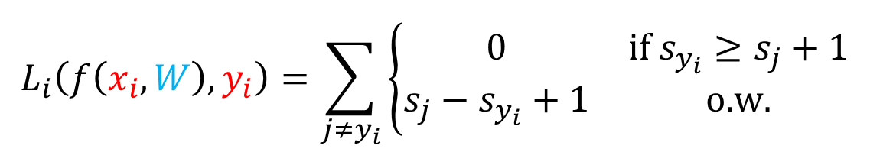

SVM loss
Machine learning
$$L_{i}\left(f\left(x_{i},W\right),y_{i}\right)=\sum_{j≠y_{i}}{\left\{\begin{matrix}0 & \text{if} s_{y_{i}}≥s_{j}+1 \\ s_{j}−s_{y_{i}}+1 & \text{o}\text{.}\text{w}\text{.}\end{matrix}\right.}$$
cat | -10 | 1 | -0.2 | 1
dog | 9.1 | 15 | 3 | 2
rat | 4.2 | 3 | 2.9 | 10
$$L_{1}\left(f\left(x_{1},W\right),y_{1}\right)=0+\left(9.1−4.2+1\right)=5.9$$
$$L_{2}\left(f\left(x_{2},W\right),y_{2}\right)=0+0=0$$
$$L_{3}\left(f\left(x_{3},W\right),y_{3}\right)=0+(2.9−3+1)=0.9$$
$$L_{4}\left(f\left(x_{4},W\right),y_{4}\right)=(2−1+1)+(10−1+1)=12$$

Slide 12
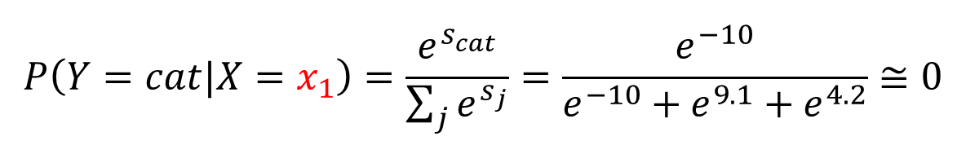
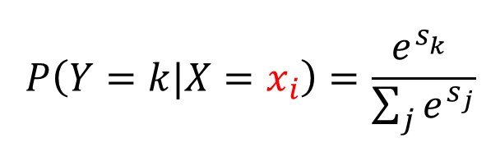
Softmax classifier
Machine learning
Use scores to define probabilities of the classes
$$P\left(Y=k|X=x_{i}\right)=\frac{e^{s_{k}^{}}}{\sum_{j}{e^{s_{j}}}}$$
cat | -10 | 1 | -0.2 | 1
dog | 9.1 | 15 | 3 | 2
rat | 4.2 | 3 | 2.9 | 10
$$P\left(Y=cat|X=x_{1}\right)=\frac{e^{s_{cat}^{}}}{\sum_{j}{e^{s_{j}}}}=\frac{e^{−10}}{e^{−10}+e^{9.1}+e^{4.2}}≅0$$

Slide 13
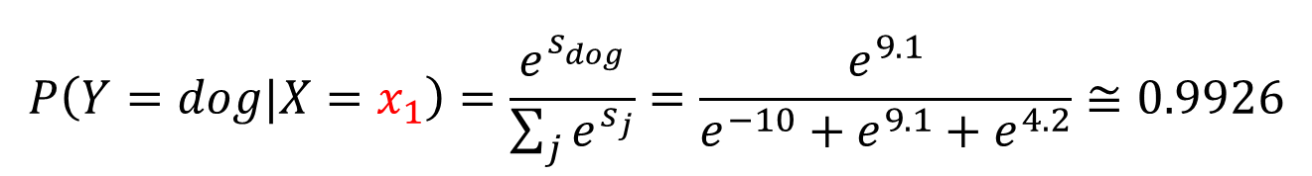
Softmax classifier
Machine learning
Use scores to define probabilities of the classes
$$P\left(Y=k|X=x_{i}\right)=\frac{e^{s_{k}^{}}}{\sum_{j}{e^{s_{j}}}}$$
cat | -10 | 1 | -0.2 | 1
dog | 9.1 | 15 | 3 | 2
rat | 4.2 | 3 | 2.9 | 10
$$P\left(Y=dog|X=x_{1}\right)=\frac{e^{s_{dog}^{}}}{\sum_{j}{e^{s_{j}}}}=\frac{e^{9.1}}{e^{−10}+e^{9.1}+e^{4.2}}≅0.9926$$

Slide 14
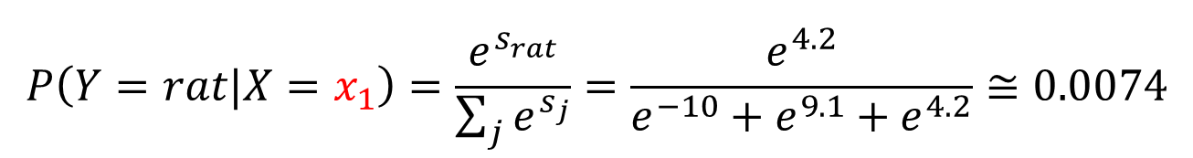
Softmax classifier
Machine learning
Use scores to define probabilities of the classes
$$P\left(Y=k|X=x_{i}\right)=\frac{e^{s_{k}^{}}}{\sum_{j}{e^{s_{j}}}}$$
cat | -10 | 1 | -0.2 | 1
dog | 9.1 | 15 | 3 | 2
rat | 4.2 | 3 | 2.9 | 10
$$P\left(Y=rat|X=x_{1}\right)=\frac{e^{s_{rat}^{}}}{\sum_{j}{e^{s_{j}}}}=\frac{e^{4.2}}{e^{−10}+e^{9.1}+e^{4.2}}≅0.0074$$

Slide 15
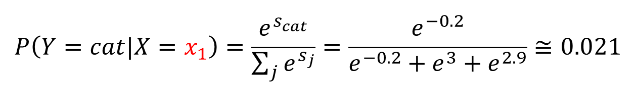
Softmax classifier
Machine learning
Use scores to define probabilities of the classes
$$P\left(Y=k|X=x_{i}\right)=\frac{e^{s_{k}^{}}}{\sum_{j}{e^{s_{j}}}}$$
cat | -10 | 1 | -0.2 | 1
dog | 9.1 | 15 | 3 | 2
rat | 4.2 | 3 | 2.9 | 10
$$P\left(Y=cat|X=x_{1}\right)=\frac{e^{s_{cat}^{}}}{\sum_{j}{e^{s_{j}}}}=\frac{e^{−0.2}}{e^{−0.2}+e^{3}+e^{2.9}}≅0.021$$

Slide 16

Softmax classifier
Machine learning
Use scores to define probabilities of the classes
$$P\left(Y=k|X=x_{i}\right)=\frac{e^{s_{k}^{}}}{\sum_{j}{e^{s_{j}}}}$$
cat | -10 | 1 | -0.2 | 1
dog | 9.1 | 15 | 3 | 2
rat | 4.2 | 3 | 2.9 | 10
$$P\left(Y=dog|X=x_{1}\right)=\frac{e^{s_{dog}^{}}}{\sum_{j}{e^{s_{j}}}}=\frac{e^{3}}{e^{−0.2}+e^{3}+e^{2.9}}≅0.514$$

Slide 17
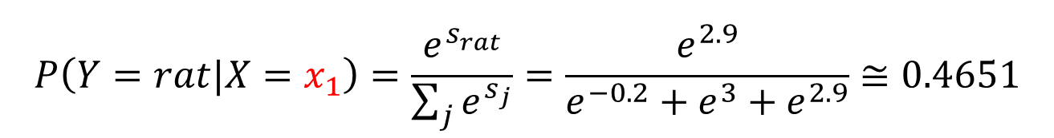
Softmax classifier
Machine learning
Use scores to define probabilities of the classes
$$P\left(Y=k|X=x_{i}\right)=\frac{e^{s_{k}^{}}}{\sum_{j}{e^{s_{j}}}}$$
cat | -10 | 1 | -0.2 | 1
dog | 9.1 | 15 | 3 | 2
rat | 4.2 | 3 | 2.9 | 10
$$P\left(Y=rat|X=x_{1}\right)=\frac{e^{s_{rat}^{}}}{\sum_{j}{e^{s_{j}}}}=\frac{e^{2.9}}{e^{−0.2}+e^{3}+e^{2.9}}≅0.4651$$

Slide 18
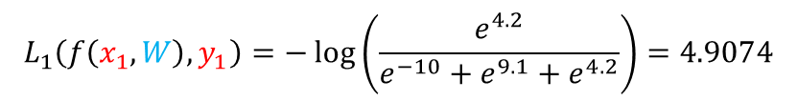
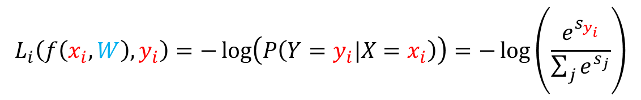
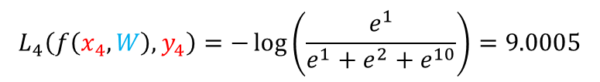
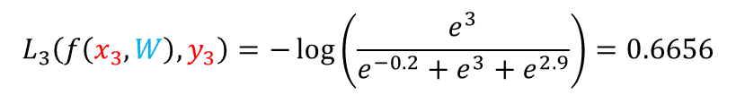
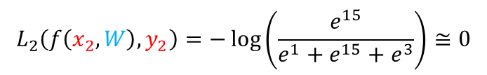
Softmax classifier: loss function
Machine learning
$$L_{i}\left(f\left(x_{i},W\right),y_{i}\right)=−\log\left(P\left(Y=y_{i}|X=x_{i}\right)\right)=−\log\left(\frac{e^{s_{y_{i}}^{}}}{\sum_{j}{e^{s_{j}}}}\right)$$
cat | -10 | 1 | -0.2 | 1
dog | 9.1 | 15 | 3 | 2
rat | 4.2 | 3 | 2.9 | 10
$$L_{1}\left(f\left(x_{1},W\right),y_{1}\right)=−\log\left(\frac{e^{4.2}}{e^{−10}+e^{9.1}+e^{4.2}}\right)=4.9074$$
$$L_{2}\left(f\left(x_{2},W\right),y_{2}\right)=−\log\left(\frac{e^{15}}{e^{1}+e^{15}+e^{3}}\right)≅0$$
$$L_{3}\left(f\left(x_{3},W\right),y_{3}\right)=−\log\left(\frac{e^{3}}{e^{−0.2}+e^{3}+e^{2.9}}\right)=0.6656$$
$$L_{4}\left(f\left(x_{4},W\right),y_{4}\right)=−\log\left(\frac{e^{1}}{e^{1}+e^{2}+e^{10}}\right)=9.0005$$

Slide 19
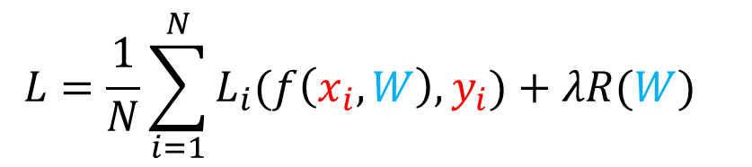
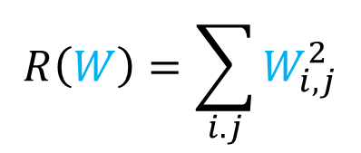
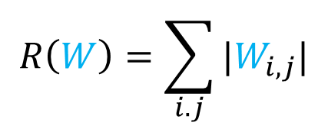
Classifier: regularization
Machine learning
$${L=\frac{1}{N}\sum_{i=1}^{N}{L_{i}(f\left(x_{i},W\right),y_{i})}+λR(W)}_{}$$
Data loss
Regularization
$$R\left(W\right)=\sum_{i.j}{W_{i,j}^{2}}$$
$$R\left(W\right)=\sum_{i.j}{{|W}_{i,j}|}$$

Slide 20
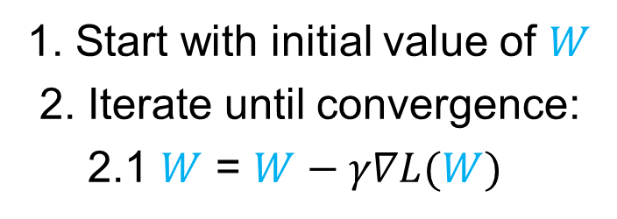
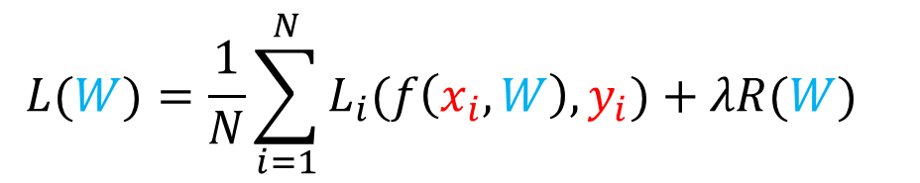
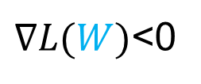


Optimization
Machine learning
How to find the parameters W minimizing the loss $L(W)$?
$${L(W)=\frac{1}{N}\sum_{i=1}^{N}{L_{i}(f\left(x_{i},W\right),y_{i})}+λR(W)}_{}$$
Gradient descent algorithm: go in the opposite direction of the gradient
$$L(W)$$
$∇L(W)$<0
1. Start with initial value of $W$
2. Iterate until convergence:
2.1 $W$ = $W−γ∇L(W)$
$$W$$

Slide 21
Assessing performance
Machine learning
Dataset
Training
Test
Use training data to find optimal parameters
Test performance on fresh data

Slide 22

Assessing performance: accuracy
Machine learning
accuracy: $\frac{\text{\#}\text{correctly} \text{classified} \text{samples}}{\text{\# }\text{samples}}$
If in the test set you have 50 images with dogs and 50 images with cats, are you satisfied if your classifier gives you an accuracy of 95%?
If in the test set you have 95 images with dogs and 5 images with cats, are you satisfied if your classifier gives you an accuracy of 95%?
You are training a classifier to detect if a patient is affected or not by COVID 19? In your test set there are 5 COVID-positive patient and 95 COVID-negative patients. Are you satisfied if your classifier gives you an accuracy of 95%?

Slide 23
Assessing performance: confusion matrix and cost matrix
Machine learning
 |  | Actual class
 |  | Cat | Dog | Rat
Predicted class | Cat | 80 | 7 | 1
 | Dog | 5 | 90 | 22
 | Rat | 15 | 3 | 77
 |  | Actual class
 |  | Positive | Negative
Predicted class | Positive | TP | FP
 | Negative | FN | TN
 |  | Actual class
 |  | Positive | Negative
Predicted class | Positive | 98 | 25
 | Negative | 2 | 75
 |  | Actual class
 |  | Positive | Negative
Predicted class | Positive | 90 | 10
 | Negative | 10 | 90
acc: 86%
acc: 90%
sens: 98%
sens: 90%

Slide 24
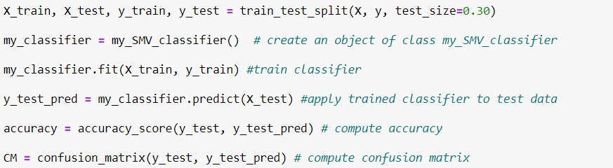
Classification pipeline
Machine learning

