Slide 1

UW MLEARN 410 B
Instructors:
Justin Donaldson
Zach Alexander
Sid Rajaram
Data Science: Service, Communities, and Search
Salesforce Einstein
TA: Jose Villalta

Slide 2



Service Cloud Einstein
Is this e-mail Spam?
What kind of help does the customer need?
Is it a standard question? Can I just auto-reply?
Is it a high priority case? Should it be bumped up the queue?
Which of my agents has the skillset to handle this case? And what is their availability like? Who should get this case?
Is there some bug/problem that is causing a bunch of new cases to occur right now (like trending hashtags)?

Slide 3
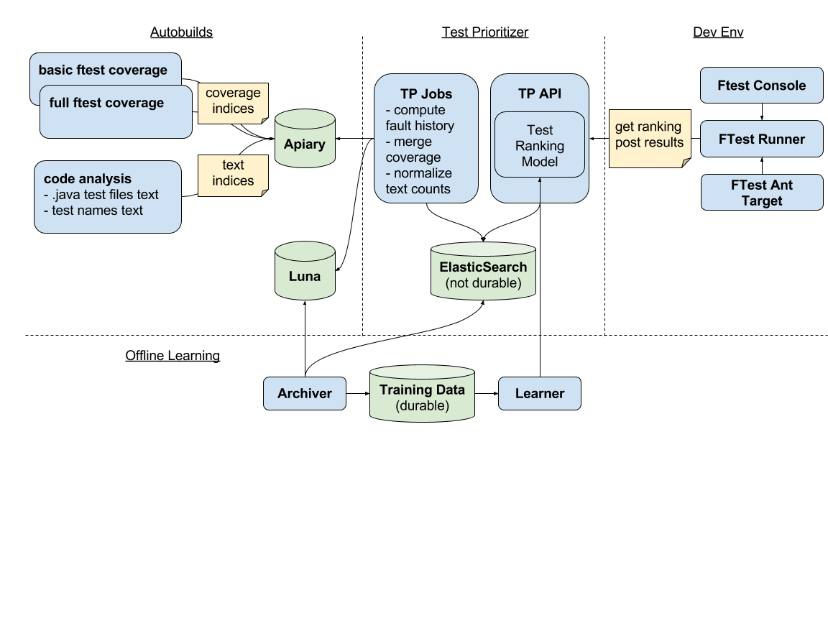
Productivity Intelligence
Will this code cause a bug?
Who should review this changelist?
Who can fix this error?
Are there some associated tests for the code I am trying to change?

Slide 4
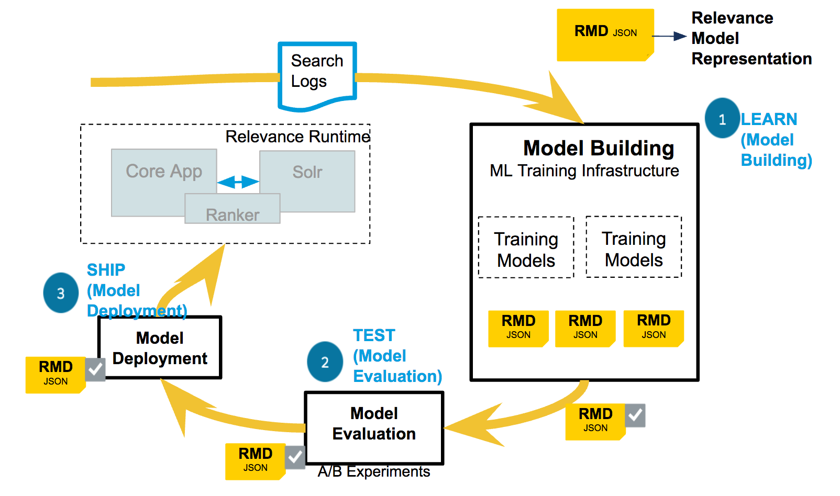
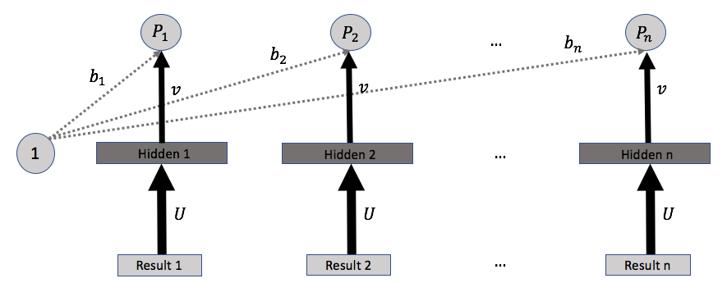
Search Relevance
Rank documents returned by a search engine.
Need to understand the query…
AND the documents…
AND the user’s intent…

Slide 5
Course Topics
Supervised Learning (Classification and Regression)
Generalized Linear Models (1 class – Sid)
Trees and Forests (1 class – Justin)
Unsupervised Learning
Clustering (1 class – Justin)
Dimensionality Reduction (1 class – Justin)
Topic Models (1 class – Zach)
Domain-specific ML
Recommender Systems (1 class – Justin)
Advanced Topics : Neural Networks, Out-of-Core (1 class – Sid)
Anomaly Detection (1 class – Sid)
Learning to Rank (1 class – Zach)
Project Presentations (1 class - Sid, Zach, Justin)

Slide 6

In-class Logistics
Some lecturing and slides…but mostly
“Flipped” classroom:
Will have R Markdown notebooks we’re going to walk through where you fill in the steps
Try to work in small groups (2-3) to discuss, but then implement your own solutions
YOU WILL NEED R STUDIO TO WORK ON THESE NOTEBOOKS AND TO DO HOMEWORKS

Slide 7
Homeworks
2 homeworks:
Supervised Learning
Covering the first two lectures
Will be put up on the Canvas site very soon
Due 4/20
Unsupervised Learning
Covering lecture 3-5
Will be released soon after we start the module
Due 5/18
R Markdown notebooks again

Slide 8
Homeworks
2 homeworks:
Supervised Learning
Covering the first two lectures
Will be put up on the Canvas site very soon
Due 4/20
Unsupervised Learning
Covering lecture 3-5
Will be released soon after we start the module
Due 5/18
R Markdown notebooks again

Slide 9
Project
Work individually
Use any language/tools you want – if it’s not R, we may not be able to help with any issues that arise!
Ideally, something that is relevant to you
In-class presentation and written report
Not pre-cleaned/processed data
CHECK WITH US FIRST!
Proposals due as part of Homework 1.

Slide 10
What the course is about
Primarily about building the end-to-end model building process.
We’ll mostly explain topics via example
We’ll cover some theory and algorithms, but it won’t be the focus of the course..

Slide 11
Textbook ML caricature
Features X
Inference Algorithm
Model f(•)
Target y
Supervised Learning
Given matrix X, with targets (labels) y,
learn f s.t. f(X) = y

Slide 12
Let’s decompose this
Features X
Inference Algorithm
Model f(•)
Target y

Slide 13
Real data never looks like this
Features X
X is numeric – your raw data probably isn’t
Raw text
Categorical features (Strings? Numeric?)
Date-Time features
Corrupt/missing data
Privacy concerns
You will spend most of your time getting to a usable X

Slide 14
Featurizing Text Data
Featurizer
Raw(er) Data
Raw Data
Normalize text
foreign languages(?), remove punctuation, case
tokenize into words/phrases, drop stop words
Vectorize documents
Counting/TF-IDF vectorizer
Word2vec (use external data?)
Topic models

Slide 15

Categorical Data
Featurizer
Raw(er) Data
Raw Data
Cardinal (cat/dog) or ordinal (high/medium/low)?
May already be numeric
If ordinal, can your model work with that?
Does your model work with categorical features? Or One-hot representations?

Slide 16
Other Data Types
Featurizer
Raw(er) Data
Raw Data
DateTimes
Datetime object, UTC timestamp, Formatted string (e.g. “YYYY-MM-DDT00:00:00”)
Need local time? Timezones?
Convert to number of seconds/hours/days from some fixed date
Missing data/Nulls
Impute with mean? with a regression model? +/- Infinity?

Slide 17

Featurizer
Join
Aggregate
Join
Featurizer
Featurizer
Scale issues
Data may be in different places
Featurizer
Features X

Slide 18
Back to the big picture
Features X
Inference Algorithm
Model f(•)
Target y

Slide 19
Target
Target y
Needs to be aligned to users needs
Can often be hard to define
E.g. - predicting whether a sales opportunity is likely to convert…in what timeframe
Need to do everything we did to define X

Slide 20
Back to the big picture
Features X
Inference Algorithm
Model f(•)
Target y

Slide 21
Considerations for models
Model f(•)
Easy to debug?
Are the parameters directly interpretable to you?
Is it easy to understand prediction for a given sample?
Is the bug due to a poorly formulated problem? a bug in the code? bad data (includes bugs in the data pipeline)?
Need to track useful metrics

Slide 22
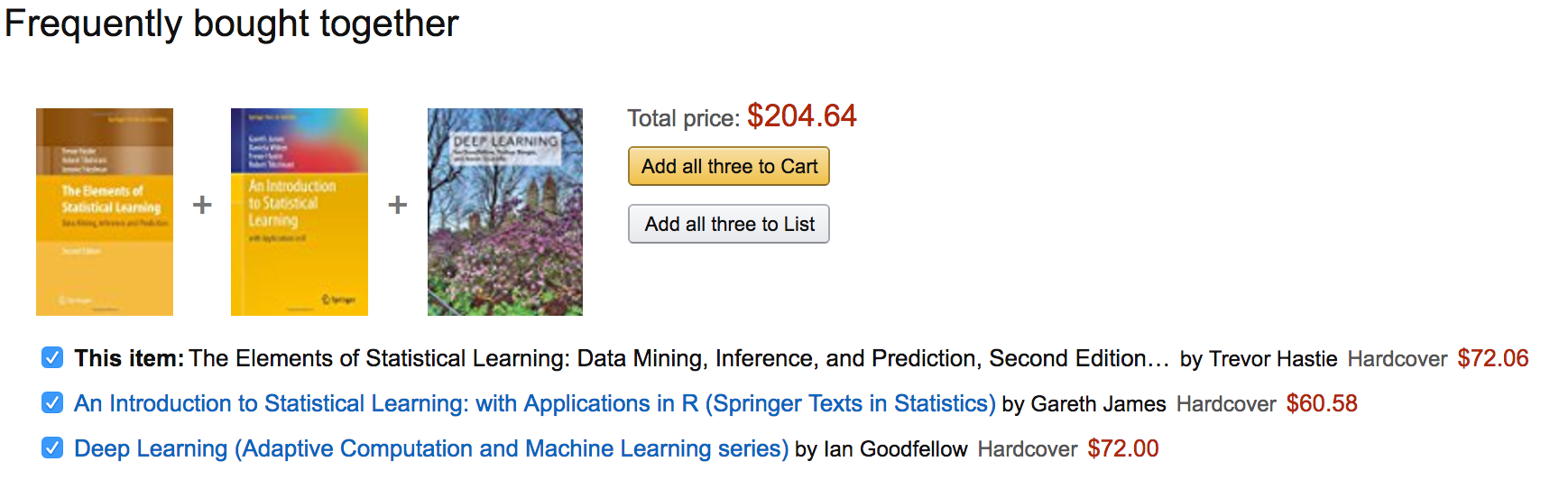

Can you explain what to a customer?

Slide 23
Can you explain why to a customer?
Understand important factors / causal assessments
Can be used for decision making/policy changes
E.g. – HR models to predict employee churn…use to change compensation/benefits structure

Slide 24
Back to the big picture
Features X
Inference Algorithm
Model f(•)
Target y

Slide 25
(Model, Training algorithm)
Inference Algorithm
Model f(•)
Need to be selected jointly
Not all inference algorithms work with all models
Need to consider scale/performance issues
Deep learning models need lots of data
Big Data -> online learning algorithm
Big Data -> distributed learning algorithm

Slide 26

The Netflix Prize (2006-2009)
Prize = $1 million
Want to predict movie rating, given <user, movie, date>
Measurement metric – RMSE (controversial)
Early leaders – Geoff Hinton’s team using Restricted Boltzmann Machines (RBMs)

Slide 27
The Netflix Prize (2006-2009)
RBMs are a type of neural network that is very slow to train
Final winner – used an ensemble of models, including 100s of RBMs (> 10% improvement)
Netflix did not use the winning solution techniques – too slow and expensive!

Slide 28
Course Topics
Supervised Learning Methods (Classification/Regression)
Basic Linear Models (today)
Trees and Forests
Unsupervised Learning
Clustering
Dimensionality Reduction
Topic Models
Domain-specific Machine Learning
Recommender Systems
Advanced Topics
Anomaly Detection
Learning to Rank
Project Presentations

Slide 29
Course Topics
What are you interested in learning?
Make suggestions in Discussion on Canvas site
Deep Learning
Any other suggestions or questions for logistics?

