Slide 1
Dimensionality Reduction

Slide 2
Intro
The Curse of Dimensionality
Distances between points grow very fast
Analogy: Finding penny on a line, a football field, in a building
Ways to reduce dimensionality
Feature Subset Selection
O(2^{n})if we try all
Forward selection – add feature that decreases the error the most
Backward selection – remove feature that decreases the error the most (or increases it only slightly)
But selection is greedy not necessarily optimal
Feature Extraction
PCA
LDA
FA
MDS

Slide 3
Principal Component Analysis (PCA)

Slide 4
What It Does
Comes up with a new coordinate system
Performs a rotation of your dataset that decorrelates the features
Allows you to reduce the dimensionality of your data

Slide 5
Uses
Dimensionality reduction
Pattern recognition (e.g. Eigenfaces)

Slide 6
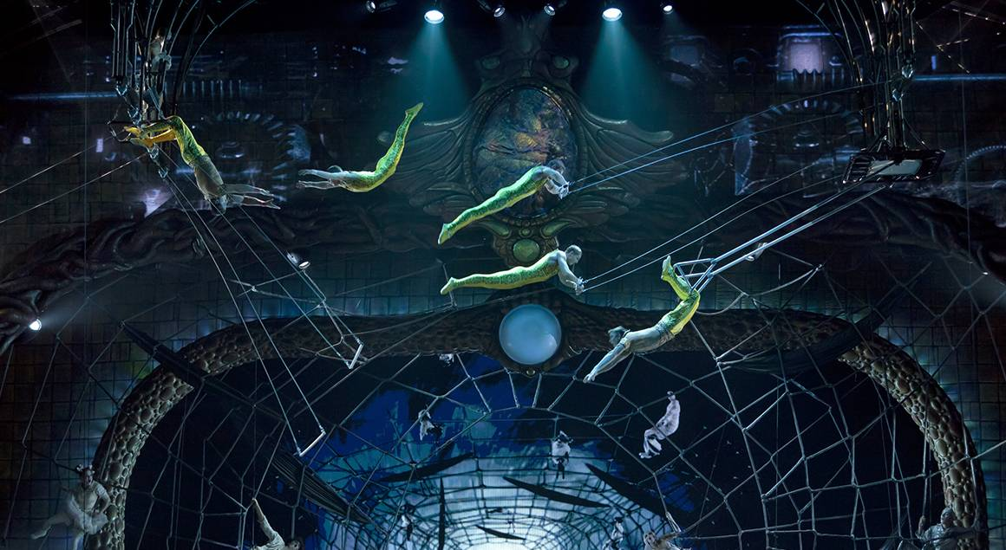
Cinematography

Slide 7

The Pareto Principle
Notes:
From designorate.com

Slide 8
PCA
Creates new features that are linear combinations of the original features
New features are orthogonal to each other
Keep the new features that account for a large amount of the variance in the original dataset
Re-base the dataset’s coordinate system in a new space defined by its lines of greatest variance

Slide 9
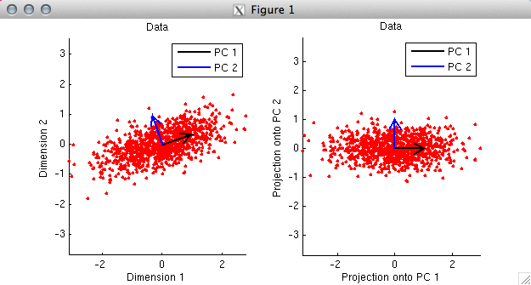
Visualization
Notes:
Image from http://4.bp.blogspot.com/-wduUats3Qrg/TxEs6SuI41I/AAAAAAAAA7Y/iYA5qcv_GTI/s1600/018-pca-001.png

Slide 10
Principal Components
Linearly uncorrelated variables
1st principal component has the largest possible variance
Each succeeding component has highest possible variance. Constraint: Must be orthogonal to all the preceding components

Slide 11
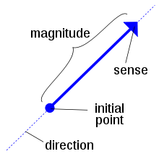

Observation About Vectors
Almost all vectors change direction when multiplied by a matrix
Certain exceptional vectors (which are called eigenvectors) remain in the same direction
Notes:
Images from Wikipedia.\

Slide 12
Eigenvector
A vector that when multiplied by a given matrix gives a scalar multiple of itself
The 0 vector is never considered an eigenvector
The scalar multiple is called its eigenvalue λ.
Notes:
Image from Wikimedia

Slide 13
Eigenvalue
A scalar
Scale factor corresponding to a particular eigenvector
Merely elongates or shrinks or reverses v, or leaves it unchanged

Slide 14
Eigens Expressed As An Equation
A: a square matrix
x: a nonzero vector (“eigenvector”)
λ: a nonzero scalar (“eigenvalue of A”)
Ax = λx

Slide 15
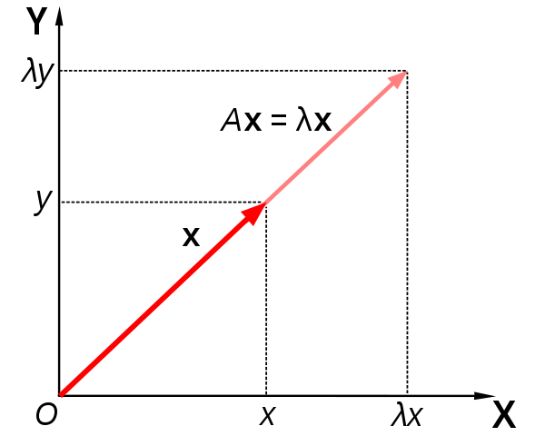
Graphical Depiction

Slide 16
Example of Eigenvalue & Eigenvector Pair
Ax = λx

Slide 17
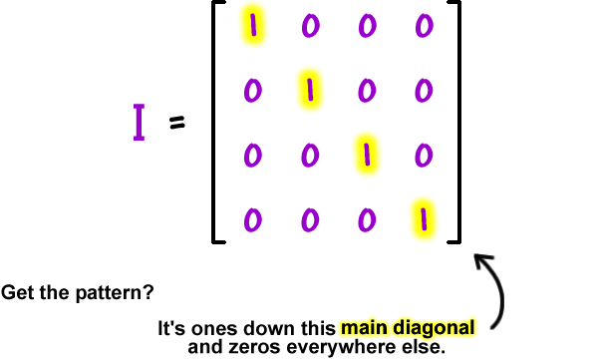
Identity Matrix
A square matrix that looks like this:
Notes:
From http://www.coolmath.com/sites/cmat/files/images/05-matrices-16.gif

Slide 18
Eigen
German for “very own”
“My very own apartment”: »Meine eigene Wohnung«

Slide 19
Characteristic Polynomial
Start with Aλ = λv
I is the identity matrix
Noting that Iv = v, rewrite as (A – λI)v = 0
A – λI is square matrix
| | is notation for determinant

Slide 20
Characteristic Equation of A
Since v is nonzero, A-λI is singular (non invertible); therefore its determinant is 0.
The roots of this n-degree polynomial are the eigenvalues of A.

Slide 21
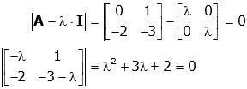
Example Calculation of Eigenvalues
Solutions are λ= -1 and λ = -2
Notes:
Image from http://lpsa.swarthmore.edu/MtrxVibe/EigMat/images/Matrix20.gif

Slide 22
Eigenvalue Equation
Use to obtain the corresponding eigenvector v for each eigenvalue λ

Slide 24
Eigenvalues and Eigenvectors in R
> eigen(x)
demo

Slide 25
R Functions for PCA
prcomp() - Uses SVD, the preferred method
Display shows standard deviations of the components
> pr<-prcomp(dataset, scale=TRUE)
Transform the data into the new coordinate system:
> new<-pr$x[,1:2]
princomp() uses covariance matrix—for compatibility with S-PLUS

Slide 26
Tips
Dataset can have numeric values only. Need to exclude nonnumeric features with brackets or subset.
modelname<-princomp(dataset)
summary(modelname) gives proportion of the total variance explained by each component.
Modelname$loadings
Modelnames$scores

Slide 27
Options
center
scale
scale.

Slide 28
Component Loadings
Eigenvectors •√Eigenvalues
Correlation between the component and the original features: how much variation in a feature is explained by a component

Slide 29
Preparation
Center the variables
Scale the variables
Skewness transformation: makes the distribution more symmetrical
Box-Cox transformation: makes the distribution more normal like

Slide 30
Scoring
V: the matrix whose columns are the eigenvectors of the covariance matrix. Each eigenvector is normalized to have unit length.
V^{T} now defines a rotation
Start with original dataset x.
Calculate mean of each column to obtain row vector m.
Subtract m from each row of x to obtain z. Multiply z by V^{T} to obtain the new matrix of new coordinates c.

Slide 31
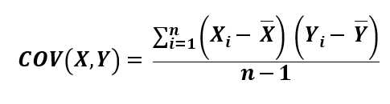
Covariance
(Numerator can be expressed as XX^{T})

Slide 32
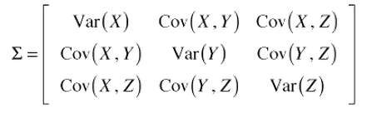
Covariance Matrix

Slide 33
Principal Components
The first principal component is the eigenvector of the covariance matrix that has the largest eigenvalue
This vector points into the direction of the largest variance of the data
The magnitude of this vector equals the corresponding eigenvalue.
The second largest eigenvector is orthogonal to the largest eigenvector, and points into the direction of the second largest spread of the data.

Slide 34
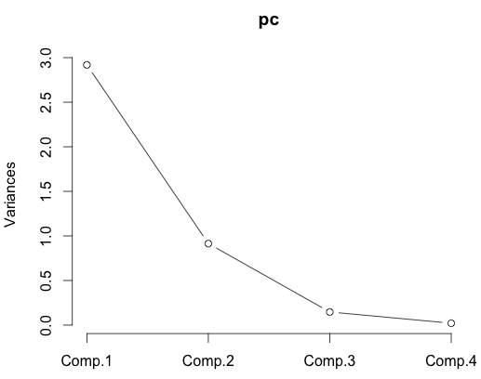
Scree Plot
Plots the variances against the number of the principal component
Used to visiually assess which components explain most of the variability
In R: fit <- princomp(dataset)
screeplot(fit)

Slide 35
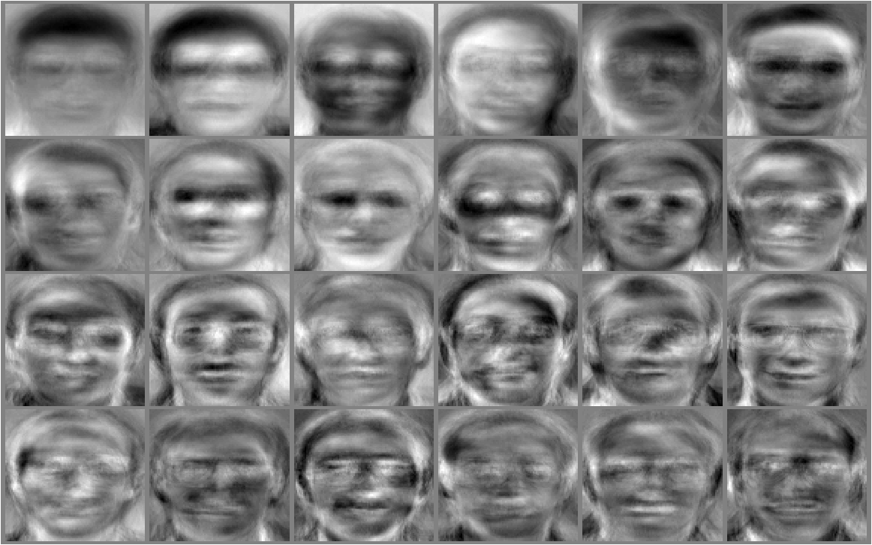
Eigenfaces

Slide 36
Multidimensional Scaling

Slide 37
Overview of MDS
You are given pairwise relationships between cases, e.g.
Distance between cities
Measures of similarity/dissimilarity
Importance
Preferences
MDS lays these cases out as points in an n-dimensional space
Traditional use is with n=2 or n=3 to visualize relationships in the data for exploratory purposes
In ML we can also use to reduce dimensionality of data

Slide 38
Contrast with PCA
PCA reduces dimensionality while retaining variance
MDS
Can be used to introduce dimensionality
Can be used to reduces dimensionality while retaining the relative distances

Slide 39
Distances Between Some European Cities
 | 1 | 2 | 3 | 4 | 5 | 6 | 7 | 8 | 9 | 10
1 | 0 | 569 | 667 | 530 | 141 | 140 | 357 | 396 | 570 | 190
2 | 569 | 0 | 1212 | 1043 | 617 | 446 | 325 | 423 | 787 | 648
3 | 667 | 1212 | 0 | 201 | 596 | 768 | 923 | 882 | 714 | 714
4 | 530 | 1043 | 201 | 0 | 431 | 608 | 740 | 690 | 516 | 622
5 | 141 | 617 | 596 | 431 | 0 | 177 | 340 | 337 | 436 | 320
6 | 140 | 446 | 768 | 608 | 177 | 0 | 218 | 272 | 519 | 302
7 | 357 | 325 | 923 | 740 | 340 | 218 | 0 | 114 | 472 | 514
8 | 396 | 423 | 882 | 690 | 337 | 272 | 114 | 0 | 364 | 573
9 | 569 | 787 | 714 | 526 | 436 | 519 | 472 | 364 | 0 | 755
10 | 190 | 648 | 714 | 622 | 320 | 302 | 514 | 573 | 755 | 0
Notes:
https://books.google.com/books?id=NYDSBwAAQBAJ&pg=PA464

Slide 40
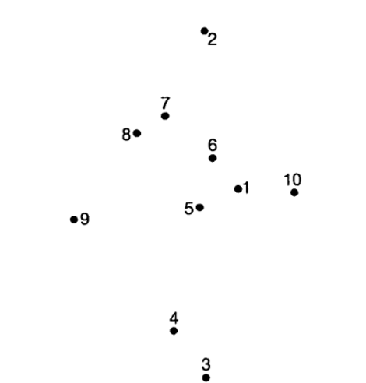
Constructed Space
Notes:
2D visualization preserving relative distances

Slide 41
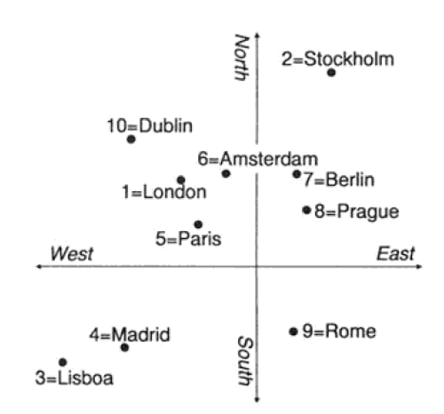
Actual locations
Notes:
Can be achieved through reflections and axis rotation.

Slide 42
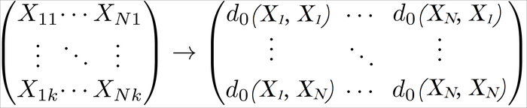
For Dimensionalty Reduction
Original data matrix – Each column represents a feature. Each of the N rows represents a point.
Create Dissimilarity Matrix storing the dist() distances d₀ between the points. The R function does this.
Notes:
https://www.packtpub.com/graphics/9781782161400/graphics/1400_11_33.jpg

Slide 43
Performing MDS in R
k is number of dimensions you want for the reconstructed space
d is full symmetric Dissimilarity Matrix
cmdscale(d, k=3)
The c in cmdscale stands for “classical”

Slide 44
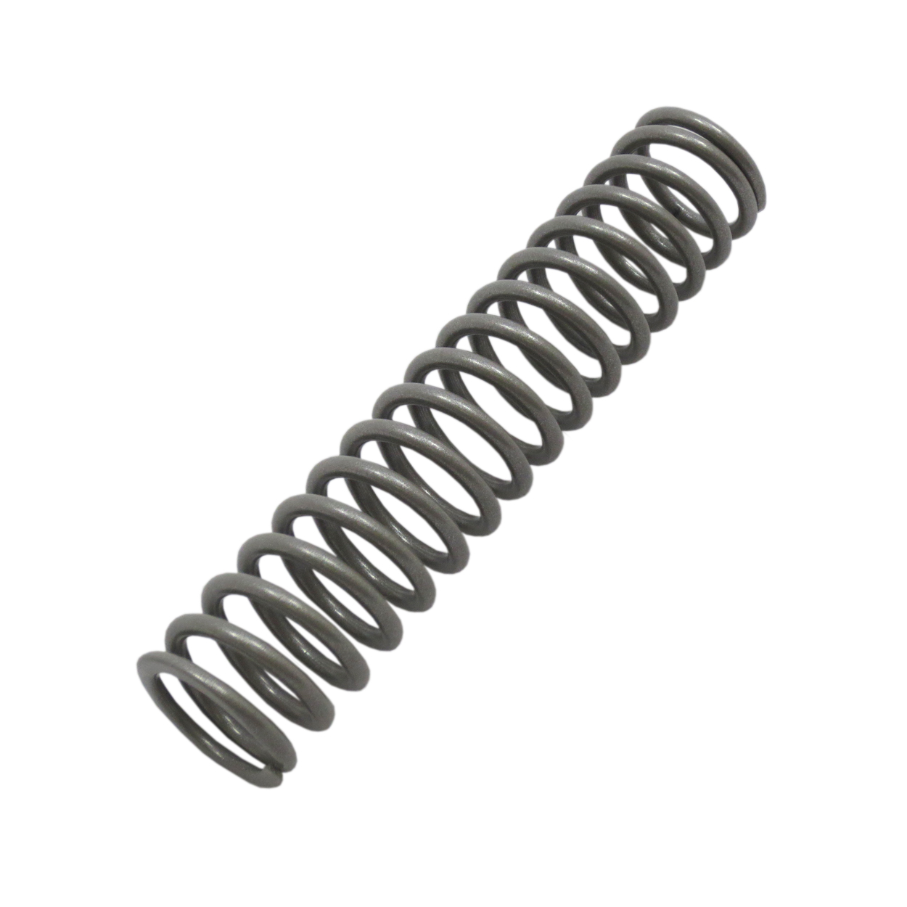
Non-Metric MDS
Exact distances in the reconstructed space can be off a little
Imagine springs of the original distance between the points. Want to minimize the overall stress
Notes:
This spring can compress and elongate, both causing stress. http://www.pasreform.com/webshop/images/stories/virtuemart/product/700008.jpg

Slide 45
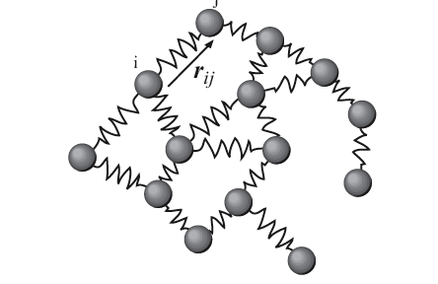
Spring model
Notes:
https://upload.wikimedia.org/wikipedia/commons/c/c8/Elastic_network_model.png

Slide 46


Common Stress Metrics
Notes:
http://fedc.wiwi.hu-berlin.de/xplore/tutorials/mvahtmlimg3999.gif, http://fedc.wiwi.hu-berlin.de/xplore/tutorials/mvahtmlimg4000.gif

Slide 47
NMDS in R
dmat is lower-triangle Dissimilarity Matrix
nmds(dmat)

Slide 48
tsne
t-Distributed Stochastic Neighbor Embedding

Slide 49
Basic Idea
Maps points in n dimensions onto a visualizable 2 or 3 dimensions
Computes probability distribution of each point being similar to each other point
Does this for both the hi dim and lo dim representations
Then minimizes divergence between the high dimension and low dimension distributions

Slide 50
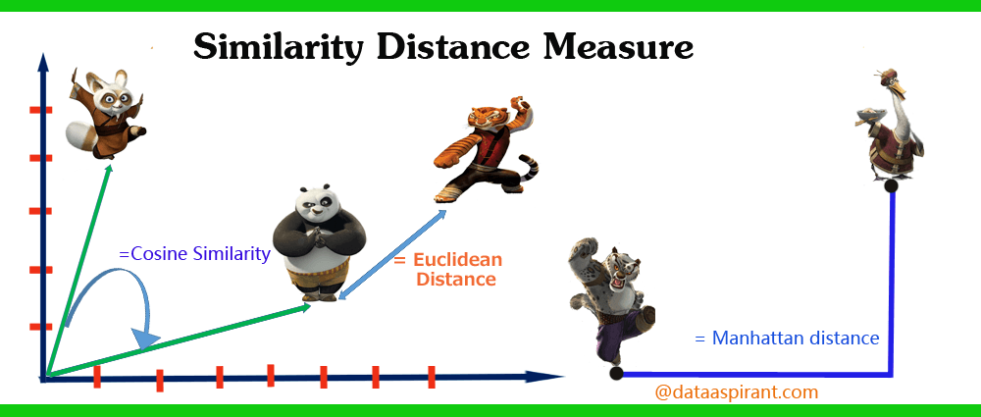
Euclidean distance
Notes:
https://i1.wp.com/dataaspirant.com/wp-content/uploads/2015/04/cover_post_final.png, https://wikimedia.org/api/rest_v1/media/math/render/svg/a0ef4fe055b2a51b4cca43a05e5d1cd93f758dcc

Slide 51
tsne takes a Probabilistic Approach to Similarity
Model the distance as having a probability distribution
Treat measured distance the peak of a symmetric bell curve
Assign lower variances to points that are in denser areas
Originally the low dim and hi dim representations each used Gaussian distributions
Refinement of the technique now uses the heavier-tailed Student’s t-distribution for the lo dim
Notes:
Using term “peak” rather than mean because the t-distribution with 1 degree of freedom, aka Cauchy distribution, technically does not have a mean.

Slide 52
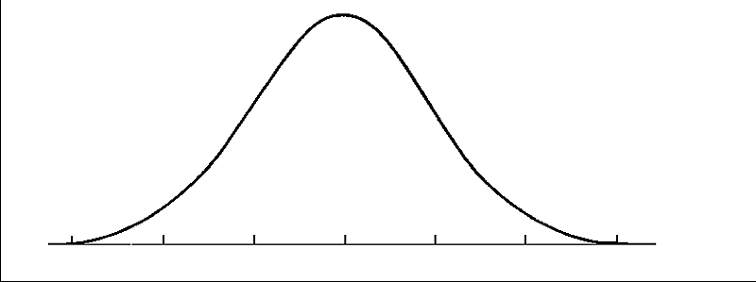
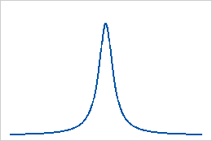

Slide 53
tsne in R
Performs tsne dimensionality reduction on an R matrix or a "dist" object
tsne(X, initial_config = NULL, k = 2, initial_dims = 30, perplexity = 30,
max_iter = 1000, min_cost = 0, epoch_callback = NULL, whiten = TRUE, epoch=100)

Slide 54
R Demo of tsna and Comparison with PCA
Notes:
colors = rainbow(length(unique(iris$Species)))
names(colors) = unique(iris$Species)
ecb = function(x,y){ plot(x,t='n'); text(x,labels=iris$Species, col=colors[iris$Species]) }
tsne_iris = tsne(iris[,1:4], epoch_callback = ecb, perplexity=50)
# compare to PCA
dev.new()
pca_iris = princomp(iris[,1:4])$scores[,1:2]
plot(pca_iris, t='n')
text(pca_iris, labels=iris$Species,col=colors[iris$Species])

Slide 55
Factor Analysis

Slide 56
Factor Analysis
Discovers latent factors that influence the features
Each original feature is a linear combination of the factors

