Slide 1
Topic Models
Zach Alexander - UW Machine Learning
May 4, 2017

Slide 2
About Me
Principal Data Scientist – Salesforce.com
My team supports the entire Search organization.
Search relevance/ranking
Query Understanding
Entity prediction
Query expansion (synonyms, did you mean?, etc..)
Document understanding

Slide 3
Past
Ph.D. in Applied Math from University of Colorado
Computational Topology (not machine learning)
Data Scientist at Seagate Technology
Hard Disk Quality Modeling
Certificate in Data Science @ UW (2013)
Data Scientist at Microsoft
Real-time media @ Skype
Call quality / root-cause analysis
Instructor at Galvanize
12-week Data Science ‘boot camp’

Slide 4
Goals for Today
Solid, intuitive understanding of SVD
Which leads to some intuition about all topic models
Practical experience implementing topic models in R
Singular Value Decomposition
Non-negative Matrix Factorization
Latent Dirichlet Allocation
Practical experience interpreting topic models in R
NOT theoretical foundations of the three algorithms.

Slide 5
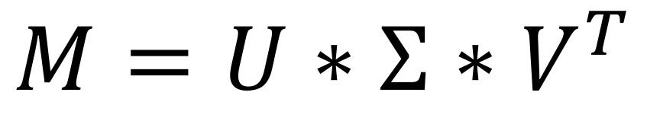
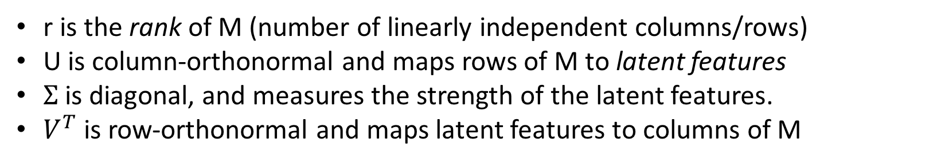
Singular Value Decomposition
The most fundamental matrix decomposition
$$M=U∗Σ{∗V}^{T}$$
m x n
m x r
r x r
r x n
r is the rank of M (number of linearly independent columns/rows)
U is column-orthonormal and maps rows of M to latent features
$Σ$ is diagonal, and measures the strength of the latent features.
$V^{T}$ is row-orthonormal and maps latent features to columns of M

Slide 6
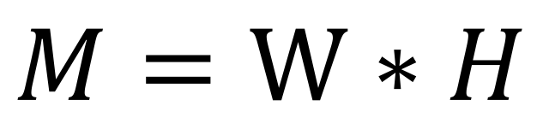
Nonnegative Matrix Factorization
A more heuristic matrix factorization approach
$$M=W∗H$$
m x n
m x k
k x n
Algorithm:
Hold W constant, solve for H
Clip H below at 0.
Hold H constant, Solve for W.
Clip W from below at 0.
Repeat…
k is the desired number of latent features
W maps rows of M to latent features
H maps latent features to columns of M
Add the constraint that W, H >= 0.

Slide 7
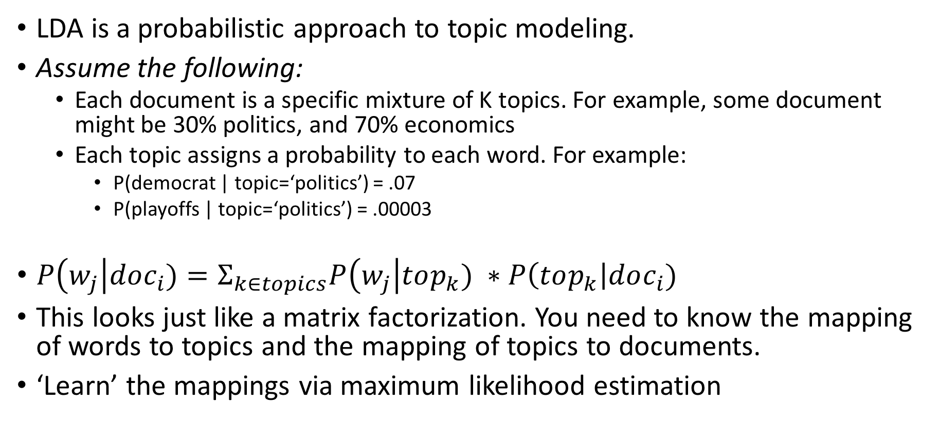
Latent Dirichlet Allocation
LDA is a probabilistic approach to topic modeling.
Assume the following:
Each document is a specific mixture of K topics. For example, some document might be 30% politics, and 70% economics
Each topic assigns a probability to each word. For example:
P(democrat | topic=‘politics’) = .07
P(playoffs | topic=‘politics’) = .00003
$P\left(w_{j}\right|doc_{i})=Σ_{k∈topics}P\left(w_{j}\right|top_{k}) ∗P\left(top_{k}\right|doc_{i})$
This looks just like a matrix factorization. You need to know the mapping of words to topics and the mapping of topics to documents.
‘Learn’ the mappings via maximum likelihood estimation

