Slide 1
Ambient Intelligence
Mats De Meyer
Michiel Aernouts
Dennis Joosens
Notes:
‹#›

Slide 2
Table of Contents
Introduction
Mobile node
NFC-PIR node
Raspberry Pi
Notes:
‹#›

Slide 3
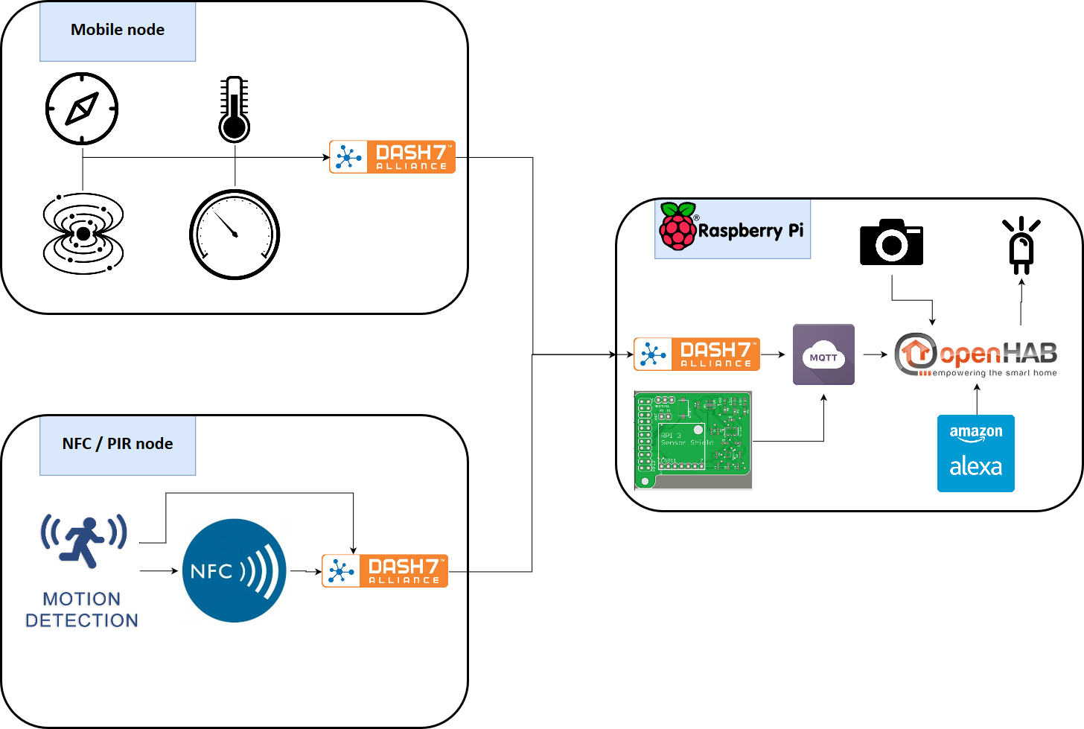
Basic Diagram
Notes:
‹#›

Slide 4
Group Contributions
Hardware
STM PCB
Pi Sensor PCB
Code
Orientation sensor driver
NFC Reader
Merging magnetometer & humidity sensor on Pi
Mobile node code
HABPanel custom widgets
Power consumption measurements
Notes:
‹#›

Slide 5
Mobile Node
Notes:
‹#›

Slide 6
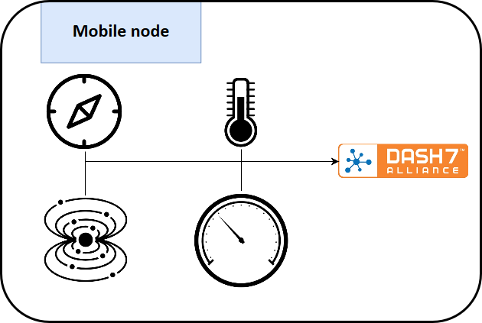
Mobile Node
Notes:
‹#›

Slide 7
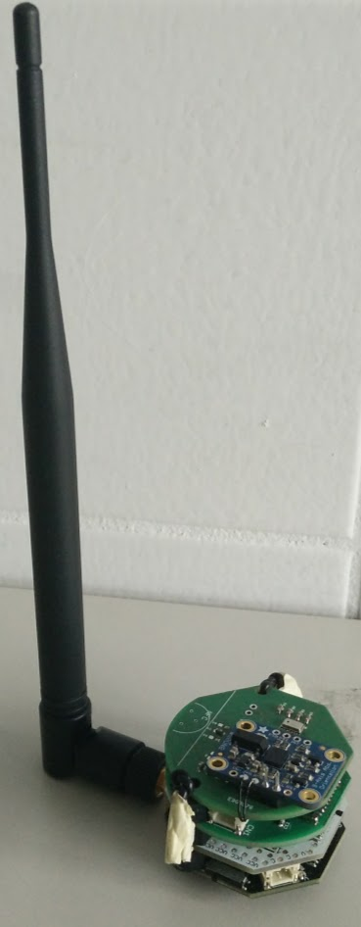
Mobile Node: STM32 PCB
STM32L162
LQFP-64 package
AN3216: Application note document
Switch for USB/Battery power
Battery charger over USB
RGB led as indicator
Initial idea: combine µc and sensor pcb
-> clearance issues -> separate pcb’s
Notes:
‹#›

Slide 8
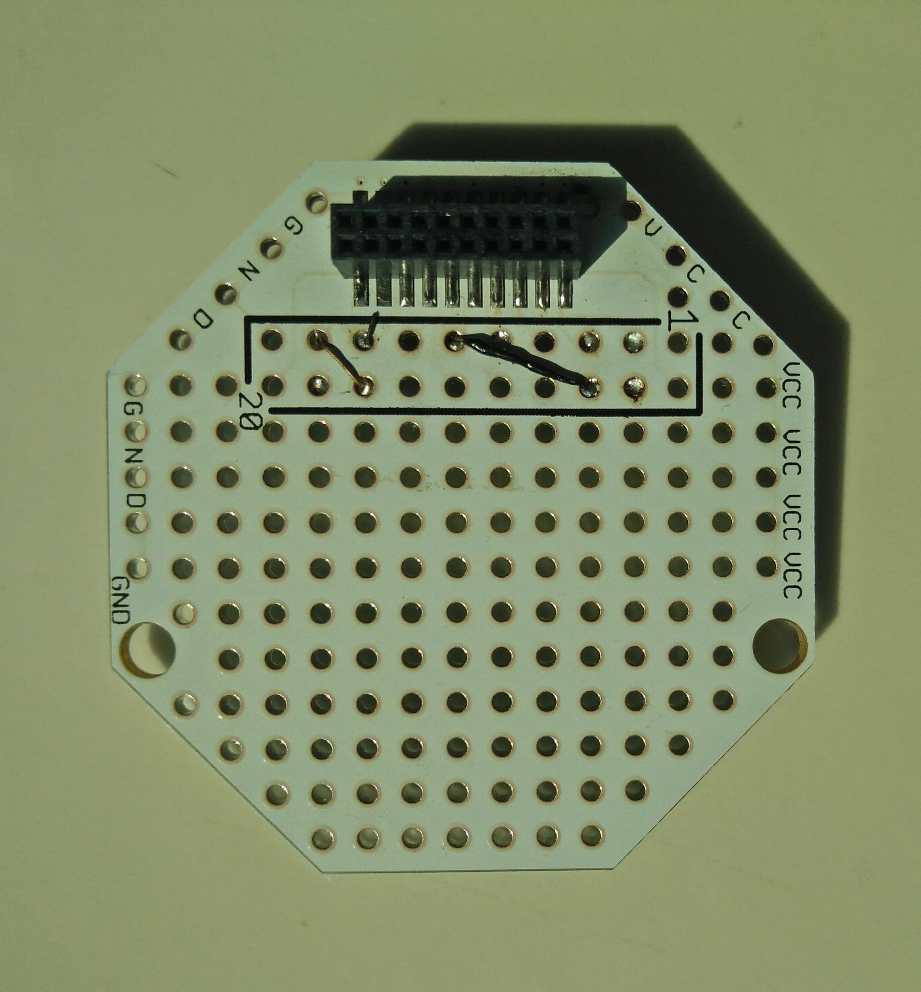
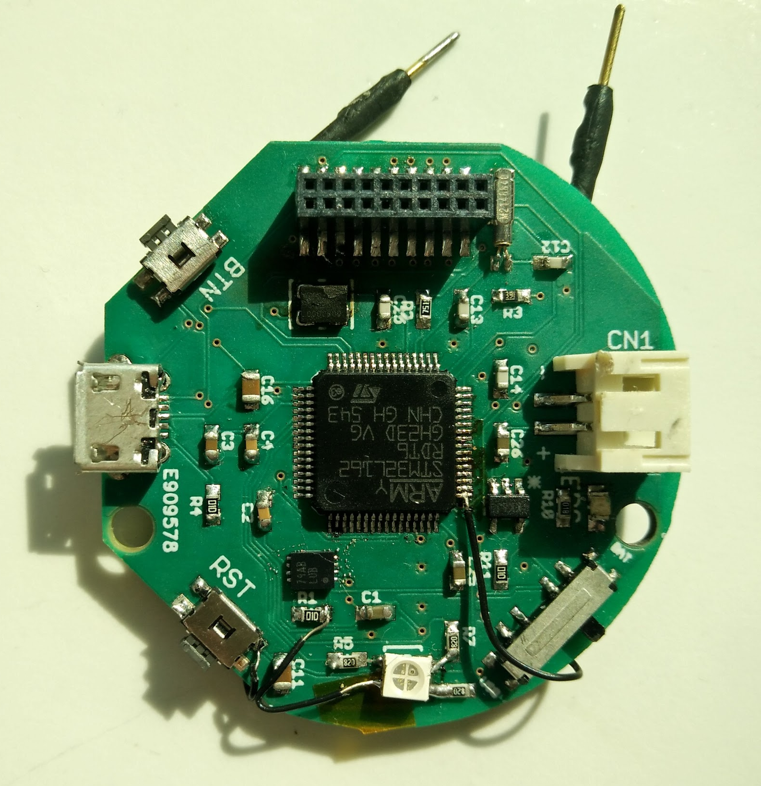
Mobile Node: PCB Hacks
RGB led common anode <-> common cathode
Reset and SWCLK wires required for flashing
Adapter PCB to connect reset with GPIO
-> pullup D7 reset to save power
Wrong UART pins connected
-> fix on adapter
Notes:
‹#›

Slide 9
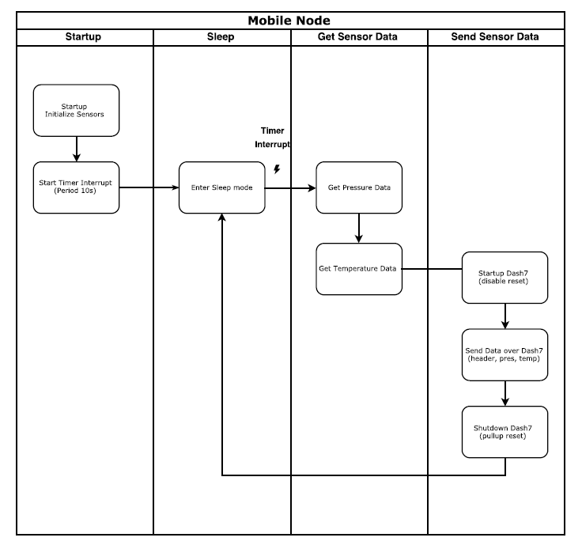
Mobile Node: Workflow
Notes:
‹#›

Slide 10




Mobile Node: Sensor PCB
MPL3115A2
Temperature
Barometer
MAG3110*
Magnetometer
BNO055
Not implemented
-> Breakout board connected
Notes:
‹#›

Slide 11

Mobile Node: Dash7
ALP Generator
Serial wrapper
Data headers
NFC/PIR node
Mobile node mapping (‘42’)
Mobile node (‘21’)
Notes:
‹#›

Slide 12

Mobile Node: Localisation
Dash 7 localisation
Fingerprinting
Existing Dash7 gateways
IDLab MQTT backend
MongoDB
kNN algorithm
Notes:
‹#›

Slide 13
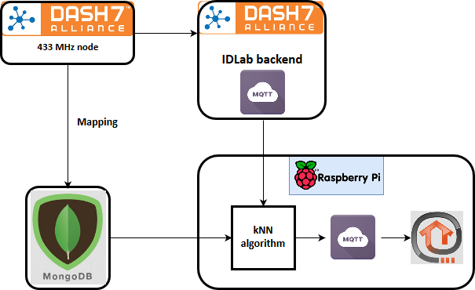
Mobile Node: Localisation
Notes:
‹#›

Slide 14
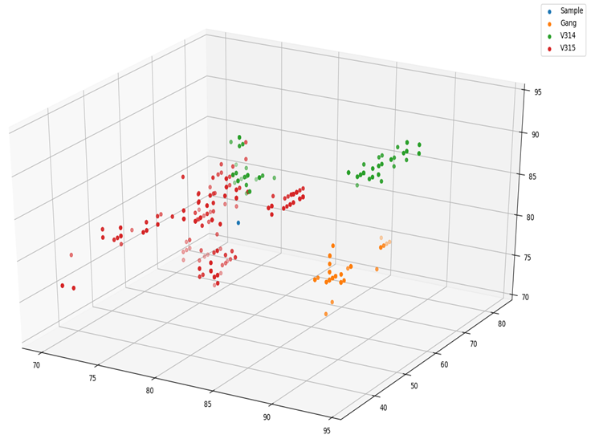
Mobile Node: Localisation
Notes:
‹#›

Slide 15
Mobile Node: Localisation
Mobile node localisation
Fingerprinting
Magnetometer
Orientation
Using our own sensor PCB
MongoDB
kNN algorithm
Notes:
‹#›

Slide 16
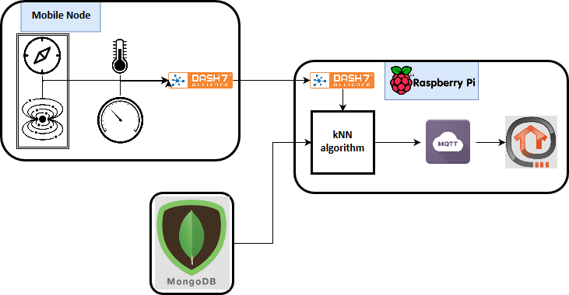
Mobile Node: Localisation
Notes:
‹#›

Slide 17
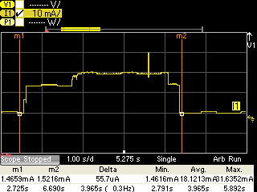
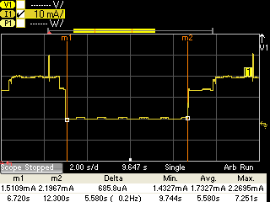
Mobile Node: Power Consumption
WAKE UP
READ
SEND
SLEEP
BAR READ
Notes:
‹#›

Slide 18
NFC/PIR Node
Notes:
‹#›

Slide 19
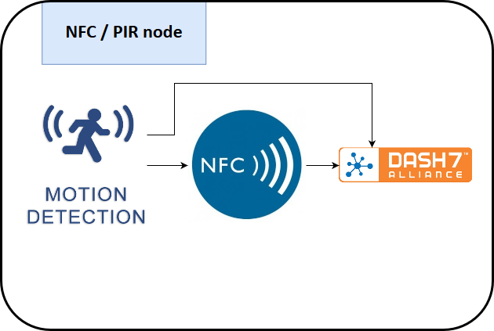
NFC/PIR Node
Notes:
‹#›

Slide 20
NFC/PIR Node
Static node placed by the door
Contains:
STM PCB
PIR sensor
RFID reader
Dash7 module
UID & motion shown in Openhab
Notes:
‹#›

Slide 21
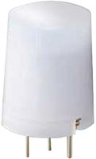
NFC/PIR Node: PIR
5m detection range
tape to make it more directional
movement first then NFC enabled
Notes:
‹#›

Slide 22
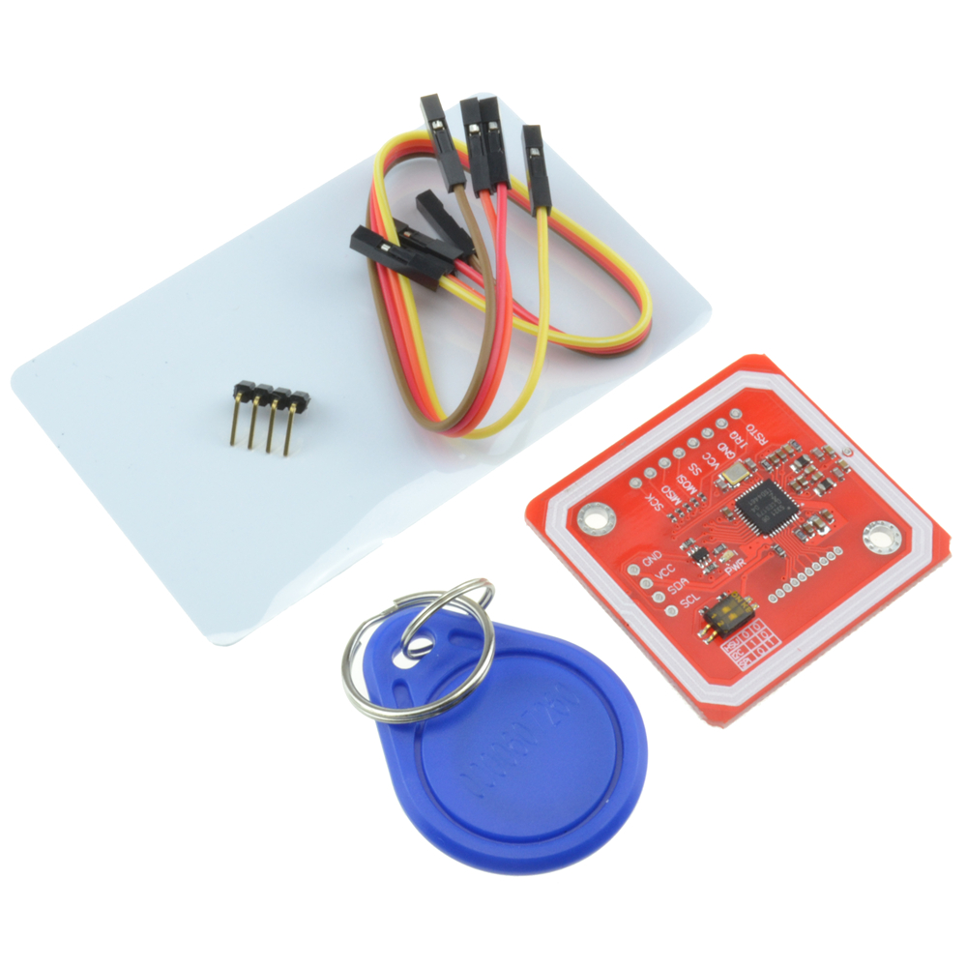
NFC/PIR Node: PN532
1 kB card + key (MIFARE classic ISO14443A)
13.56 MHz
4 Byte UID read out
sent to HABPanel over Dash7
Notes:
‹#›

Slide 23
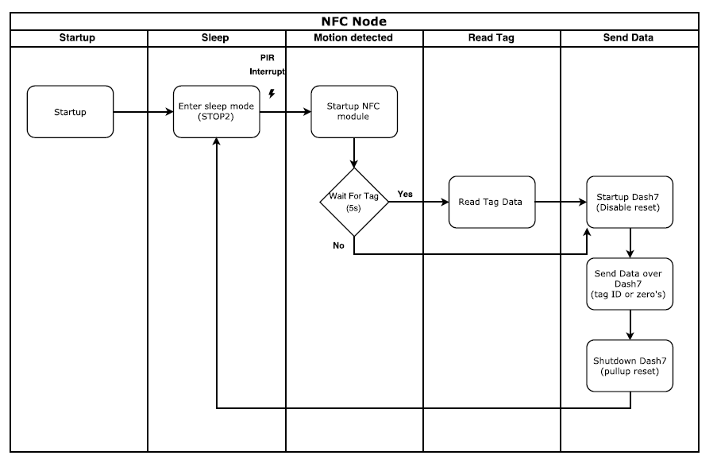
NFC/PIR Node: Workflow
Notes:
‹#›

Slide 24
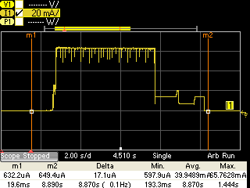
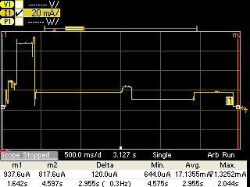
NFC/PIR node: Power consumption
WAKEUP
READ NFC
UART
STOP MODE
DASH7
ZOOMED
Notes:
‹#›

Slide 25
Raspberry Pi
Notes:
‹#›

Slide 26
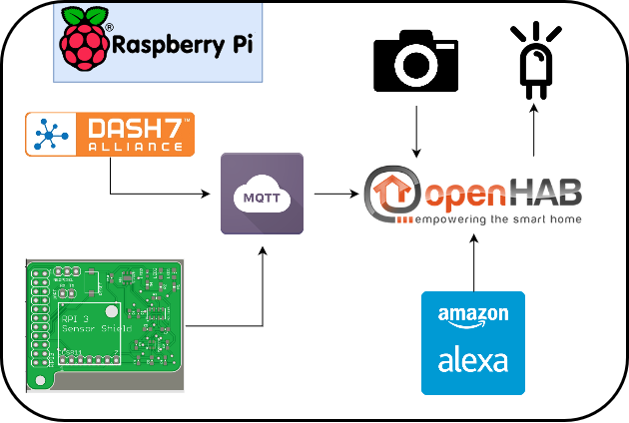
RPi
Notes:
‹#›

Slide 27

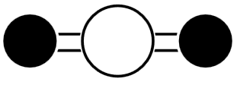
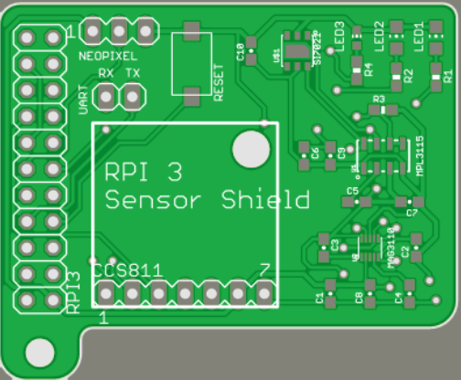
RPi: Sensor Shield
Sensors
Barometer
Temperature
Pressure
Magnetometer*
Humidity
CO2
NeoPixel
Temperature & CO2
Party mode
Notes:
‹#›

Slide 28

RPi: MQTT
Mosquitto broker
Topics
Pi shield
Mobile node
NFC/PIR Node
Notes:
‹#›

Slide 29
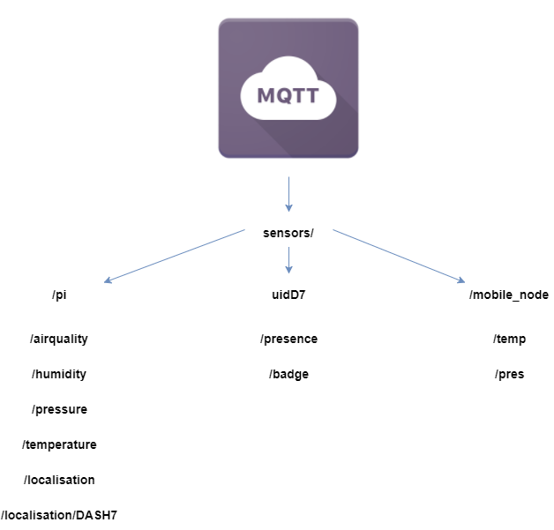
RPi: MQTT
Notes:
‹#›

Slide 30

RPi: OpenHAB2
Homepage
Camera
Sensor readings
NFC / PIR reading
Mobile Node page
Localisation
Weather
Notes:
‹#›

Slide 31

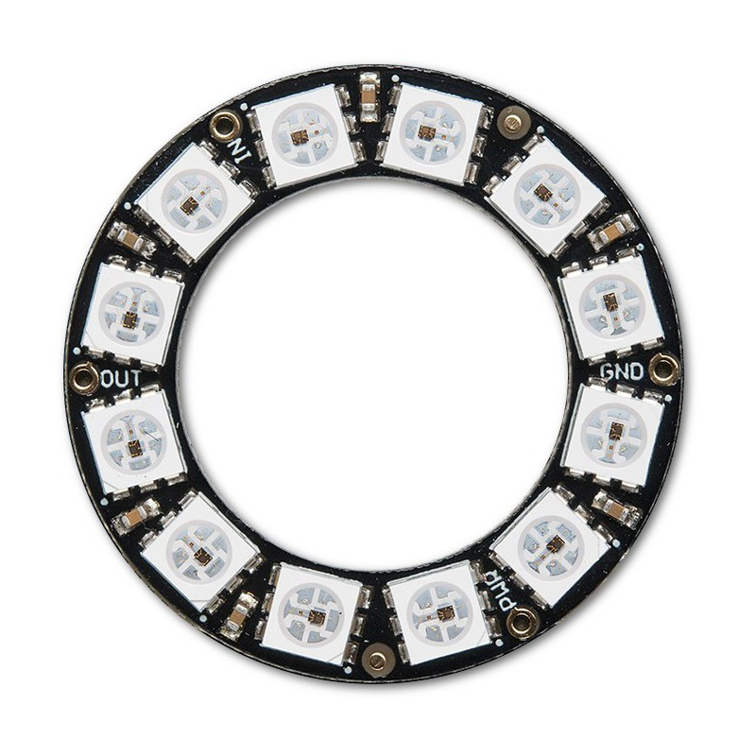
RPi: Alexa
Check for weather forecast
Custom skills
“Alexa, turn on lights”
OpenHAB Alexa Smart Home Skill
Drives Neopixel + Led
HABPanel control switch
Notes:
‹#›

Slide 32

Q & A
Notes:
‹#›

