Slide 1

II-Ambient Intelligence 2297FTIKAI Teammmd project
Mats De Meyer
Michiel Aernouts Dennis Joosens

Slide 2
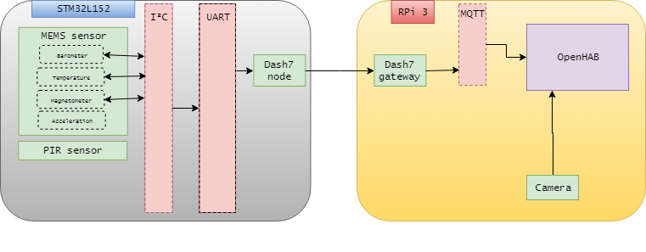
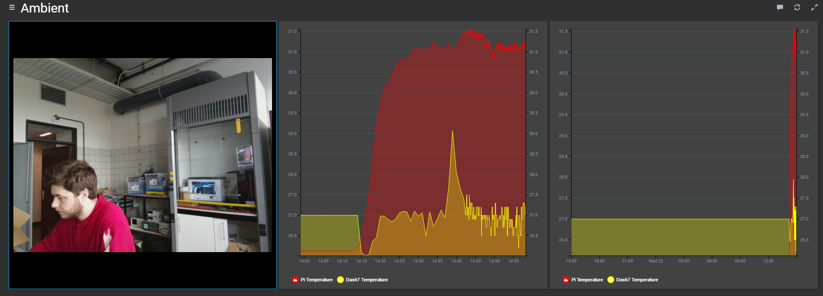
Current progress
Notes:
Dries

Slide 3
Concept
Basics
Sensordata (temperature, air quality etc)
DASH7
MQTT
OpenHAB
Localization
PIR
Fingerprinting
Extra’s
Amazon Alexa
OpenCV image processing (e.g. facial recognition)
Control external devices
I2C
Notes:
Wouter

Slide 4
Hardware
SMT32L152RE
Raspberry Pi 3
Raspberry Pi Camera
Mems Evaluation Board
Dash7 Nodes (868 Mhz)
PIR sensor
Air quality sensor
NFC/RFID
I2C
Notes:
Wouter

Slide 5
Localization
PIR
Triangulation
Wi-Fi fingerprinting
Magnetometer
Barometer for height
Detect presence and identify (PIR, NFC)
To be determined
I2C
Notes:
Wouter

Slide 6
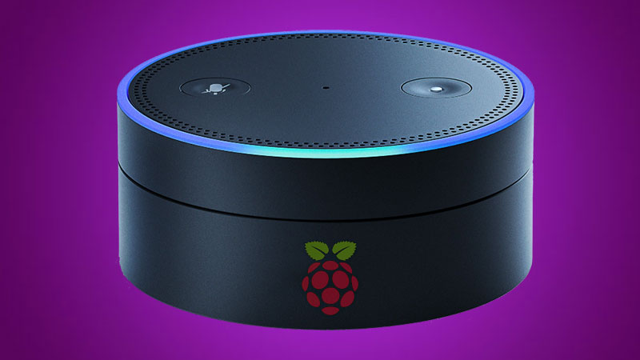
Alexa
Alexa Pi github
Get sensor data
Welcoming message
Run scripts
Microphone & speakers via USB soundcard
I2C
Notes:
Wouter

Slide 7



Notes:
Hardware uitzoeken en samenzitten om PCB te bespreken (octa library)

