Slide 1

Renewable power plant

Slide 2
Last week
Generated graphs
More work on weather data
Still incomplete

Slide 3
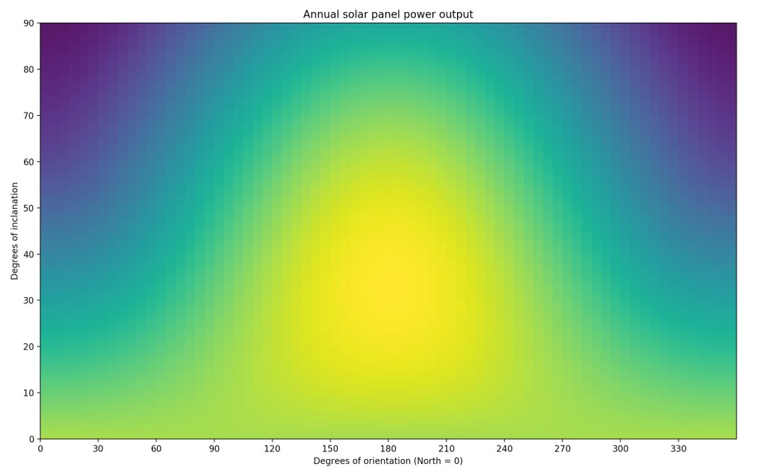
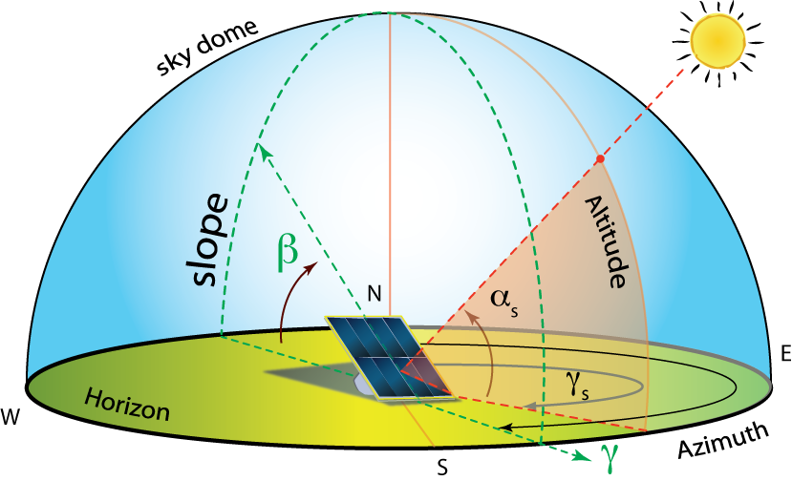
Angle and orientation of solar panels

Slide 4
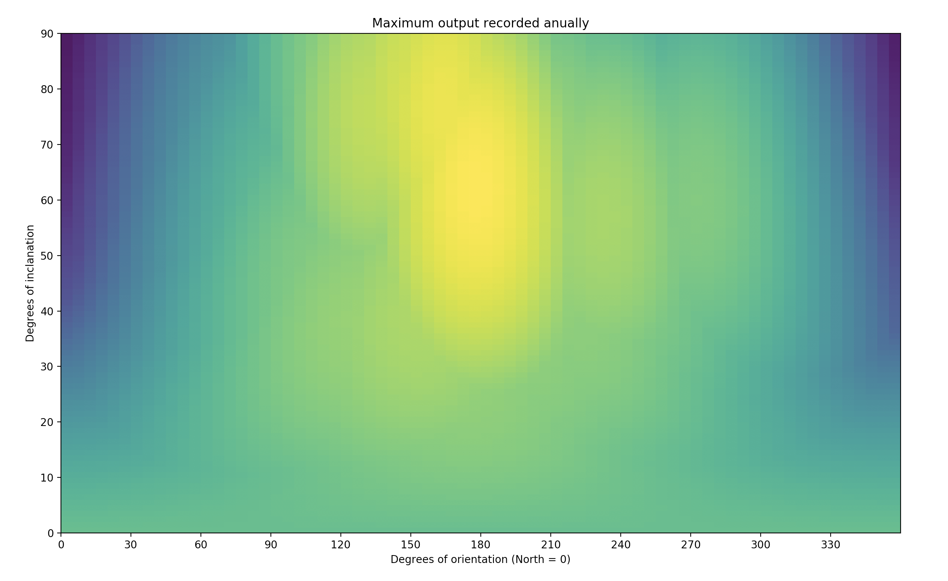
Possible anomaly in calculations
No symmetry in the graph points to possible anomaly in the calculations.
Further investigation is needed.

Slide 5
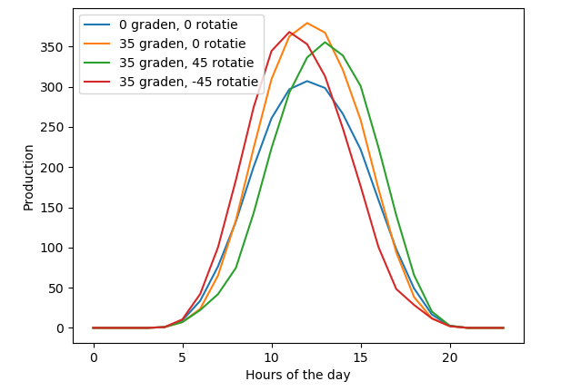
Poweroutput of solar panels
Higher peaks with 35-degree inclination
Panels pointed slightly east start generating earlier in the day
Panels pointed slightly west generate a bit longer
Panels pointed south have the highest maximum

Slide 6
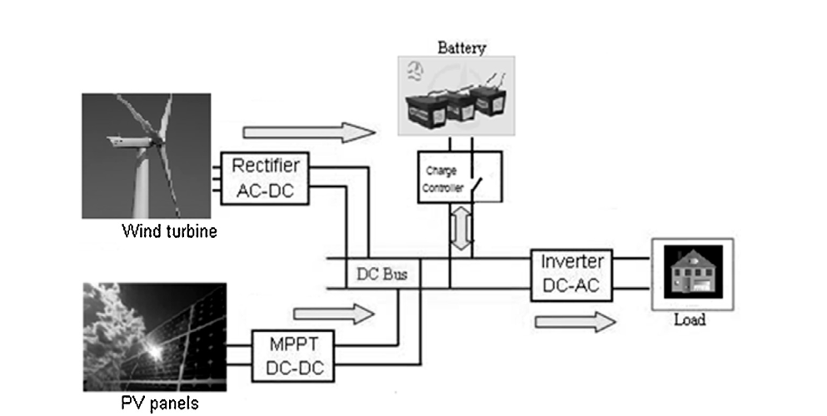

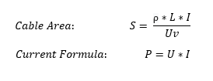
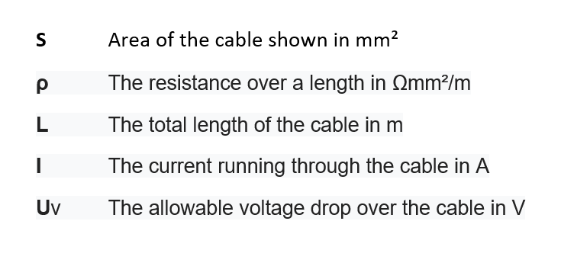
Cable cost calculation

Slide 7
This week
Presentation at event
Checking anomaly/ correcting if needed.
Work on completing KNMI-data.

Slide 8
Questions?

