Slide 1

Revamping the MAGNET website
Brief overview and next steps
5 October, 2020, Michiel van Dijk

Slide 2
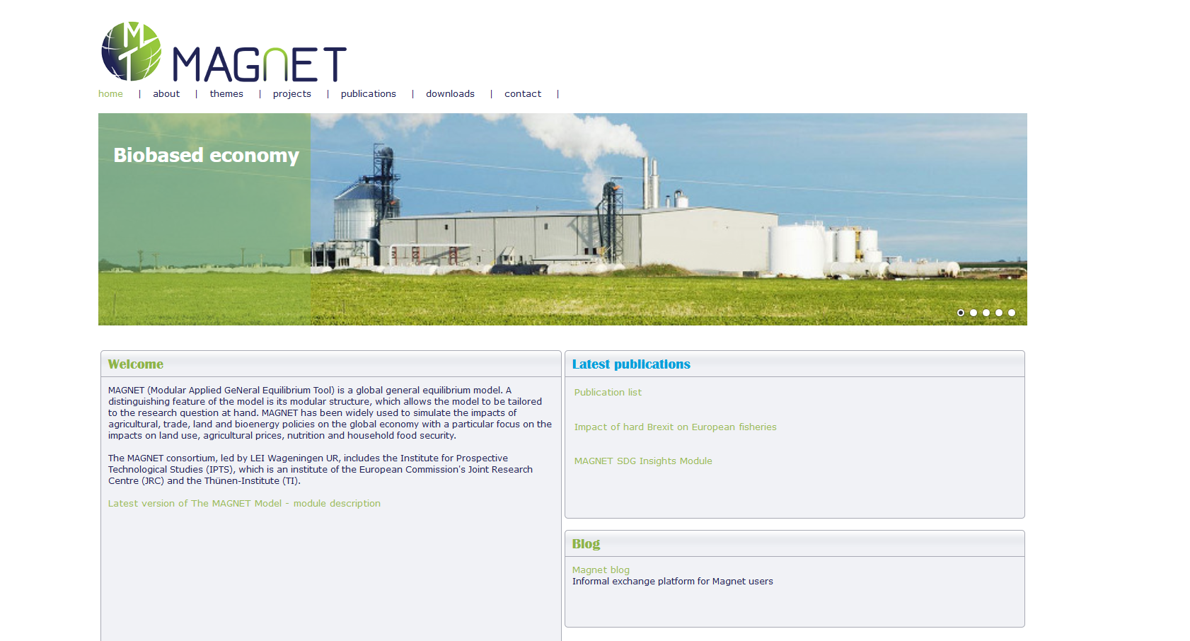
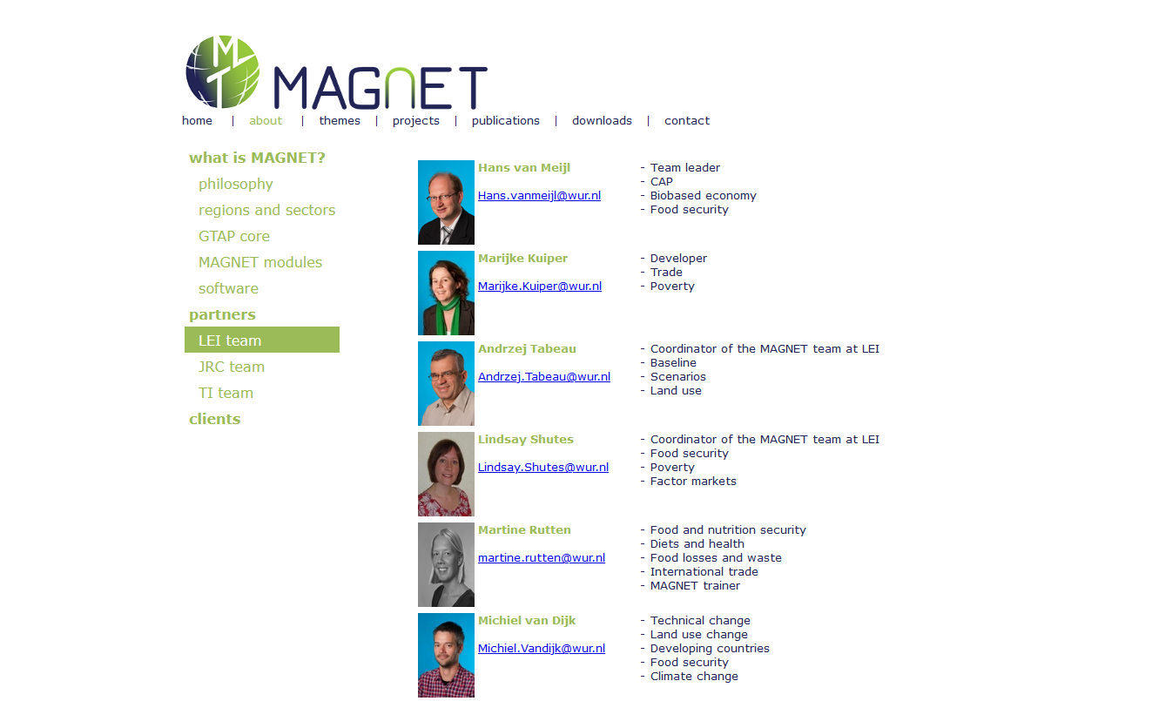
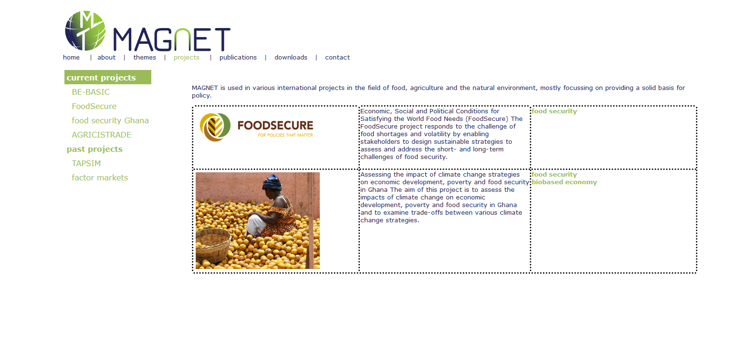
www.magnet-model.org

Slide 3
What is new?
New design using the open source Wowchemy Academic theme
Created using a combination of Hugo, Rstudio and Markdown
Works (a bit) like the MAGNET model
Versioning
Local changes copied to the cloud (Github)
Automatically updated
‘Academic’ theme
MAGNET publication list that can easily be updated
Team page
Blog
Projects
Search function

Slide 4
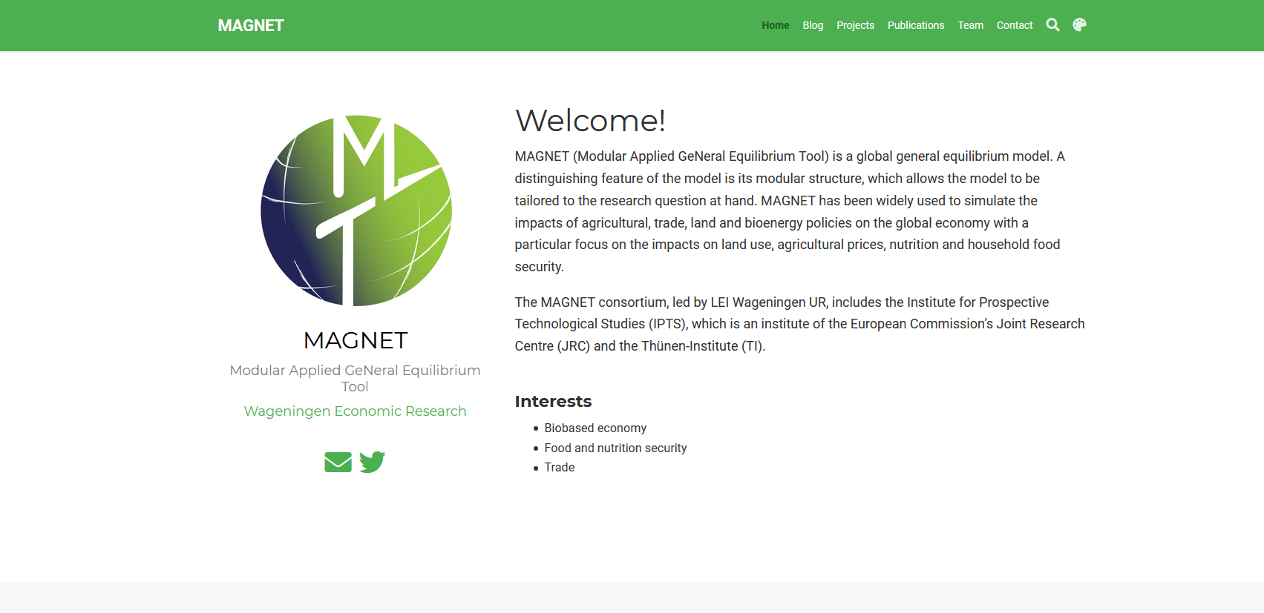
www. https://magnet-model.netlify.app/

Slide 5
Next steps – short term
Please provide
Personal information (_index.md)
A nice picture (avatar.jpg)
CV ([name].pdf)
MAGNET references (add DOI codes!)
User name = publication name
Instructions can be found on the SharePoint.
\WEBSITE 2020\team

Slide 6
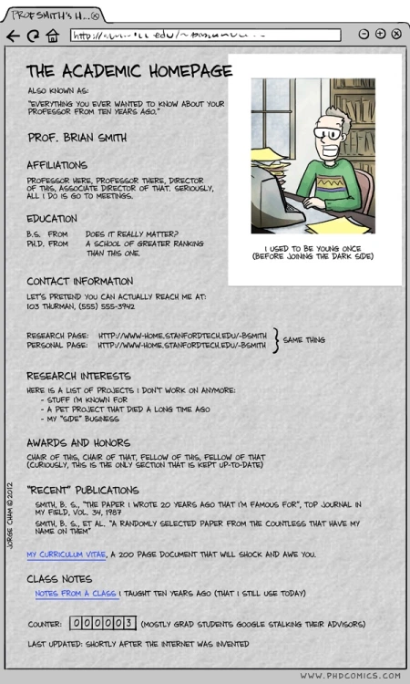
Next steps – medium term
Need 2 to 3 volunteers to manage and improve technical part of the website.
Who adds content and when?
MAGNET description & manual
Blog and/or project summaries?
Involvement of MAGNET consortium members?

Slide 7
Thank you!

