Slide 1

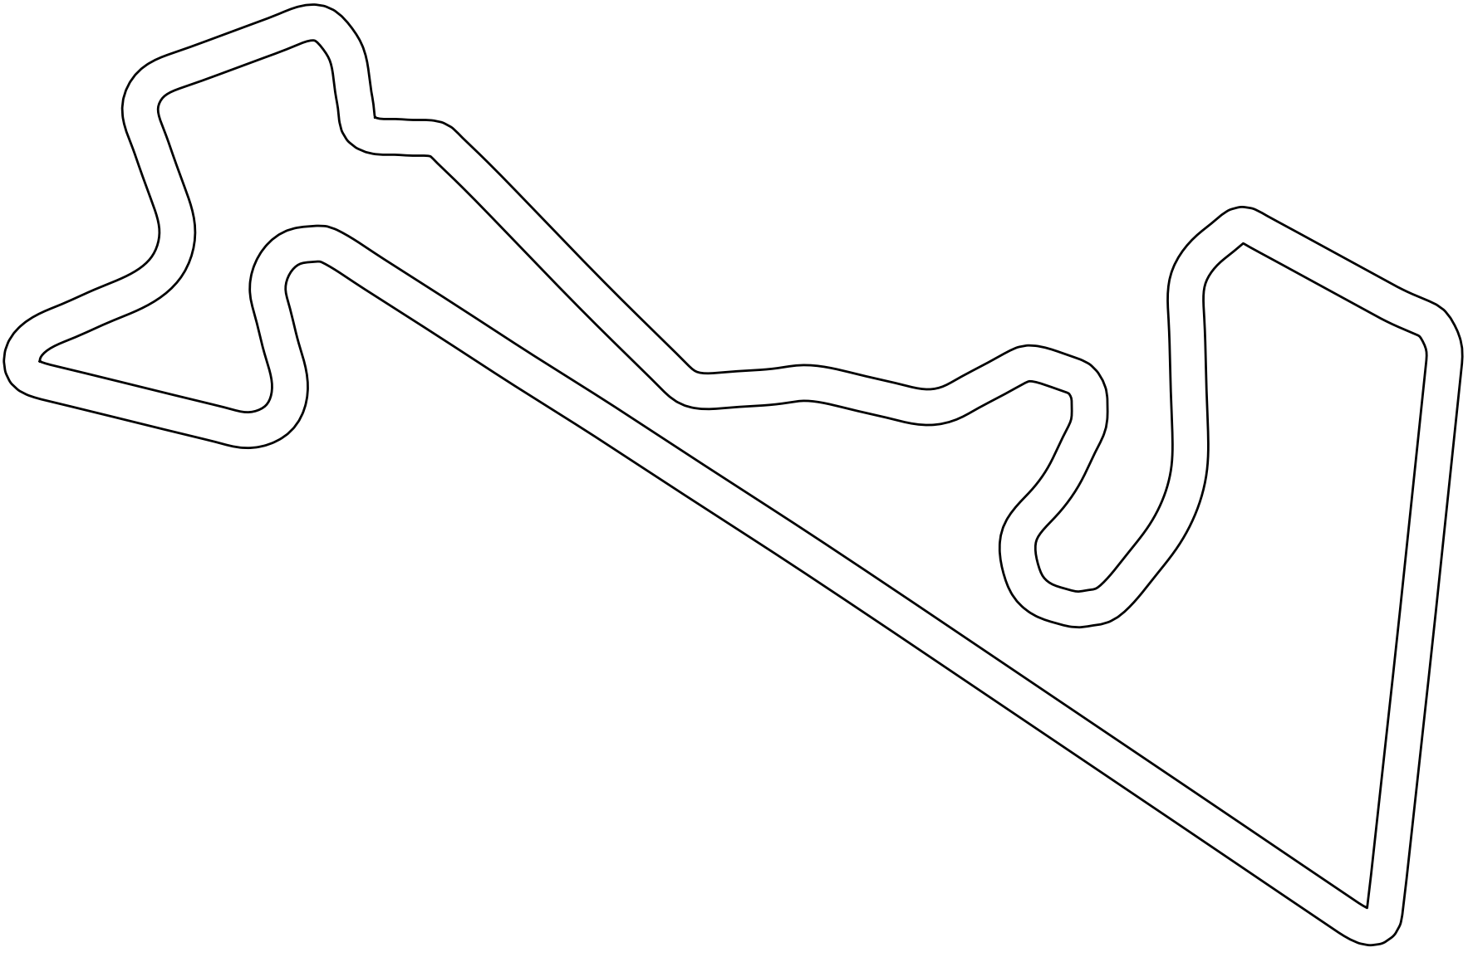
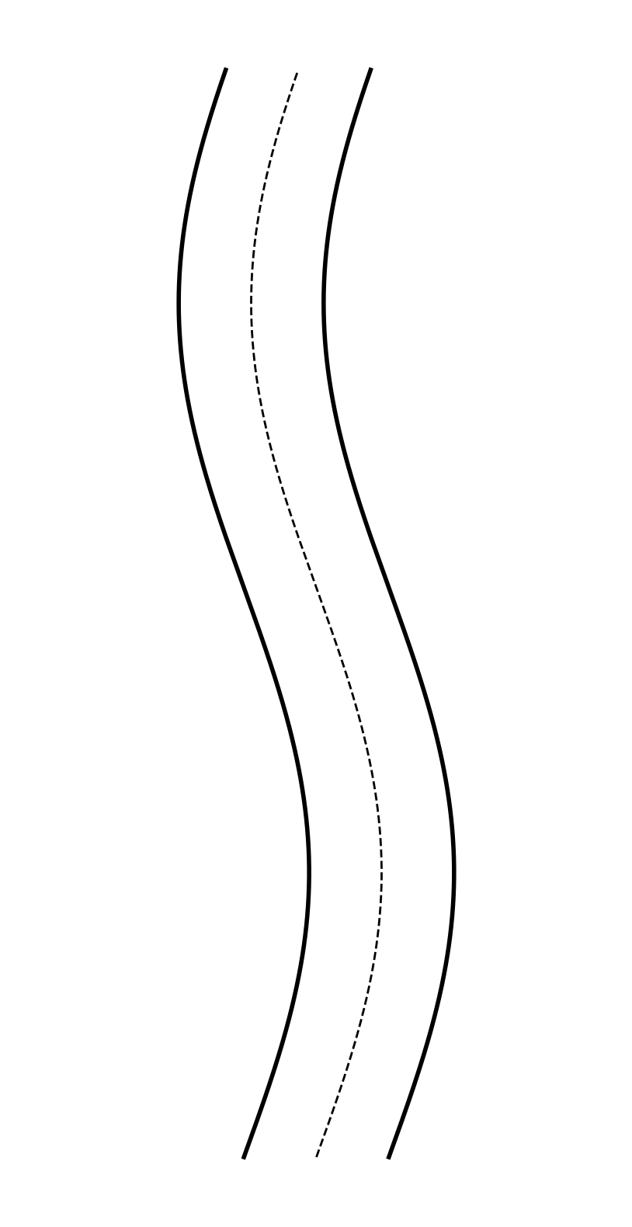

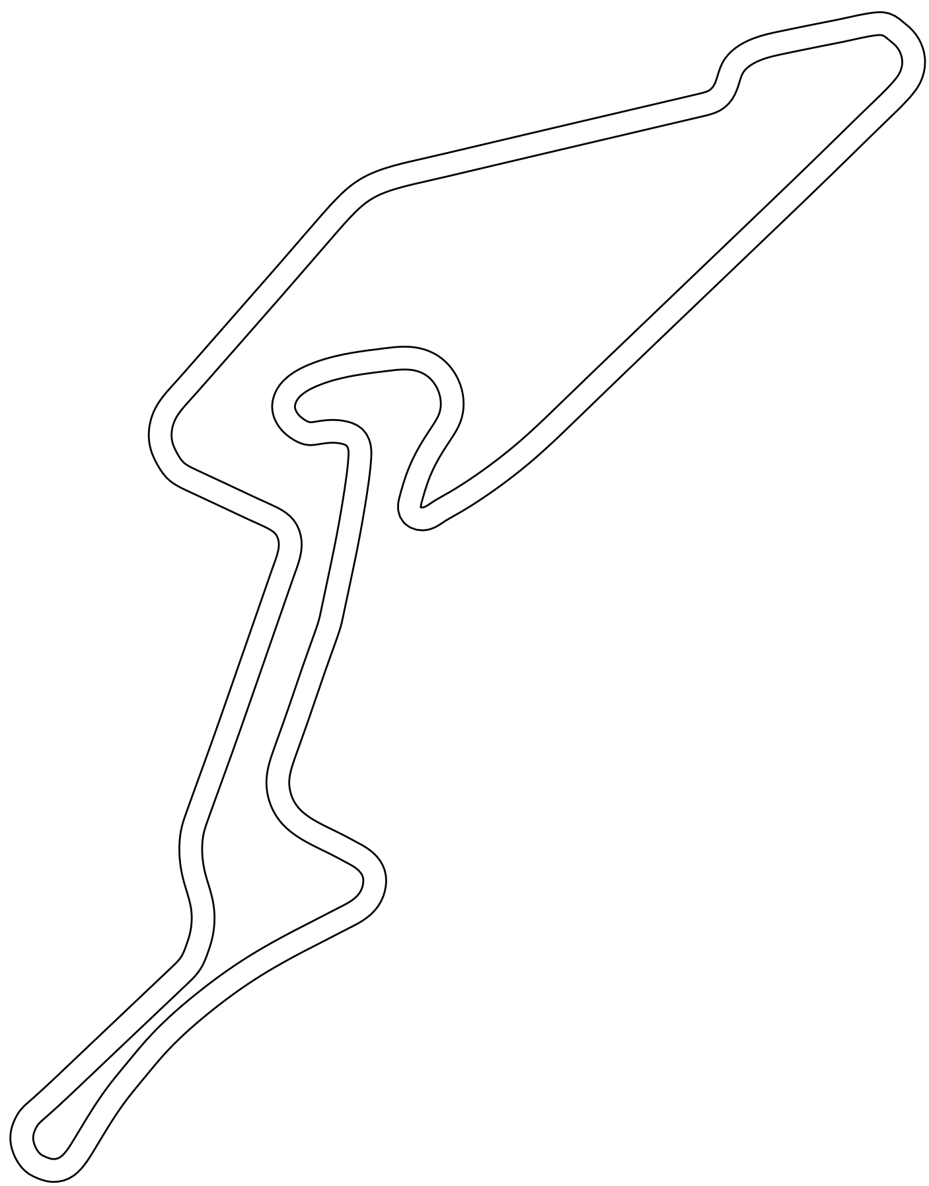

Action
(a). Austin (Train)
(c). MoscowRaceway
(e). Head-to-Head Racing
Linear
GRU
Opponent
(b). Hockenheim
(d). Nuerburgring
Concat
Norm
Mask
Ego
Scans
Speed
(f). Model Design

