Slide 1
Cantor 2023
Project-Based Professional Development for STEM Students

Slide 2
Mission Statement
To cultivate excellence in academics and professional development for STEM students through process-driven member education and handpicked projects.
2

Slide 3
Value Proposition
While business students at the University of Michigan have a large network of clubs geared toward professional development, STEM students do not
This would be the only student organization which identifies the key steps required for STEM students to get offers at top-tier companies
This club would provide its members with course scheduling insights, resume/application material support, insight to the recruitment timeline, technical interview preparation, project-based learning, and leadership development opportunities
3

Slide 4
Founding Principles
Recruitment for high school graduates should focus on aptitude, curiosity, and commitment, not on ability to stand out in an (arbitrary) interview process
Process-driven learning early in college best fosters development
A single-minded focus on working backwards from top-tier job offer requirements and developing in-demand skills/experiences will motivate members to engage with the club
4

Slide 5
Key Offerings
Early access to key professional development resources (resume/cover letter workshops, networking input, peer-advising)
Course advising for younger students
Project-based learning of key employable skills
Leadership/Promotion opportunities
Member-exclusive recruitment/networking events
5

Slide 6
Organizational Structure

Slide 7
Leadership Team Structure
President
Quant Team Lead
SWE Team Lead
VP Corporate Relations
VP Professional Development
Senior Vice President
VP Operations
VP Recruitment
7

Slide 8
Coding/Quant Structure
Project Team Leader
1st Year Project Manager
2nd Year Project Manager
3rd Year Project Manager
Technical Skills Leader
1st Year Member Educator
2nd Year Member Educator
3rd Year Member Educator
Project Team
Project Team
Project Team
8

Slide 9
Corporate Outreach

Slide 10
Corporate Partners
Companies view student organizations such as this as a pool of highly qualified students
Strategic outreach after membership has grown and projects have been completed, followed by fostering recruiter relations (and club alumni relations in the long term) will allow for exclusive corporate connections
These will be a selling point for new members
10

Slide 11
Networking
Club participation in corporate coding challenges, hackathons
Hosting corporate partners for large events, followed by member-exclusive networking opportunities
Developing a network of alumni who recruit from this organization every year
11

Slide 12
New-Member Recruitment

Slide 13
Modified Recruitment Process
Maintain a short, simple process
Emphasize a focus on aptitude and drive
Build curiosity about the club through interesting questions and tasks
13

Slide 14
Recruitment Timeline
Info
Sessions
Marketing the club and taking questions
Online Applications
Simple (no written prompts)
Aptitude Test
Testing quick thinking, core skills
Final Superday
Review presentations on pre-assigned tasks

Slide 15
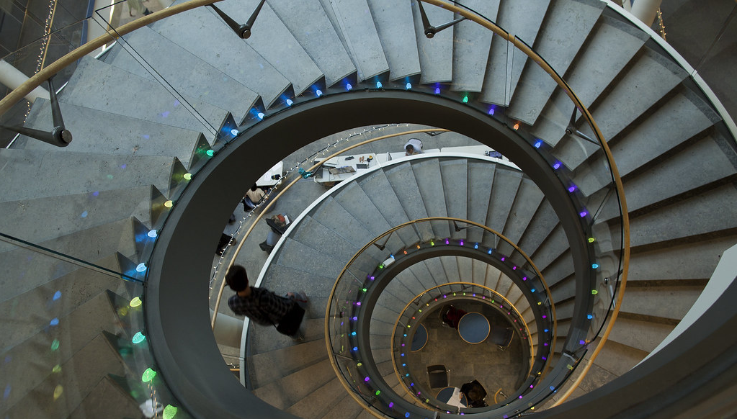
Lead Michigan’s Best and Brightest

Slide 16
Looking forward
We are establishing dual-affiliation with both the Ross School of Business and the College of Engineering
We are placing people in key roles and developing the club offerings over the course of the next 5-6 months
In late March/early April we will begin corporate outreach
16

Slide 17
Engage with the club
Reach out to me (Rohan Agrawal, +1 (475) 239-0223) with interest in joining and taking up responsibilities
I will be placing people in key roles over the course of the next few weeks
This will be a rewarding experience for all founding members and an opportunity to connect with recruiters and strengthen job applications
17

Slide 18



