Slide 1
presentation 2023
Name of Presenter
Subtitle, if needed

Slide 2
A Typical Slide
Create new slides by duplicating existing slides.
If you already have a slide with content, you can go to layout. Select a layout from the dropdown and it will change the layout of the slide you are currently on. (If you select this option to create a new slide, remember to copy and paste “name of initiative” text on the footer on your new slide.)
Text color may be in blue, black or grey as shown..
NAME OF INITIATIVE

Slide 3

A Typical Slide: Co-branded Logo Option
Sometimes another logo has to be added on your presentation. Follow the design shown on this slide.
Align the new logo with the Wharton logo – at bottom. Do not move the Wharton logo.
Both logo’s should have the same visual weight.
NAME OF INITIATIVE

Slide 4
A typical bulleted text slide
Item on the list.
Sub-item on the list
Item on the list
Sub-item on the list
NAME OF INITIATIVE

Slide 5
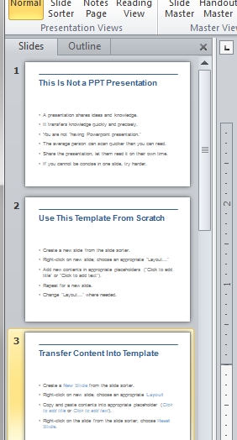
A typical text slide with image
Images are most often aligned to fit in the width of the red rule at top of the page.
NAME OF INITIATIVE

Slide 6












A typical page with a lot of text and/or graphics
In this template the title has been minimized and there is no logo on page. This template can also be used for existing presentations.
This is caption text for the images.
NAME OF INITIATIVE

Slide 7

Map title
Map base for adding in text and images
NAME OF INITIATIVE

Slide 8
LISTING OF INITIATIVES
LISTING OF INITIATIVE
LISTING OF INITIATIVE
LISTING OF INITIATIVE
LISTING OF INITIATIVE
LISTING OF INITIATIVE
LISTING OF INITIATIVE
LISTING OF INITIATIVE
NAME OF INITIATIVE

Slide 9
A Title Only Slide with Chart
Source: AACSB International
NAME OF INITIATIVE

Slide 10
A Title Only Slide with Table
Choose from 18 concentrations plus an individualized option
Accounting | Global Analysis | Marketing
Actuarial Science | Health Care Management & Policy | Marketing & Communication
Business & Public Policy | Insurance & Risk Management | Operations & Information Management
Entrepreneurship | Legal Studies | Real Estate
Environmental Policy & Management | Management | Retailing
Finance | Managing Electronic Commerce | Statistics
NAME OF INITIATIVE

Slide 11
Graphic Resources
Fonts:
Arial, bold (header and body copy)
Arial Narrow all caps (graphic titles)
Cantor Blue
Cantor Red
ARROW
Title text
Main body text
Highlight text
Optional body text
Simple Title
Minimal Descriptive Text
Simple Title
Minimal Descriptive Text
Simple Title
Minimal Descriptive Text
Simple Title
Minimal Descriptive Text
Simple Title
Minimal Descriptive Text
Use these secondary colors sparingly, e.g. in charts and data representation.
NAME OF INITIATIVE

Slide 12
Emphasis Slide
At times, text needs to be set against blue to pull out a few lines of text. Use this template for text and graphics when needed.
NAME OF INITIATIVE

Slide 13
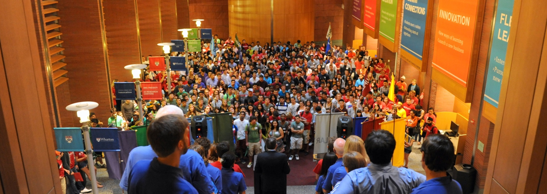
Content with One Large Image
NAME OF INITIATIVE

Slide 14



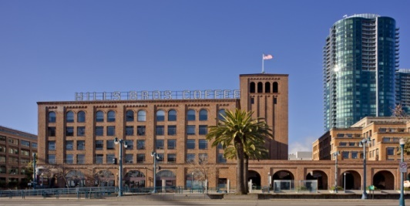
Layout with text and small images
First point
Second point
Third point
NAME OF INITIATIVE

Slide 15
Section divider SLIDE with optional text
Can have subtext and smaller text bottom right to more information
An accessory slide should be used sparingly to emphasize a point, or to provide visual break in the pacing. It should not be used to present text-heavy contents.

Slide 16

an Photo variation of an accessory slide
Can have additional text at top
An accessory slide should be used sparingly to emphasize a point, or to provide visual break in the pacing. It should not be used to present text-heavy contents.

Slide 17

Call to Action

Slide 18



