Slide 1



Android
By: Vincent Nagel

Slide 2
Outline
What is Android?
Why Android?
Demo app

Slide 3
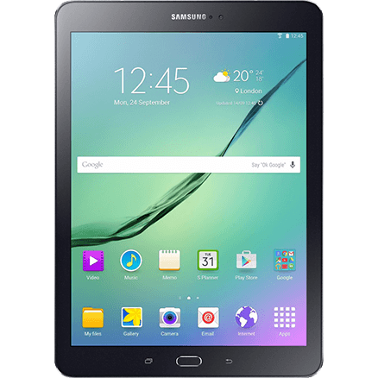
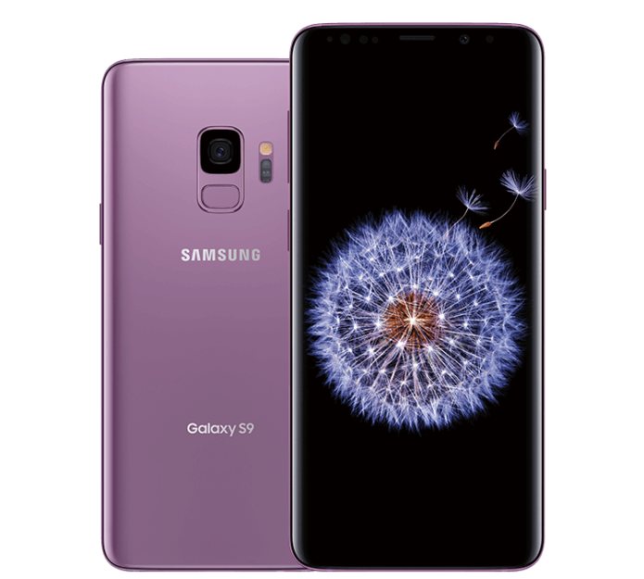
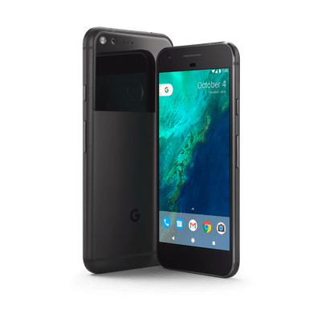
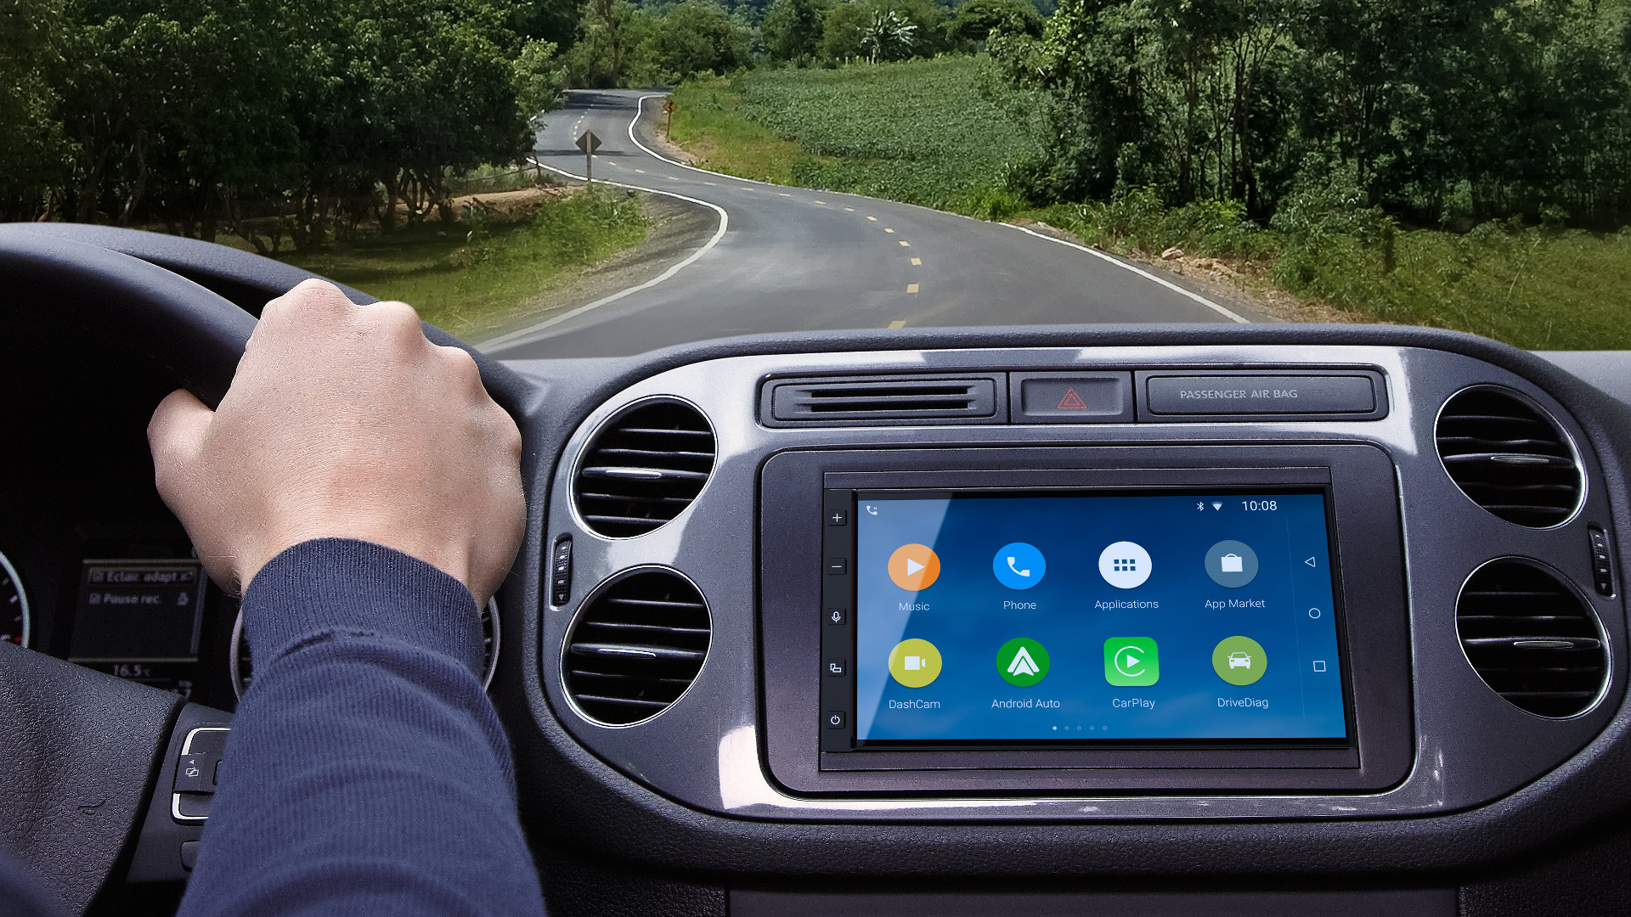
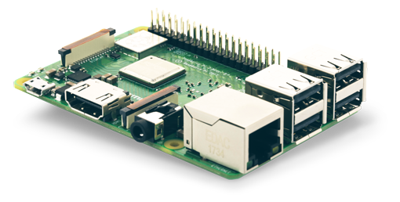
What is Android?
Mobile operating system
Developed by Google
Based on Linux kernel
Designed primarily for phones and tablets
Android Things, Android Auto, Wear OS, Chrome OS, and more!
Notes:
Android uses Linux Kernel for:
Threading
Low-level memory management
Security features
Well-known, so allows device manufacturers to develop hardware drivers easily
Also runs on consoles like Nvidia Shield, Android TV

Slide 4



Why Android?
Learn valuable, transferrable skills
Java – one of the most widely-used programming languages
Software development life cycle
Teamwork
Software Development Life Cycle
Variety of opportunities
Android Things, Android Auto, Wear OS, Chrome OS, and more!
Low barrier to entry
Put as many apps on Play Store forever for only $25!
Notes:
Can write C/C++ if you want!
Native Android libraries
Performance-critical sections of the app
Kotlin
New official Android programming language since 2017
Integrates well with Java
Java can call Kotlin code and vice-versa
Concise

Slide 5
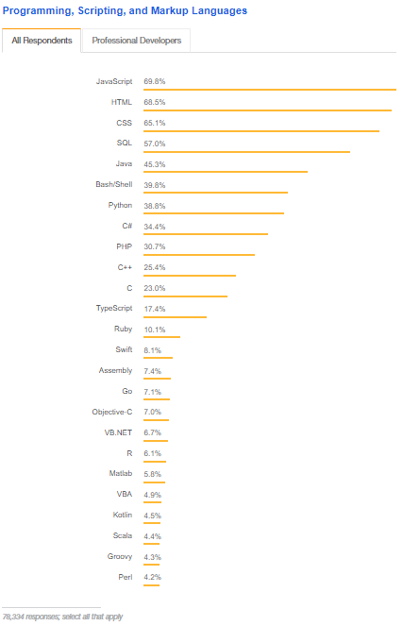
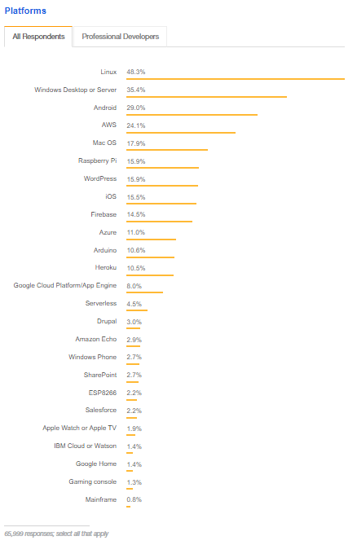
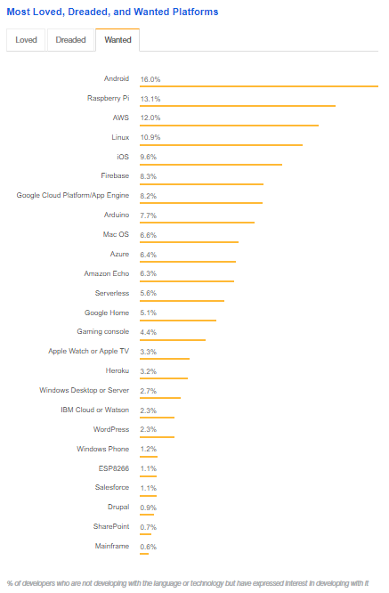
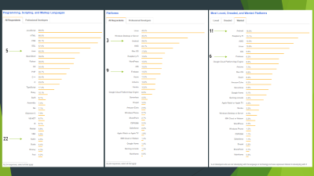

1!
3
5
22
Notes:
2018 StackOverflow survey of over 100,000 developers
Java is 5th most used programming language
Android is 3rd most commonly used developer platform
Android is 1st most wanted platform to develop on
https://insights.stackoverflow.com/survey/2018/#community

Slide 6
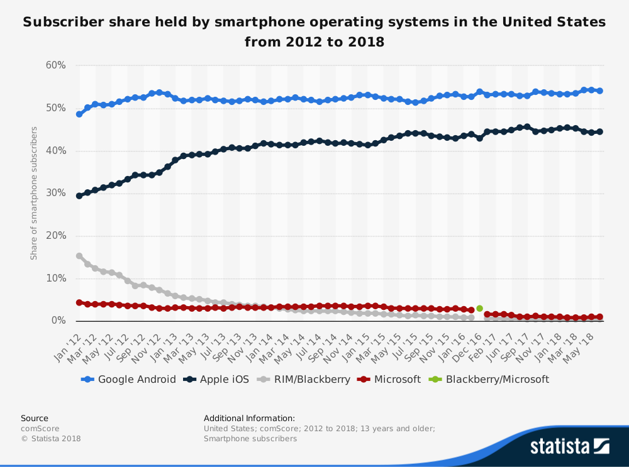
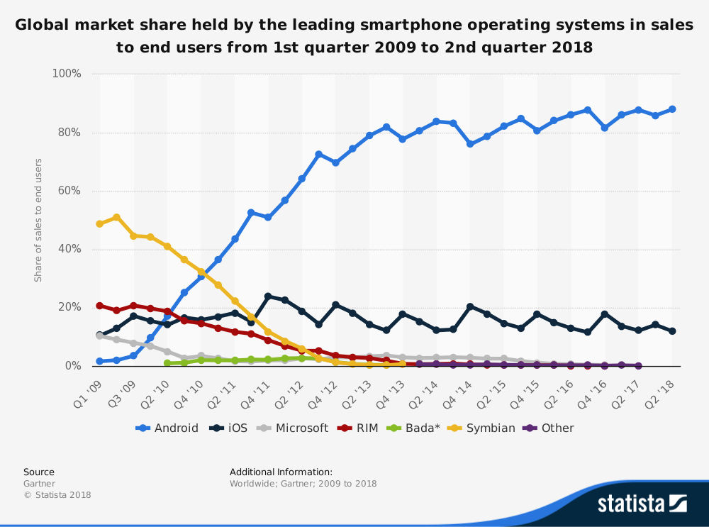
Why Android?
Android is the most popular mobile platform in the US and worldwide
Notes:
https://www.statista.com/statistics/266572/market-share-held-by-smartphone-platforms-in-the-united-states/
https://www.statista.com/statistics/266136/global-market-share-held-by-smartphone-operating-systems/

Slide 7
Resources
developer.android.com/guide
Codelabs
Free online courses
Documentation
YouTube
The New Boston, Slide Nerd, Android Developers, Derek Banas
Other
Android Hive, Tutorials Point, Vogella
github.com/JStumpp/awesome-android
Huge curated list of Android libraries and resources
Notes:
developer.android.com
You can count it on to be up to date
The rest are good, though you will often find a good one just by Googling your problem.
DON’T just copy and paste code from StackOverflow or blog posts without knowing what they are doing.

Slide 8
Thank you!
Check out the Android team! github.com/michiganhackers/androidapp
StackOverflow survey: insights.stackoverflow.com/survey/2018/#community

