Slide 1

Android
By: Vincent Nagel

Slide 2
Outline
What is Android?
Why Android?

Slide 3
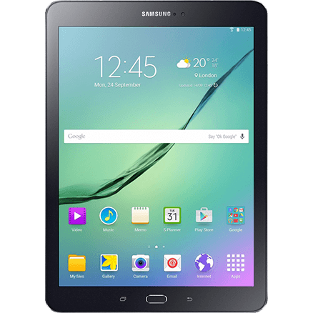
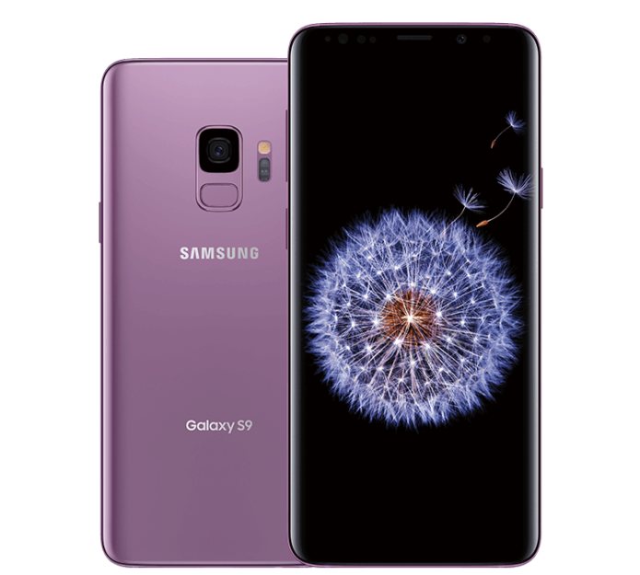
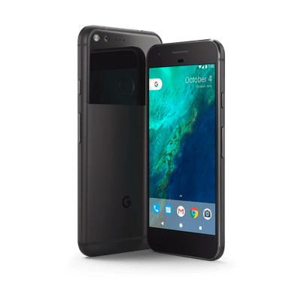
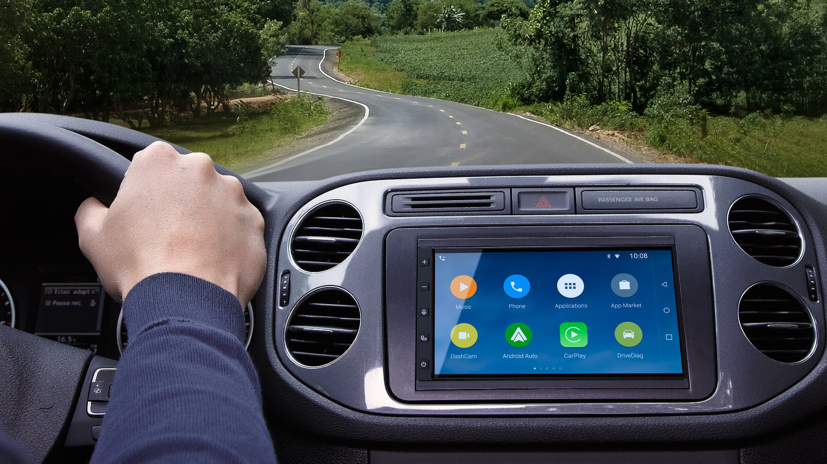
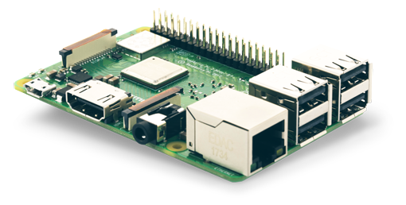
What is Android?
Mobile operating system
Developed by Google
Based on Linux kernel
Designed primarily for phones and tablets
Android Things, Android Auto, Wear OS, Chrome OS, and more!
Notes:
Android uses Linux Kernel for:
Threading
Low-level memory management
Security features
Well-known, so allows device manufacturers to develop hardware drivers easily
Chrome OS
Devices that run Chrome OS like Chromebooks can run Android apps
Also runs on consoles like Nvidia Shield, Android TV

Slide 4



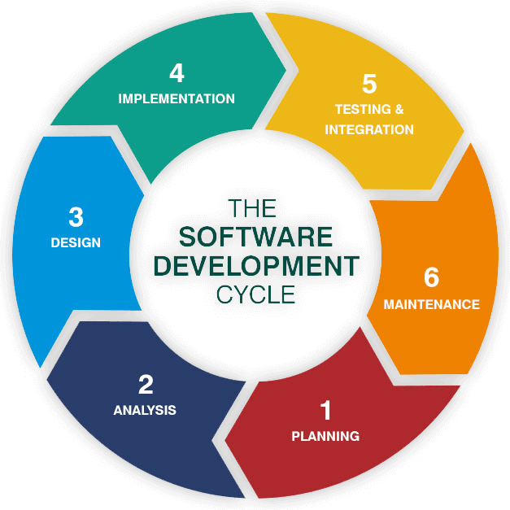
Why Android?
Learn valuable, transferrable skills
Java – one of the most widely-used programming languages
UX/UI
Databases
Software development life cycle
Software Development Life Cycle
Variety of opportunities
Android Things, Android Auto, Wear OS, Chrome OS, and more!
Low barrier to entry
Put as many apps on Play Store forever for only $25!
Numerous resources (see slide 12)
Notes:
Can write C/C++ if you want!
Native Android libraries
Performance-critical sections of the app
Kotlin
New official Android programming language since 2017
Integrates well with Java
Java can call Kotlin code and vice-versa
Concise

Slide 5
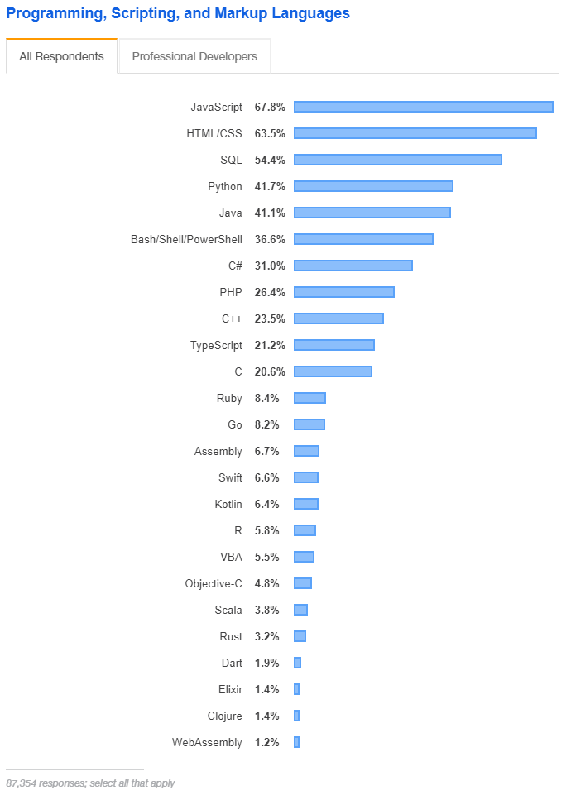
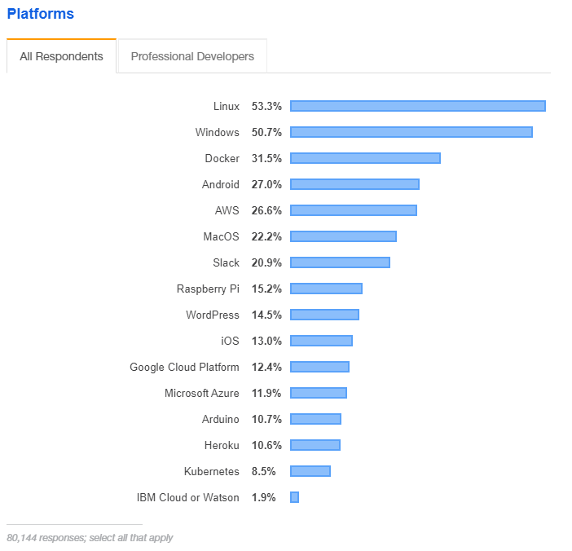
Why Android?
4
5
16
Notes:
2019 StackOverflow survey of about 90,000 developers
Java is 5th most used programming language
Since 2018 survey
Java still 5th
Kotlin moved up from 22
Not just used in Android development
Starting to replace Java on server-side as well
e.g. I just interviewed at Target and they’re doing all new android dev and a large portion of server-side dev in Kotlin
Platforms: docker new category, so replaced Android in #3 spot

Slide 6
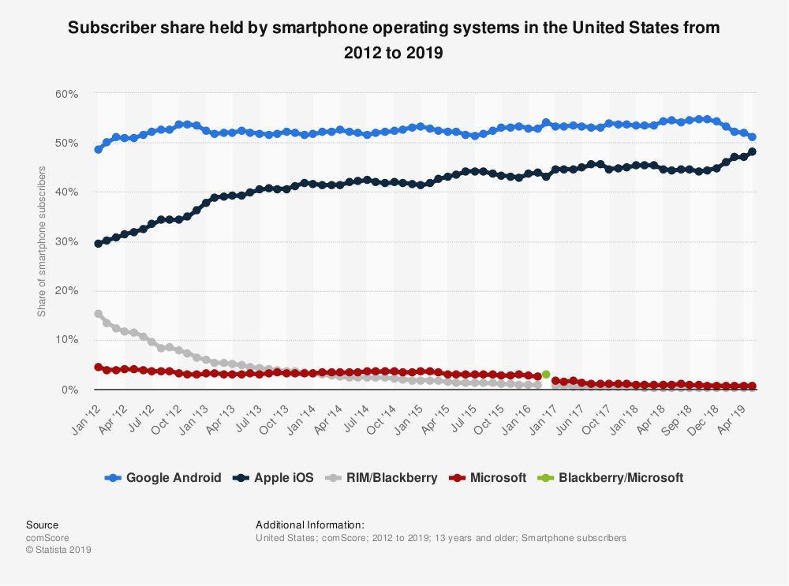
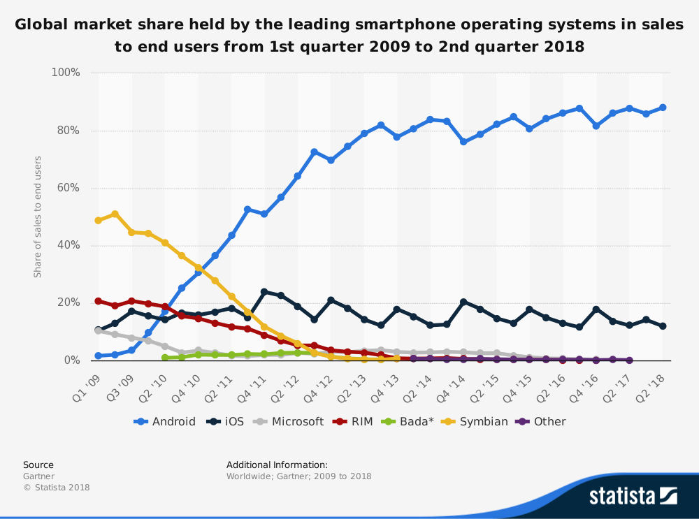
Why Android?
Most popular mobile platform in the US
and worldwide!
Notes:
https://www.statista.com/statistics/266572/market-share-held-by-smartphone-platforms-in-the-united-states/
https://www.statista.com/statistics/266136/global-market-share-held-by-smartphone-operating-systems/
ios released 2007
android release 2008

Slide 7
Resources
bit.ly/androidOnboard
bit.ly/android-pres
http://bit.ly/so-survey-2019
Notes:
onboarding document
explains how to get set up for android development
has good resources for learning android development
e.g. Michigan Hackers has bought a Udemy course for members to use. Contact a core lead if you want access to it.

