Slide 1
TEAM 22
Literature Survey
FACE
TRACKING

Slide 2
Search Methods
Key Word: Face tracking, Face tracker
Database: Google Scholar & Web of Science

Slide 3
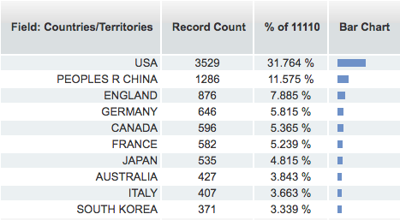
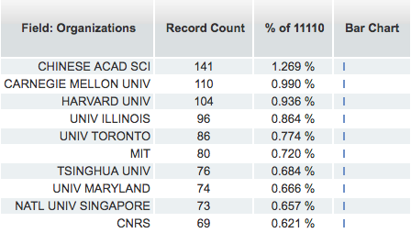
Present status Numbers
Data from Web of Science

Slide 4
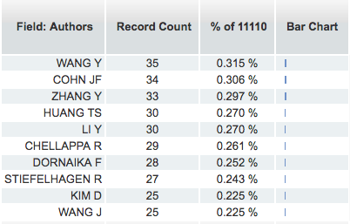
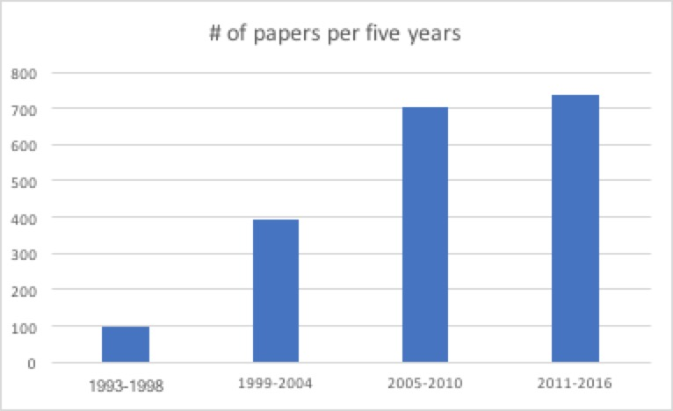
Present status Numbers
Data from Web of Science & Google Scholar

Slide 5
Present status Numbers
2117
Bradski, Gary R. "Computer vision face tracking for use in a perceptual user interface." (1998).
337
Kim, Minyoung, et al. "Face tracking and recognition with visual constraints in real-world videos." Computer Vision and Pattern Recognition, 2008. CVPR 2008. IEEE Conference on. IEEE, 2008.
391
Allen, John G., Richard YD Xu, and Jesse S. Jin. "Object tracking using camshift algorithm and multiple quantized feature spaces." Proceedings of the Pan-Sydney area workshop on Visual information processing. Australian Computer Society, Inc., 2004.

Slide 6
Present status Summary
Target representation
and localization
A bottom-up process.
Kernel-based tracking or Mean-shift tracking
Contour tracking
Comaniciu, Dorin, Visvanathan Ramesh, and Peter Meer. "Kernel-based object tracking." IEEE Transactions on pattern analysis and machine intelligence 25.5 (2003): 564-577.
A top-down process.
Kalman filter
Particle filter
Qian, Richard J., M. Ibrahim Sezan, and Kristine E. Matthews. "A robust real-time face tracking algorithm." Image Processing, 1998. ICIP 98. Proceedings. 1998 International Conference on. Vol. 1. IEEE, 1998.
Filtering and data association
https://en.wikipedia.org/wiki/Video_tracking

Slide 7
Present status Summary
Target representation
and localization
A bottom-up process.
Kernel-based tracking or Mean-shift tracking
Contour tracking
Comaniciu, Dorin, Visvanathan Ramesh, and Peter Meer. "Kernel-based object tracking." IEEE Transactions on pattern analysis and machine intelligence 25.5 (2003): 564-577.
A top-down process.
Kalman filter
Particle filter
Qian, Richard J., M. Ibrahim Sezan, and Kristine E. Matthews. "A robust real-time face tracking algorithm." Image Processing, 1998. ICIP 98. Proceedings. 1998 International Conference on. Vol. 1. IEEE, 1998.
Filtering and data association
https://en.wikipedia.org/wiki/Video_tracking

Slide 8
Present status Summary
Target representation
and localization
A bottom-up process.
Kernel-based tracking or Mean-shift tracking
Contour tracking
Comaniciu, Dorin, Visvanathan Ramesh, and Peter Meer. "Kernel-based object tracking." IEEE Transactions on pattern analysis and machine intelligence 25.5 (2003): 564-577.
A top-down process.
Kalman filter
Particle filter
Qian, Richard J., M. Ibrahim Sezan, and Kristine E. Matthews. "A robust real-time face tracking algorithm." Image Processing, 1998. ICIP 98. Proceedings. 1998 International Conference on. Vol. 1. IEEE, 1998.
Filtering and data association
https://en.wikipedia.org/wiki/Video_tracking

Slide 9
Present status Papers
Yang, Jie, and Alex Waibel. "A real-time face tracker." Applications of Computer Vision, 1996. WACV'96., Proceedings 3rd IEEE Workshop on. IEEE, 1996.
Qian, Richard J., M. Ibrahim Sezan, and Kristine E. Matthews. "A robust real-time face tracking algorithm." Image Processing, 1998. ICIP 98. Proceedings. 1998 International Conference on. Vol. 1. IEEE, 1998.
Comaniciu, Dorin, Visvanathan Ramesh, and Peter Meer. "Kernel-based object tracking." IEEE Transactions on pattern analysis and machine intelligence 25.5 (2003): 564-577.
Stern, Helman, and Boris Efros. "Adaptive color space switching for face tracking in multi-colored lighting environments." Automatic Face and Gesture Recognition, 2002. Proceedings. Fifth IEEE International Conference on. IEEE, 2002.

Slide 10
Present status Papers
Allen, John G., Richard YD Xu, and Jesse S. Jin. "Object tracking using camshift algorithm and multiple quantized feature spaces." Proceedings of the Pan-Sydney area workshop on Visual information processing. Australian Computer Society, Inc., 2004.
Kim, Minyoung, et al. "Face tracking and recognition with visual constraints in real-world videos." Computer Vision and Pattern Recognition, 2008. CVPR 2008. IEEE Conference on. IEEE, 2008.
Shen, Jie, et al. "The first facial landmark tracking in-the-wild challenge: Benchmark and results." Computer Vision Workshop (ICCVW), 2015 IEEE International Conference on. IEEE, 2015.

Slide 11
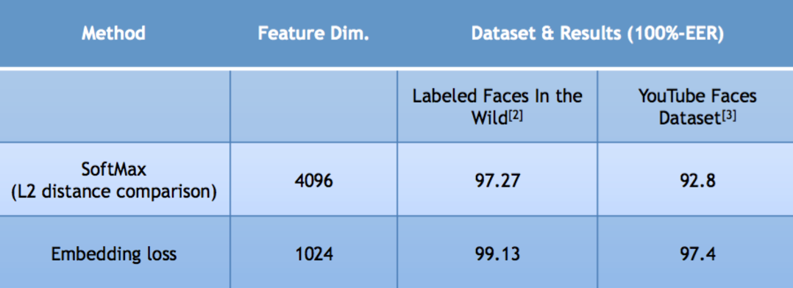
Present status Application
VGG Face
Frame extraction
Shot boundary detection
Face detection detector
Face tracking
local version of the cascade DPM face
Kanade-Lucas-Tomasi (KLT) tracker

Slide 12
Improvement & Future
Balance between Speed and Accuracy
Robustness: Color, Light, Shape, Movement, Size
What can we do?
Optimization under specially constrained environment

Slide 13
Q&A

Slide 14
Q&A

