Slide 1
TEAM 22
I
Design
Review
FACE TRACKING

Slide 2

Introduction Sponsor
United Automotive
Electronic System

Slide 3
Introduction Team
Team 22
Image Recognition
based on
Machine Learning &
Neural Network
Huan Zheng (Leader)
Xuefeng Hu
Siying Li
Zhenren Lu
Shengjie Pan

Slide 4
People Huan Zheng
Leader of the Team
Research Intern for Algorithms Platform @地平线机器人公司(funded by 余凯);
Mentored by Lichao Huang (arXiv:1509.04874).
Researched on YOLO for Object Detection.
Faster R-CNN for Face Detection.
Read papers for Object Detection/Face Detection/Reinforcement Learning.
Researched in
Artificial intelligence Painter Based On Neural Networks.
Efficient Deep Learning for Stereo Matching.
Related Course:
CNN/DL(Stanford online); CV/ML (Imperial College London) taught by Lichao
Related Language: C/C++/Python/ MATLAB
Framework: Worked with Mxnet. Familiar with Tensorflow/Caffe/Torch.

Slide 5
People Xuefeng Hu
Related courses:
(Graduated based) Machine Learning @University of Michigan;
Computer Vision @University of Michigan;
Research in Quantum Machine Learning with Professor Yaoyun Shi;
Research in Movie Face Clustering with Professor Jia Deng;
Research in Talking Face Detection with Professor Jia Deng;
Ph.D. offers in computer vision from UCSB and USC(oral).
Related Language: C/C++/Python/Torch/ MATLAB
Other related projects:
Human & pets face matching;
CNN implementation in MATLAB.

Slide 6
People Siying Li
Related courses:
Computer Vision @University of Michigan;
Internship for Hinacom in 2016SU;
Research in medical image detection algorithm.
MS. offer in computer vision from UM.
Related Language: C/C++/ MATLAB
Other related projects:
Human & pets face matching;
CNN implementation in MATLAB;
Robot waiter using Apriltag detection.

Slide 7
People Zhenren Lu
Related classes:
Intro to Machine Learning @University of Michigan
Intro to Artificial Intelligence(grader) @University of Michigan
Convolutional Neural Networks for visual Recognition
Related Language: C/C++/Python/Java/MATLAB

Slide 8
People Shengjie Pan
Related courses:
Machine Learning @ University of Michigan;
Information Retrieval @University of Michigan;
Research
Data Mining with Professor Danai Koutra;
Human Computer Interaction with Professor Eytan Adar;
Related Language: C/C++/Python/Java/ MATLAB

Slide 9
Design Problem Problem
A new in-car interaction method?

Slide 10

Design Problem Solution
Gesture control!
A gesture
tracking system
https://www.google.com/url?sa=i&rct=j&q=&esrc=s&source=images&cd=&cad=rja&uact=8&ved=0ahUKEwjy7dnZnrbUAhUh_IMKHbvMAmQQjRwIBw&url=http%3A%2F%2Fwww.conceptdraw.com

Slide 11

Design Problem Obstacle
Lack of gesture data
Take 1 month to
collect & label data
No time for
creative work

Slide 12
Design Problem Problem Redefine
A gesture tracking system?
A object tracking system
A face tracking system!

Slide 13
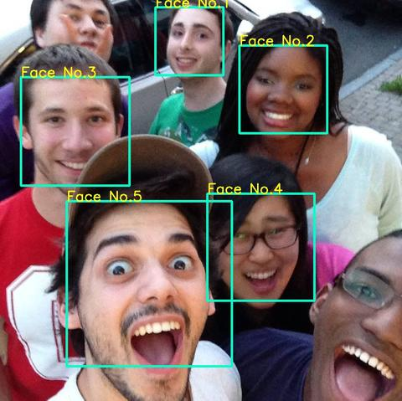
Design Problem Final Solution
A real-time, high accuracy face tracking system with high robustness
http://7xrb89.com1.z0.glb.clouddn.com/demo1.jpg-cee

Slide 14
Literature Study Summary
Target representation
and localization
A bottom-up process.
Kernel-based tracking or Mean-shift tracking
Contour tracking
Comaniciu, Dorin, Visvanathan Ramesh, and Peter Meer. "Kernel-based object tracking." IEEE Transactions on pattern analysis and machine intelligence 25.5 (2003): 564-577.
A top-down process.
Kalman filter
Particle filter
Qian, Richard J., M. Ibrahim Sezan, and Kristine E. Matthews. "A robust real-time face tracking algorithm." Image Processing, 1998. ICIP 98. Proceedings. 1998 International Conference on. Vol. 1. IEEE, 1998.
Filtering and data association
https://en.wikipedia.org/wiki/Video_tracking

Slide 15
Literature Study Baseline Model
KCF: Kernelized Correlation Filter (2015, 583 citations)
Henriques J F, Caseiro R, Martins P, et al. High-speed tracking with kernelized correlation filters[J]. IEEE Transactions on Pattern Analysis and Machine Intelligence, 2015, 37(3): 583-596.

Slide 16
Literature Study Benchmark
Y. Wu, J. Lim, and M. H. Yang, “Online object tracking: A
benchmark,” in Proc. Comput. Vis. Pattern Recognit., 2013,
pp. 2411–2418.
50 Videos benchmark
Same benchmark of KCF paper

Slide 17
Design Specifications Customer
“We want a fast reliable tracker which can be installed in a car!”

Slide 18
Design Specifications Engineer
Fast = Speed (> 24 Frame per second)
Accurate = High Precision
Reliable = High Recall
In a car = Portability
In a car -> High robustness
Robustness -> Stability

Slide 19
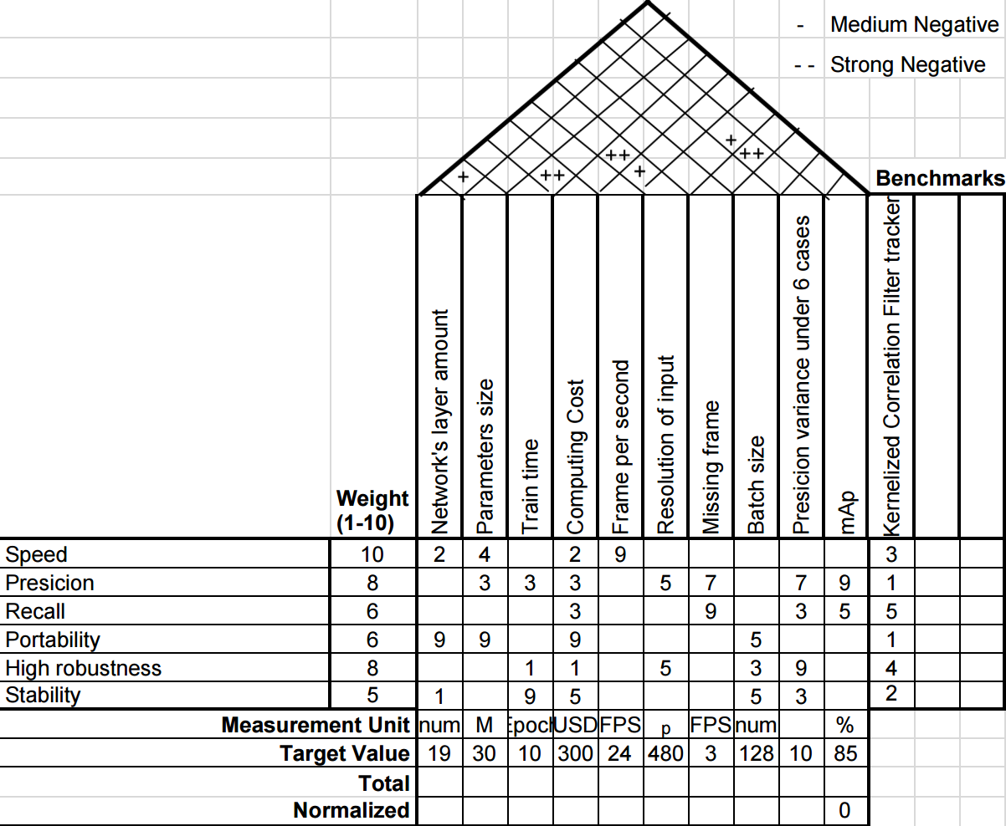
QFD

Slide 20
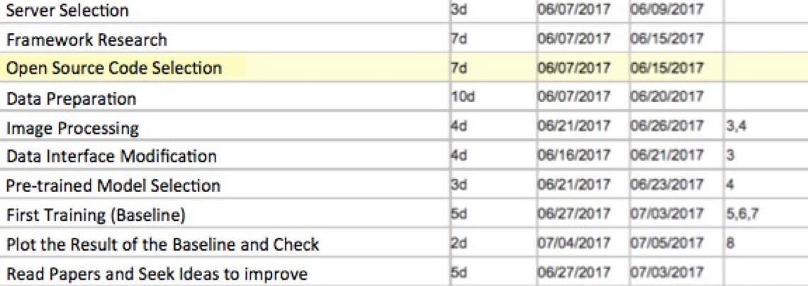
Project Plan Schedule

Slide 21
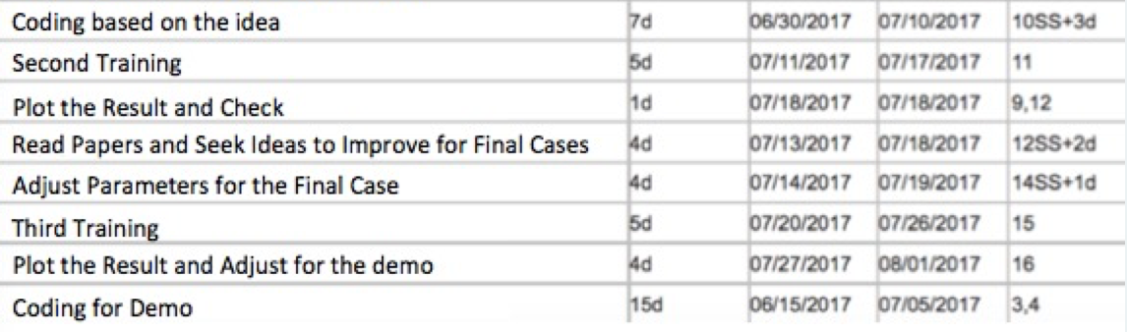
Project Plan Schedule

Slide 22
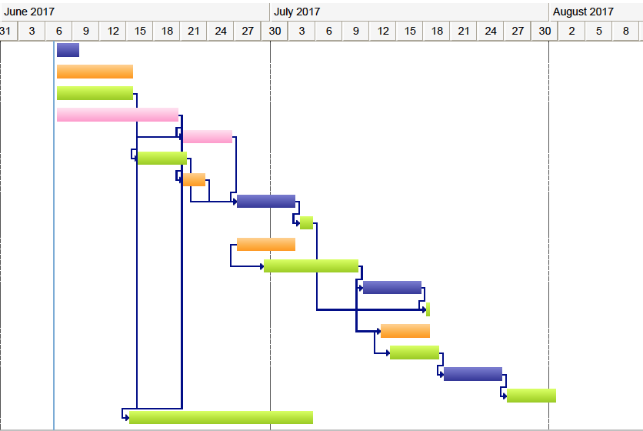
Project Plan Schedule

Slide 23
Project Plan Difficulties
Collecting appropriate and sufficient training and test data
Keeping the model converge during the training
Setting up reliable and reasonable evaluation method and tools
Compressing the model and fitting the limited computing resource

Slide 24
Project Plan Anticipate
Stable tracker
Robust for extreme cases
Portable and reusable
Real time

Slide 25
Q&A

Slide 26
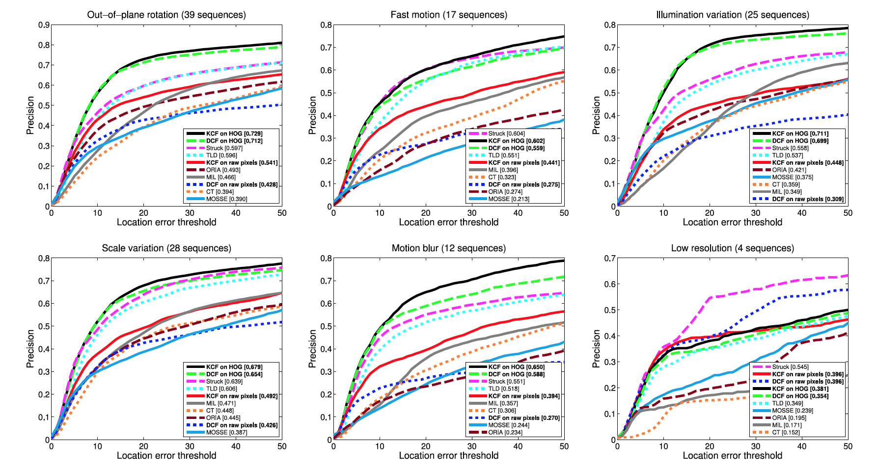
Robustness

