Slide 1
TEAM 22
FACE TRACKING

Slide 2
Progress Update
Training of Tiny face detector most completed
Gaussian blur of wider faces for fine tuning
Code study of KCF and modification
Study of real-time camera API

Slide 3
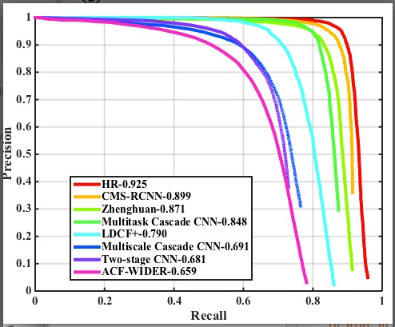
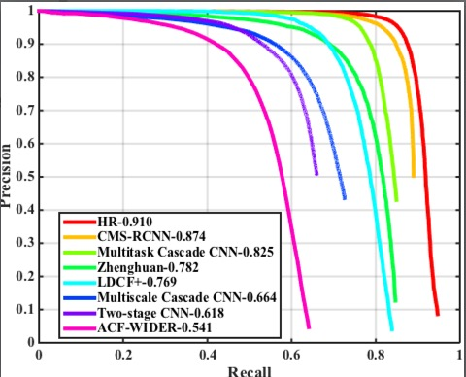
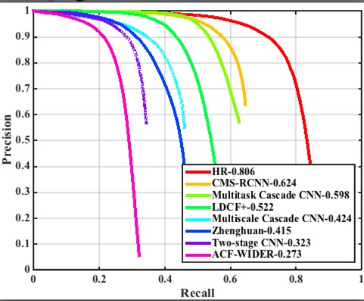
Progress Update Tiny face Detector

Slide 4
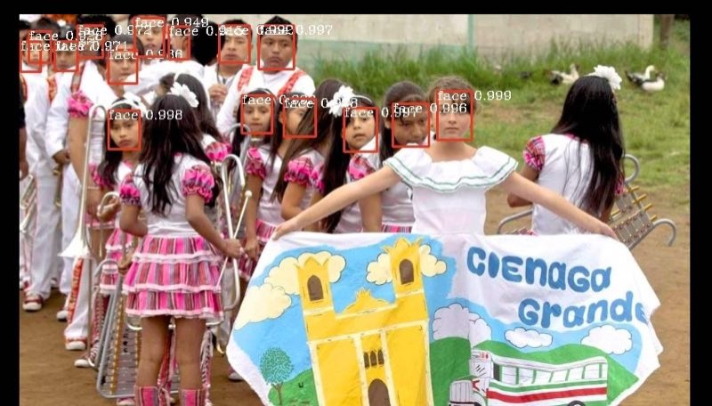
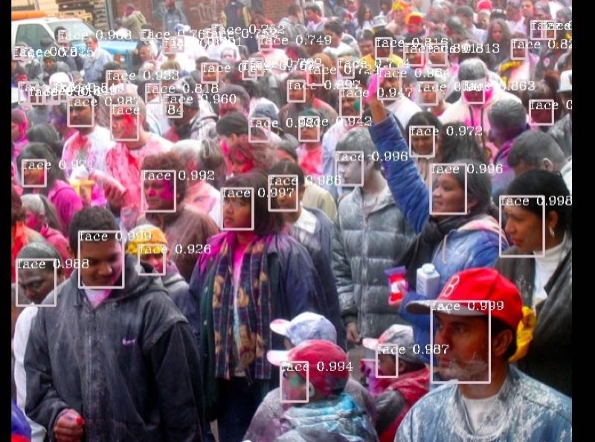
Progress Update Tiny face Detector

Slide 5
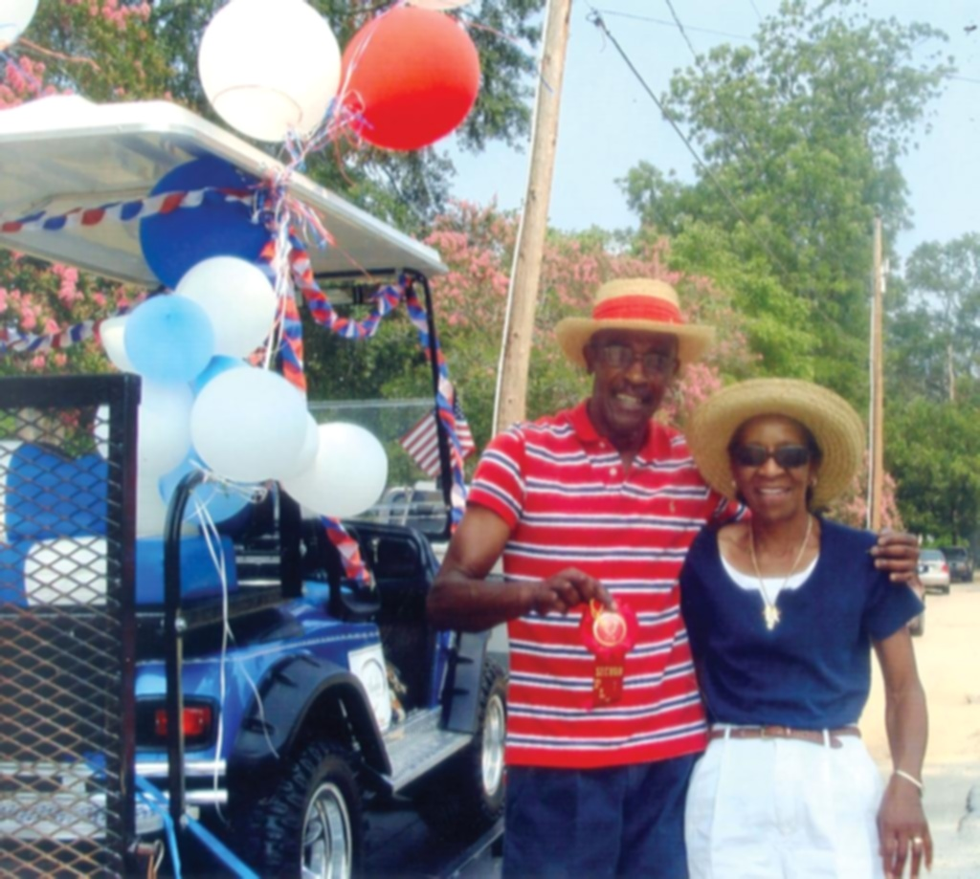
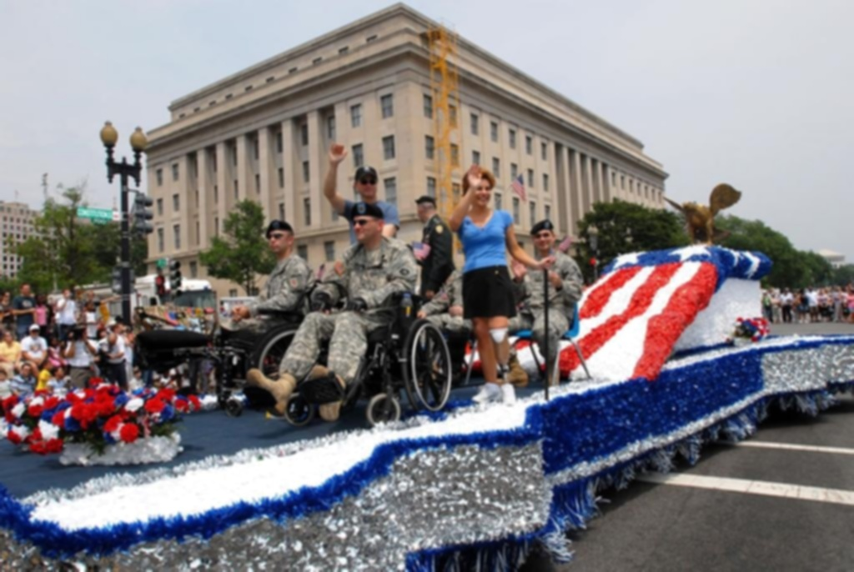
Progress Update Wider face blur

Slide 6
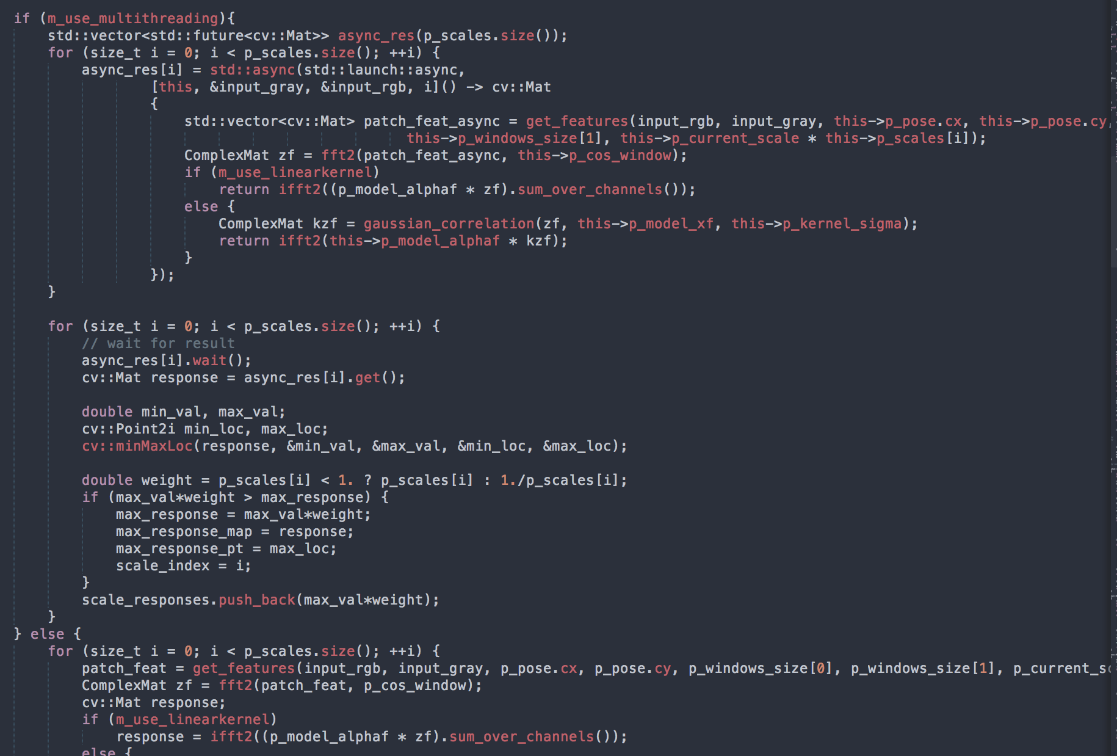
Progress Update Code Study

Slide 7
Progress Update Next step
Code study and code modification
Code integration: KCF and detector, KCF and livestream input
Fine tuning of face detector
Other engineering issue

Slide 8
Q&A

