Slide 1
Introduction to Kalman Filters
CEE 6430: Probabilistic Methods in Hydroscienecs
Fall 2008
Acknowledgements: Numerous sources on WWW, book, papers

Slide 2
Overview
What could Kalman Filters be used for in Hydrosciences?
What is a Kalman Filter?
Conceptual Overview
The Theory of Kalman Filter (only the equations you need to use)
Simple Example (with lots of blah blah talk through handouts)

Slide 3
A “Hydro” Example
Suppose you have a hydrologic model that predicts river water level every hour (using the usual inputs).
You know that your model is not perfect and you don’t trust it 100%. So you want to send someone to check the river level in person.
However, the river level can only be checked once a day around noon and not every hour.
Furthermore, the person who measures the river level can not be trusted 100% either.
So how do you combine both outputs of river level (from model and from measurement) so that you get a ‘fused’ and better estimate? – Kalman filtering

Slide 4
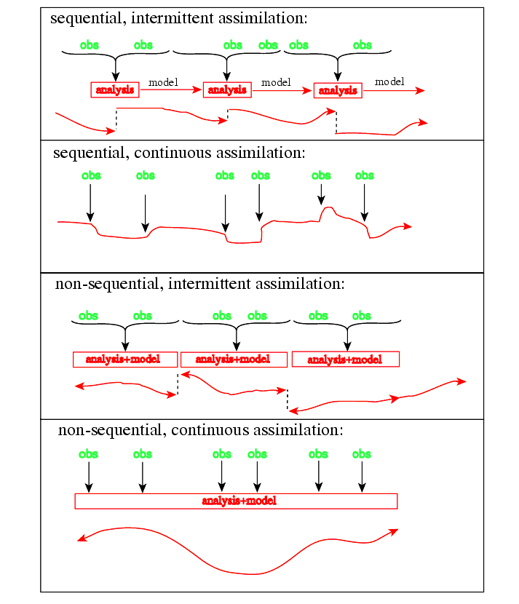
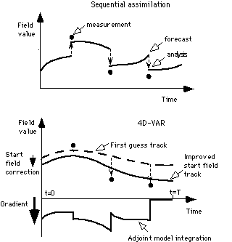
Graphically speaking

Slide 5
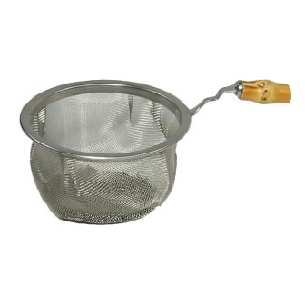
What is a Filter by the way?
Class – define mathematically what a filter is (make an analogy to a real filter)
Other applications of Kalman Filtering (or Filtering in general):
Your Car GPS (predict and update location)
Surface to Air Missile (hitting the target)
Ship or Rocket navigation (Appollo 11 used some sort of filtering to make sure it didn’t miss the Moon!)

Slide 6
The Problem in General
(let’s get a little more technical)
Black Box
System
Error Sources
Sometimes the system state and the measurement may be two different things (not like river level example)
External Controls
System
System State (desired but not known)
Observed Measurements
Optimal Estimate of System State
Measuring Devices
Estimator
Measurement
Error Sources
System state cannot be measured directly
Need to estimate “optimally” from measurements

Slide 7
What is a Kalman Filter?
Recursive data processing algorithm
Generates optimal estimate of desired quantities given the set of measurements
Optimal?
  For linear system and white Gaussian errors, Kalman filter is “best” estimate based on all previous measurements
  For non-linear system optimality is ‘qualified’
Recursive?
  Doesn’t need to store all previous measurements and reprocess all data each time step

Slide 8
Conceptual Overview
Simple example to motivate the workings of the Kalman Filter
The essential equations you need to know (Kalman Filtering for Dummies!)
Examples: Prediction and Correction

Slide 9
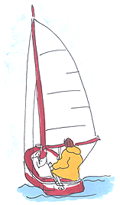
Conceptual Overview
y
Lost on the 1-dimensional line (imagine that you are guessing your position by looking at the stars using sextant)
Position – y(t)
Assume Gaussian distributed measurements

Slide 10
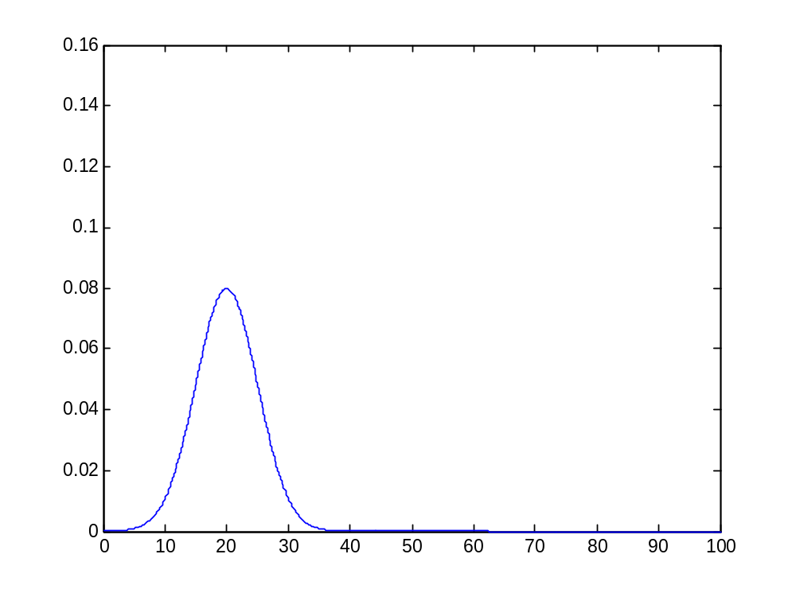
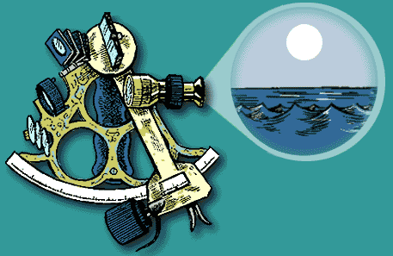
Conceptual Overview
State space – position
Measurement - position
Sextant is not perfect
Sextant Measurement at t₁: Mean = z₁ and Variance = σ_{z1}
Optimal estimate of position is: ŷ(t₁) = z₁
Variance of error in estimate: σ²_{x} (t₁) = σ²_{z1}
Boat in same position at time t₂ - Predicted position is z₁

Slide 11
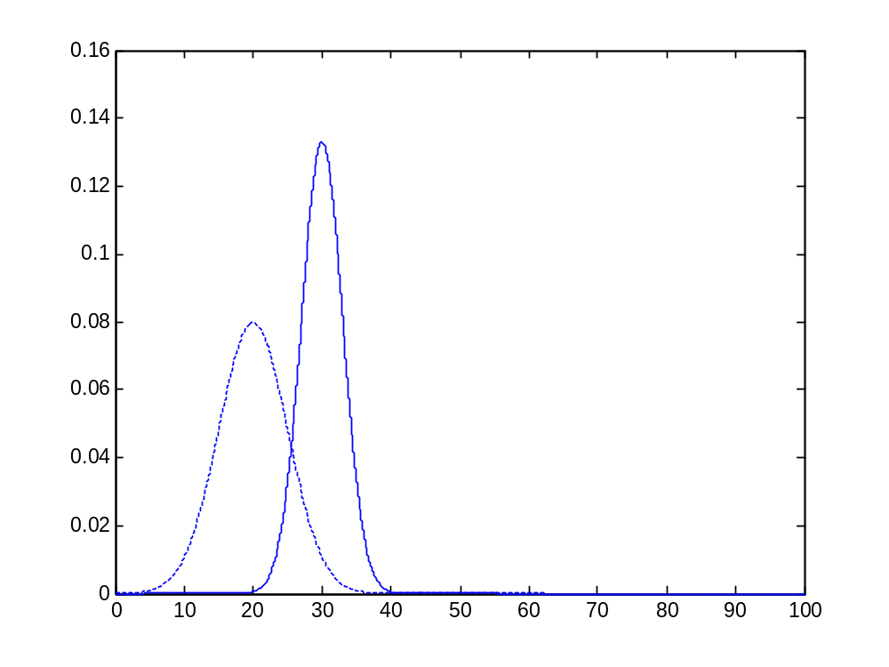
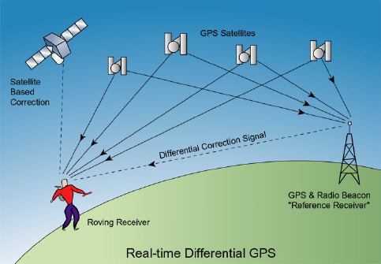
Conceptual Overview
prediction ŷ⁻(t₂)
State (by looking at the stars at t2)
Measurement usign GPS z(t₂)
So we have the prediction ŷ⁻(t₂)
GPS Measurement at t₂: Mean = z₂ and Variance = σ_{z2}
Need to correct the prediction by Sextant due to measurement to get ŷ(t₂)
Closer to more trusted measurement – should we do linear interpolation?

Slide 12
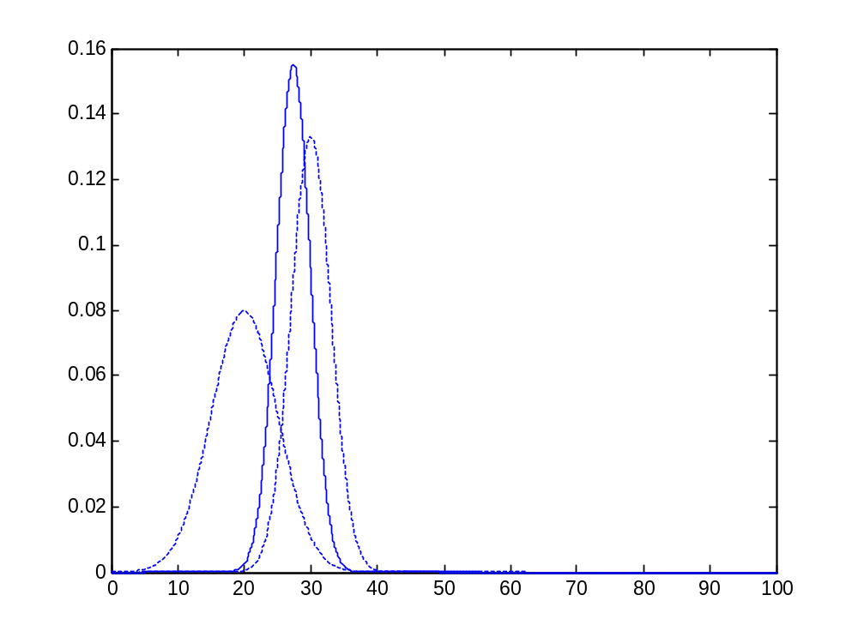
Conceptual Overview
prediction ŷ⁻(t₂)
corrected optimal estimate ŷ(t₂)
Kalman filter helps you fuse measurement and prediction on the basis of how much you trust each
(I would trust the GPS more than the sextant)
measurement z(t₂)
Corrected mean is the new optimal estimate of position (basically you’ve ‘updated’ the predicted position by Sextant using GPS
New variance is smaller than either of the previous two variances

Slide 13
Conceptual Overview
(The Kalman Equations)
Lessons so far:
Make prediction based on previous data - ŷ⁻, σ⁻
Take measurement – z_{k}, σ_{z}
Optimal estimate (ŷ) = Prediction + (Kalman Gain) * (Measurement - Prediction)
Variance of estimate = Variance of prediction * (1 – Kalman Gain)

Slide 14
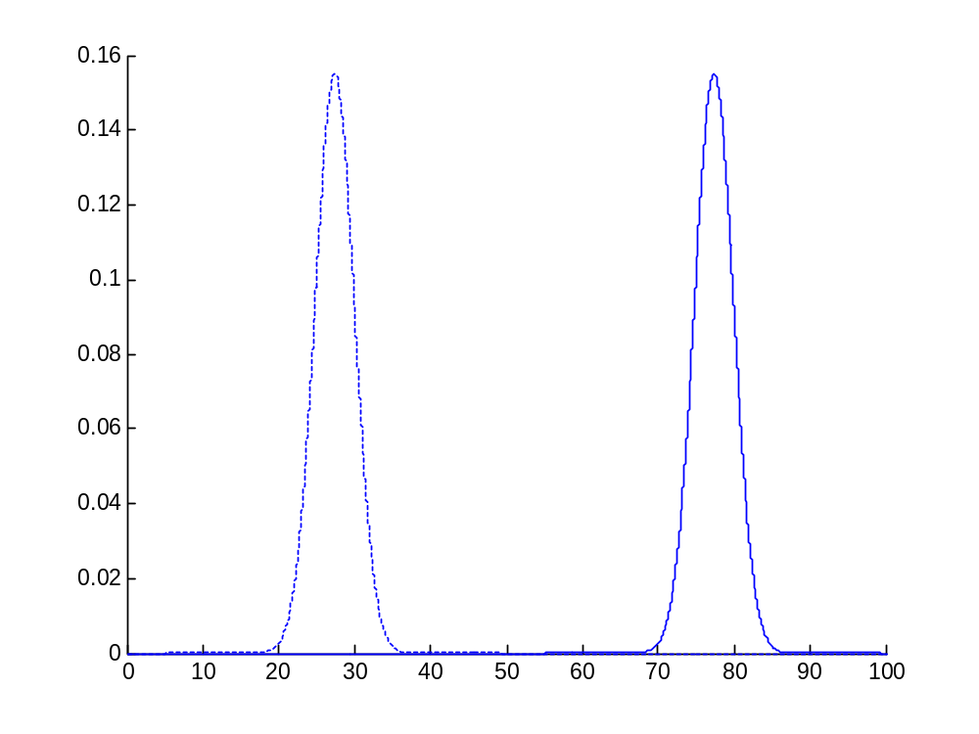
Conceptual Overview
What if the boat was now moving?
ŷ(t₂)
Naïve Prediction (sextant) ŷ⁻(t₃)
At time t₃, boat moves with velocity dy/dt=u
Naïve approach: Shift probability to the right to predict
This would work if we knew the velocity exactly (perfect model)

Slide 15
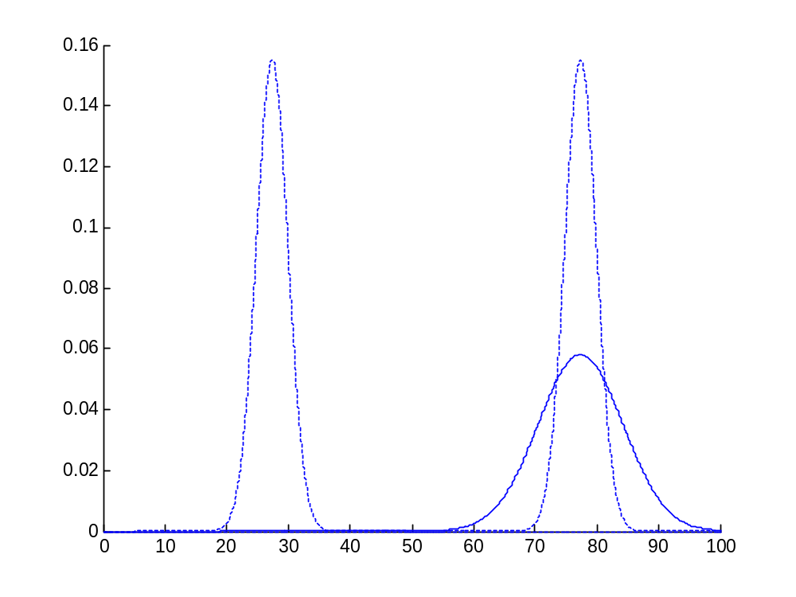
Conceptual Overview
Naïve Prediction ŷ⁻(t₃)
ŷ(t₂)
But you may not be so sure about the exact velocity
Prediction ŷ⁻(t₃)
Better to assume imperfect model by adding Gaussian noise
dy/dt = u + w
Distribution for prediction moves and spreads out

Slide 16
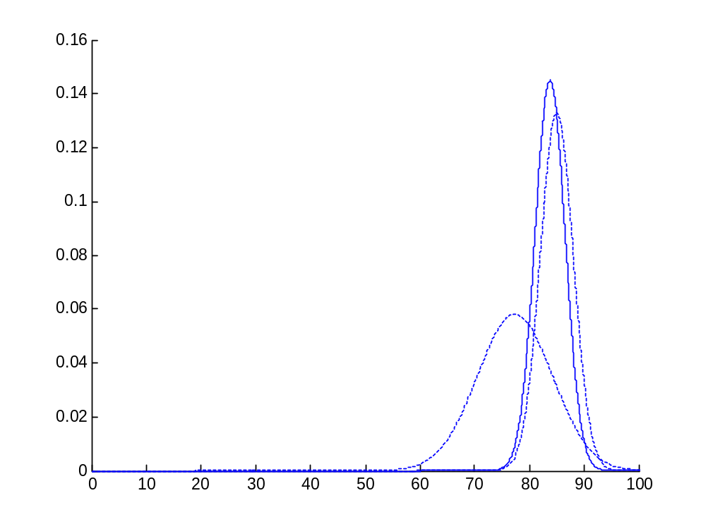
Conceptual Overview
Corrected optimal estimate ŷ(t₃) Updated Sextant position using GPS
Measurement z(t₃) GPS
Prediction ŷ⁻(t₃) Sextant
Now we take a measurement at t₃
Need to once again correct the prediction
Same as before

Slide 17
Conceptual Overview
Lessons learnt from conceptual overview:
  Initial conditions (ŷ_{k-1} and σ_{k-1})
  Prediction (ŷ⁻_{k} , σ⁻_{k})
    Use initial conditions and model (eg. constant velocity) to make prediction
  Measurement (z_{k})
    Take measurement
  Correction (ŷ_{k} , σ_{k})
    Use measurement to correct prediction by ‘blending’ prediction and residual – always a case of merging only two Gaussians
    Optimal estimate with smaller variance

Slide 18
Blending Factor
If we are sure about measurements:
  Measurement error covariance (R) decreases to zero
  K decreases and weights residual more heavily than prediction
If we are sure about prediction
  Prediction error covariance P⁻_{k} decreases to zero
  K increases and weights prediction more heavily than residual

Slide 19
The set of Kalman Filtering Equations in Detail
Correction (Measurement Update)
Prediction (Time Update)
(1) Compute the Kalman Gain
(1) Project the state ahead
K = P⁻_{k}H^{T}(HP⁻_{k}H^{T} + R)⁻¹
ŷ⁻_{k} = Ay_{k-1} + Bu_{k}
(2) Update estimate with measurement z_{k}
(2) Project the error covariance ahead
ŷ_{k} = ŷ⁻_{k} + K(z_{k} - H ŷ⁻_{k} )
P⁻_{k} = AP_{k-1}A^{T} + Q
(3) Update Error Covariance
P_{k} = (I - KH)P⁻_{k}

Slide 20
Assumptions behind Kalman Filter
The model you use to predict the ‘state’ needs to be a LINEAR function of the measurement (so how do we use non-linear rainfall-runoff models?)
The model error and the measurement error (noise) must be Gaussian with zero mean

Slide 21
What if the noise is NOT Gaussian?
Given only the mean and standard deviation of noise, the Kalman filter is the best linear estimator. Non-linear estimators may be better.
Why is Kalman Filtering so popular?
· Good results in practice due to optimality and structure.
· Convenient form for online real time processing.
· Easy to formulate and implement given a basic understanding.
· Measurement equations need not be inverted.
ALSO popular in hydrosciences, weather/oceanography/ hydrologic modeling, data assimilation

Slide 22
Now ..to understand the jargons
(You may begin the handouts)
First read the hand out by PD Joseph
Next, read the hand out by Welch and Bishop titled ‘An Introduction to the Kalman Filter’. (you can skip pages 4-5, 7-11). Pages 7-11 are on ‘Extended Kalman Filtering’ (for non-linear systems). Read the solved example from pages 11-16.

Slide 23
Homework (conceptual)
Explain in NO MORE THAN 1 PAGE the example that you read from pages 11-16 in the handout by Welch and Bishop. Basically, I want you to give me a simple conceptual overview of why and how ‘filtering’ was applied using the previous analogy on a boat lost in sea.
DUE – Same date as the Class project report.
EXTRA CREDIT 5% marks– If you review (3-4 pages) the classic paper in 1960 by Kalman (hand out)
EXTRA CREDIT 5% marks – if you turn in a detailed summary of the STEVE software (pros/cons, what it is etc.)

Slide 24
References
Kalman, R. E. 1960. “A New Approach to Linear Filtering and Prediction Problems”, Transaction of the ASME--Journal of Basic Engineering, pp. 35-45 (March 1960).
Welch, G and Bishop, G. 2001. “An introduction to the Kalman Filter”, http://www.cs.unc.edu/~welch/kalman/
By the way Dr. Rudolf Kalman is alive and living well today

