Slide 1
Sampling Methods for Estimation:
An Introduction
Particle Filters, Sequential
Monte-Carlo, and Related Topics
Nahum Shimkin
Faculty of Electrical Engineering
Technion

Slide 2
Outline
The nonlinear estimation problem
Monte-Carlo Sampling:
- Crude Monte-Carlo
- Importance Sampling
Sequential Monte-Carlo

Slide 3
The Estimation Problem:
Consider a discrete-time stochastic system with state
x_{t}X (usually ^{n}), and observation y_{t}Y. The system is specified by the following prior data:
p(x_{o}): initial state distribution
p(x_{t+1}| x_{t}): state transition law (t=0, 1, 2, ..)
p(y_{t}| x_{t}): measurement distribution (t=1, 2, ..)
Denote

Slide 4

The Estimation Problem (cont’d)
Note:
As usual, we assume the Markovian state property:
The above laws are often specified through state equations:
The system may be time-varying, for simplicity we omit the time variable.

Slide 5



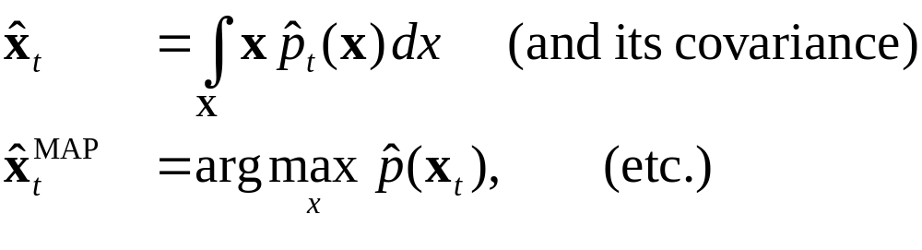
The Estimation Problem (cont’d)
We wish to estimate the state x_{t}, based on the prior data and the observations y_{1:t}.
The MMSE-optimal estimator, for example, is given by with covariance
More generally, compute the posterior state distribution:
We can then compute

Slide 6
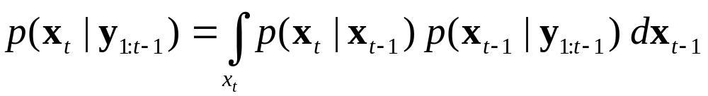
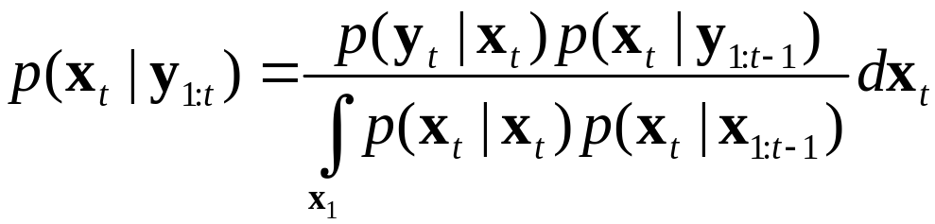
Posterior Distribution Formulas:
Using the Bayes rule, we easily obtain the following two-step recursive formulas that relate p(x_{t}|y_{1:t}) to
p(x_{t-1}| y_{1:t-1}) and y_{t}:
Time Update (prediction step):
Measurement Update:

Slide 7
Posterior Distribution Formulas: (2)
Unfortunately, these are hard to compute directly – especially when x is high-dimensional!
Some well-known approximations:
The Extended Kalman Filter
Gaussian Sum Filters
General/Specific Numerical Integration Methods
Sampling-based methods – Particle Filters.

Slide 8
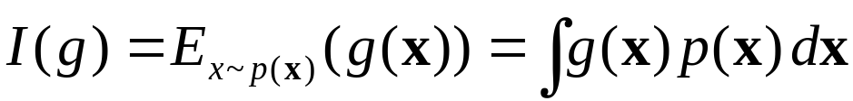
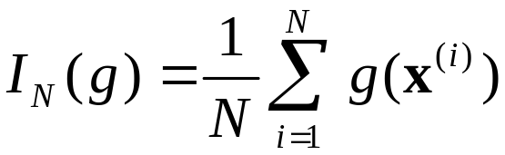

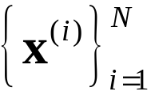
Monte-Carlo Sampling:
Crude Monte Carlo
The basic idea:
Estimate the expectation integral
by the following mean:
where That is, are independent samples from p(x).

Slide 9
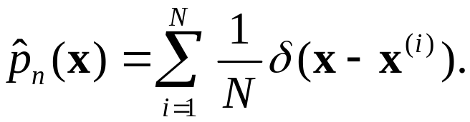
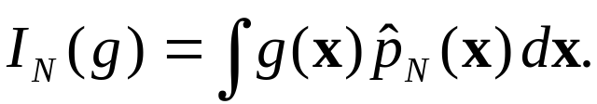



Crude Monte-Carlo – Interpretation
We can interpret Monte-Carlo sampling as trying to approximate p(x) by the discrete distribution
It is easily seen that
The samples x^{(i)} are sometimes called “particles”, with weights w^{(i)} = N^{-1.}

Slide 10




Crude Monte Carlo: Properties
The following basic properties follow from standard results for i.i.d. sequences.
Bias: I_{N} (g) is an unbiased estimate of I(g), namely
SLLN:
CLT:
whenever
Advantages (over numerical integration):
➢ Straightforward scheme.
➢ Focuses on “important” areas of p(x).
➢ Rate of convergence does not depend (directly) on dim(x).

Slide 11
The Monte-Carlo Method: Origins
Conceiver: Stanislav Ulam (1946).
Early developments (1940’s-50’s):
➢ Ulam & Von-Neumann: Importance Sampling, Rejection Sampling.
➢ Metropolis & Von-Neumann: Markov-Chain Monte-Carlo (MCMC).
A surprisingly large array of applications, including
➢ global optimization
➢ statistical and quantum physics
➢ computational biology
➢ signal and image processing
➢ rare-event simulation
➢ state estimation …

Slide 12

Importance Sampling (IS)
Idea:
Sample x from another distribution, q(x).
Use weights to obtain the correct distribution.
Advantages:
May be (much) easier to sample from q than from p.
The covariance may be (much) smaller
⇒ Faster convergence / better accuracy.

Slide 13

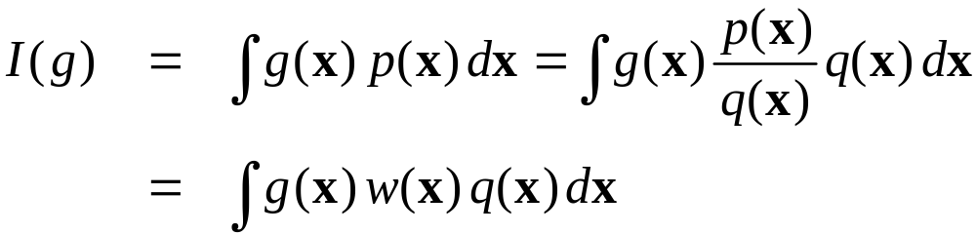
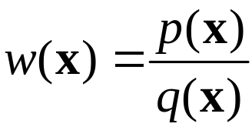
Importance Sampling (2)
Let q(x) be a selected distribution over x – the proposal distribution. Assume that
Observe that:
where
is the likelihood ratio, or simply the weight-function.

Slide 14

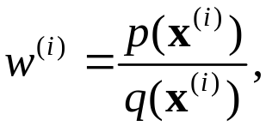
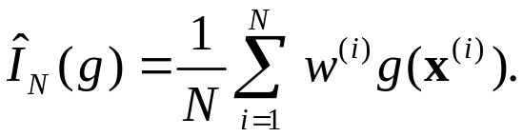

Importance Sampling (3)
This immediately leads to the IS algorithm:
(1) Sample
(2) Compute the weights and
Basic Properties:
The above-mentioned convergence properties are maintained.
The CLT covariance is now
This covariance is minimized by q(x)=p(x) g(x). Unfortunately this choice is often too complicated, and we settle for approximations.

Slide 15
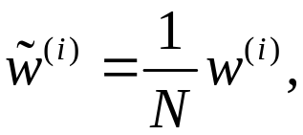
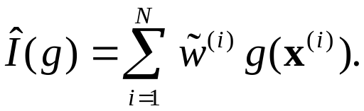
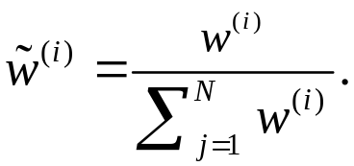

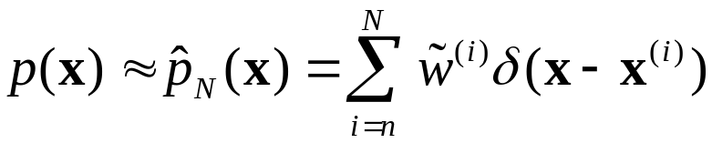
Importance Sampling (4)
Additional Comments:
It is often convenient to use the normalized weights
so that
The weights w^{(i)} are sometimes not properly normalized
for example, when p(x) is known up to a (multiplicative) constant.
We can still use the last formula, with
We may interpret as a “weighted-particles” approximation to p(x):

Slide 16
Two Discrete Approximations

Slide 17






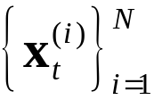


The Particle Filter Algorithm
We can now apply these ideas to our filtering problem. The basic algorithm is as follows:
0. Initialization: sample from p₀(x) to obtain with For t=1,2,…, given
Time update: For i=1,…, N sample
Set
Measurement update: For i=1,…, N, evaluate the (unnormalized) importance weights:
Resampling: Sample N points from the discrete distribution corresponding to Continue with

Slide 18

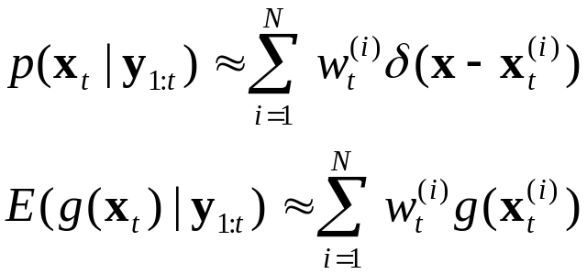

The Particle Filter Algorithm (2)
Output: Based on we can estimate
We may also use for that purpose.
This algorithm is the original “bootstrap filter” introduced in Gordon et al. (1993).
CONDENSATION is a similar algorithm developed independently in the computer vision context (Isard and Blake, 1998).
Many improvements and variations now exist.

Slide 19
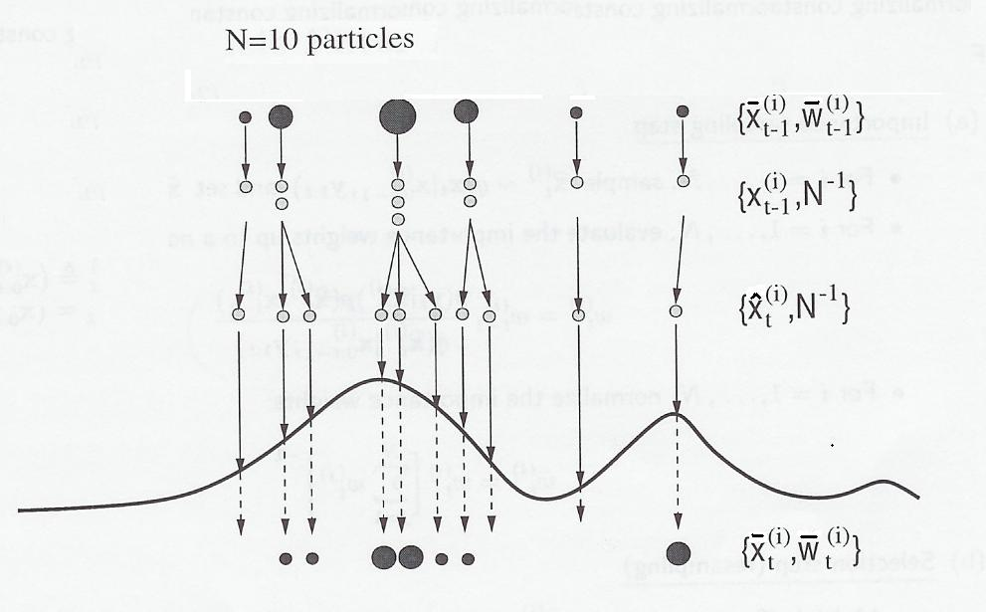




Particle Flow
(from Doucet et. al., 2001)

Slide 20
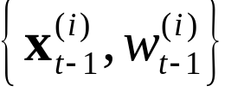


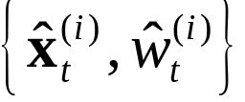


The Particle Filter: Time Update
Recall that approximates and is given.
An approximation is therefore obtained by sampling and setting
For example, for the familiar state model we get

Slide 21


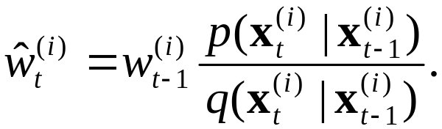

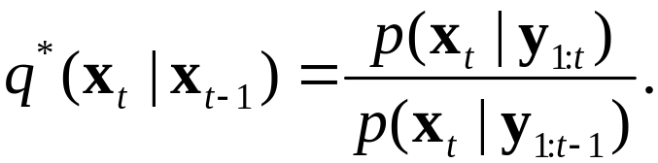
The Particle Filter: Time Update (2)
It is possible (and often useful) to sample from another (proposal) distribution
In that case we need to modify the weights:
The ideal choice for would by
Some schemes exist which try to approximate sampling with q* - e.g., using MCMC.

Slide 22
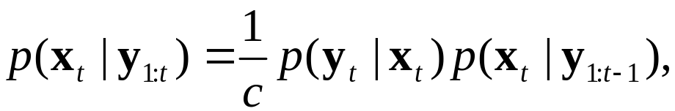

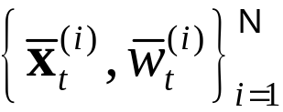



The Particle Filter: Measurement Update
Recall that
and approximate
To obtain an approximation to
we only need to modify the weights accordingly:
with

Slide 23







The Particle Filter: Resampling
Resampling is not strictly required for asymptotic convergence (as ).
However, without it, the distributions tend to degenerate, with few “large” particles, and many small ones.
The idea is therefore to split large particles into several smaller ones, and discard very small particles.
Random sampling from is one option. Another is a deterministic splitting of particles according to namely: particles at with
In fact, the last option tends to reduce the variance.

Slide 24
Additional Issues and Comments
Data Association:
This is an important problem for applications such as multiple target tracking, and visual tracking.
Within the Kalman Filter framework, such problems are often treated by creating multiple explicit hypothesis regarding the data origin which may lead to combinatorial explosion.
Isard and Blake (1998) observed that particle filters open new possibilities for data association for tracking. Specifically, different particles can be associated to different measurements, based on some “closeness” (or likelihood) measure.
Encouraging results have been reported.

Slide 25
Additional Issues and Comments (2)
Joint Parameter and State Estimation:
As is well known, this “adaptive estimation” problem can be reduced to a standard estimation problem by embedding the parameters in the state vector.
This however leads to a bi-linear state equation, for which standard KF algorithms did not prove successful. The problem is currently treated using non-sequential algorithms (e.g. EM + smoothing).
Particle filters have been applied to this problem with encouraging results.

Slide 26
Additional Issues and Comments (3)
Low-noise State Components:
State components which are not excited by external noise (such as fixed parameters) pose a problem since the respective particle components may be fixed in their place, and cannot correct initially bad placements.
The simplest solution is to add a little noise. Additional suggestions involve intermediate MCMC steps, and related ideas.

Slide 27
Conclusion:
Particle Filters and Sequential Monte Carlo Methods are an evolving and active topic, with good potential to handle “hard” estimation problems, involving non-linearity and multi-modal distributions.
In general, these schemes are computationally expensive as the number of “particles” N needs to be large for precise results.
Additional work is required on the computational issue – in particular, optimizing the choice of N, and related error bounds.
Another promising direction is the merging of sampling methods with more disciplined approaches (such as Gaussian filters, and the Rao-Blackwellization scheme …).

Slide 28
To Probe Further:
Monte-Carlo Methods (at large):
R. Rubinstein, Simulation and the Monte-Carlo Method, Wiley, 1981 (and 1996).
J.S. Liu, Monte-Carlo Strategies in Scientific Computing, Springer, 2001.
M. Evans and T. Swartz, “Methods for approximating integrals in statistics with special emphasis on Bayesian integration problems”, Statistical Science 10(3), 1995, pp. 254-272.
Particle Filters:
N.J. Gordon, D. J. Salmond and A. Smith, “Novel approach to non-linear / non-Gaussian Bayesian state estimation”, IEE Proceedings-F 140(2), pp. 107-113.
M. Isard and A. Blake, “CONDENSATION – conditional density propagation for visual tracking”, International Journal of Computer Vision 28(1), pp. 5-28.
A Doucet, N. de Freitas and N. Gordon (eds.) Sequential Monte Carlo Method in Practice, Springer, 2001.
S. Arulampalam et al., “A tutorial on particle filters, for on-line non-linear/non-Gaussian Bayesian tracking”, IEEE Trans. on Signal Processing 50(2), 2002.

