Slide 1


MAR 580: Advanced Population Modeling for Management of Living Marine Resources
Lecture 2
Maximum Likelihood Estimation
(Acknowledgements: Tony Wood, Myung 2003)
8 September 2015

Slide 2
Where Are We?
Re-introductions…
Questions from last week’s lecture or reading (syllabus, programming concepts, ADMB, linear models)?
Maximum Likelihood Estimation (Cooch & White, MARK Chapter 1, …)

Slide 3
Lecture Outline
Modelling and Modelers
Goodness-of-Fit (Hilborn & Walters 1992) - review
Maximum Likelihood Estimation
Theory and Applications
Binomial Likelihood
Multinomial Likelihood and Mark-Recapture Application
Normal Likelihood
Other distributions
Lab 2 – Mark Recapture Experiment, Length-Weight re-estimation

Slide 4
Modelling and Modelers
Model Users
Previously developed models are applied to specific problems and objectives
Models are applied using software has been debugged and verified through beta-testing and quality control, and refined through user feedback, usually applying current conventions on ‘best practices.’
Each application can be evaluated using routine diagnostics.
Model Builders
Use previously developed software to apply a series of (valid) model types and configurations to determine ‘optimal model’ or multi-model inference.
Balance of quality-control and flexibility for systems with high volume through-put of applied models (Northeast Regional Stock Assessment Workshop, ICES Advisory System, …)
Model Developers
Write code to tailor models to available data, address more complicated problems & objectives and advance the science and practices of modeling as a research tool.
Code testing and model validation may be incomplete for application to specific problems.

Slide 5

NOAA Fisheries Toolbox
Web Site: http://nft.nefsc.noaa.gov
Beta-testing site: http://nft.nefsc.noaa.gov/beta/
User Name: nft
Password: nifty

Slide 6
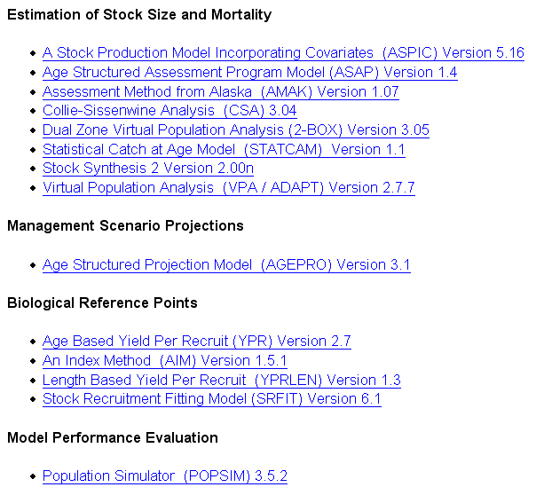

Slide 7
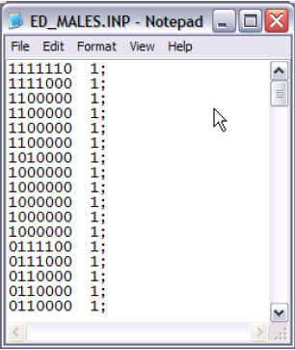
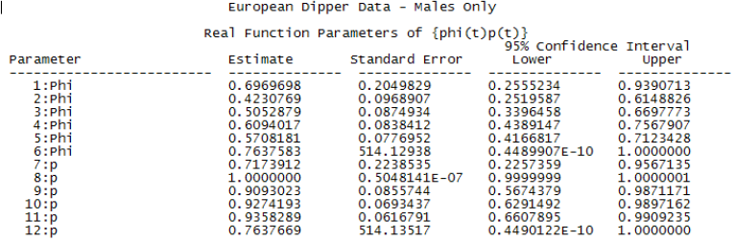
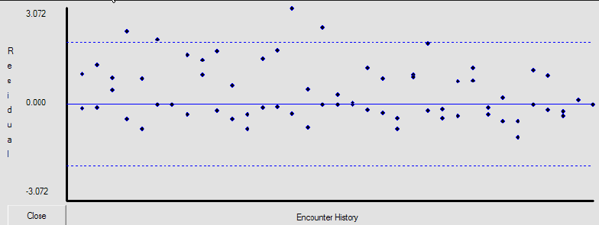
MARK
Software package for analysis of marked individuals.

Slide 8
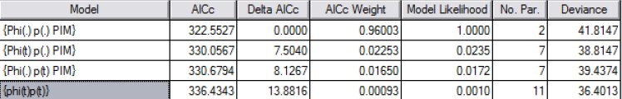
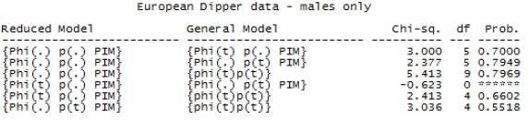
MARK
Powerful linear programming for model building, model selection and multi-model inference.

Slide 9


Software Packages for Model Application
FLR (Fisheries Library in R)
DISTANCE: Software for the design and analysis of distance sampling surveys of wildlife populations (a Windows-based program and a suite of packages for the statistical programming language R).

Slide 10
Model Building

Slide 11
Model Fitting
Essential requirements of parameter estimation:
A theoretical model of the system (with parameters)
Observed data from the system
A goodness of fit criterion
Parameters are estimated by finding values that offer the best agreement between the model and the data.

Slide 12
Goodness of Fit
Two common criteria:
Least squares
parameters are chosen to minimize the difference between sample data and model predictions:
SS=∑ (observed-predicted)²
Most commonly used
Maximum likelihood
parameters are chosen to maximize the probability of the observed data being from the modeled system.
Advanced applications require knowledge of mathematical statistics (not covered in this course)

Slide 13
Graphic Grid Search
Plot the goodness of fit criterion as a function of the parameter value (“response surface”).
Good practice for ANY estimation procedure.

Slide 14
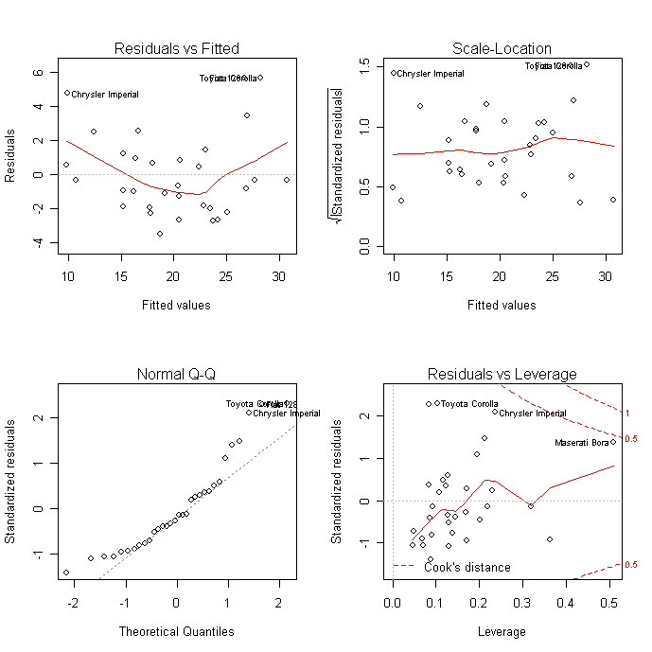
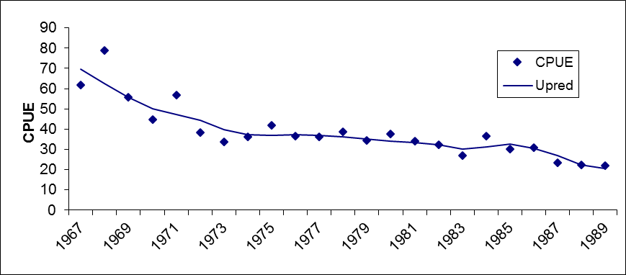
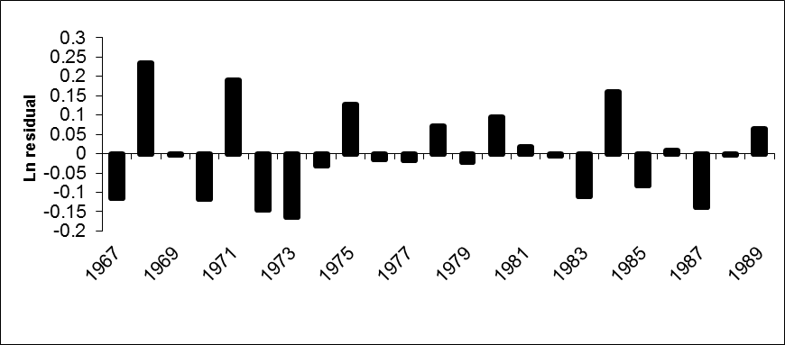
Model Validation

Slide 15
Multiple Parameters and Correlation

Slide 16
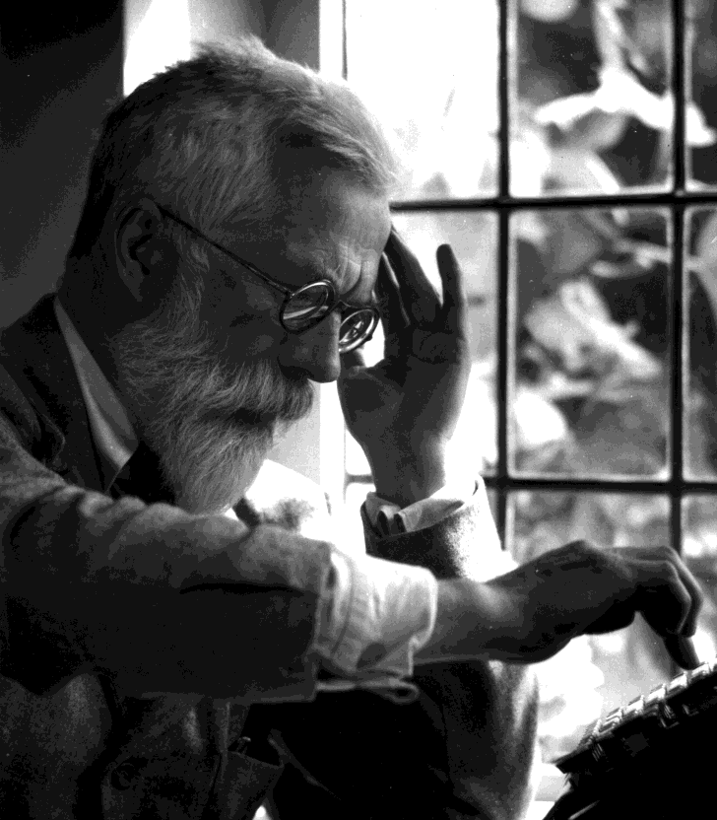
Likelihood Theory
Fisher (1922)
For hypothesis testing, we infer the probability of being consistent with a hypothetical frequency distribution.
An observation y is significantly different than the null hypothesis if P < 5%
or P(obs | par) < 0.05
95%

Slide 17
Likelihood Theory
Similar to inferring the probability of an observation belonging to a hypothetical population,
we can also infer the likelihood of parameter values given observations:
L(parameters | observations)
P(obs|par) = L(par|obs)
The MARK chapter occasionally uses sloppy notation like L(obs|par)

Slide 18
Likelihood Applications
Many of statistical inference methods are based on likelihood (Chi-Square test, G-test, Contingency Tables, Log-linear models).
For example, the G-test assumes a binomial distribution of frequencies:

Slide 19
Likelihood Applications
Log likelihood ratio:
Significantly different frequency than expected from hypothetical distribution.

Slide 20
Binomial Probability Distribution Function (PDF)
y: number of ‘successful’ outcomes in one observation of ten successive trials (e.g. toss a coin 10 times, a positive outcome is getting a tail).
There are only two possible outcomes:
Success (T) and
Failure (F)
We use a binomial probability distribution function to estimate the probability of a success on any one trial (w).

Slide 21
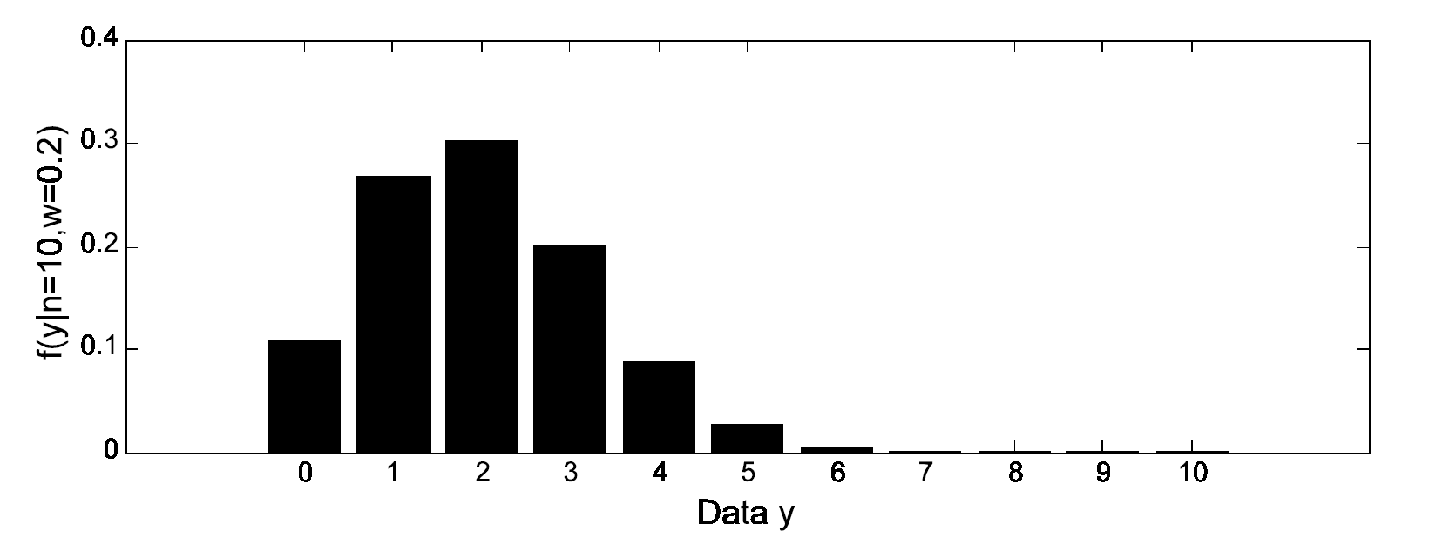
Binomial Probability Distribution Function (PDF)
Example: probability of observing any value y from ten trials (0-10) if the probability of ‘success’ is 20%

Slide 22
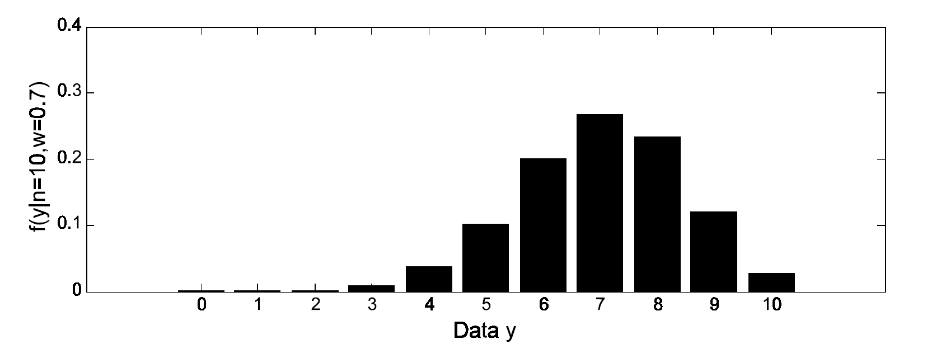
Binomial Probability Distribution Function (PDF)
Example: probability of observing any value y from ten trials (0-10) if the probability of ‘success’ is 70%

Slide 23
Binomial Likelihood
Inferential statistics to derives the probability of obtaining observed data if a hypothesis (and hypothetical parameter values) are true.
In parameter estimation, we collect data to inform unknown parameters in a model of that represents the system of inference, and we can find the one probability distribution that is most likely to have produced the data.

Slide 24
Binomial Likelihood
We define the likelihood function by reversing the roles of the data vector y and the parameter vector w to represent the likelihood of parameter w given the observed data y.
The likelihood function for 7 successes in 10 trials is:

Slide 25
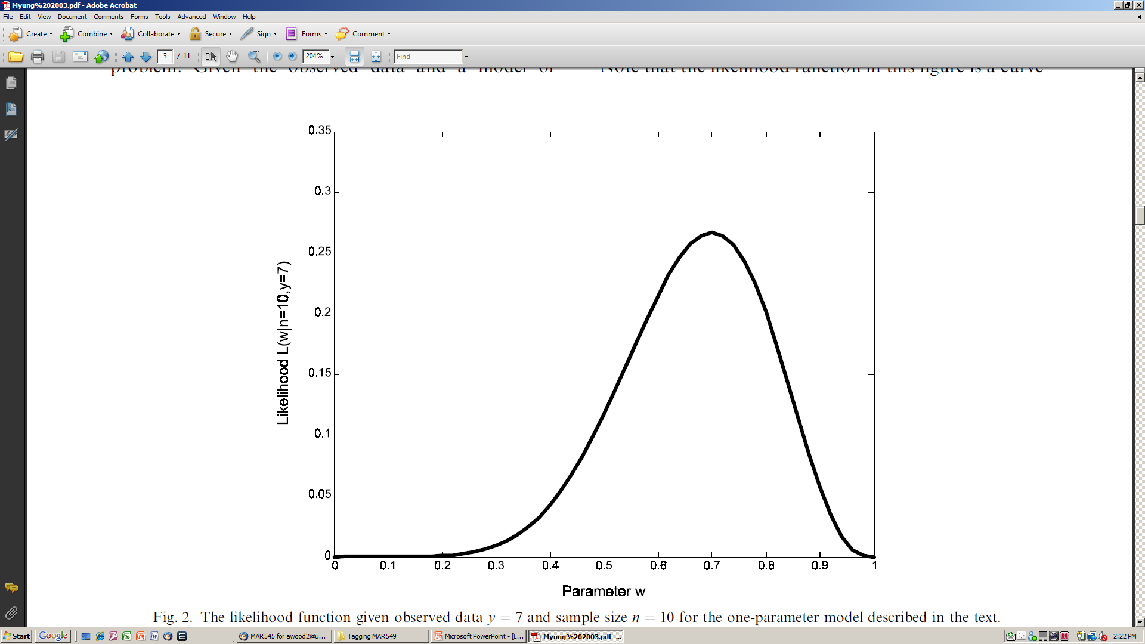
Maximum Likelihood Estimation (MLE)
The likelihood is greatest (0.267) at w = 0.7.
Maximum Likelihood Estimation (MLE) uses numerical optimization to find the parameter estimates that maximize this likelihood function.

Slide 26
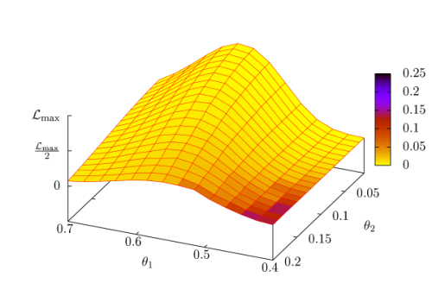
Multiple Parameters
With one unknown parameter, graphic grid search can identify the most likely parameter value for the data.
As the number of parameters increases the likelihood function becomes more complicated leading to multi-dimensional geometrical surfaces.

Slide 27
Multinomial Probability Distribution
The binomial distribution can be expanded to include multiple parameters for a multinomial distribution:

Slide 28
Multinomial Probability Distribution
For example, probability of successive dice rolls:
Probability of rolling a 1 six times:

Slide 29
Multinomial Probability Distribution
2x2 Contingency Table assumes a multinomial distribution of frequencies in cells a, b, c and d in which the probability of a given frequency is:

Slide 30
Maximum Likelihood Estimation
For mathematical convenience in searching for optimal parameter values, constants (e.g., N!/y!) are ignored, log likelihood avoids small likelihood values & are additive, and negative log likelihood allows for minimization of the objective function

Slide 31
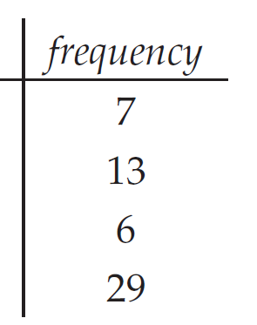
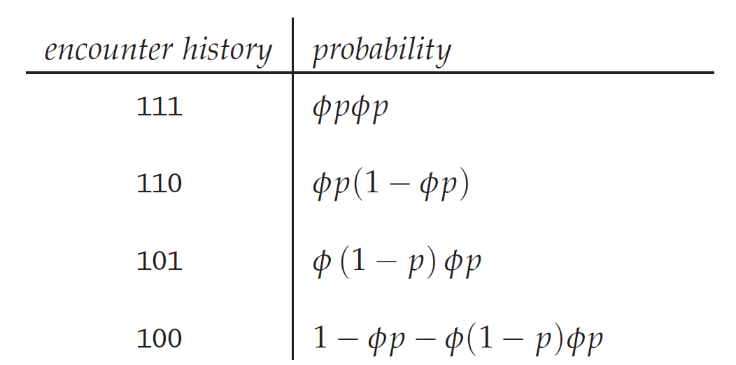
Mark-Recapture Application
Many mark recapture models are based on parameters that are probability estimates and are bounded between 0 and 1.
For example, a survival parameter is estimating the “success” (probability) of not surviving (Φ) over a given time period (or not dying, 1- Φ), along with the probability of capture (p).

Slide 32
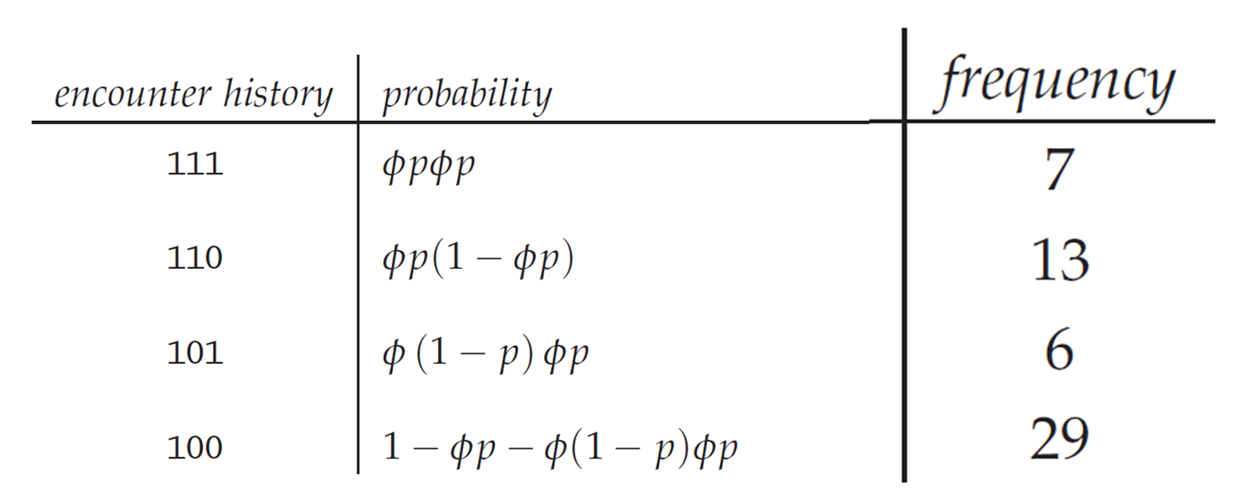
Mark-Recapture Application
Multinomial likelihood:

Slide 33
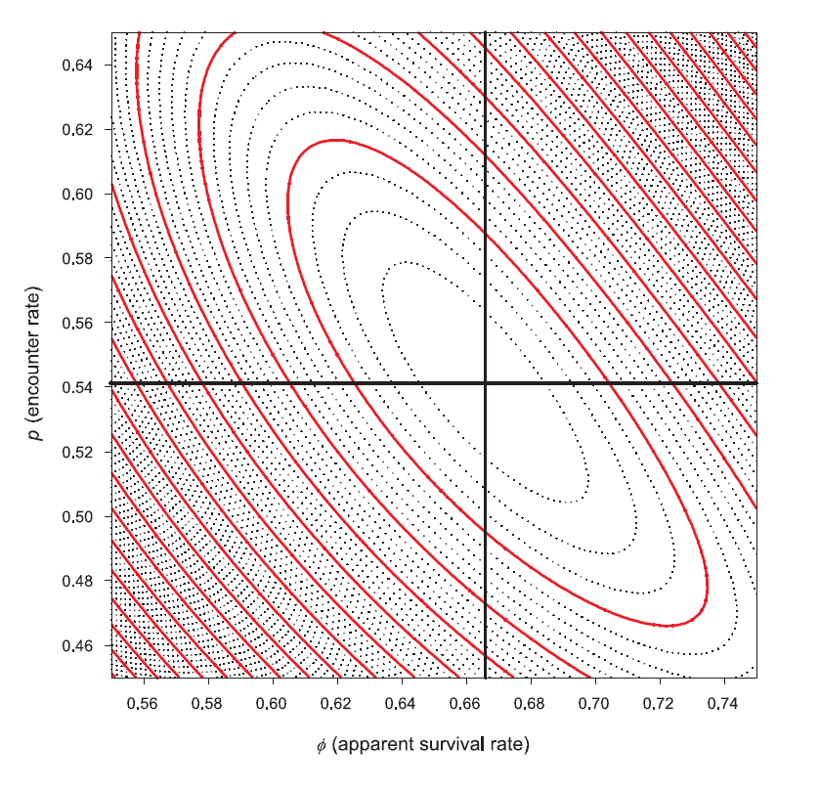
Mark-Recapture Application
Numerical search for values of and that maximize the likelihood (minimize the negative log likelihood).

Slide 34
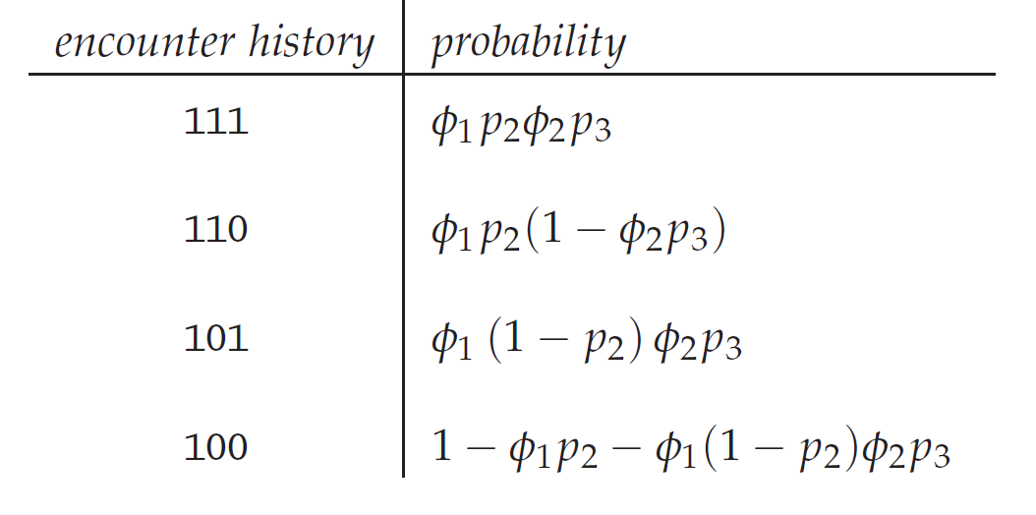
Mark-Recapture Application
The problem gets more complicated if survival and probability of capture change over time(Φ_{t}, p_{t}).

Slide 35
Mark-Recapture Application
Multinomial likelihood:

Slide 36
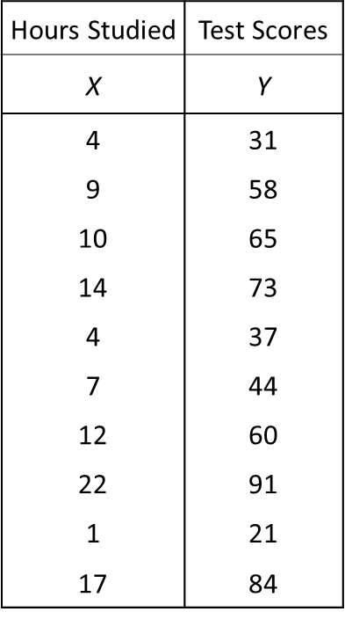
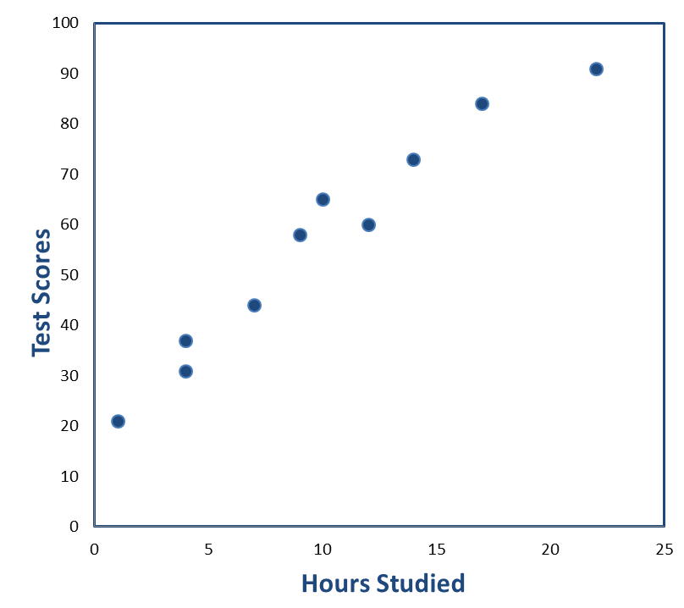
Normal Probability Distribution and MLE
A simple linear regression (usually estimated using least squares) can be estimated using likelihood:
… where ε is random noise and is assumed
to have a normal distribution.

Slide 37
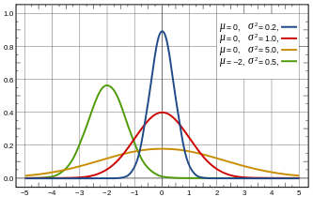
Normal Probability Distribution and MLE
The Normal probability distribution requires two parameters (mean, μ, and variance, σ²):
P
Y

Slide 38
Normal Probability Distribution and MLE
The Normal likelihood is a function of the data (X, Y) and parameter values (μ, σ²):

Slide 39
Normal Probability Distribution and MLE
For mathematical convenience in searching for optimal parameter values, log likelihood avoids small likelihood values and negative log likelihood allows for minimization of the objective function:
… and constants, like ln(√2π), are often removed.

Slide 40
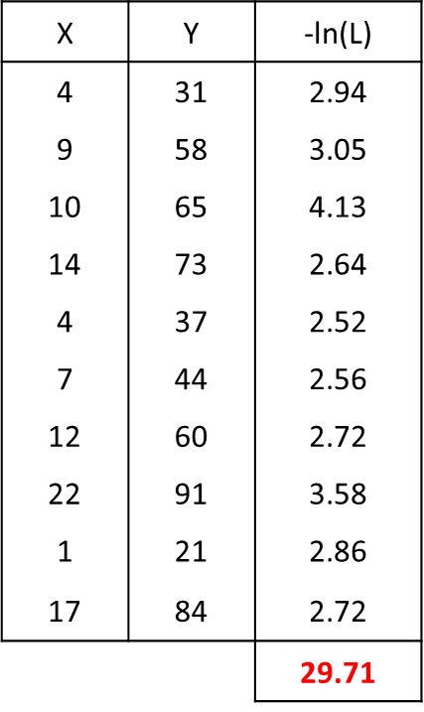
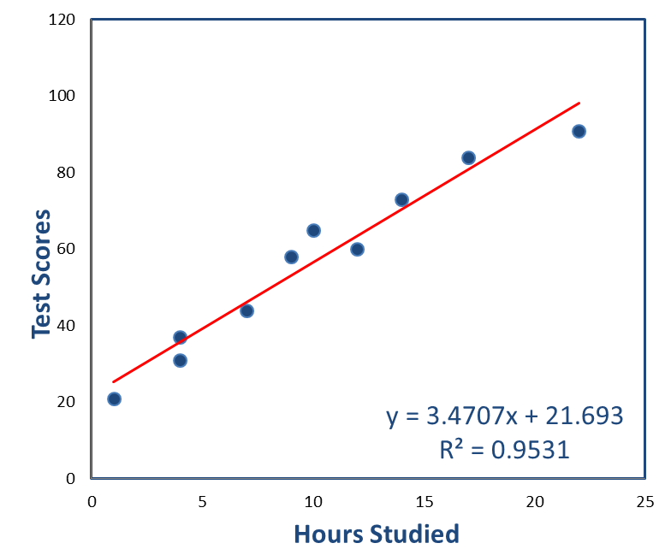
Normal Probability Distribution and MLE
σ² = 22.30

Slide 41
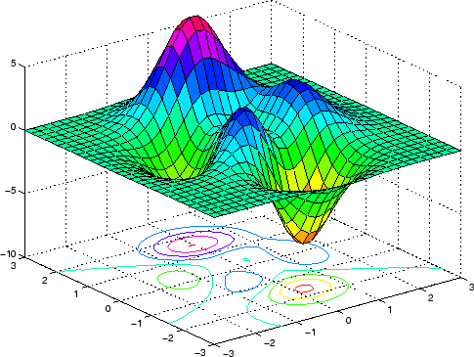
More Complicated Problems
Some nonlinear problems have complex likelihood surfaces, and finding the global minimum can be difficult.

Slide 42
Probability Distributions
Binomial
Multinomial
Normal
Lognormal
Poisson
…

Slide 43
Summary
Likelihood is mathematically equivalent to probability, but quantifies the likelihood of parameter values for a set of observed data, rather than testing the probability that observed data belongs to a hypothetical population.
Optimal parameter values can be found by numerical search to minimize the negative log likelihood.
A theoretical model of the process of interest implies a theoretical probability distribution (e.g., binomial genetic frequencies, multinomial age composition, lognormal recruitment deviations, …).
If error distributions are approximately normal, likelihood and least squares produce essentially the same results.
Many processes are not expected to have normally distributed error (genetics, age composition, recruitment).
Linear models (regression, mark-recapture) don’t require advanced numerical searches, but more advanced population models do.

Slide 44
Where Are We Going?
Lab 2
estimate survival from mark-recapture data (time varying parameters? model comparison?)
re-estimate length-weight relationships from lab1 using MLE (normal, lognormal? Nonlinear?)

