Slide 1


MAR 580: Advanced Population Modeling for Management of Living Marine Resources
Lecture 4 - Biomass Dynamics Models
8 September 2015

Slide 2
Where Are We?
Questions from Tim Miller’s guest lecture?
Biomass Dynamics Models (Polachek et al. 1993)

Slide 3
Lecture Outline
Biomass Dynamics
Logistic growth
Time series, observation error model (Polachek et al. 1993)
Lab 4 – Biomass Dynamics of South Atlantic Albacore
Polachek et al. (1993) – 1967-1989 yield and catch rate from a single fleet
ICCAT (2013) – 1956-2011 yield and catch rates from eight fleets

Slide 4
Limited Population Growth
As population biomass (B) increases, density increases, and competition for limited resources reduces the population growth rate.
Recruitment: reproduction of new fish may decrease with crowding.
Growth: individual growth rates may decrease with crowding.
Natural Mortality: may increase with crowding.

Slide 5
Logistic Growth
rate of change: dB/dt=rB(1-B/K)
continuous growth: B_{t}=K/[1+(K/B₀-1)e^{-rt}]
discrete growth: B_{t+1}=B_{t}+rB_{t}(1-B_{t}/K)
Populations increase proportional to their biomass, but the rate of increase slows as the population approaches its carrying capacity.
r: intrinsic growth rate
K: carrying capacity
Rate of change (production) is maximum when the population is at half of its carrying capacity.

Slide 6
Maximum Sustainable Yield
If removals (yield, Y) can be replaced by stock production each year, the fishery is sustainable (Russell 1931).
At half the carrying capacity (K/2), growth rate is maximal.
If stock size is maintained at half its carrying capacity, the population growth rate is fastest, and sustainable yield is greatest (Maximum Sustainable Yield=rK/4; B_{MSY}=K/2; F_{MSY}=r/2; Graham 1935).
(rK)/4
K/2

Slide 7
Fishery Catch Rates
CPUE: catch per unit effort is an index of the magnitude of the average ‘exploitable’ population over the observed time:
Greater catch rates indicate a large exploitable biomass
Trends in CPUE can be used as an index of relative trends in stock biomass

Slide 8
Stock Development & Exploitation History)

Slide 9
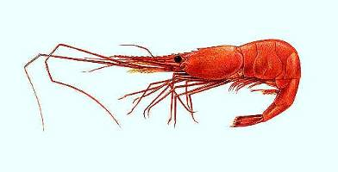
Effort Averaging Methods
Logistic process equation is converted to observable variables (effort, E, and CPUE, U)
Assumes equilibrium expectations for recent average conditions.
If the stock is decreasing during the time series, the method overestimates productivity and MSY.
Icelandic Shrimp

Slide 10
Time Series Models
Forward projection models fit to observed yield (Y) and survey indices (I) or CPUE (U) to estimate stock biomass (B).
A logistic growth process equation and can estimate a time series of biomass.
The model can predict relative indices (U or I) with measurement error:
… or process error (but not as common and does not tend to perform as well in simulation, Polachek et al. 1993):

Slide 11
Normal Probability Distribution and MLE
For mathematical convenience in searching for optimal parameter values, log likelihood avoids small likelihood values and negative log likelihood allows for minimization of the objective function:
… and constants, like ln(√2π), are often removed.

Slide 12
Alternative Production Functions
Generalized production function:
m=2 Logistic (=‘Schaefer’)
m~1 Gompertz (=‘Fox’)
‘m’ is typically difficult to estimate

Slide 13
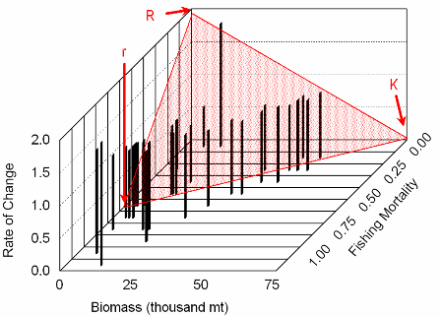
Stock Development & Exploitation Histories
“You cannot understand how a stock will respond to exploitation unless the stock has been exploited” (Hilborn & Walters 1992).
‘one-way trip’ – unreliable results
‘up & down the isocline’ – more informative, but correlated estimates
‘good contrast’ – several episodes of depletion and rebuilding throughout the dynamic range (0 to K)

Slide 14
Summary
Biological production is density dependent, and limited population growth can be modeled with a logisitic model or alternative production functions.
Density-dependent compensation allows for surplus production, sustainable yield and MSY.
Fishery production includes fishery removals
Fishing effort can be used to inform F
Fishery catch rates and surveys can be used to inform relative stock size
Time series, observation error models of biomass dynamics compare response from relative indices to absolute removals to estimate absolute stock size.

Slide 15
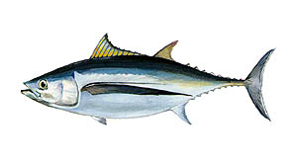
Lab 4- Biomass Dynamics of South Atlantic Albacore
Part 1 - Polachek et al. (1993) – 1967-1989 yield and catch rate from a single fleet
Lab4.tpl, .dat, …
demonstrated in class
Part 2 - ICCAT (2013) – 1956-2011 yield and catch rates from eight fleets
Brief report including introduction, methods, results, discussion, ADMB code & output due October 20

Slide 16
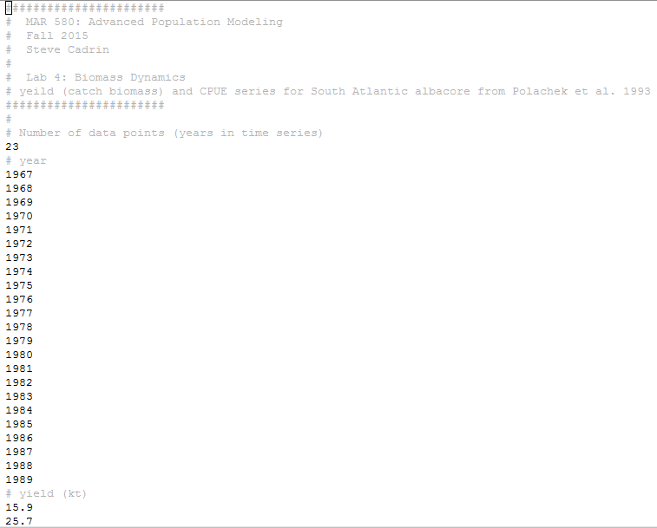
Lab4.dat
Data in Polachek et al. (1993) Table 1, year, yield, cpue

Slide 17
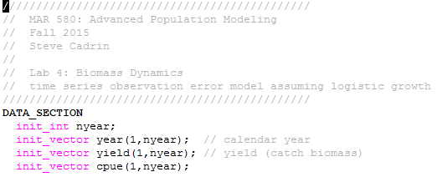
Lab4.tpl DATA_SECTION

Slide 18
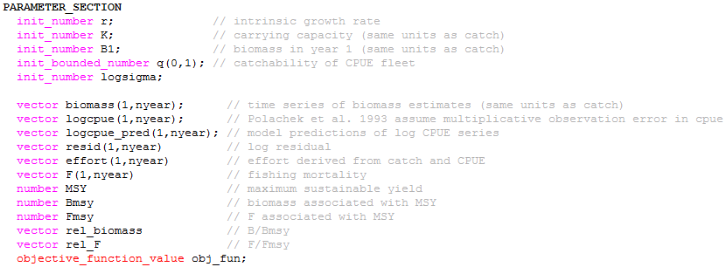
Lab4.tpl PARAMETER_SECTION

Slide 19
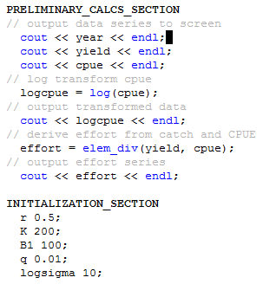
Lab4.tpl PRELIMINARY_CALCS_SECTION

Slide 20
Lab4.tpl INITIALIZATION_SECTION

Slide 21
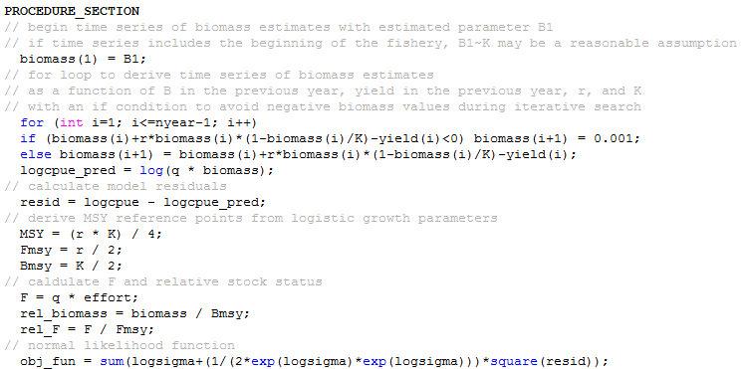
Lab4.tpl PROCEDURE_SECTION

Slide 22
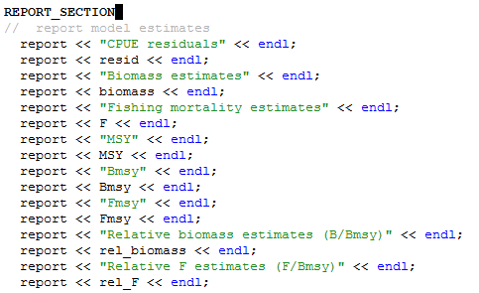
Lab4.tpl REPORT_SECTION

Slide 23

Lab4.std

Slide 24
Lab4.rep
CPUE residuals
-0.115629 0.235158 -0.000270647 -0.116425 0.189837 -0.145249 -0.164808 -0.0320117 0.126365 -0.0150861 -0.017091 0.0701493 -0.0228751 0.0946094 0.0177919 -0.00574778 -0.109491 0.160363 -0.0827454 0.00917064 -0.138054 -0.00240927 0.064449
Biomass estimates
289.588 260.215 231.77 208.899 196.125 184.451 166.322 155.494 154.097 155 154.039 150.846 146.361 142.726 139.259 134.82 125.004 129.986 136.148 127 111.782 93.4245 85.6239
Fishing mortality estimates
0.0616359 0.0780681 0.123 0.12746 0.105429 0.208758 0.199929 0.130814 0.100084 0.126409 0.142641 0.142762 0.157287 0.143414 0.16648 0.217087 0.128526 0.0865031 0.226591 0.269953 0.385137 0.277898 0.277036
MSY
19.3833
Bmsy
125.801
Fmsy
0.154079
Relative biomass estimates (B/Bmsy)
2.30195 2.06847 1.84235 1.66056 1.55901 1.46622 1.3221 1.23603 1.22493 1.2321 1.22447 1.19908 1.16343 1.13454 1.10698 1.07169 0.993664 1.03327 1.08225 1.00953 0.888562 0.742638 0.68063
Relative F estimates (F/Bmsy)
0.400028 0.506675 0.798292 0.827236 0.684254 1.35488 1.29757 0.849008 0.64956 0.820416 0.925767 0.926552 1.02082 0.930779 1.08049 1.40893 0.834155 0.56142 1.47061 1.75204 2.49961 1.80361 1.79801

Slide 25
Lab 4- Biomass Dynamics of South Atlantic Albacore
Part 2 - ICCAT (2013) – 1956-2011 yield and catch rates from eight fleets
Tips:
Yield in table 14 (page 28), CPUE in table 15 (11? Page 29)
The process equation is the same as with one fleet (sum yield for all fleets)
Estimate a separate catchability (q) for each fleet (f).
Brief report including introduction, methods, results, discussion, ADMB code & output due October 20

Slide 26
Where Are We Going?
State Space Models Newman et al. (2014) Chapters 3-4

