Slide 1
Discussion questions
In relation to the R exercise
How does the age at which a deleterious mutation unfolds its effect impact LTRS? How can you explain the evolution of aging based on these observations? Can you frame this in the context of mutation selection balance?
If you compare a scenario of antagonistic pleiotropy to the null model, what do you observe? How does antagonistic pleiotropy impact lifetime reproductive success? How can you explain the evolution of aging based on this observation?
How do you explain the evolutionary change in longevity in the Drosophila experiment? How does this finding relate to the evolution of aging, especially in the context of the two hypotheses we contrasted above?
How do you explain allele frequency changes in the C. elegans experiment? How does this finding relate to the evolution of aging, especially in the context of the two hypotheses we contrasted above?
What diseases of civilization did you research? What is an evolutionary explanation for their prevalence?

Slide 2
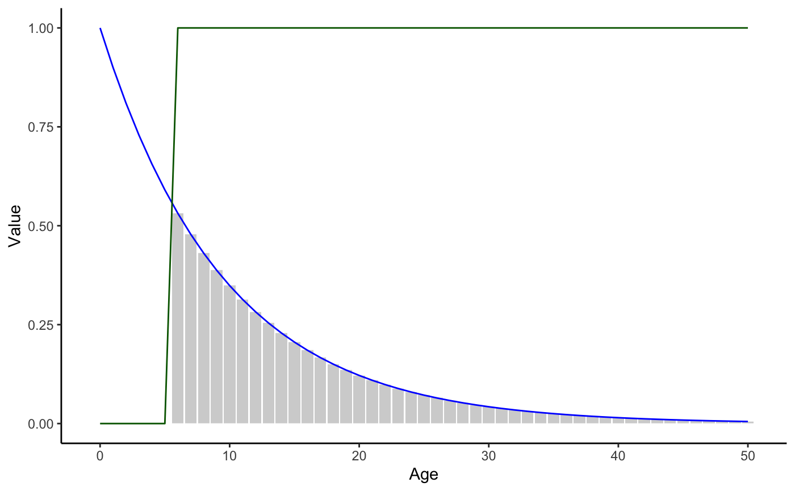
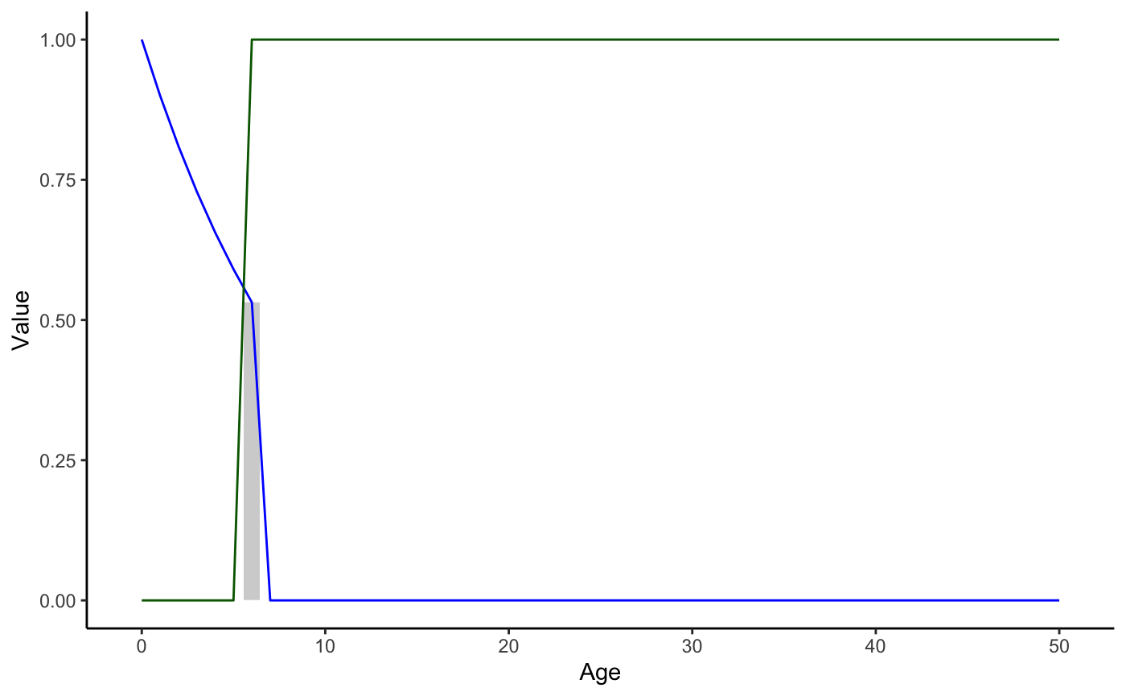

Mutation accumulation
How does the age at which a deleterious mutation unfolds its effect impact LTRS? How can you explain the evolution of aging based on these observations? Can you frame this in the context of mutation selection balance?

Slide 3
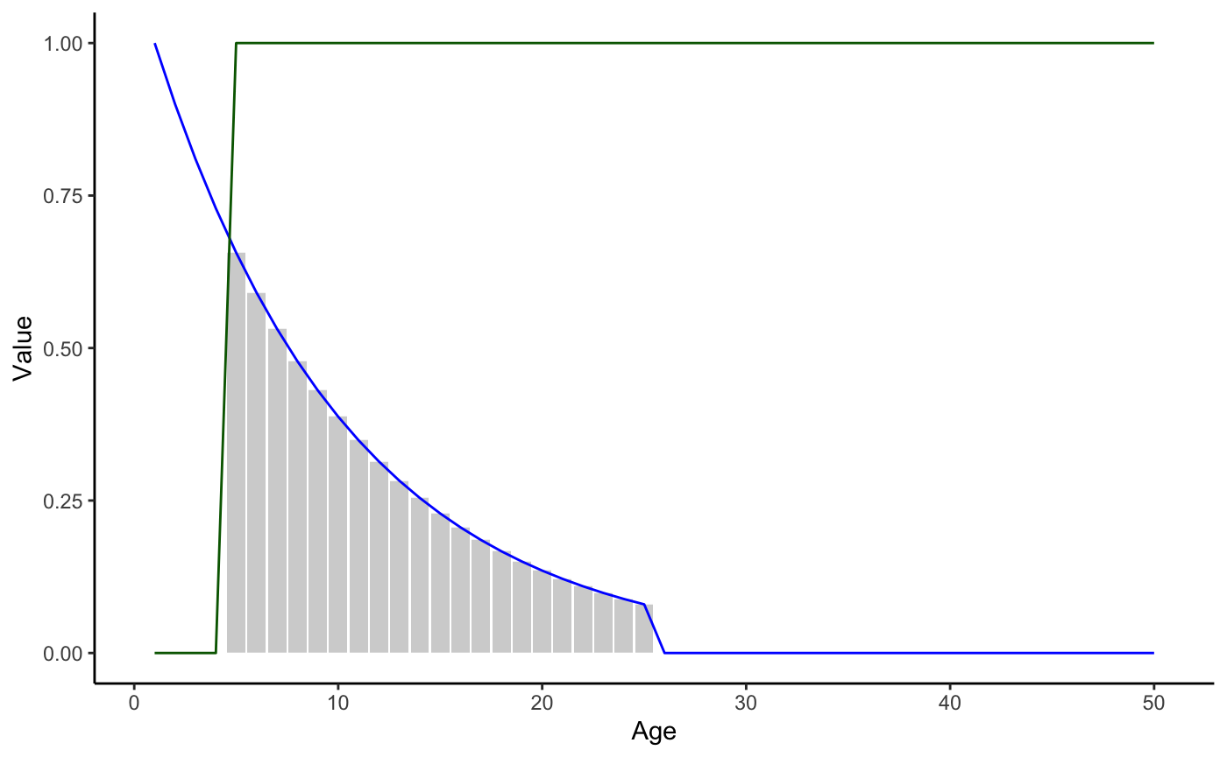
Antagonistic pleiotropy
If you compare a scenario of antagonistic pleiotropy to the null model, what do you observe? How does antagonistic pleiotropy impact lifetime reproductive success? How can you explain the evolution of aging based on this observation?

Slide 4
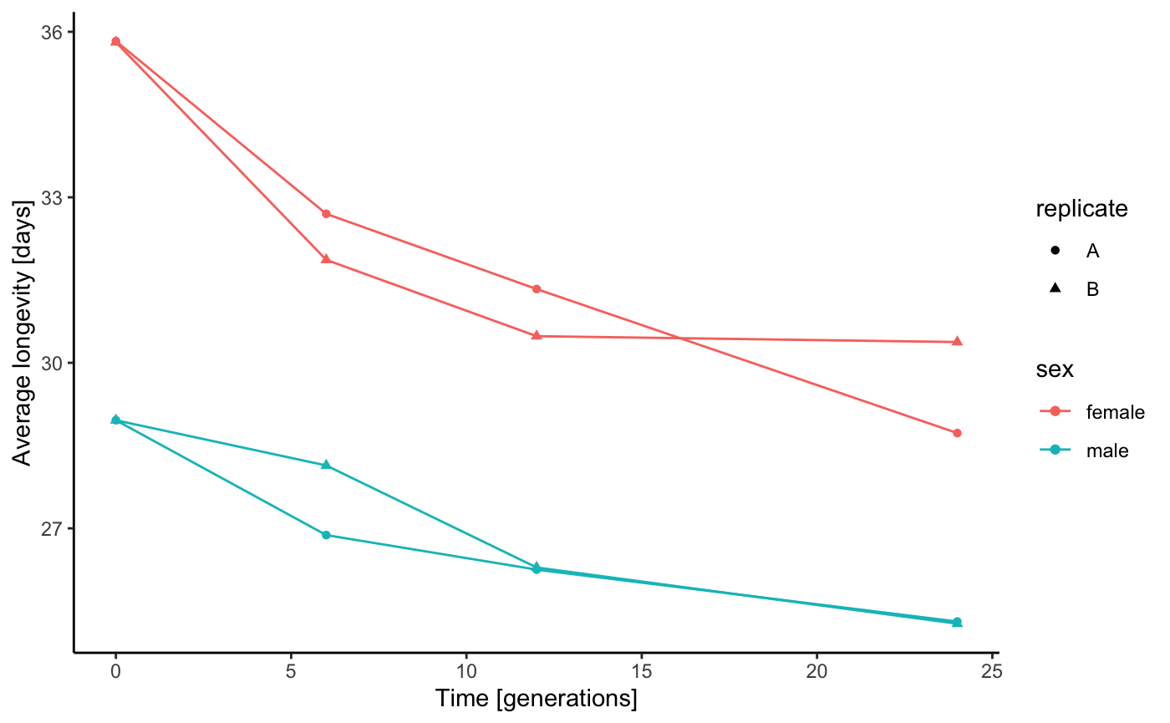
Mutation accumulation vs. antagonistic pleiotropy
How do you explain the evolutionary change in longevity in the Drosophila experiment? How does this finding relate to the evolution of aging, especially in the context of the two hypotheses we contrasted above?

Slide 5
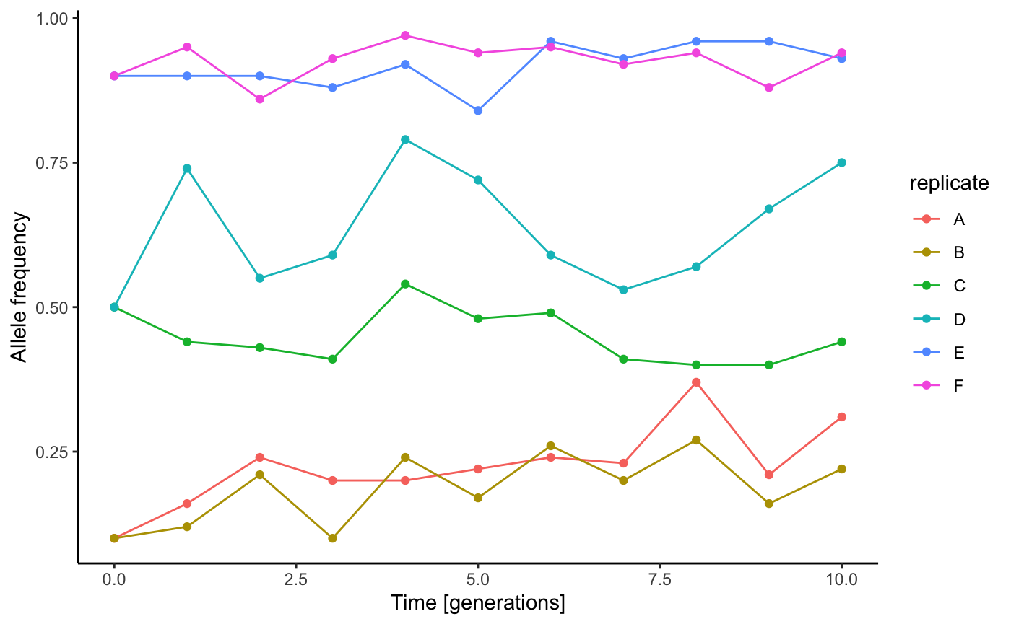
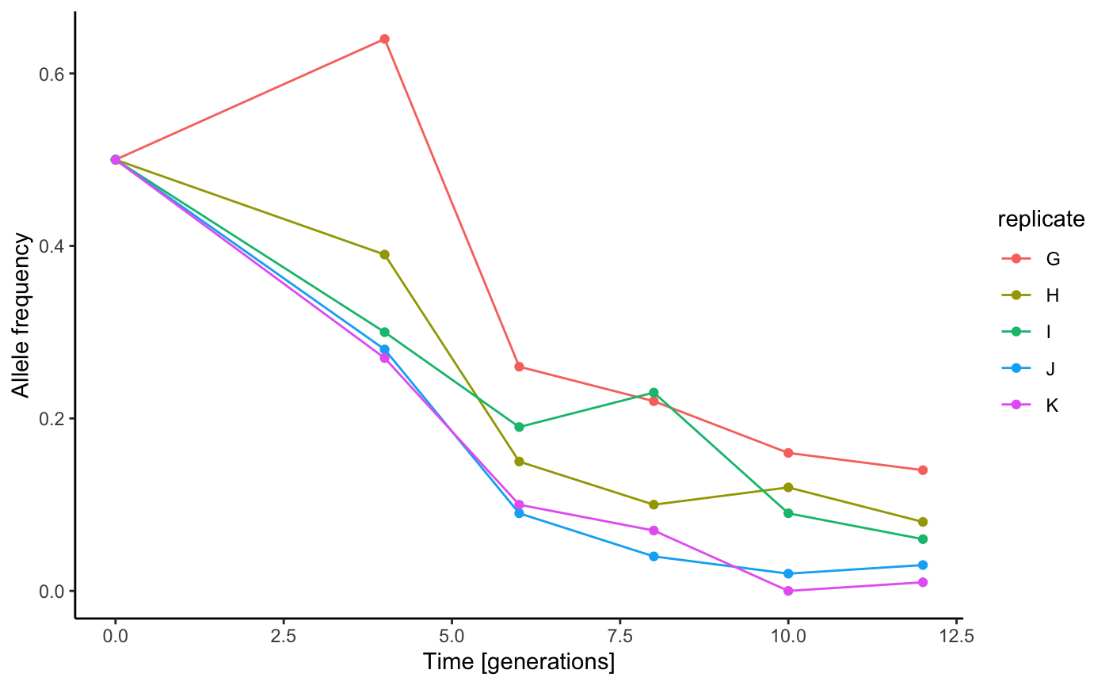
Mutation accumulation vs. antagonistic pleiotropy
How do you explain allele frequency changes in the C. elegans experiment? How does this finding relate to the evolution of aging, especially in the context of the two hypotheses we contrasted above?

