Slide 1
Discussion questions
In relation to the R exercise & worksheet
In your exercise, were the fly loci in HW equilibrium or disequilibrium? What is the utility of Hardy-Weinberg?
How do molecular processes (i.e., different types of mutations) relate to evolution?
Additional questions
Do mutation rates evolve? Under what circumstances are high/low mutation rates adaptive?

Slide 2

The power of a null model

Slide 3
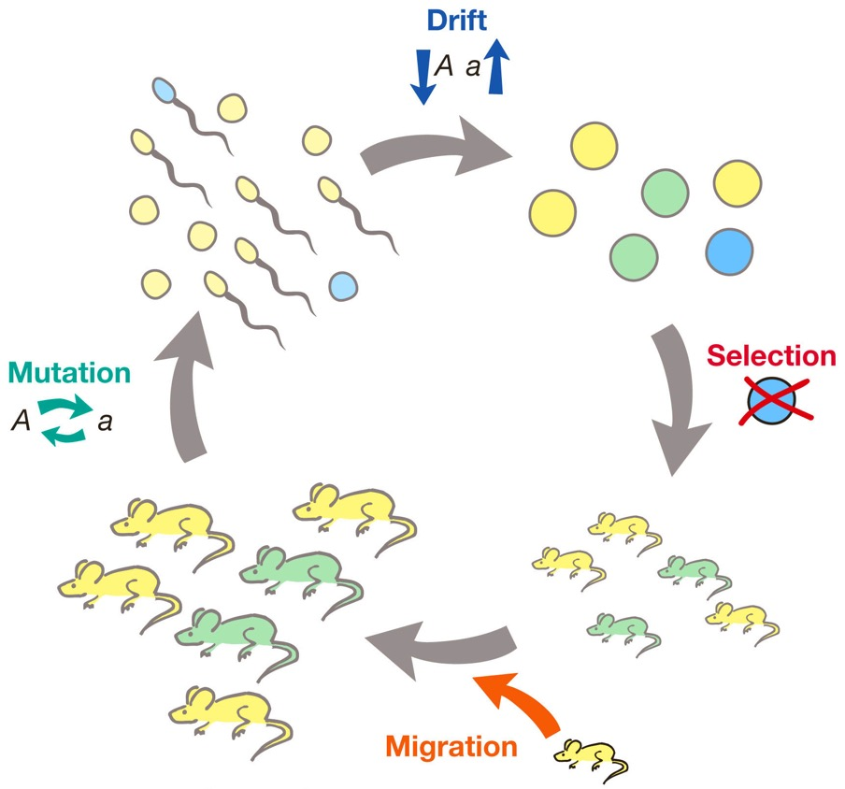
What constitutes an evolutionary force?
Selection
Mutation
Genetic drift (changes due to chance)
Migration
(Non-random mating)

Slide 4
How do evolutionary forces change allele frequencies?
Modeling selection
Modeling other evolutionary forces

Slide 5
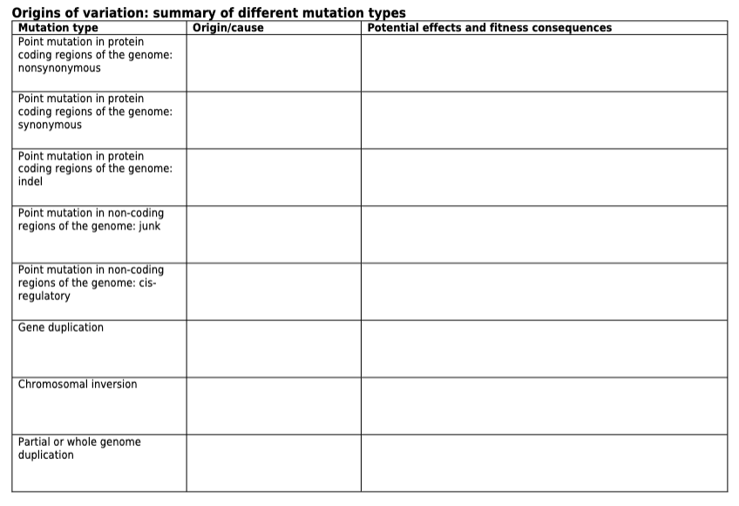
Different types of mutation and their effect on evolution
Origin/cause
What happens at a molecular level?
Describe how exactly a particular mutation type arises!
Potential effects and fitness consequences
How can a potential mutation type impact the fitness of a carrier?
Describe the various ways a particular mutation type can affect the function and fitness of an organism

Slide 6
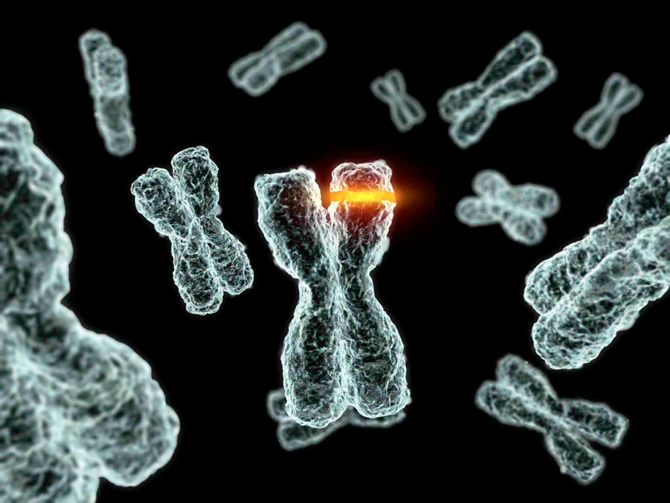
Mutation provides the raw material for evolution
Change in the nucleotide sequence in the genome
Ultimate source of genetic variation
Responsible for new alleles
Responsible for new genes (loci)
Responsible for changes in gene regulation

Slide 7
